Slide 1
Multi-objective Optimization for Series–parallel Systems Using Genetic Algorithm
Kriangkrai Chaonithi
57070701702
King Mongkut's University of Technology Thonburi

Slide 2
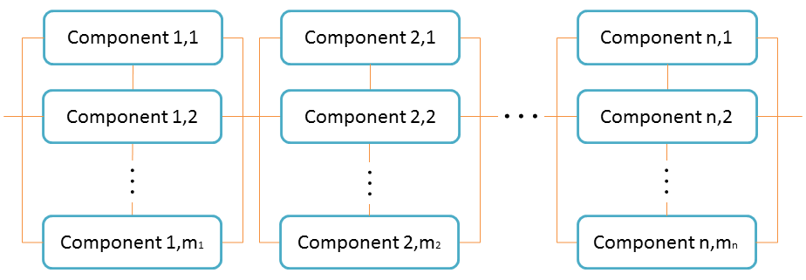
Project Description and Scope
Implement genetic algorithm to optimize system reliability, weight, and cost of series-parallel systems using weighted sum.

Slide 3
Programming Challenge
The algorithm must be able to increase population diversity of to keep exploring the problem space

Slide 4
Assumptions
A component can only be functional or fail
System reliability, cost, and weight of each component are fixed and provided
A component can be selected only once for the whole system
No repairing if a component fails.
Failure of a component is independent from other components

Slide 5
Model Formulation
Z Fitness of a system
X_{ij} Architecture X for component j at subsystem i
n Number of subsystem within the system (n = &0
m_{i} Number of component choices available for subsystem I
R_{i} Estimated reliability of the subsystem i
R_{ij} Estimated reliability of using component j at subsystem i
C_{i} Normalized cost of subsystem i
C_{ij} Normalized cost of using component j at subsystem i
W_{i} Normalized weight of subsystem i
W_{ij} Normalized weight of using component j at subsystem i
α Fitness weight of system reliability
β Fitness weight of system cost
𝛾 Fitness weight of system weight

Slide 6
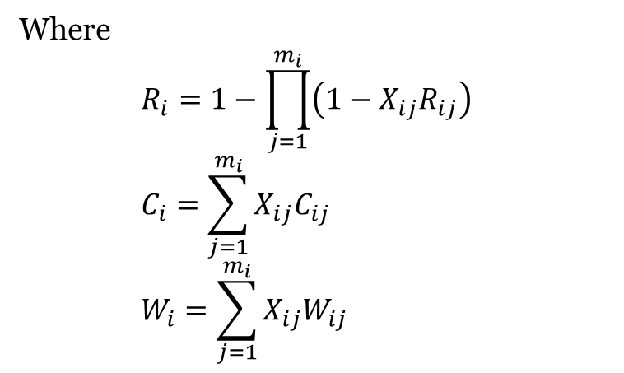
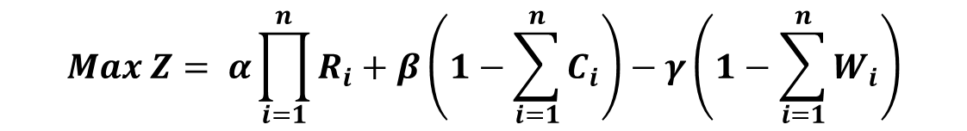
Objective Function
$$Max Z= α\prod_{i=1}^{n}{R_{i}}+β\left(1−\sum_{i=1}^{n}{C_{i}}\right)−γ\left(1−\sum_{i=1}^{n}{W_{i}}\right)$$
Where
$$R_{i}=1−\prod_{j=1}^{m_{i}}{\left({1−X}_{ij}R_{ij}\right)}$$
$$C_{i}=\sum_{j=1}^{m_{i}}{X_{ij}C_{ij}}$$
$$W_{i}=\sum_{j=1}^{m_{i}}{X_{ij}W_{ij}}$$

Slide 7
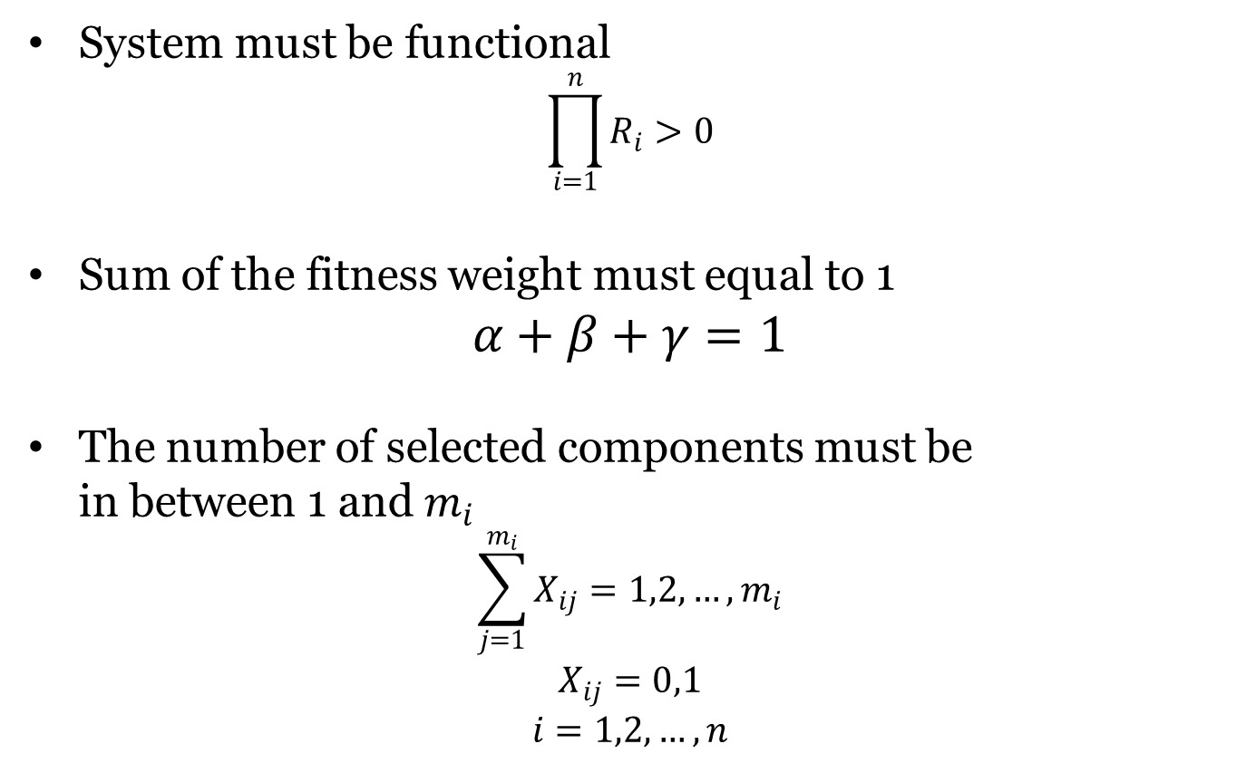
Constrains
System must be functional
$$\prod_{i=1}^{n}{R_{i}}>0$$
Sum of the fitness weight must equal to 1
$$α+β+γ=1$$
The number of selected components must be in between 1 and $m_{i}$
$$\sum_{j=1}^{m_{i}}{X_{ij}}=1,2,…,m_{i}$$
$$X_{ij}=0,1$$
$$i=1,2,…,n$$

Slide 8
Input Data
Configurable Parameters
Fitness weight of system reliability (α)
Fitness weight of system cost (β)
Fitness weight of system weight (𝛾)
Sub- system | Design Alternative
 | Comp Choice 1 |  |  | Comp Choice 2 |  |  | Comp Choice 3 |  |  | Comp Choice 4
 | R | C | W | R | C | W | R | C | W | R | C | W
1 | 0.90 | 1 | 3 | 0.93 | 1 | 4 | 0.91 | 2 | 2 | 0.95 | 4 | 5
2 | 0.95 | 4 | 8 | 0.94 | 2 | 10 | 0.93 | 1 | 9 | - | - | -
3 | 0.85 | 2 | 7 | 0.95 | 3 | 5 | 0.87 | 1 | 6 | 0.92 | 4 | 4
4 | 0.83 | 3 | 5 | 0.87 | 4 | 6 | 0.85 | 5 | 4 | - | - | -
5 | 0.94 | 2 | 4 | 0.93 | 2 | 3 | 0.95 | 5 | 5 | 0.94 | 2 | 4
6 | 0.99 | 6 | 5 | 0.98 | 4 | 4 | 0.97 | 2 | 5 | 0.96 | 2 | 4
7 | 0.91 | 4 | 7 | 0.92 | 4 | 8 | 0.94 | 5 | 0 | - | - | -

Slide 9
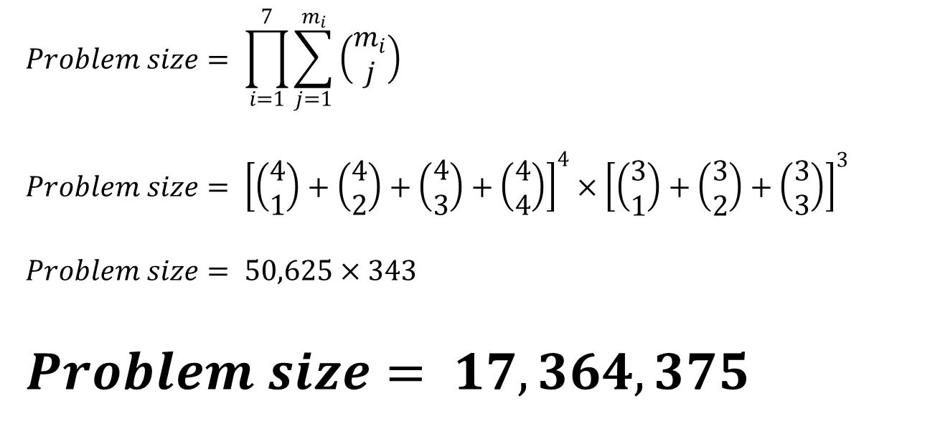
Problem Size
$$Problem size= \prod_{i=1}^{7}{\sum_{j=1}^{m_{i}}{\left(\begin{matrix}m_{i} \\ j\end{matrix}\right)}}$$
$$Problem size= {\left[\left(\begin{matrix}4 \\ 1\end{matrix}\right)+\left(\begin{matrix}4 \\ 2\end{matrix}\right)+\left(\begin{matrix}4 \\ 3\end{matrix}\right)+\left(\begin{matrix}4 \\ 4\end{matrix}\right)\right]}^{4}×{\left[\left(\begin{matrix}3 \\ 1\end{matrix}\right)+\left(\begin{matrix}3 \\ 2\end{matrix}\right)+\left(\begin{matrix}3 \\ 3\end{matrix}\right)\right]}^{3}$$
$$Problem size= 50,625×343$$
$$Problem size= 17,364,375$$

Slide 10
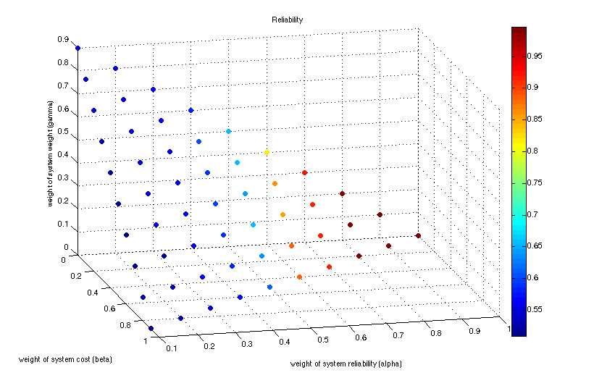
Weighted Sum
Sum of the fitness weight must equal to 1: $α+β+γ=1$

Slide 11
Genetic Algorithm
Max Generation Run: 5,000
Population size: 50
Elitism size: 3
Chromosome size: 25 (1 gene for 1 component )
Crossover Method: Tournament Selection
Tournament Size: 10 (randomly pick from population)
Crossover Rate: 80%
Mutation Method: Single point mutation
Mutation Rate: 20%

Slide 12

Chromosome Repairing Algorithm
$$\prod_{i=1}^{n}{R_{i}}>0$$
A subsystem with no component will be randomly inserted a component
The repairing function will execute after each evolution phase

Slide 13

Population Elimination
Prevent algorithm from local optimum
Improve population diversity
Select 10 top worst individuals, and regenerate them
Image from: http://www.independent.co.uk/life-style/health-and-families/health-news/birdflu-victim-had-no-direct-contact-with-poultry-6283803.html

Slide 14
Execution Result
Genetic Algorithm
α | β | 𝛾 | Fitness | Reliability | Cost | Weight | CPU Time (sec)
0.2 | 0.4 | 0.4 | 0.7108 | 0.5249 | 16 | 37 | 0.5555
0.5 | 0.3 | 0.2 | 0.6990 | 0.8359 | 32 | 63 | 0.8449
0.5 | 0.2 | 0.3 | 0.6973 | 0.7821 | 29 | 52 | 0.4965
0.8 | 0.1 | 0.1 | 0.8411 | 0.9868 | 55 | 102 | 0.1185
1.0 | 0.0 | 0.0 | 0.9958 | 0.9958 | 75 | 136 | 0.0457
Brute Force
α | β | 𝛾 | Fitness | Reliability | Cost | Weight | CPU Time (sec)
0.2 | 0.4 | 0.4 | 0.7151 | 0.507 | 14 | 38 | 89.1709
0.5 | 0.3 | 0.2 | 0.7159 | 0.9152 | 30 | 75 | 87.8117
0.5 | 0.2 | 0.3 | 0.7273 | 0.8796 | 36 | 58 | 86.5529
0.8 | 0.1 | 0.1 | 0.8603 | 0.9692 | 40 | 84 | 84.3733
1.0 | 0.0 | 0.0 | 0.9958 | 0.9958 | 75 | 136 | 83.2641

Slide 15
Result Comparison

Slide 16
GA Convergence Graph

Slide 17
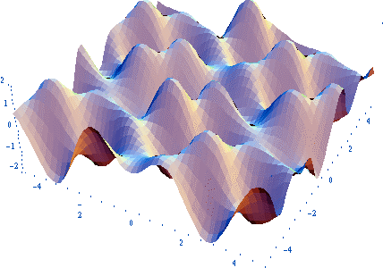
Conclusion
GA can return acceptable results
GA uses very small amount of CPU time
Due to the enormous size of problem space, GA stuck in local optimum very often
Image from: http://plato.asu.edu/gom.html

Slide 18

Further Improvement
Advance GA mechanism to increase exploration
Image from: https://secure.flickr.com/photos/lakelandlocal/404688085/

Slide 19
Reference
Chaonithi, K. (2014, November 24). CPE614­Component­Allocation­GA. Retrieved (cfc9fffb64) from https://github.com/spicydog/CPE614-Component-Allocation-GA/tree/series-palallel
Jacobson, L. (2012, February 12). Creating a genetic algorithm for beginners. Retrieved from http://www.theprojectspot.com/tutorial-post/creating-a-genetic-algorithm-for-beginners/3
Input data from Dr Naruemon Wattanapongsakorn

Slide 20
Thank you
Q&A

