Slide 1
BLUETOOTH COMMUNICATION WITH HC-05

Slide 2
Why wireless communication?
The Spider bot is controlled wirelessly because a USB cable connecting the laptop to the Arduino NANO will restrain the motion of the bot.
The Arduino code cannot be hard-coded into the micro-controller by disconnecting the cable as the input data signals from the app should be received by Arduino NANO to control the movement of the bot.
To achieve this, a HC-05 Bluetooth module is used.

Slide 3
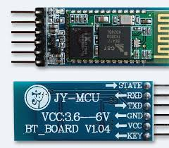

Slide 4
How it works
HC-05 is a Bluetooth device used for wireless communication with Bluetooth enabled devices (like smartphones). It communicates with microcontrollers using serial communication (USART).
The smartphone is paired with the HC-05 module, after which communication takes place. The data from the app is now sent to the module via Bluetooth.
The module receives the data and transmits it to the micro-controller through the TX pin.
Additionally, HC-05 can also transmit data wirelessly.

Slide 5
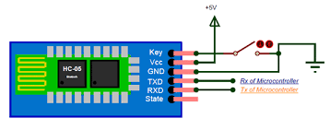
PINOUT

Slide 6
INTERFACING WITH ARDUINO
Configuring the Bluetooth module using AT commands(AT Command Mode)
The HC-05 comes with a set of AT commands to perform various tasks such as changing the module’s default settings including changing the pass code and the device name.
The communication occurs at a baud rate of 38400 bits/second.
When the HC-05 enters AT mode the on-board LED blinks with an interval of 2 seconds.

Slide 7
AT COMMANDS
Command | Description | Response
AT | Checking communication | OK
AT+PSWD=XXXX | Set Password e.g. AT+PSWD=4567 | OK
AT+NAME=XXXX | Set Bluetooth Device Name e.g. AT+NAME=MyHC-05 | OK
AT+UART=Baud rate, stop bit, parity bit | Change Baud rate e.g. AT+UART=9600,1,0 | OK
AT+VERSION? | Respond version no. of Bluetooth module | +Version: XX OK e.g. +Version: 2.0 20130107 OK
AT+ORGL | Send detail of setting done by manufacturer | Parameters: device type, module mode, serial parameter, passkey,etc.

Slide 8
TASK 0
Set up a name and a password for your Bluetooth module and pair it with your PC.

Slide 9
INTERFACING WITH ARDUINO
Using HC-05 in Data Mode
In the Data Mode the device can connect directly to other devices for communication.
We can identify the module on other devices and connection can be established by entering the password.
During power up the ‘KEY’ pin must be grounded to enter into AT-Command mode. If left free, it will by default enter into data mode.

Slide 10
TASK-1
Communicate to Arduino wirelessly by using the serial monitor for data input:
If value entered: 0: The LED must GLOW
1: The LED must be in OFF state

