Slide 1

Robotic Merit Badge Session #3
Merit Badge Counselor: Maurice Ling
August 3, 2015
http://bsatroop675.org

Slide 2
Agenda
Homework Review
More Competition Details
Electronics
  Basic Circuit Theory
  Breadboards
Programming
  Switch Statements
  Exercises
Session #3 Homework

Slide 3
Homework Review
Using GitHub to check in files and Sync
Common programming mistakes
Processing Signals from the Obstacle Sensor
  What difficulties did you encounter?
  Techniques to make the signals more manageable.
Designs for Competition
Sensor/Motor interaction
Switching from Auto to Manual control

Slide 4
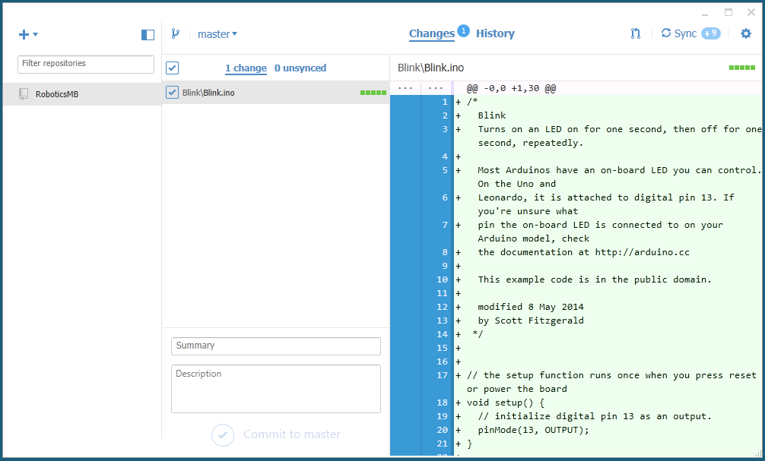
GitHub Client

Slide 5

Common Programming Mistakes
Extra Semicolons
if (i == 10);
{
Serial.println(i);
}
for (int j=0; j < 3; j++);
{
Serial.println(j);
}
Using = (assignment) instead of == (comparison)
if (i = 10)
{
Serial.println(i);
}

Slide 6
Taming the Sensor Inputs
Sensor readings include noise from sensors, environment
Techniques to make the readings more manageable
  Averaging
  Threshold

Slide 7
Taming the Sensor Inputs
    int average = 0, lastAverage = 0, sum = 0, index = 0;
    int minThreshold=100, maxThreshold=900;
    const int sensorPin=5;
    void loop()
    {
    if (index > 0) {
    if (index%numSamples == 0) // compute average
    {
    average=computeAverage();
    }
    }
    index++;
    samples[index%numSamples]=readAnalog(sensorPin); // read sensor
    if (average != lastAverage)
    {
    if (average < minThreshold)
    { // go straight
    } else if (average > maxThreshold)
    { // do evasive maneuvers
    } else
    { // adjust speed based on average value
    }
    lastAverage=average; // save the last computed average
    }
    }

Slide 8
Taming the Sensor Inputs
    const int numSamples=3
    int samples[numSamples] = {0};
    /**
    * Compute the average
    */
    int computeAverage()
    {
    int sum = 0;
    int average=0;
    for (int i=0; I < numSamples; i++)
    {
    sum+=samples[i];
    }
    average=sum/numSamples;
    return average;
    }

Slide 9
More Competition Details

Slide 10
Robotic Plutonium Carry
Objective: Transport radioactive plutonium payload from one reactor to another.
Payload will take the form of a ping pong ball
Begin and end with a human-controlled segment to load and unload the capsule.
Carefully navigate a maze autonomously
Option to team up with another scout
Complete rules in github.

Slide 11
Competition Scoring
+20 Points scored for each segment completed
Bonus points for time completed within 3 minutes
Bonus Design points
Penalty points for handling payload and manual intervention
Parent Judge panel

Slide 12
Basic Circuit Theory
V=IR
Voltage
Current
Resistance
Basic LED Circuit

Slide 13
Breadboard Basics
TBD

Slide 14
Programming

Slide 15
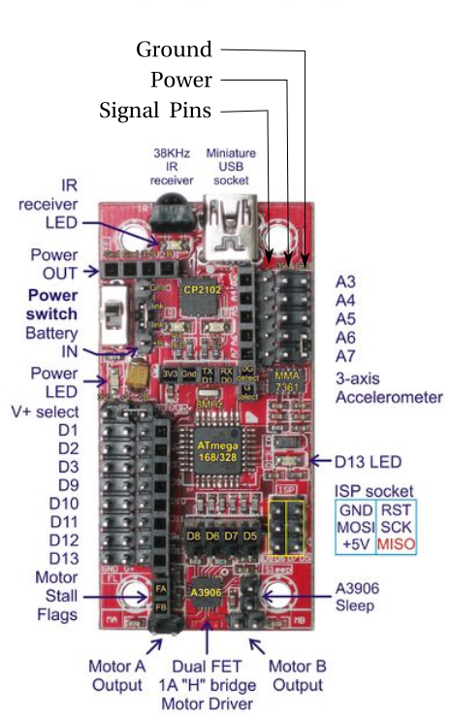
Obstacle Sensor Connections
Connect to Analog Pins
One Ground
One Power (+3.3V)
One Digital signal output
  D1 - on/off
Three Analog Inputs
  A3 - Right,
  A4 - Center,
  A5 - Left

Slide 16
Switch Statements
Like a multiple if/else statement

Slide 17
Reading the Obstacle Sensors
const int leftPin=3;
const int centerPin=4;
const int rightPin=5;
const int senseOnOffPin=1;
void setup()
{
pinMode(senseOnOffPin,OUTPUT); // set up sensor on/off pin
Serial.begin(19200); // set the serial port speed.
digitalWrite(senseOnOffPin, HIGH); // Turn on the sensor
}
void loop()
{
int sensorInput=0;
sensorInput=analogRead(leftPin); //left
Serial.print(sensorInput);
sensorInput=analogRead(centerPin); //center
Serial.print(sensorInput);
sensorInput=analogRead(rightPin); //right
Serial.print(sensorInput);
Serial.println();
}

Slide 18
Exercises
Hook up the LED circuit we talked about in class
Modify your SOS Blink program to blink the LED
Create a new program to control the blinking of the LED based on sensor inputs. The closer something gets, the faster it blinks.
Test your autonomous navigation with various obstacles and refine your algorithm.

Slide 19
Helpful Hints
const int numSensors=3;
const int sensePin[3]={5,4,3}; // array containing the pin numbers
const int senseOnOffPin=1;
int sensorInput[3]={0}; // initialize sensor inputs to 0
// setup() function omitted for brevity
void loop()
{
for (int i = 0; i < numSensors; i++)
{
sensorInput[i]=analogRead(sensePin[i]);
Serial.print(sensorInput[i]);
Serial.print(" ");
}
Serial.println();
}

Slide 20
Session #3 Homework
Complete class exercises
In your notebook, capture the design for the competition
  How to load/unload the payload
  How to carry the payload
  Sketch the logic required to navigate around a maze
Program your robot to implement your maze navigation logic
Robotics MB Workbook:
  Section 3
  Section 4 a, b

