Slide 1

Robotic Merit Badge Session #1
Merit Badge Counselor: Maurice Ling
July 6, 2015
http://bsatroop675.org

Slide 2
Agenda
Class Overview
  Schedule
  Materials for the Class
  Robotics Merit Badge Requirements
  Competition
Safety Working in Robotics
Introduction to Your Robot Brain (Dagu Micromagician)
Programming
  Development Tips
  Exercises
Assignment to work on before Session #2

Slide 3
Schedule
Class Dates | Topics
7/6 | Introduction, Material Distribution, Programming
7/20 | Programming, Electronics, Competition Specifications, Design
8/3 | Design Review, Electronics
8/17 | Pre-competition Preparation, Advanced Topics
8/31 | Robotics Showcase/Competition

Slide 4
Computer Setup
Review Class Reference Guide.
  Arduino IDE Installation
  USB Driver Installation
  Github account
    Fork https://github.com/mcli/RoboticsMB
    Clone your RoboticsMB project
    Launch Git Shell or Terminal
    Setup upstream project:
    Synchronize upstream project (when needed)
git remote add upstream https://github.com/mcli/RoboticsMB.git
git fetch upstream
git checkout master
git merge upstream/master

Slide 5
GitHub
GitHub is a source code control service, based on the “git” utility
I will use it to look at your programs to monitor your progress
Commit and synchronize your code to make it available in your GitHub repository.
Commit your code when you reach a stable point in development to checkpoint your changes.
You can also synchronize with my project to get any class examples or utilities.
Fork https://github.com/mcli/RoboticsMB and make it your upstream project (See Preparing for the First Session).

Slide 6
Material Inventory
Carrying Case
Tadpole Robot Kit
  The Tadpole is only the starting point for your robot design.
  You will be modifying it to achieve your own design goals.
4 AAA NiMH batteries
Engineering notebook
Merit Badge Booklet
Merit Badge Workbook

Slide 7
Scout-Provided Materials
Blue Card signed by Scoutmaster
Computer with Arduino development environment installed
USB-A to mini-USB Cable
AAA NiMH battery charger
Small phillips screw driver
Pen/Pencil for taking notes

Slide 8
Other Useful Items
Sony/Universal Remote Control
Electric Multimeter to measure Voltage and Resistance
Solder and Soldering Iron

Slide 9
Merit Badge Requirements
All Requirements are listed in the Workbook and Merit Badge Booklet and cover:
Safety
Robotics in industry
General Knowledge
Demonstration
Competitions
Careers
Complete the workbook on your own for Merit Badge Counselor review/check-off

Slide 10
Robotics Showcase Competition
Gives you objectives for your robot design.
You may optionally work together with one other scout as a team.
Have fun.
More details will be announced at the 2nd Session

Slide 11
Safety Working with Robotics

Slide 12
Safety Working with Robotics
Have a clean work area
Electrical Circuits
  Always disconnect power when modifying circuits.
Electro-static discharge
Precautions when cutting material

Slide 13
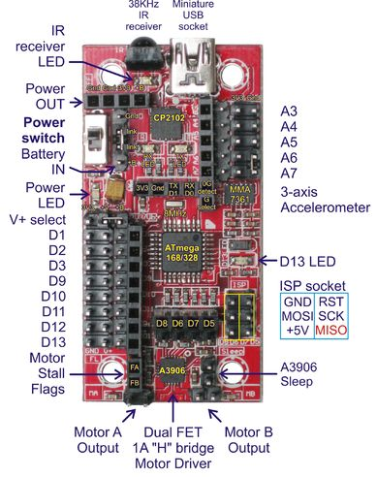
Introduction to Your Robot Brain
The MicroMagician Controller
  Atmega 328 microprocessor
  Digital and Analog pins (I/O)
  Power in/out -3.3V vs 5V
  Motor driver and connections
  Accelerometer
  IR receiver

Slide 14
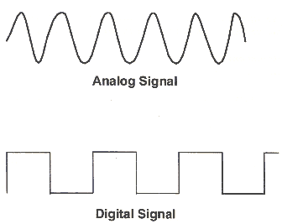
Analog Vs Digital Signals
Analog signals are continuous with many values between minimum and maximum. e.g. a sine wave. Typically used for sensor processing.
Digital signals are discrete. e.g. 0 or 1. Typically used to turn something on or off.

Slide 15
Arduino IDE Setup
Board Configuration
  Arduino Pro or Pro Mini
  Atmega 328 (3.3V, 8MHz)
Serial Port
  Windows – COM3
  Mac – (port that does not say bluetooth)

Slide 16
Development Tips
Using the IDE to compile and upload programs (“sketches”)
Using the Reference: Help → Reference
  setup() - Runs once
  loop() - Gets called continuously
  ; (semicolon)
  Data Types
  = (assignment) vs == (equal to)
All code must be within a function
Utilizing libraries (microM Library)

Slide 17
Programming Exercises - Blink
Load the Blink program from Examples → 01.Basics
Save it in your sketchbook
Compile it and upload it to the MicroMagician Board
void setup() {
// initialize digital pin 13 as an output.
pinMode(13, OUTPUT);
}
// the loop function runs over and over again forever
void loop() {
digitalWrite(13, HIGH); // turn the LED on (HIGH is the voltage level)
delay(1000); // wait for a second
digitalWrite(13, LOW); // turn the LED off by making the voltage LOW
delay(1000); // wait for a second
}

Slide 18
Programming Exercises – Modifying Blink
Save the pin number (13) in an “int” variable and replace all instances of “13” with the variable. e.g. int ledPin=13;
Modify the program to generate the SOS signal – 3 short, 3 long, 3 short, pause, then repeat.
Save as BlinkSOS and github commit.
Revise the program to add 2 function, shortBlinks() and longBlinks(), to generate the SOS signal to make the program shorter and more readable.
Save and github commit.
Revise the program to use one function instead of two (combine shortBlinks() and longBlinks() into one)
Save and github commit and sync.

Slide 19
Programming Exercises – Blink SOS – 2 functions
void setup()
{
// same setup as before
}
void shortBlinks()
{
for (int I = 0; I < 3)
{
// call digitalWrite/delay here
}
}
// define void longBlinks() here, similar to shortBlinks()
void loop()
{
shortBlinks();
longBlinks();
shortBlinks();
delay(1000);
}

Slide 20
Programming Exercises – Blink SOS in 1 function
void setup()
{
// same setup as before
}
void blinks(int length)
{
// have an if/then statement to check if length is negative,
// delay with the absolute value of length and don't blink
// call digitalWrite and delay(length) here
}
// define void longBlinks() here, similar to shortBlinks()
void loop()
{
// call blinks here with different parameters
}

Slide 21
Programming Exercises – Accelerometer
Load the MicroM example “impact”: Files →libraries → microM → impact
Open the Serial Monitor: Tools → Serial Monitor
Run program, then tap the board lightly from different directions to see the delta values change
Save the program into your sketches
Modify the program to print the x, y, and z axis readings (not the delta readings)
Turn the board in different directions and observe the readings.

Slide 22
Programming Exercises – Accelerometer
#include <microM.h>
void setup()
{
microM.Setup(); // this must be called first in your setup function
microM.sensitivity=50; // if your robot vibrates or moves over a rough surface
// then increase this value to prevent false triggering
microM.devibrate=50; // depends on the construction of your robot. Increase
// the value if you get additional readings after initial impact
Serial.begin(9600); // initialize serial monitor
Serial.println("Ready");
}

Slide 23
Programming Exercises – Accelerometer
void loop()
{
microM.Impact(); // function must be called at least once every 2mS to
//work accurately
If (microM.magnitude>0) // display results of impact
{
Serial.println("");
Serial.print("\tMagnitude:");
Serial.print(microM.magnitude);
Serial.print("\tDelta X:");
Serial.print(microM.deltx);
Serial.print("\tDelta Y:");
Serial.print(microM.delty);
Serial.print("\tDelta Z:");
Serial.println(microM.deltz);
Serial.println("");
microM.magnitude=0; // prevents display repeating the same values
}

Slide 24
Assignment
Finish Class Exercises
Commit and sync your programming exercises to your GitHub RoboticsMB project.
Put together your tadpole robot following the instructions at instructables.com. Note that our Tadpole kit does not contain the bumper switches.
Follow the tutorials at RocketBrandStudios to program and calibrate the motors.
If you have Sony or universal remote control, use the microM → IR Receiver project to determine what codes correspond to which buttons on your remote. Write the button names/functions and the corresponding codes in a table in your engineering notebook. See if you can control your robot using the IR remote control.

