Slide 1

Robotic Merit Badge Session #2
Merit Badge Counselor: Maurice Ling
July 20, 2015
http://bsatroop675.org

Slide 2
Agenda
Homework Review
Competition Details
Electronics
  Hooking up the Obstacle Sensor
Programming
  Reading the Obstacle Sensor inputs
  Exercises
Session #2 Homework

Slide 3
Homework Review
Programming with Functions
Functions with arguments
Calibrating Motors
IR Control
Using GitHub

Slide 4
Programming with Functions
void setup()
{
// same setup as before
}
void shortBlinks()
{
for (int i = 0; i < 3; i++)
{
// call digitalWrite/delay here set pin HIGH, then LOW
}
}
// define void longBlinks() here, similar to shortBlinks()
void loop()
{
shortBlinks();
longBlinks();
shortBlinks();
delay(1000);
}

Slide 5
Functions with Arguments
const int ledPin=13;
// same setup() as before
void blinks(int length)
{
for (int i = 0; i < 3; i++) // Loop three times
{
digitalWrite(ledPin, HIGH); // turn on
delay(length);
digitalWrite(ledPin, LOW); // turn off
delay(length);
}
}
void loop()
{
const int longLength=1000;
const int shortLength=500;
blinks(shortLength);
blinks(longLength);
blinks(shortLength);
delay(longLength); // pause before repeating sequence
}

Slide 6
Calibrating The Motors
Connections to Motor A Output and Motor B Output
microM.motors(leftSpeed,rightSpeed,leftBrake,rightBrake);
Figuring out the Right and Left Motors
Making your robot go straight.

Slide 7
Looking Under the Hood at the microM Library
microM.h – Header file defines the microM C++ class and methods (functions) you can use.
microM.cpp – The implementation of the C++ class
void MicroM::Motors(int leftSpeed, int rightSpeed, byte leftBrake, byte rightBrake)
{
pinMode(7,OUTPUT);
PinMode(8,OUTPUT);
if(leftBrake!=0)
{
digitalWrite(5,1);
digitalWrite(7,1);
}
else
{
If (leftSpeed==0)
{
digitalWrite(5,0);
digitalWrite(7,0);
}
I f(leftSpeed>0)
{
analogWrite(5,leftSpeed);
digitalWrite(7,0);
}
If (leftSpeed<0)
{
leftSpeed+=255;
analogWrite(5,leftSpeed);
digitalWrite(7,1);
}
}
...

Slide 8
Remote Key to IR Command Table
Remote Key | IR Command Code
1-9 | 1-9
0 | 10
Left | 124
Right | 125
Up | 122
Down | 123
Enter | 12
Play | 51
Pause | 58
Stop | 57
Computer Controller Example

Slide 9
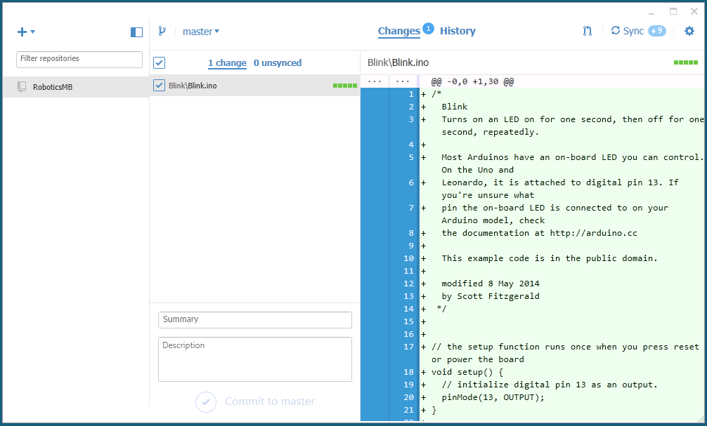
GitHub Client

Slide 10
Announcing the 2015 Troop 675
Robotics Competition!

Slide 11
Robotic Uranium Carry
Objective: Transport radioactive uranium capsule from one reactor to another.
Uranium capsule will take the form of a ping pong ball
Begin and end with a human-controlled segment to load and unload the capsule.
Carefully navigate a maze autonomously
Option to team up with another scout

Slide 12
Competition Scoring
Points scored for each portion completed
Bonus points for time completed within 5 minutes
Bonus Creativity points
Bonus Design points
Penalty points
Parent Judge panel

Slide 13
Obstacle Sensor

Slide 14
Obstacle Sensor Hookup
TBD

Slide 15
Programming Exercises
TBD

Slide 16
Session #2 Homework
Complete class exercises
In your notebook, capture the design for the competition
  How to load/unload the capsule
  How to carry the capsule
  Sketch the logic required to navigate maze
Program your robot to implement your maze navigation logic
Robotics MB Workbook:
  Section 3
  Section 4 a, b

