Slide 1
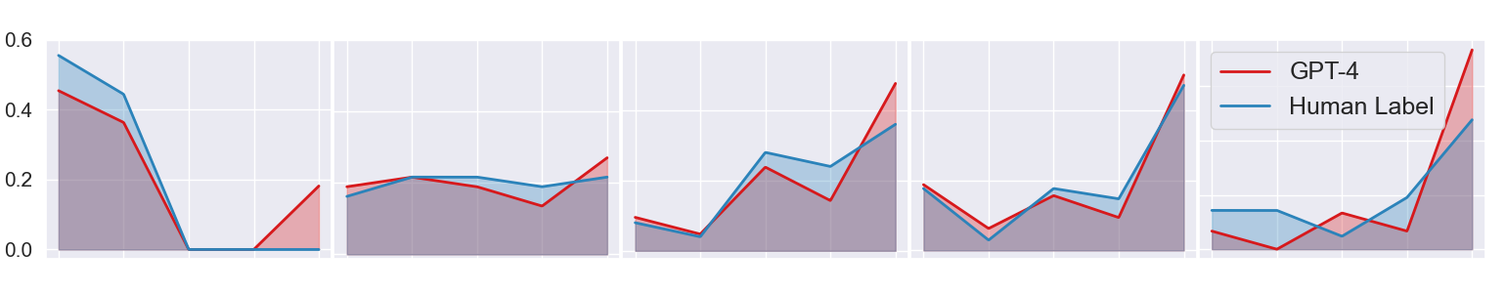
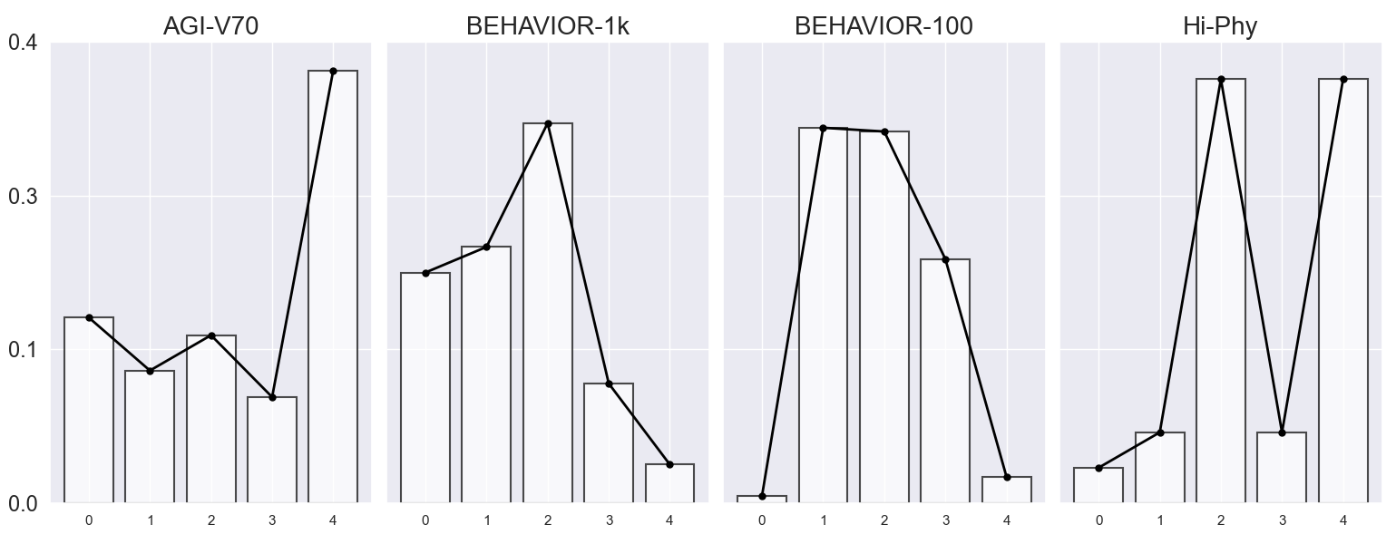
(a) Level-wise distribution of assessed abilities in AGI-V70
Level 1
Level 2
Level 3
Level 4
Level 5
Density distribution
(b) Distribution of assessed abilities across various benchmarks
Density distribution
Feature Perception
Object Perception
Spatial Vision
Temporal Vision
Visual Reasoning

Slide 2
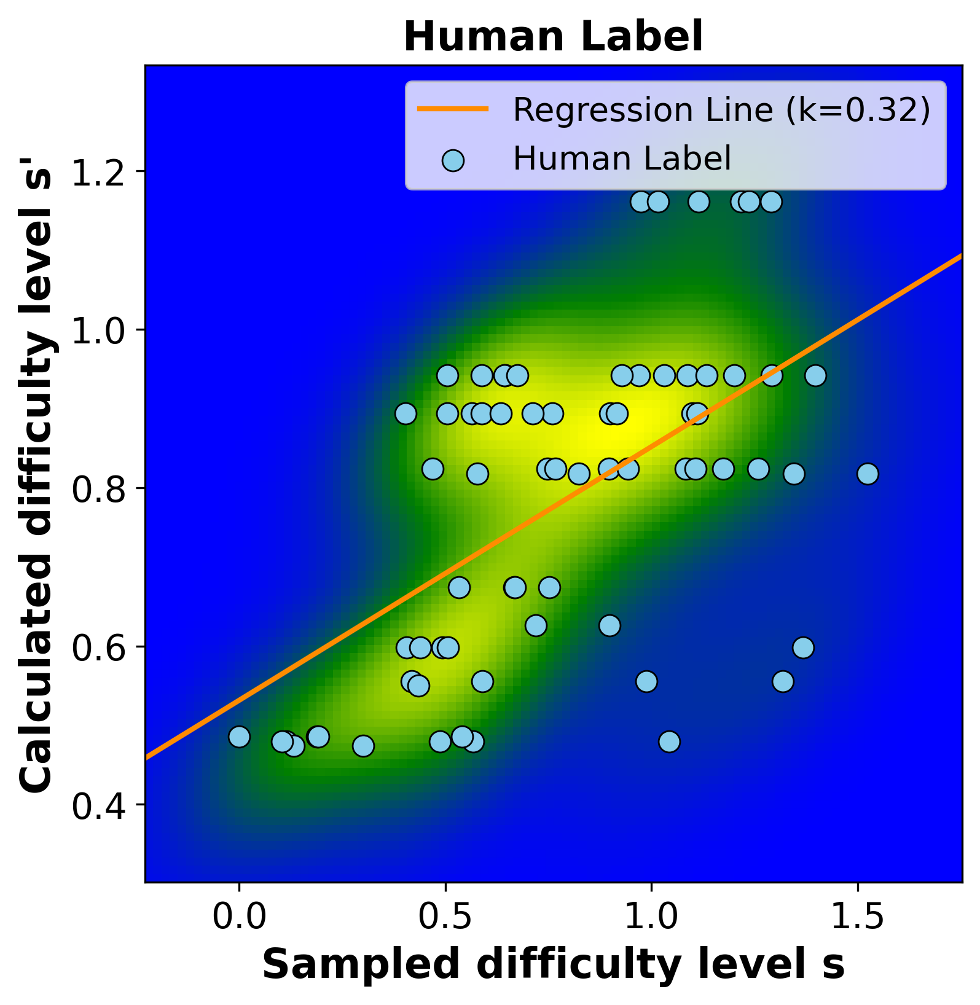
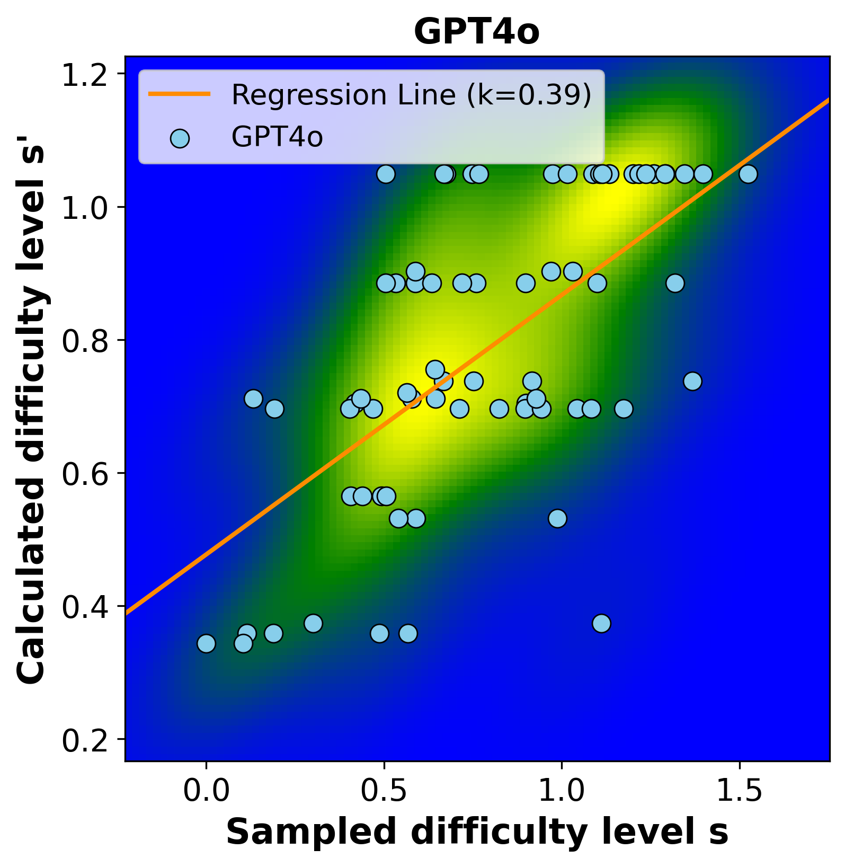
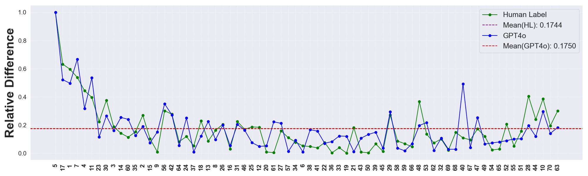

(a) Correlation Heatmap between s and s’
(b) Relative Difference $∆(t)$
Task Indices

