Slide 1
LIVE FROM THE RUNNING SYSTEM
CareGrid
ICU Bed-Arbitration Decision Support
Scoring the critical-care waitlist on severity, survival likelihood, and waiting time — explained at every layer, audited on every re-rank, and decided by the clinician.
XGBoost survival model
SOFA + age + comorbidity
AUC 0.61 · Brier 0.121
hold-out validated before use
3 weight profiles
policy stance as a named preset
SHAP-explainable
every prediction attributed
Clinician in the loop
confirm or deviate, always logged

Slide 2
THE PROBLEM
Which waiting patient gets the next ICU bed?
Critical-care capacity is fixed and the queue is never empty. Every candidate — the sickest, the most likely to survive, the longest-waiter — is a real human whose claim the team must weigh under time pressure and public scrutiny.
Zero-sum scarcity
Every occupied ICU bed blocks another patient; choosing is inevitable, so the choice must be defensible.
Conflicting signals
Severity, survival likelihood, and time waited pull in opposite directions — the ranking has to make the trade-off explicit.
Opaque scoring
Existing triage scores rank the queue but never say why — no factor breakdown, no explanation a nurse can challenge.
Unreviewable decisions
Allocations decided in a human's head leave no record — no replay, no evidence for a morbidity-and-mortality review.
What if the queue could rank itself — and be able to say why?
2

Slide 3
THE MODEL
One queue, three signals — explained at every layer
1 · Clinical inputs
Six SOFA organ components + age + comorbidity — quantities a clinician already knows and can verify on the chart.
2 · Survival model
CPU gradient-boosted trees trained on 2,880 ICU-patient outcomes; predicts each candidate's survival probability per episode.
3 · Validated gate
Hold-out AUC 0.61 · Brier 0.121 · decile calibration — a demo refuses to run on a model that fails the tolerance.
4 · Explained rank
Priority Score = w₁·severity + w₂·survival + w₃·wait with SHAP attribution on the survival term, a deterministic Tie-Break Cascade, and a snapshot audit trail.
The scoring model combines a trained ML survival predictor with transparent, deterministic arbitration logic — so the machine-learning part is explainable and the fairness part is reproducible.
3

Slide 4
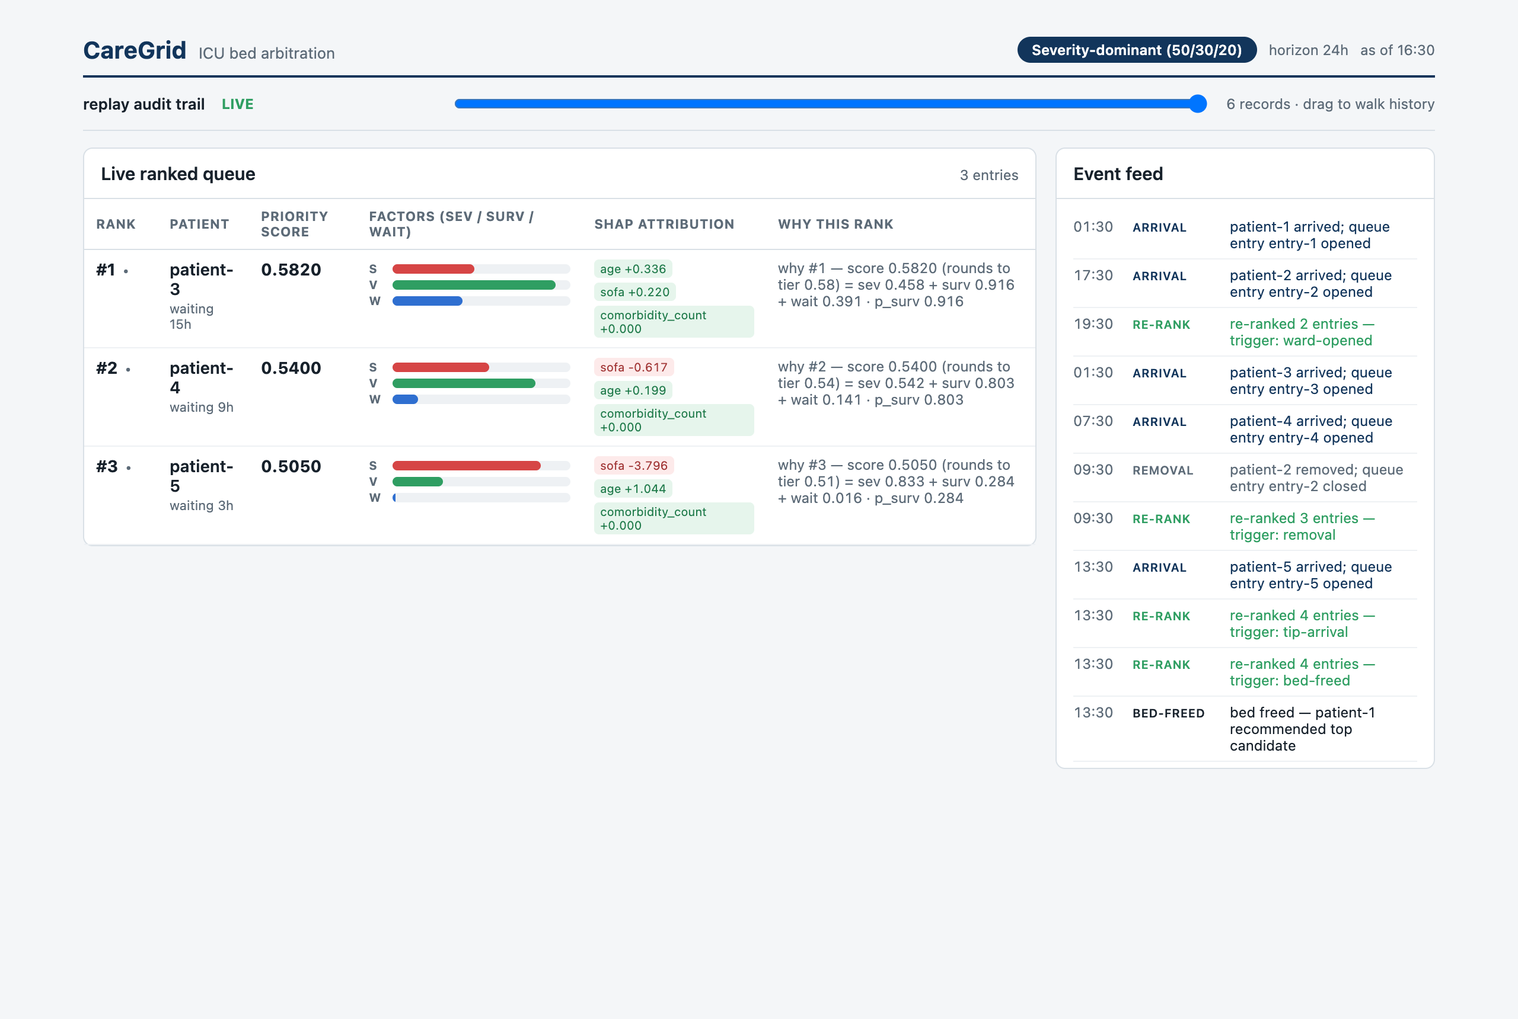
LIVE DASHBOARD — THE RANKED QUEUE
Every priority score you can trace
WHY IT'S UNIQUE
Transparent scoring
Each score is the weighted sum 0.582 = 0.5·sev 0.458 + 0.3·surv 0.916 + 0.2·wait 0.391 under the 50/30/20 profile — with the three normalized factors drawn as bars beside the number.
WHY IT'S UNIQUE
SHAP on every prediction
Green/red chips attribute each survival probability: the SOFA-20 patient's −3.80 sofa term and +1.04 age term explain its 0.284 p-surv at a glance.
KEY BENEFIT
Defensible to the bedside
Every rank maps to medical quantities — six SOFA organs, age, comorbidity, hours waited — a clinician can verify rather than trust.
Live view: Severity-dominant (50/30/20) profile · 24h wait horizon · as of 2026-01-01 11:00.
4

Slide 5
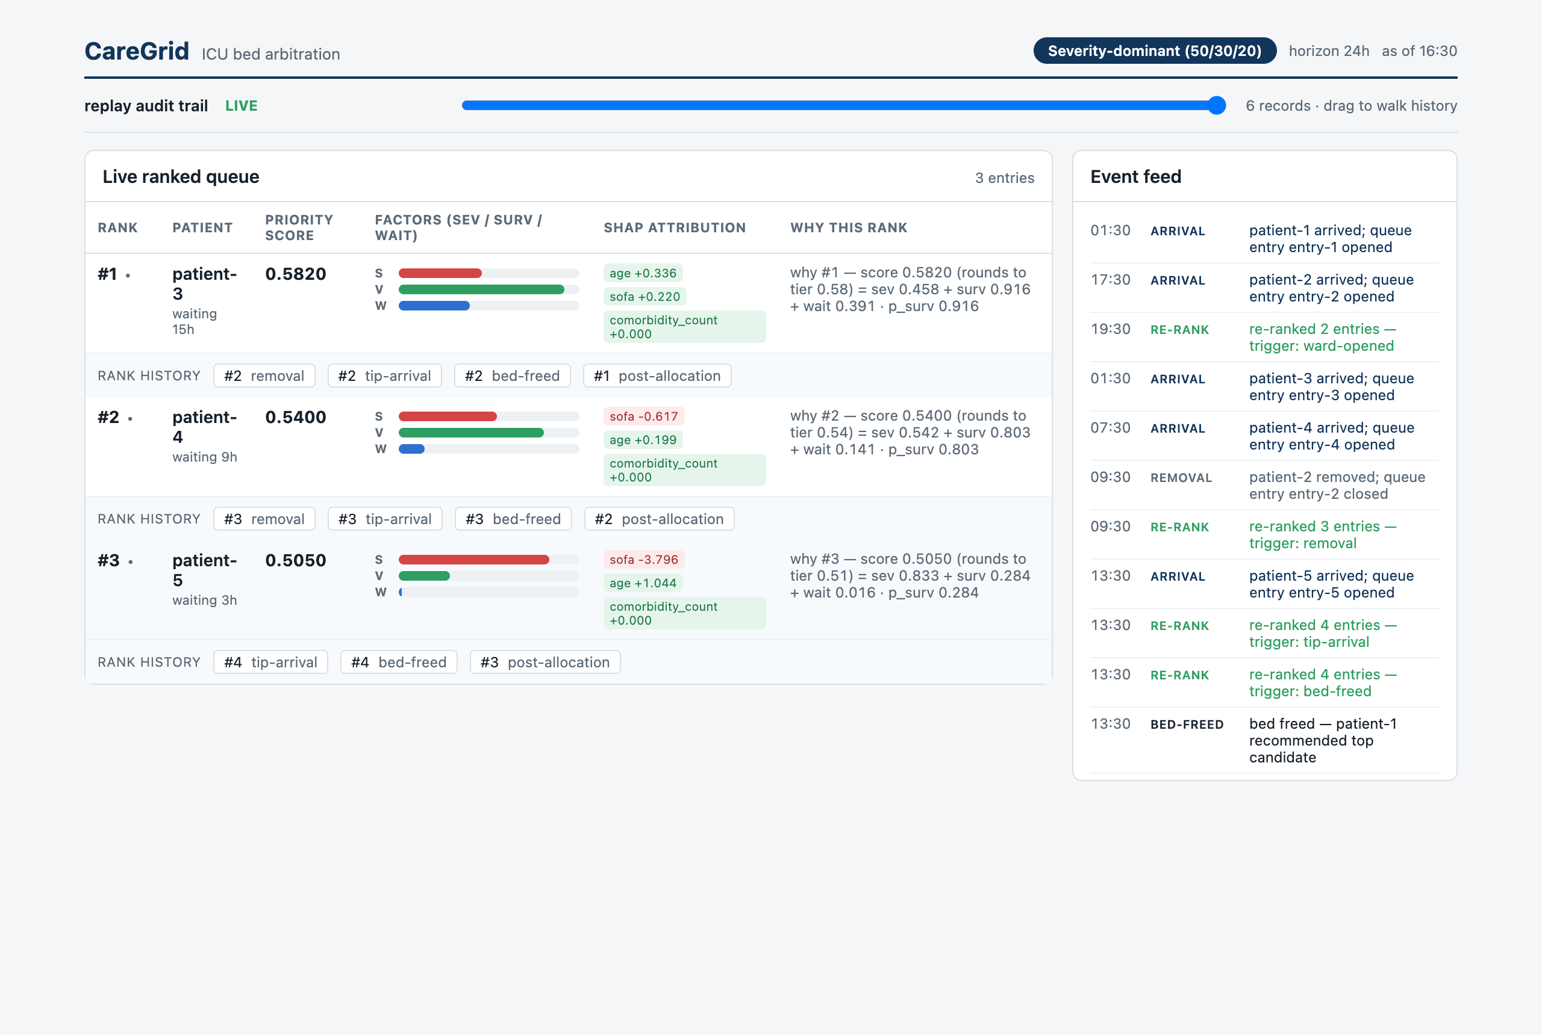
LIVE DASHBOARD — PER-PATIENT TRACEABILITY
A journey for every patient in the queue
WHY IT'S UNIQUE
Rank history per patient
Click any row and the patient's rank on every snapshot unfolds, each chip labelled with the trigger — arrival, removal, freed bed — behind that move.
WHY IT'S UNIQUE
Movement signs
Up, down, unchanged, new: the live queue wears its own history on its sleeve as the ward changes around it.
KEY BENEFIT
Accountability
“Why did this patient's priority change?” has a documented, replayable answer — not a guess.
5

Slide 6
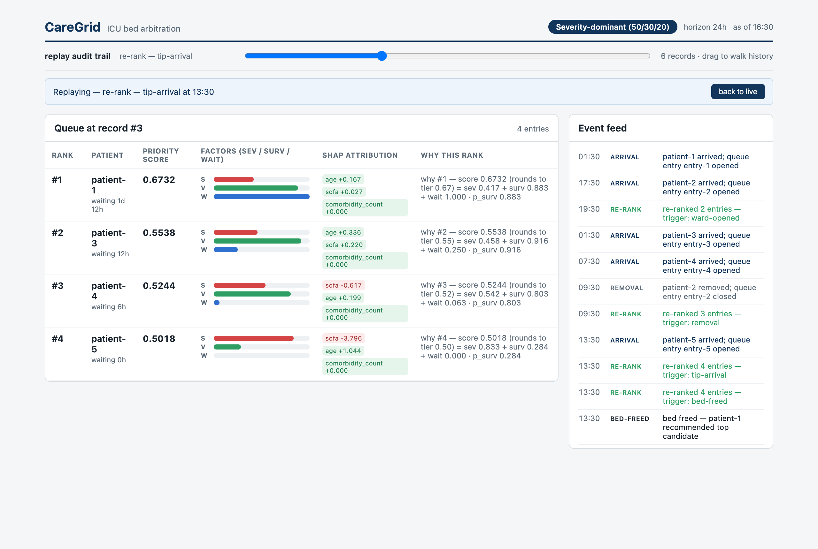
LIVE DASHBOARD — REPLAY THE AUDIT TRAIL
The ward changed; the queue reacted — and it's recorded
WHY IT'S UNIQUE
Snapshot per re-rank
Every arrival, removal, or freed bed writes an immutable Ranking Snapshot. The header shows record #3 — re-rank: tip-arrival — with the newly arrived SOFA-20 patient in the mix.
HOW IT WORKS
Waiting time saturates
The wait factor follows a 24h quadratic horizon then caps — protecting the 36h long-waiter (patient-1) without ever letting a wait dominate the decision.
KEY BENEFIT
Reproduce any instant
Drag the slider back in time: the queue at any recorded moment is exactly what was ranked then — recreatable, reviewable, shareable.
6

Slide 7
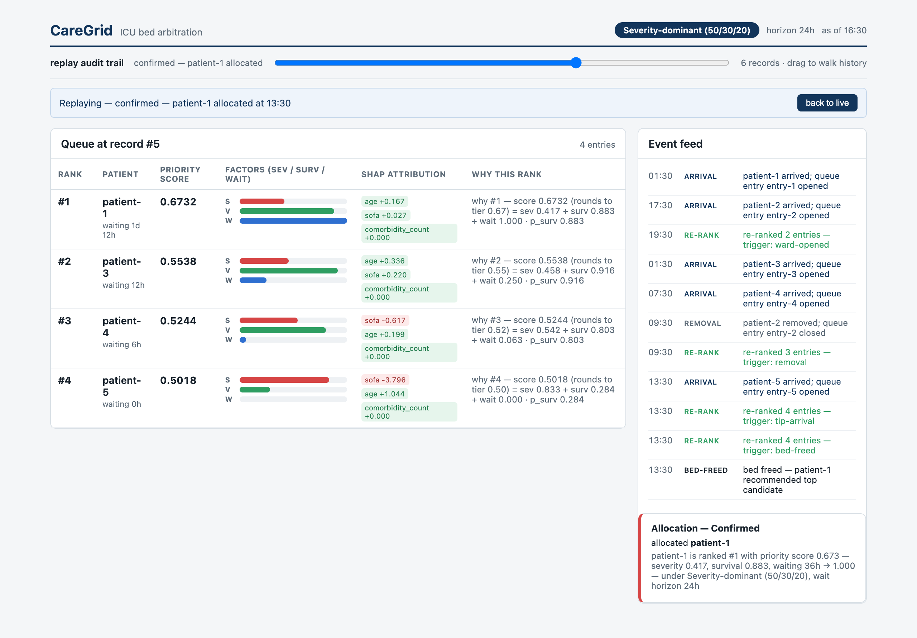
LIVE DASHBOARD — THE ARBITRATION DECISION
The system recommends. The clinician decides.
HOW IT WORKS
Recommendation with reasoning
When a bed frees, the panel states the case: “patient-1 is ranked #1 with priority score 0.673 — severity 0.417, survival 0.8…” — the evidence, next to the queue.
WHY IT'S UNIQUE
Confirm or consciously deviate
The clinician confirms — or overrides to a lower-ranked candidate, and the deviation, the recommendation it overrode, and any note are recorded in the same audit trail.
KEY BENEFIT
Human-in-the-loop by design
The system never auto-allocates. The final call is always the clinician's, and always auditable after the fact.
7

Slide 8
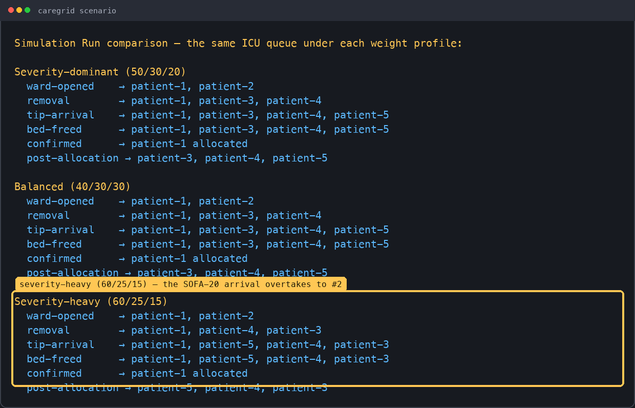
SAME QUEUE, THREE POLICY STANCES — CLI REPLAY
The weight profile is a policy decision, made visible
WHY IT'S UNIQUE
One queue, three answers
The identical ward is replayed under Severity-dominant, Balanced, and Severity-heavy — and the highlighted block shows the SOFA-20 arrival overtaking to #2 when the policy says severity matters most.
HOW IT WORKS
Named weight presets
50/30/20, 40/30/30, 60/25/15 — each Weight Profile is scoped to the run and logged with every snapshot, so a score is always traceable to its stance.
KEY BENEFIT
Policy discussions, not black boxes
Hospitals argue about weights, not about hidden logic — the ethical stance is an explicit, comparable parameter.
8

Slide 9
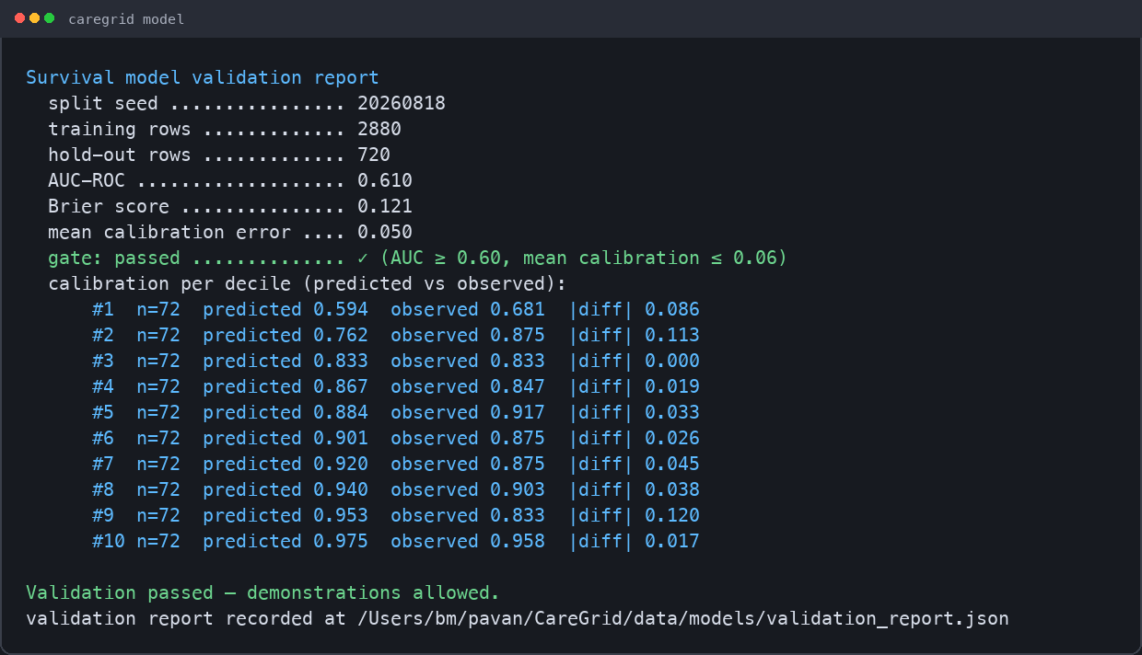
THE SURVIVAL MODEL — VALIDATED GATE
A demo refuses to run on an unvalidated model
WHY IT'S UNIQUE
Hold-out validation gate
AUC 0.61, Brier 0.121, per-decile calibration to 0.05 — and if the model fails the tolerance (AUC ≥ 0.60, mean calibration ≤ 0.06), every demonstration path refuses to run.
HOW IT WORKS
Honest metrics, in the open
The report is written alongside the trained booster, decile by decile, so the strengths — and the calibration tail — are visible before anyone trusts a rank.
KEY BENEFIT
Safe by construction
You cannot demo, serve, or replay on a model that hasn't proven itself on data it never saw — the gate is in the code path, not in a review meeting.
9

Slide 10
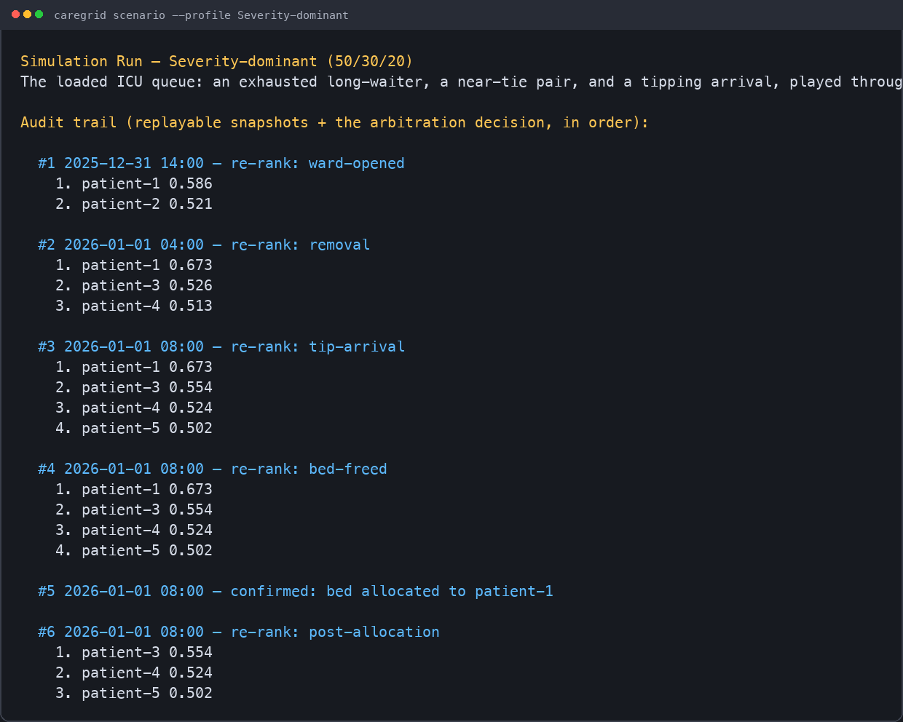
END-TO-END SIMULATION RUN — THE CLI TRAIL
One replayable audit trail, from ward opening to allocation
HOW IT WORKS
Score drift you can read
patient-1 climbs 0.586 → 0.673 purely as hours-on-list grow past the horizon — the waiting factor at work, snapshot by snapshot.
WHY IT'S UNIQUE
Append-only Ranking Snapshots
Each snapshot records the ordered queue, factor breakdown, SHAP attribution, weight profile, horizon, and trigger — one continuous, reproducible story.
KEY BENEFIT
Ready for review
A morbidity-and-mortality committee can replay tonight's decision morning-after, exactly as made — including any deviation and the note.
10

Slide 11
THE MODEL, IN ONE PAGE
Key benefits of the CareGrid model
Explainable ML
Every survival prediction carries SHAP attribution; every score decomposes into severity, survival, and waiting so a nurse can follow the math.
Deterministic fairness
The Tie-Break Cascade resolves near-equal scores on severity → survival → wait → order-of-arrival, and says which stage decided.
Clinician in the loop
Recommendation always faces a human confirm-or-deviate decision, with the deviation recorded alongside the recommendation it overrode.
Immutable audit trail
An append-only Ranking Snapshot after every re-rank — profile, horizon, factors, SHAP, trigger — replayable end-to-end.
Policy as configuration
Weight Profiles are named, scoped to the run, and logged with every snapshot, so an ethical stance is explicit and comparable.
Safe by construction
Hold-out validation gates every demonstration: no demo, dashboard, or replay runs on a model that fails AUC and calibration tolerance.
11

Slide 12
From queue to decision, explained and on record.
CareGrid ranks the critical-care waitlist with a validated, explainable survival model; re-ranks on every change; and hands the clinician a recommendation on a bed they can trace, question, or override — every step written to an immutable audit trail.
Not a black box. Not an autopilot. A decision-support system built to be reviewed.
12

