Slide 1
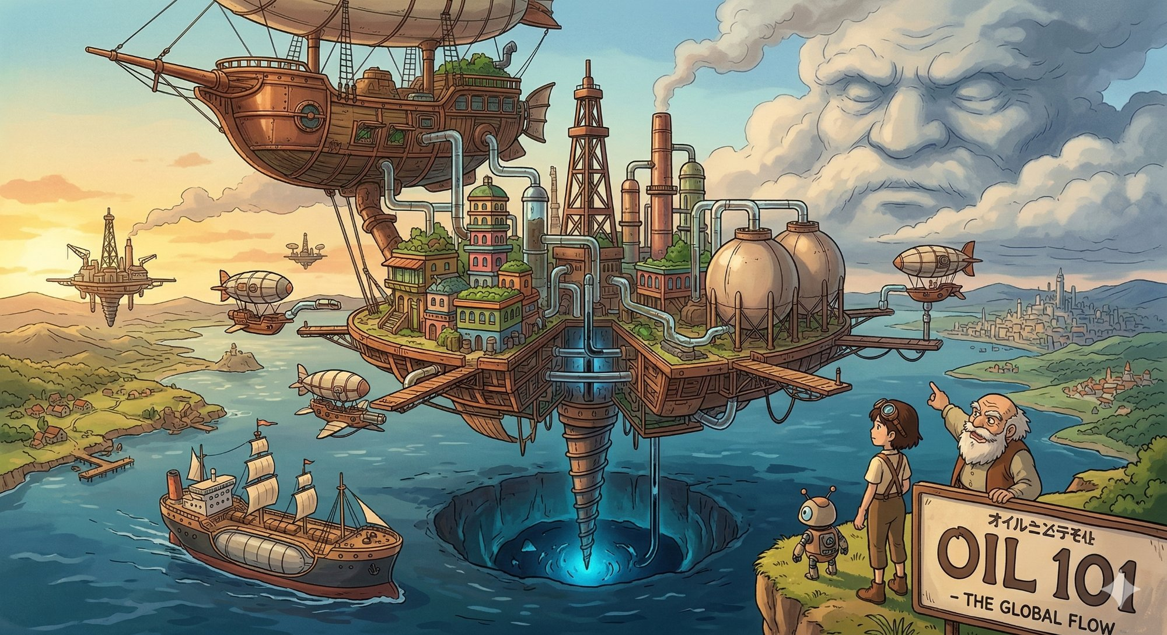
ENERGY
Learning Hub
RAG-Powered Knowledge System for Oil, Gas & Energy Education
Derek Eng
March 2026

Slide 2



The Challenge
Why energy newcomers need a smarter way to learn
Fragmented Knowledge
Energy topics span geology, economics, policy, and engineering — scattered across dense textbooks and reports
Steep Learning Curve
Newcomers face jargon-heavy material with no guided pathway from basics to advanced concepts
No Interactive Access
Static PDFs and textbooks don’t answer follow-up questions or adapt to a learner’s level

Slide 3
Target Audience
Who the Energy Learning Hub is built for
1
2
3
New Industry Entrants
English-Speaking Learners
Self-Directed Explorers
Graduates and career-switchers entering oil, gas, or renewable energy sectors for the first time
Professionals and students comfortable with English-language technical content and terminology
Curious individuals who want guided, interactive access to expert-level energy knowledge at their own pace

Slide 4

The Solution
An AI-powered, interactive learning platform grounded in authoritative energy texts
RAG-Powered Answers
LangGraph Router
Responses grounded in curated PDFs with page-level citations
Gemini and Qwen orchestrated via LangGraph for resilience
Tiered FAQ Pathways
Web Deployment
Beginner → Intermediate → Advanced guided learning journeys
Interactive Gradio UI deployed to Render for global access

Slide 5
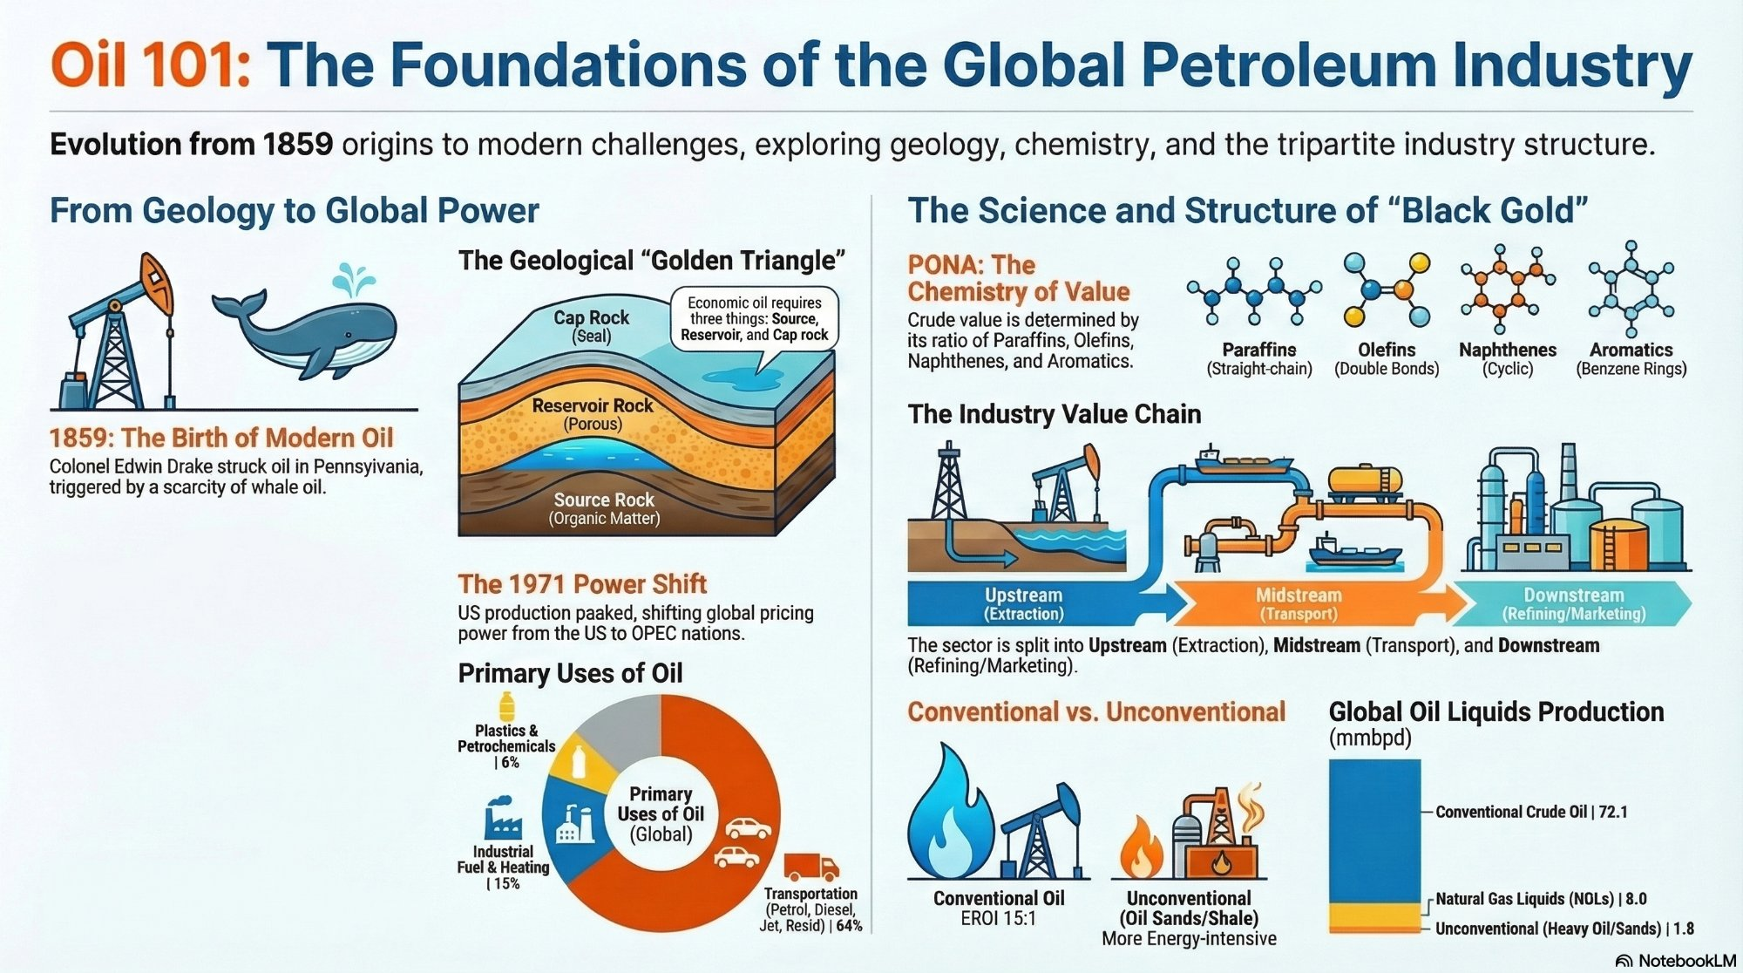
Current Data Source
Oil 101 by Morgan Downey — The Foundations of the Global Petroleum Industry

Slide 6

Technical Architecture
End-to-end system design: from PDF ingestion to web-deployed answers
PDF
Ingestion
Chunking
& Embedding
Vector
Store
LangGraph
Router
Gradio
UI
PyPDFLoader
+ metadata
500-char chunks
MiniLM-L6-v2
ChromaDB
with citations
Gemini / Qwen
fallback
Deployed on
Render
Data Source
Secret Keys
Output
Oil 101 by Morgan Downey (PDF)
Stored on Google Drive
GEMINI_API_KEY
HF_TOKEN
Cited RAG answers + side-by-side
LLM comparison for learners

Slide 7

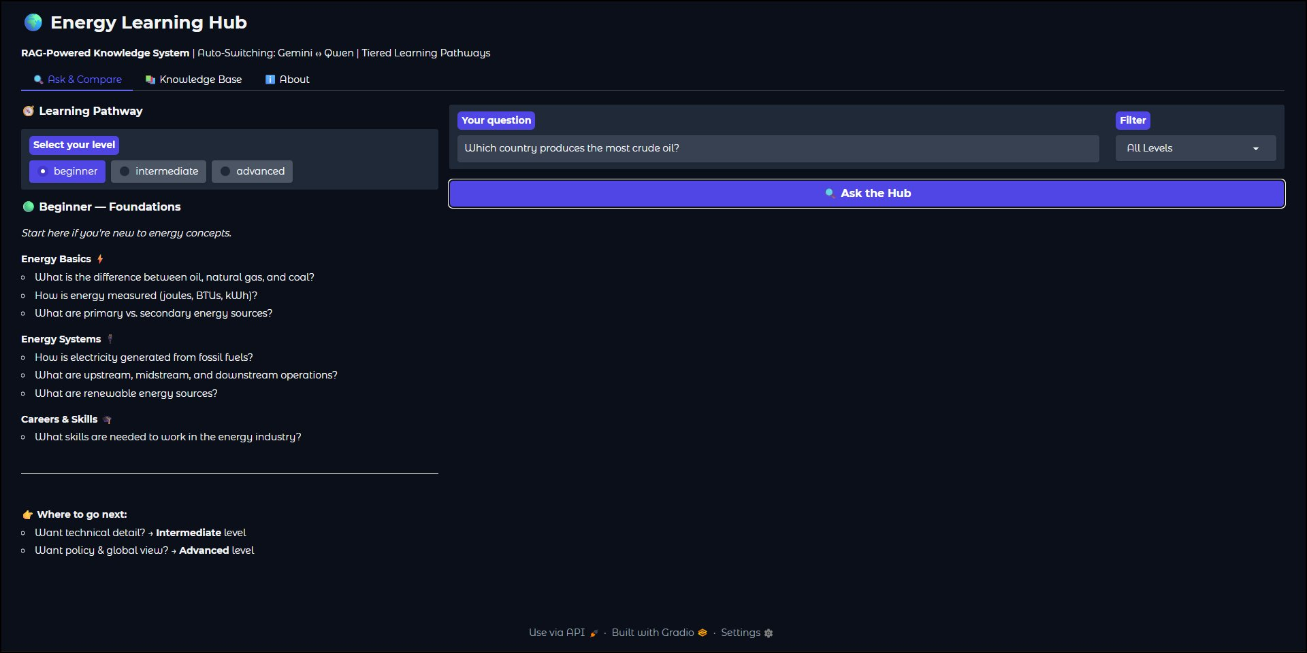
Live on the Web
The Energy Learning Hub is deployed and accessible worldwide
https://energylearninghub.onrender.com

Slide 8
LLM Strategy
Two models orchestrated by LangGraph for resilient, comparable responses
Google Gemini
Qwen (HuggingFace)
Primary LLM
Fallback LLM
gemini-2.5-flash
Qwen2.5-7B-Instruct
Fast, cost-effective general reasoning. Handles the majority of learner queries with low latency.
Open-source fallback via HuggingFace Inference API. Activated when Gemini hits its quota limit.
Key: GEMINI_API_KEY
Key: HF_TOKEN
LangGraph Router: Fan-out retrieval → parallel LLM calls → merge results → display with model attribution

Slide 9




Future Plans
Scaling the hub beyond Oil 101 into a comprehensive energy learning platform
Mobile Platform
Multiple Data Sources
Responsive mobile-first UI so learners can study on-the-go. Explore native iOS/Android app with offline cached FAQs and push notifications for new content.
Ingest additional PDFs, IEA/OPEC reports, academic journals, and industry whitepapers. Support Word docs, web scraping, and structured data alongside PDFs.
Additional LLM Providers
Assessments & Progress
Integrate Claude, Llama, and other LLMs via the LangGraph router. Enable learners to compare answers across even more models for richer insights.
Add micro-quizzes at the end of each tier. Track learner progress with completion badges and personalized recommendations for next topics.

Slide 10

Summary & Next Steps
RAG system grounded in Oil 101 by Morgan Downey delivers cited, accurate answers
LangGraph orchestrates Gemini and Qwen with automatic failover
Tiered FAQ pathways (21 questions) guide learners from basics to strategic depth
Live at energylearninghub.onrender.com — interactive, always-on web access
Next Steps
Launch mobile-responsive version and explore native mobile apps
Ingest IEA, OPEC, and additional textbook PDFs to expand knowledge base
Integrate additional LLM providers (Claude, Llama) for broader comparison
Add learner assessments, progress tracking, and completion badges
Derek Eng | Energy Learning Hub | 2026

