Slide 1
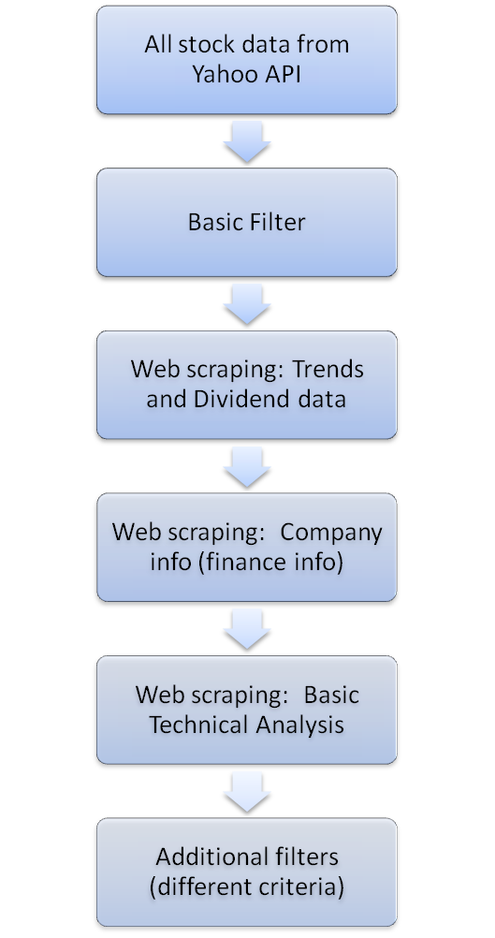
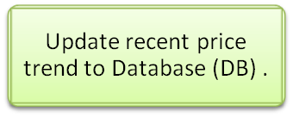
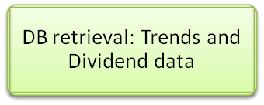
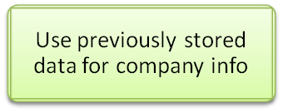
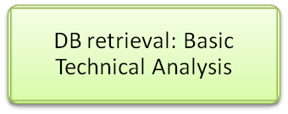
1
Python Integrated Stock data Retrieval and Criteria Filter
2
Alternative
(time saving)
All stock symbol extraction using Yahoo Finance APII, also include latest prices.
Basic filter to remove delisted stocks, high price etc
Scrape from web for recent price movement and dividend payout for each year
  ALT: store all data to database and retrieve them for price and dividend for time saving.
Scrape company info, finance data from YQL.
  ALT: retrieved once and store as dataframe for further use. Only need updated per quarter.
Web scraping for historical prices for tech analysis.
  ALT: retrieve fr DB instead of scrape the price again.
Additional filters according to user’s criteria. Multiple set can be collected.
3
4
5
6

