Slide 1
corona virus tracker
Submitted by
Prithvi raj s

Slide 2
objective
The project objective will be focused on developing an app to track daily covid case all over the world
This app update daily bases using github

Slide 3
scope
This app help to know the positive cases and total number of cases all over the gloab
It is important to be aware of rasing covid case

Slide 4
requirements
Operating System: Windows 10.
Tools: Spring Boot- To develop the project,
My SQL – For the database.
JSP
Front End: Java Springboot, Servelet.
Programming Language: JAVA.
Back End: My SQL.

Slide 5
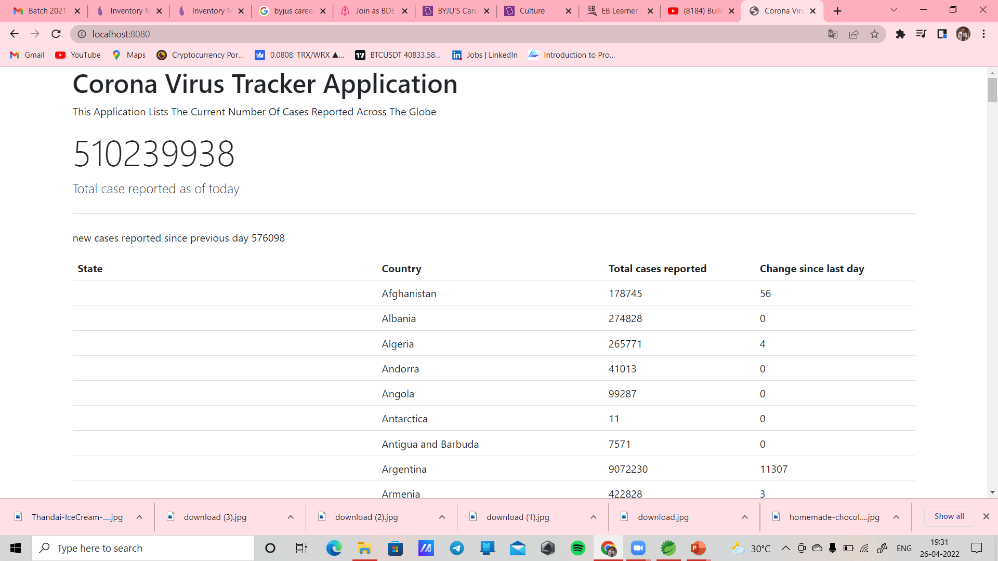
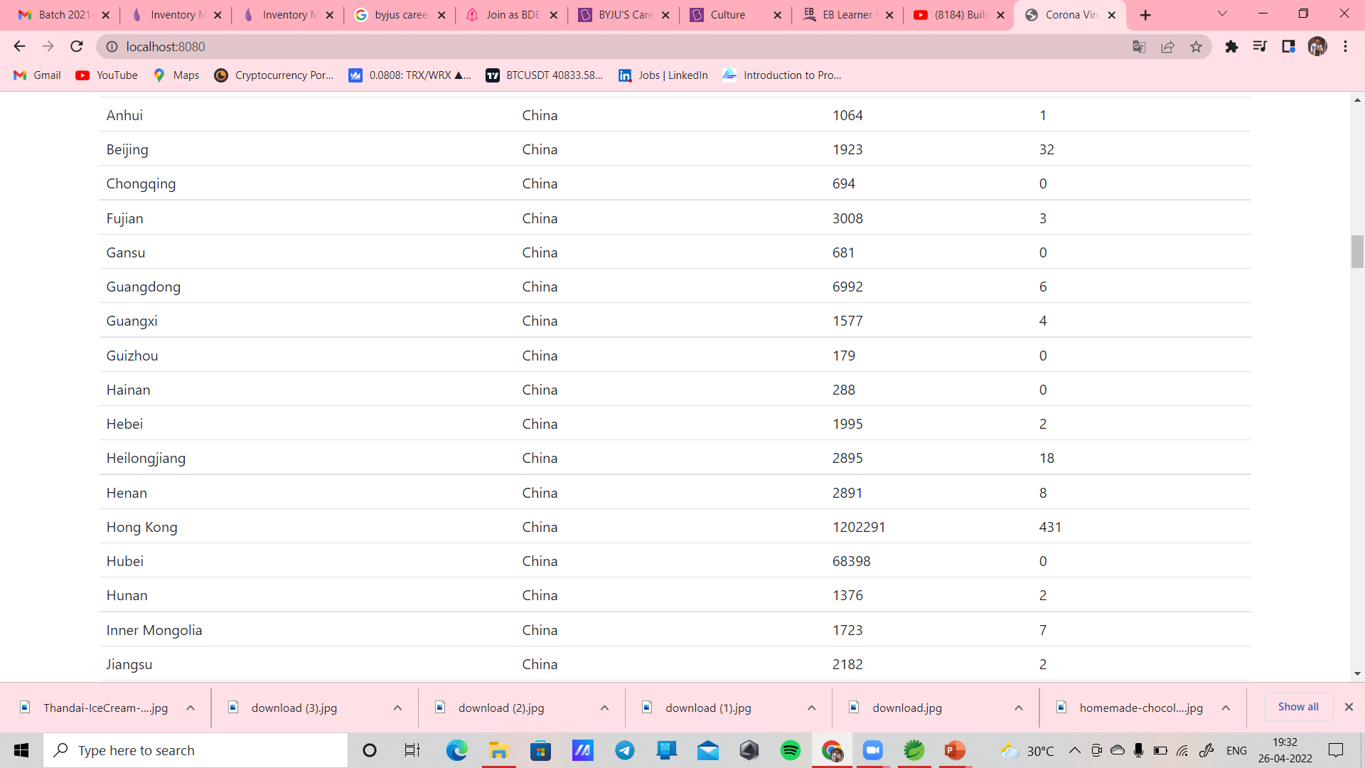
output

