Slide 1

Mini Project
METHOD
Modernized Weight Converter
OUTPUT
ERROR
OBJECT
DESIGN
INTRO
DESIGNED BY PRITHVIRAJ

Slide 2
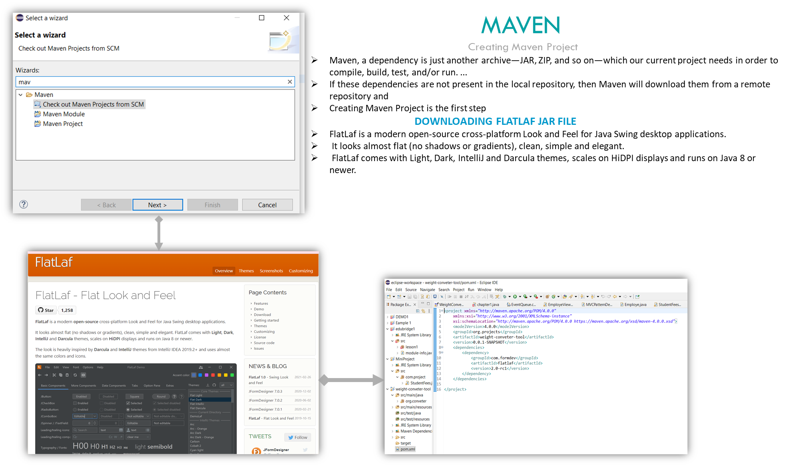
OUTPUT
OBJECT
METHOD
ERROR
DESIGN
INTRO

Slide 3
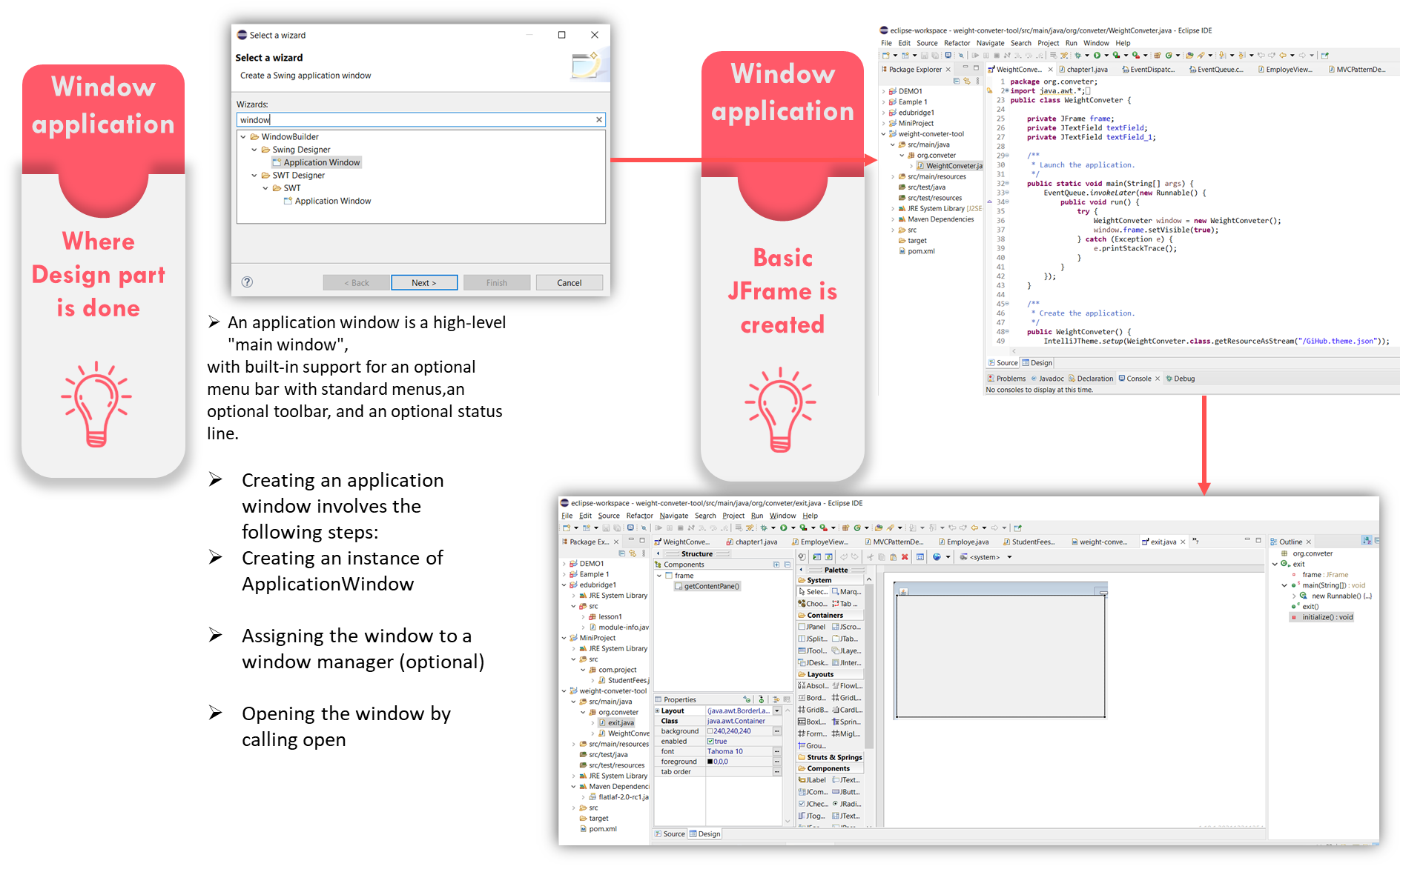
OUTPUT
ERROR
OBJECT
DESIGN
INTRO

Slide 4
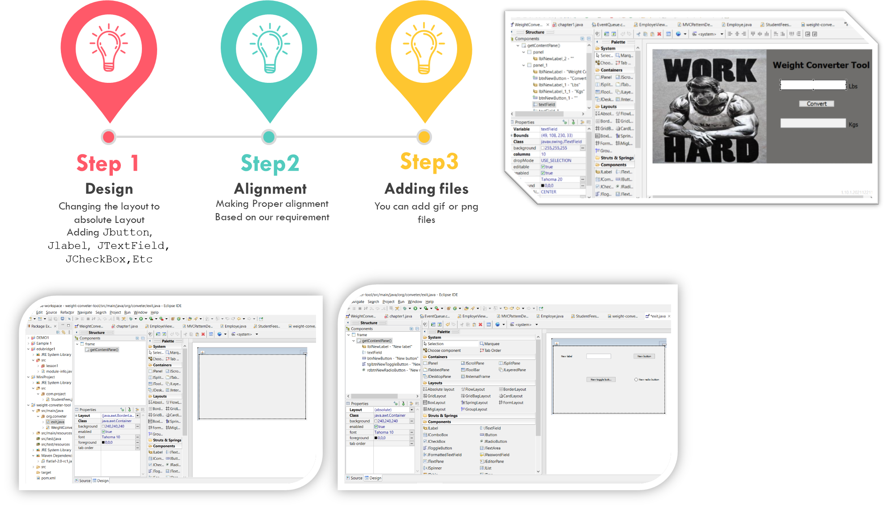
OUTPUT
METHOD
ERROR
OBJECT
DESIGN
INTRO

Slide 5

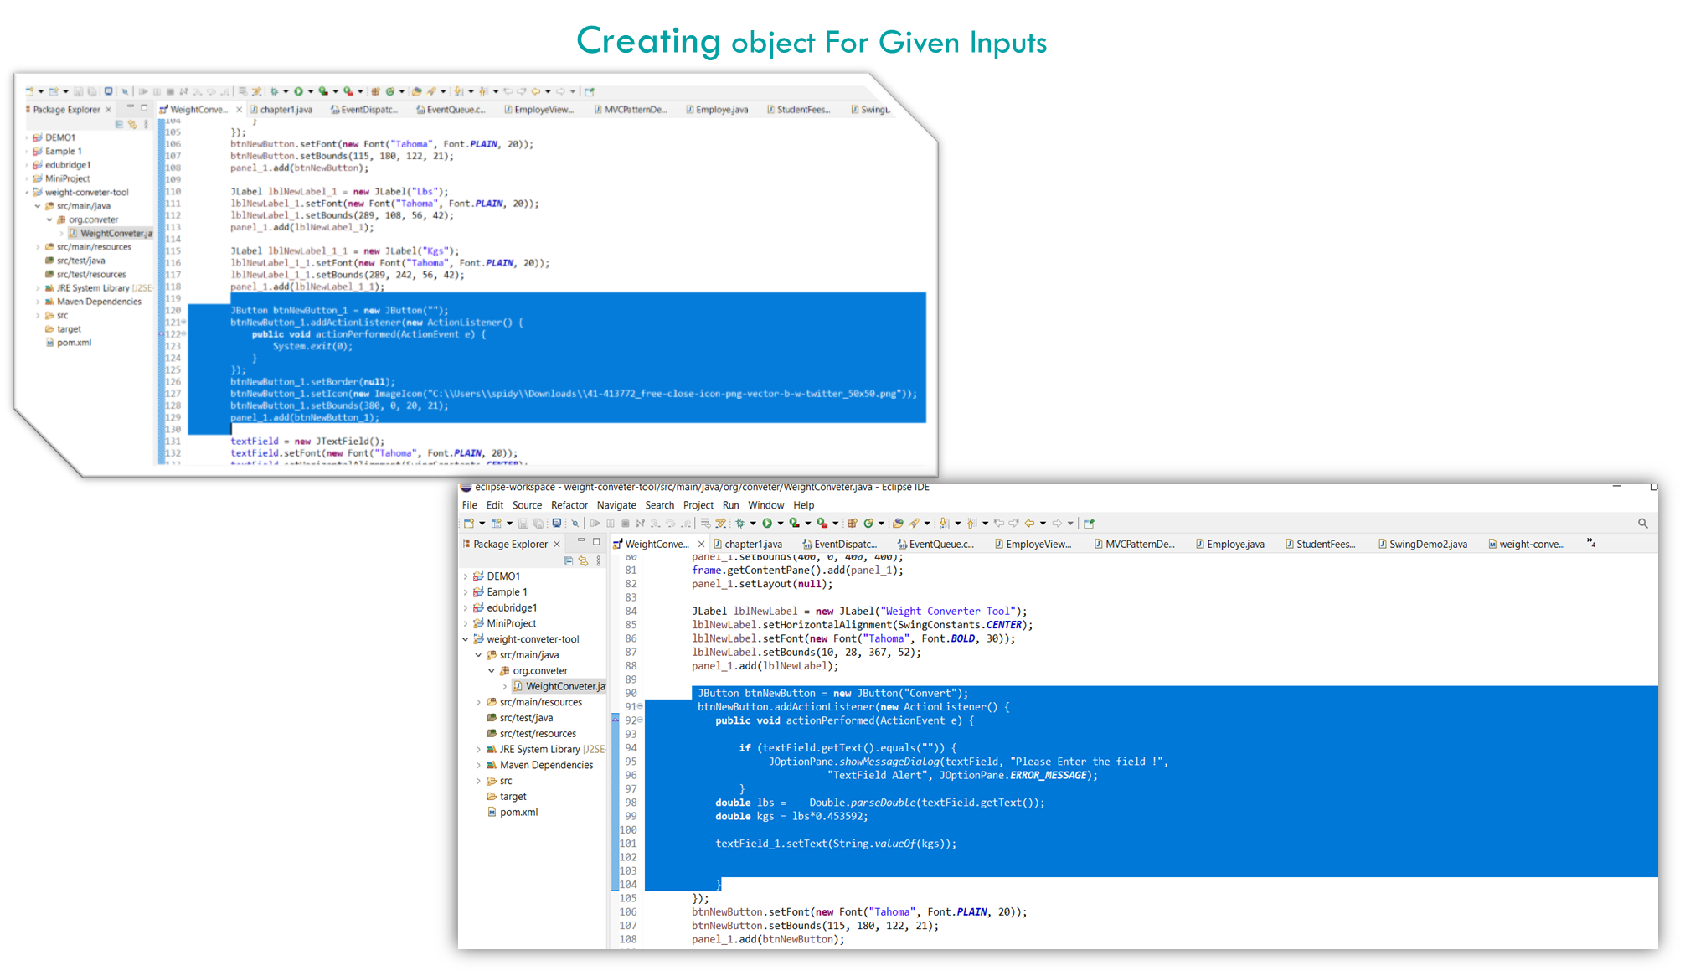
OUTPUT
METHOD
ERROR
teams
DESIGN
INTRO

Slide 6
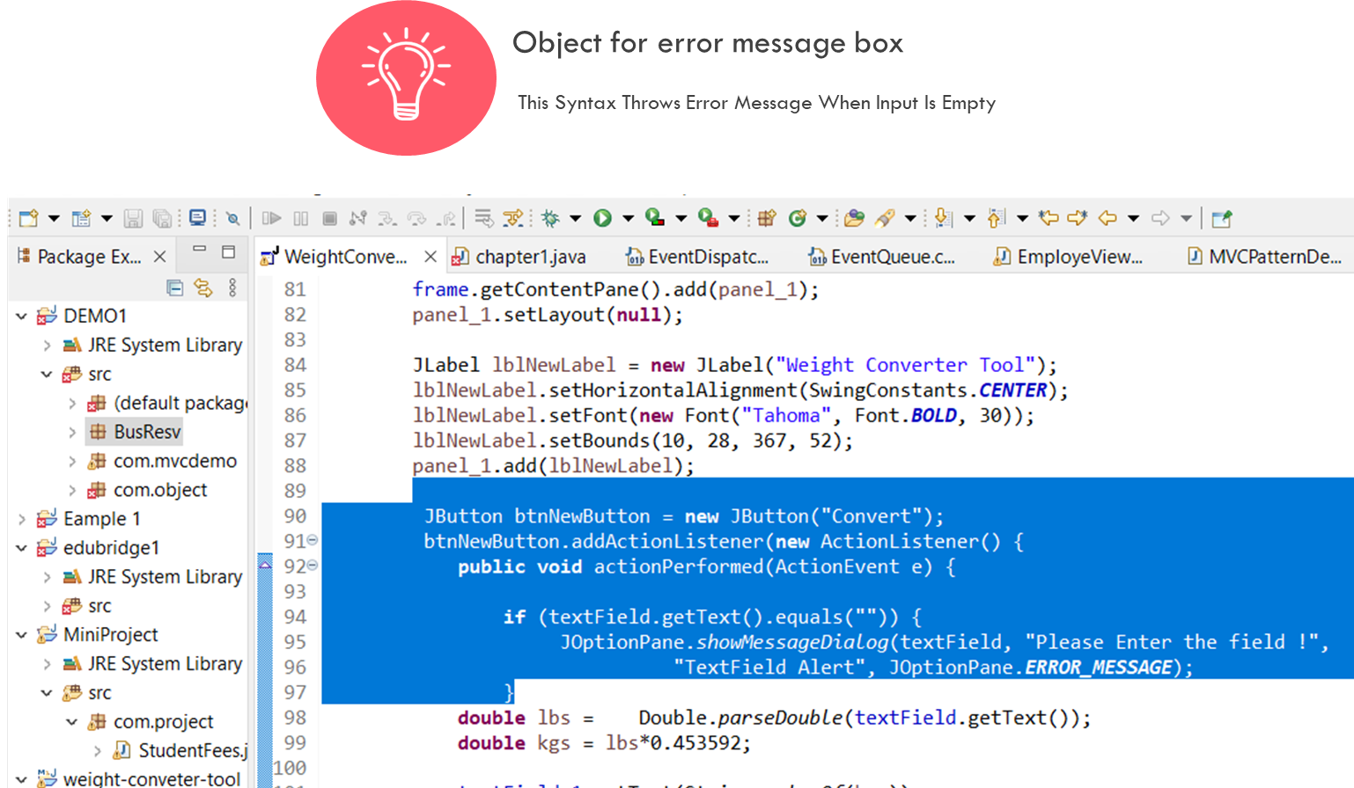
OUTPUT
ERROR
METHOD
OBJECT
DESIGN
INTRO

Slide 7

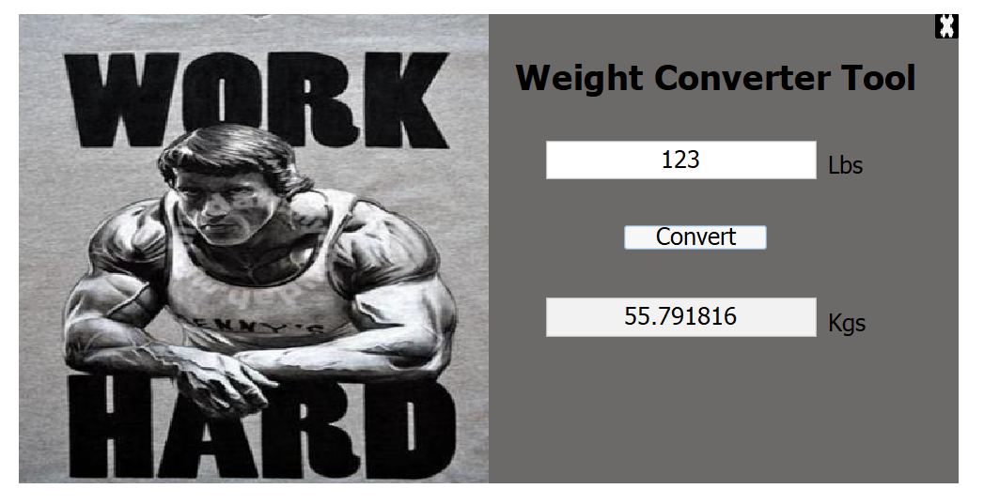
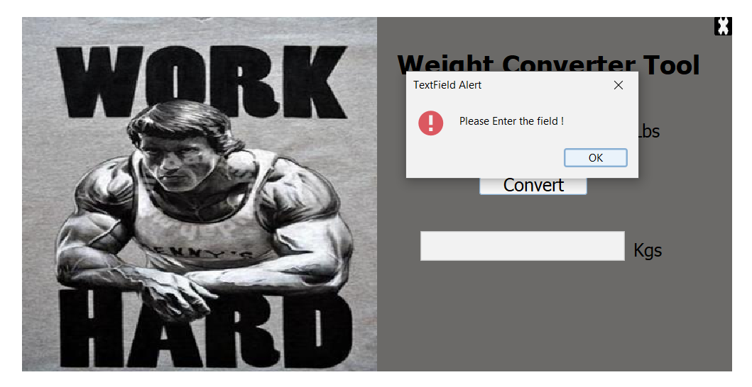
OUTPUT
Output For Both Conversion And Error
OUTPUT
METHOD
ERROR
OBJECT
DESIGN
INTRO

