Slide 1
online registration system
Submitted by
Prithvi raj s

Slide 2
objective
The project objective will be focused on developing an online registration to ensure the effectiveness of the flow of registration.
The registration process can be online without the need of paperwork anymore

Slide 3
scope
Online registration allows the attendee to register when it is most convenient for them.
It is important for the organizer to establish specific open and close dates, giving your registrants ample time to complete the registration.

Slide 4
requirements
Operating System: Windows 10.
Tools: Eclipse IDE - To develop the project,
My SQL – For the database.
Front End: Java Swing, AWT.
Programming Language: JAVA.
Back End: My SQL.

Slide 5
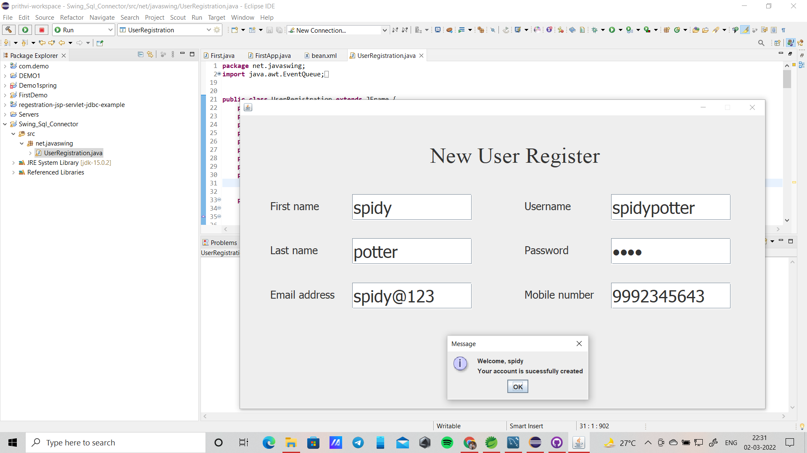
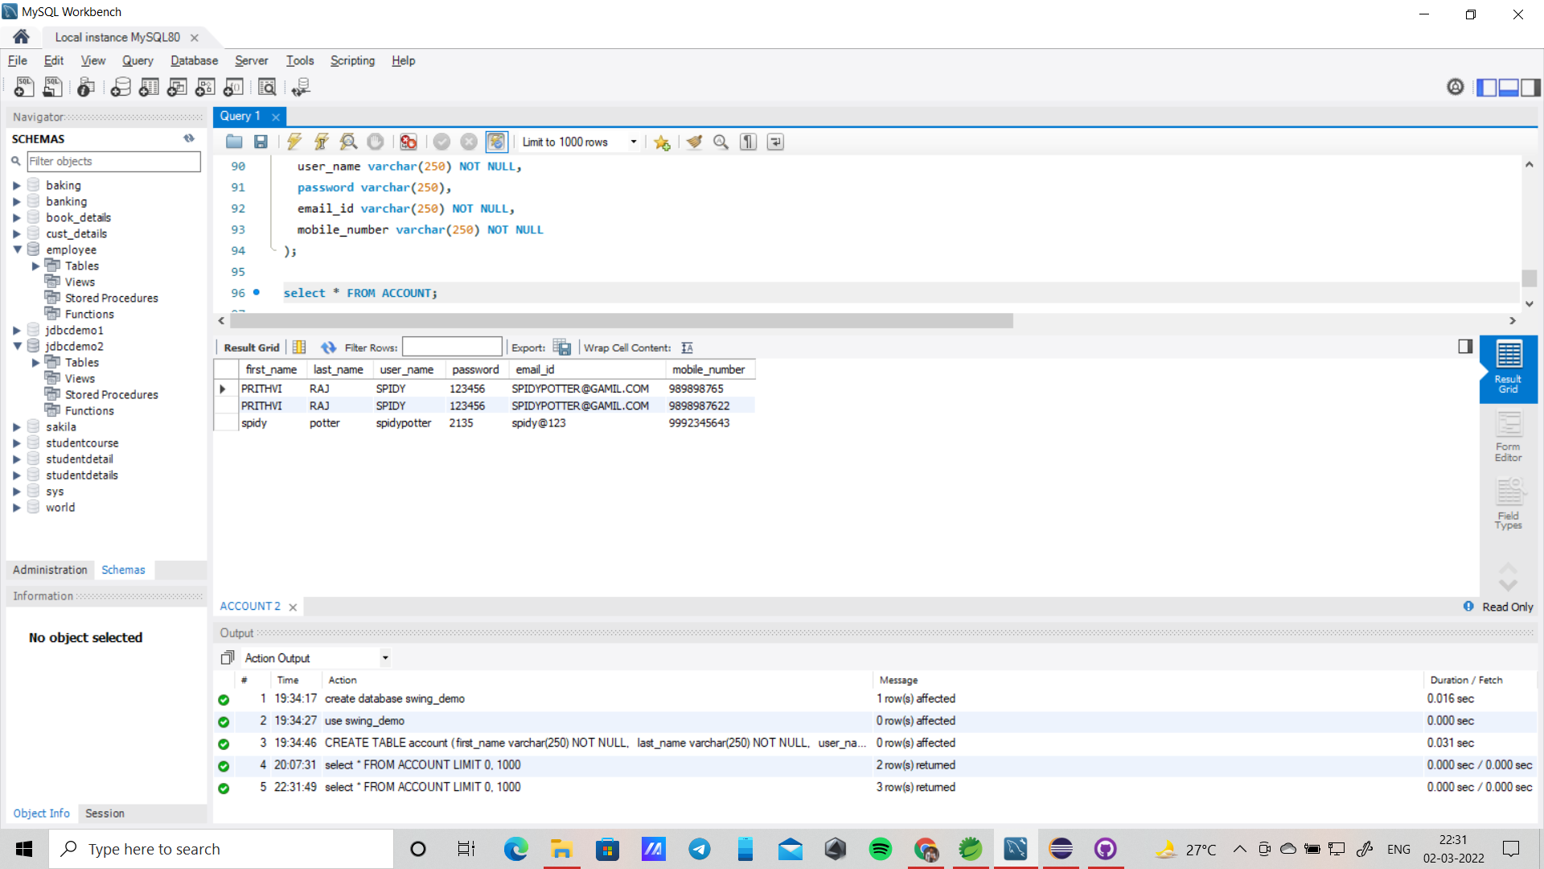
output

