Slide 1



Machine Learning to Control Prescription Drug Costs

Slide 2
Project Purpose
Recognize Physicians whose drug costs are remarkably higher than predicted.
Use machine learning algorithms with over 50 variables for hundreds of thousands of physicians to make a prediction for each physicians annual prescription drug costs.
Physicians who are much higher than predicted may be strongly affected by pharmaceutical representatives & marketing

Slide 3

Privatized Medicare Insurance
Medicare is broken into three parts (A,B, and D). Prescription drugs are provided through Medicare Part D
Medicare Advantage Plans are purchased from and implemented by private insurance companies. They provide all parts of Medicare
Medicare advantage plans can choose which doctors are in their plan

Slide 4

Prescription Drug Costs
Drug costs are driven up by ’brand name’ drugs.
Annually 20 billion is spent to convince doctors of the benefits of brand name drugs.
Brand name drugs do not always have higher efficacy than generic, but are almost always more expensive.

Slide 5
Dataset Description
Dataset was comprised of two separate csv files from Medicare.gov
One file included information about each physicians’ patient population
2nd file included information on each physician annual drug costs
Merged data frame included over 50 features for each physician:
features and their percentage of total importance to algorithm:
Total number of prescriptions written: 39.2%
Sum of importance of all chronic illnesses: 17.2%
Average annual prescription cost for respective specialty: 9.5%
Number of Beneficiaries with Medicaid: 6.5%
Sum of Age Demographic Information: 6.2%

Slide 6
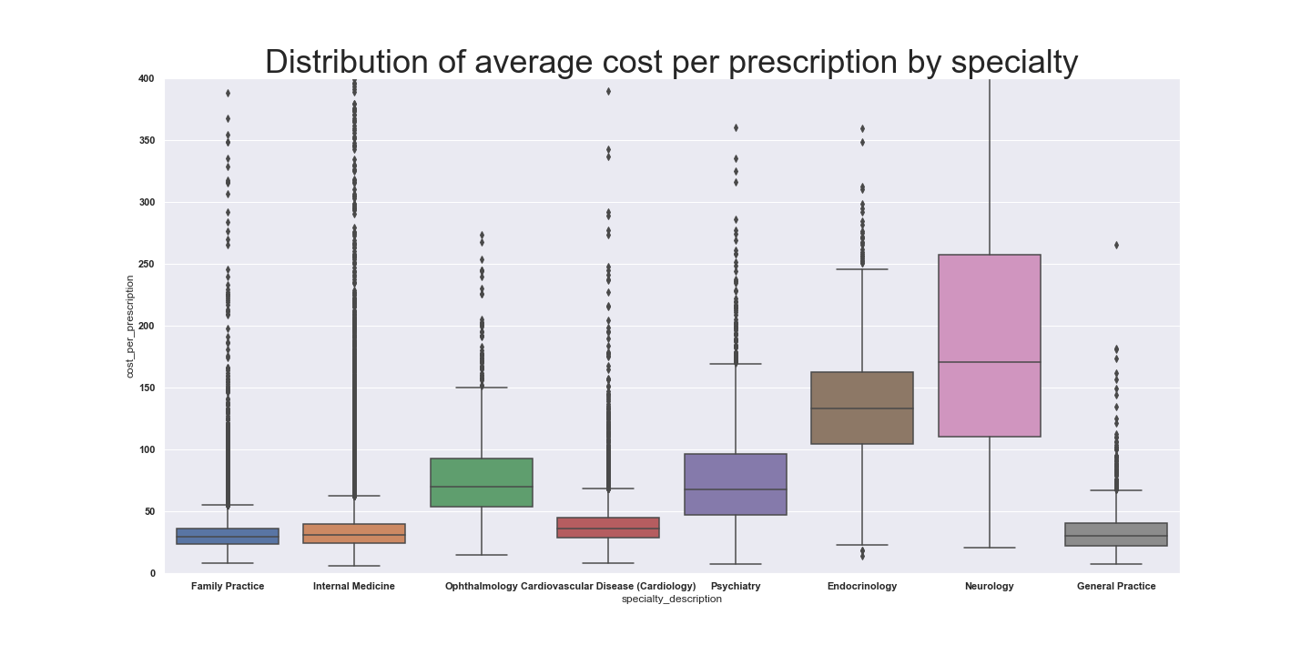
Considerations for Specialties
Specialty type strongly correlates with prescription drug costs
Important for algorithm to recognize specific specialties as categorical variable

Slide 7
Chronic Illnesses in Relation to Medical Specialty
Specialist treat illness that pertain to their specific knowledge.
In physician’s patient population only data for the illnesses that the physician treats should correlate with total prescription drug costs.
One reason algorithms must differentiate between specialties is to recognize and quantify correlations between patient populations’ frequency of specific diseases and drug costs of specific specialties

Slide 8
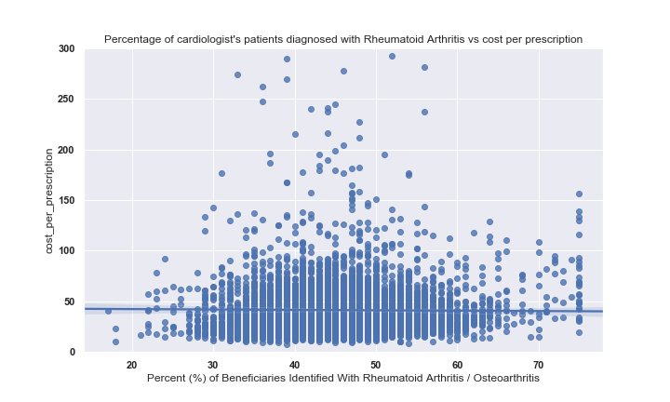
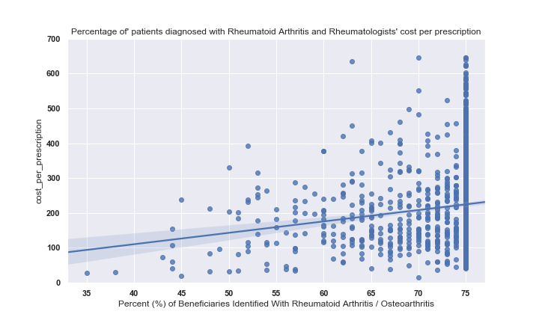
Rheumatoid Arthritis Effect on Different Specialties Prescription Drug Costs
Percentage of patients with Rheumatoid Arthritis is correlated with Rheumatologists prescription drug costs but not cardiologists drug costs.

Slide 9
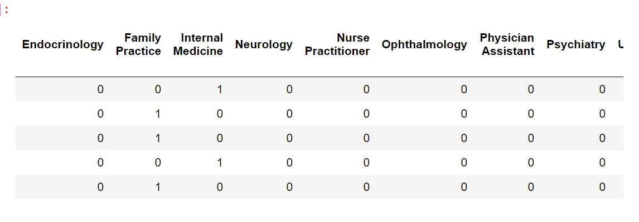
Dealing with Categorical Data
The dataset included over seventy different specialties. Algorithms can’t effectively use so many categorical variables.
Dataset was filtered to include the most common 8 specialties
Created dummy variables so that a new feature was created for each specialty included.
Additionally, a feature equal to the average annual drug cost of respective physician’s specialty was created

Slide 10
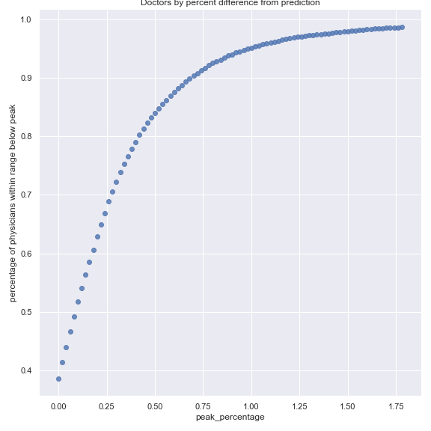
Results
Gradient Boosting was the most effective algorithm; had a Coefficient of Determination of .66
Indicates 66% of the variance in drug costs was predictable from the variables present in the data
79.5% of physicians were no more than 40% above predicted and 88.2% were no more than 60% above predicted annual prescription drug costs.
Potential causes of variance not explained by the Coefficient of determination :
How easily persuaded specific physician are to the marketing and pharmaceutical companies representatives
Doctor has a unique population or sub-specialty not represented in data

Slide 12
Other Potential Applications of Project
This data could also be useful to pharmaceutical companies.
If a company was releasing a new medication they could look at physicians that are outliers as potentially highly effective to market to
Companies could put extra resources toward targeting these outliers.
Additionally, the Algorithm and data could easily be manipulated to focus on the specialties and types of drugs relevant to the company.

