Slide 1


Medicare Part D and Medical Cost Control

Slide 2

How drugs prescribed effect health insurance companies profitability
Medicare is broken into three parts (A,B, and D). Prescription drugs are provided through Medicare Part D
There is no public options for Medicare Part D, plans are purchased from and implemented by private insurance companies
Part D prescription drug coverage can be provided in ‘Medicare Advantage Plans.’ These are privately managed Health Management Organizations (HMOs) that individuals assign their Medicare benefits to.
HMOs select the specific doctors who are included in there network.
Because they provide the drug benefits Medicare advantage pans can be more profitable by encouraging systems that control drug costs.

Slide 3

Pharmaceutical Marketing
The overall costs of drugs are driven up by newer, ’brand name’ drugs. Drugs which do not have generic prescriptions available.
Annually, 30 billion dollars is spent on drug. Over 20 billion of the marketing is spent by pharmaceutical companies to convince doctors of the benefit of their brand name drugs.
Drug companies have a history of giving gifts to physicians, free samples and hiring very personable sales representatives.
Some physicians are more easily persuaded to write brand name drugs regardless of efficacy.
Newer drugs do not always have higher efficacy

Slide 4
Controlling Drug Cost
Insurance companies can control drug costs through many methods:
they can write formularies that have lower copays for cheaper medications
if multiple medications are effective for the same illness, they do not need to provide coverage for all
Insurance carriers can also require prior authorization by doctors before patients can fill certain prescriptions or can require patients try less expensive medications first.
In this data science analysis, machine learning algorithms are used to recognize physicians with medication costs higher than expected.
I look at hundreds of thousands of doctors and using over 50 different features for each doctor the algorithm predicts what the annual drug cost of each doctor should be.
Special care was taken to make sure algorithms took consideration of the specialty of each physician in making predictions

Slide 5
What was dataset comprised of?
Important features the algorithms used to make predictive conclusions included number of prescriptions written, health demographics of patient populations, and socio-economic demographics of patient population.
Creating distinctions between specialty of Doctor’s was also of great importance
Among the over 50 examples of features the algorithm looked at for each doctor:
Total 30 Day prescriptions filled for entire year
Every physician’s percentage of patients diagnosed with specific chronic diseases like (Diabetes, Arthritis, etc)
Percentage of patients on Medicare
Number of Medicare Beneficiaries they asaw

Slide 6
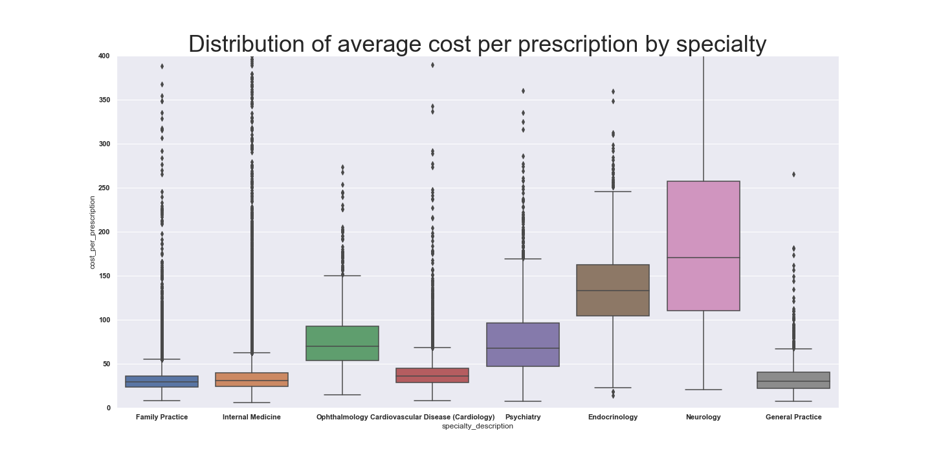
Considerations for Specialties
When making predictions on what doctor’s drug costs could be it was important to make sure our machine learning algorithm’s were taking into consideration physicians specialties.
One reason for this is specialties have such different average cost per prescription because more expensive medications may be commonly used for the specific chronic illnesses that they regularly deal with

Slide 7
Specific Chronic Illnesses effect different specialties differently
Specialist treat illness that pertain to their specific knowledge.
The frequency of a specific disease in their patients have a much greater effect on their prescription drug costs than unrelated illnesses.
One reason algorithms must differentiate specialties is so that they can recognize the different correlations between the disease of their patients and how to quantify the effect of patient illness on drug costs.

Slide 8
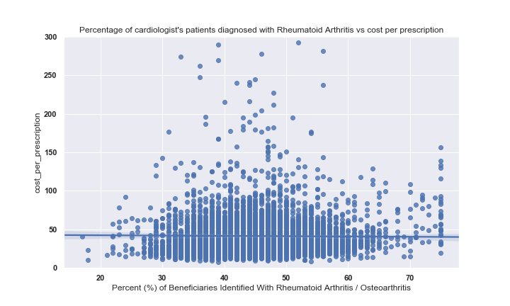
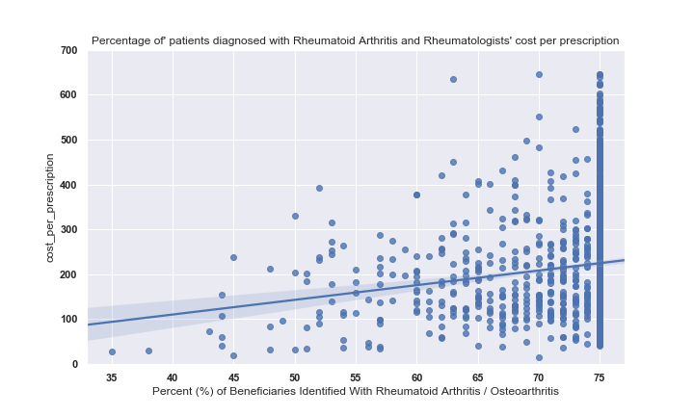
Patients’ specific diseases frequencies have varying correlation with average drug costs depending on physician specialty

Slide 9
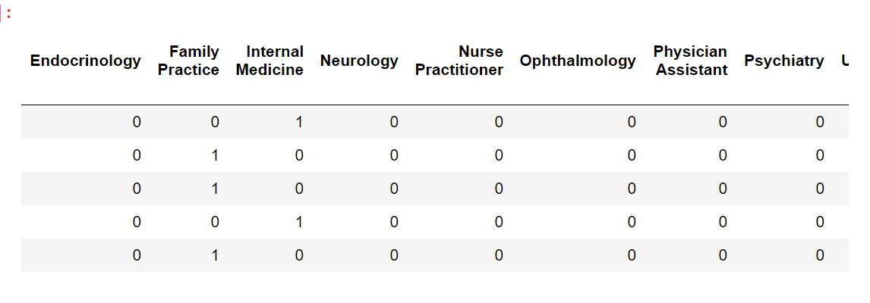
Modifying the data to recognize differences in specialties
The dataset included over seventy different specialties. With that many categorical variables the machine learning algorithm is unable to use the categorical variables effectively.
In order for the algorithms to apply the categorical variables it was necessary to filter out the less common of the 70 listed in the data.
I then created dummy variables so that a new category was created for each specialty.
I also created an additional feature which was simply the average annual drug cost of a physicians

Slide 11
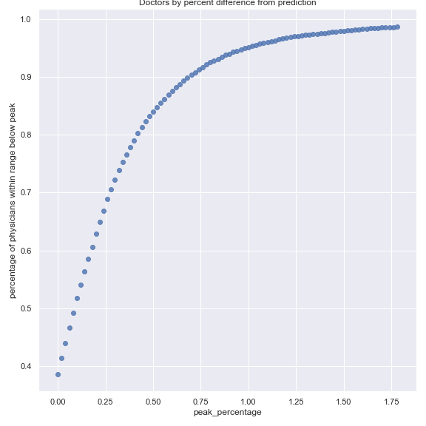
How Effective was Algorithm?
Random Forest and Gradient Boosting were both tested as potential Machine Learning Models
Gradient Boosting was found to be more effective with a Coefficient of Determinitation of .67
This indicates that the Algorithm found 67% of the variance in drug costs predictable from the variables present in the dataframe
The variance not explained by the Coefficient of determination is largely due to effects not measured by our variables. For instance the persuasion of pharmaceutical companies representatives on doctors, or a doctor having a large percentage of patients with a health condition not represented in the data.
Given that are potential reasonable explanations why drug costs could be higher this would primarily be used as a way to recognize doctors that could be looked into for deeper understanding.
.

Slide 12
Could pharamaceutical Companies make sense of this data?
This data could also be useful to pharmaceutical companies. For instance if a company was releasing a new medication they could look at physicians that are outliers as potential effective to market to
Pharmaceutical’s releasing new medications could target their marketing efforts toward outliers as well. They would want to recognize outlier physicians as physicians who are particularly open to marketing.
Additionally with just a few modifications they switch in the specialties that pertain most closely for there drugs. They could also look filter the data to specifically look at there competitor drugs and see which doctors have been most open to prescribing brand name medications.

