Slide 1


Medicare Part D and Medical Cost Control

Slide 2

How drugs prescribed effect health insurance companies profitability
Medicare is broken into three parts (A,B, and D). Prescription drugs are provided through Medicare Part D
There is no public options for Medicare Part D, plans are purchased from and implemented by private insurance companies
Part D prescription drug coverage can be provided in ‘Medicare Advantage Plans.’ These are privately managed Health Management Organizations (HMOs) that individuals assign their Medicare benefits to.
HMOs select the specific doctors who are included in there network.
Because they provide the drug benefits Medicare advantage pans can be more profitable by encouraging systems that control drug costs.

Slide 3

Pharmaceutical Marketing
The overall costs of drugs are driven up by newer, ’brand name’ drugs. Drugs which do not have generic prescriptions available.
Annually, 30 billion dollars is spent on drug. Over 20 billion of the marketing is spent by pharmaceutical companies to convince doctors of the benefit of their brand name drugs.
Drug companies have a history of giving gifts to physicians, free samples and hiring very personable sales representatives.
Some physicians are more easily persuaded to write brand name drugs regardless of efficacy.
Newer drugs do not always have higher efficacy

Slide 4
Controlling Drug Cost
Insurance companies can control drug costs through many methods:
they can write formularies that have lower copays for cheaper medications
if multiple medications are effective for the same illness, they do not need to provide coverage for all
Insurance carriers can also require prior authorization by doctors before patients can fill certain prescriptions or can require patients try less expensive medications first.
In this data science analysis, machine learning algorithms are used to recognize physicians with medication costs higher than expected.
I look at hundreds of thousands of doctors and using over 50 different features for each doctor the algorithm predicts what the annual drug cost of each doctor should be.
Special care was taken to make sure algorithms took consideration of the specialty of each physician in making predictions

Slide 5
What was dataset comprised of?
Dataset was comprised of two separate Dataframes from Medicare.gov
One file included information about physicians’ patient population: health demographics of patient populations, socio-economic demographics of patient population, etc..
2nd file was a dataframe of every type of drug the doctor had prescribed for the year and the related amounts and costs.
There were 50 features the algorithm looked at for each physician:
After using Machine learning ‘feature importance,’ values were assigned for each feature based on the percentage of information they gave to fit the model to the data.
The most important groups of features in order of importance:
Number of prescriptions written: 39.2%
Sum of importance of all chronic illnesses: 17.2%
Average annual prescription cost for respective specialty: 9.5%
Number of Beneficiaries with Medicaid: 6.5%
Sum of Age Demographic Information: 6.2%

Slide 6
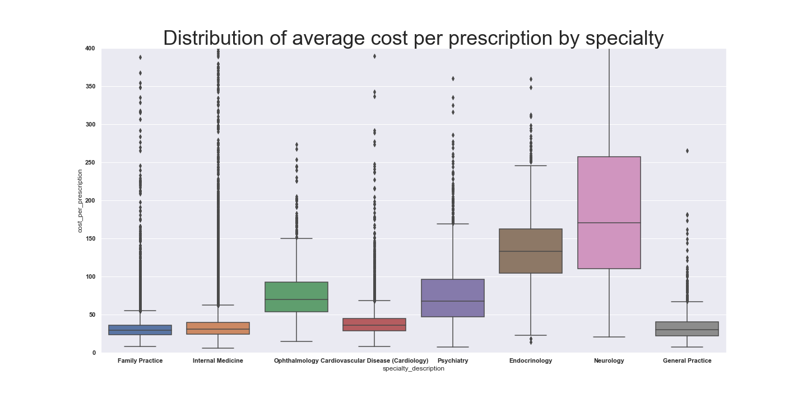
Considerations for Specialties
When making predictions on what doctor’s drug costs could be it was important to make sure our machine learning algorithm’s dealt with specialties as a categorical variable
Dealing with different chronic illnesses different types of specialists prescribe distinctly different set of drugs with highly variable average cost per prescription

Slide 7
Specific Chronic Illnesses effect different specialties differently
Specialist treat illness that pertain to their specific knowledge.
If a disease falls in the domain of the specialty, it’s frequency in physician’s patient population has a much greater affect on prescription drug costs of a doctor.
One reason algorithms must differentiate specialties is so that they can recognize and quantify correlations between the frequency of specific diseases and different specialties drug costs

Slide 8
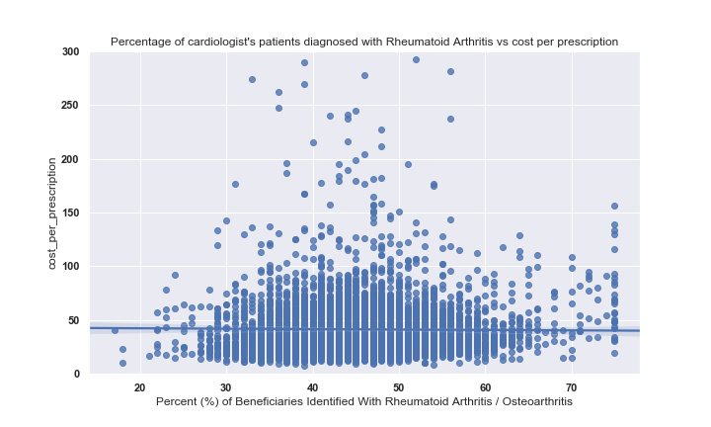
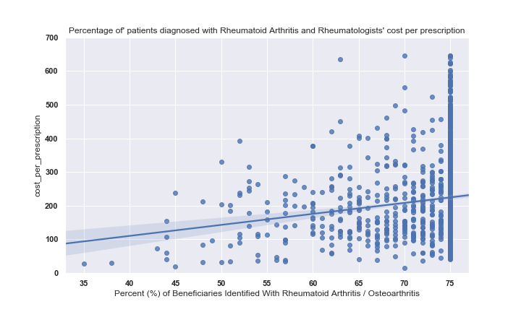
Patients’ specific diseases frequencies have varying correlation with average drug costs depending on physician specialty

Slide 9
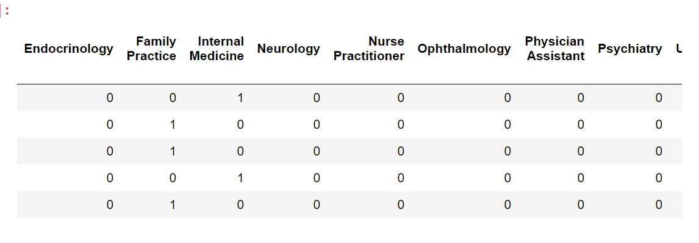
Modifying the data to recognize differences in specialties
The dataset included over seventy different specialties. With that many categorical variables the machine learning algorithm is unable to use the categorical variables effectively.
In order for the algorithms to apply the categorical variables it was necessary to filter out some specialties. I filtered the less common of the 70 listed in the data.
I then created dummy variables so that a new category was created for each specialty.
I also created an additional feature which was simply the average annual drug cost of all physicians in a respective physician’s specialty

Slide 10
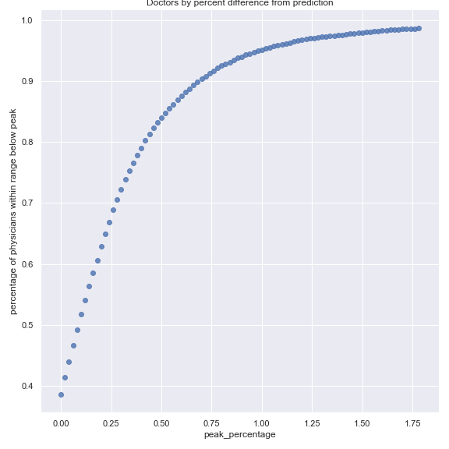
How Effective was Algorithm?
Random Forest and Gradient Boosting were both tested as potential Machine Learning Models
Gradient Boosting was found to be slightly more effective; it had a Coefficient of Determinitation of .67
This indicates that the Algorithm found 67% of the variance in drug costs predictable from the variables present in the data
The variance not explained by the Coefficient of determination is likely due to effects not measured by our variables. Potential examples include:
How effected specific physician are to the marketing and persuasion of pharmaceutical companies representatives
Doctor having a large percentage of patients with a health condition not represented in the data.
Given that there are multiple potential explanations why drug costs could be higher than predicted, it would be appropriate to investigate flagged individuals before making definitive conclusions

Slide 11
Could pharamaceutical Companies make sense of this data?
This data could also be useful to pharmaceutical companies.
If a company was releasing a new medication they could look at physicians that are outliers as potentially highly effective to market to
Companies could put extra resources toward targeting these outliers.
Additionally, the Algorithm and data could easily be manipulated to focus on the specialties and types of drugs relevant to the company.

