Slide 1


Medicare Part D and Medical Cost Control

Slide 3

How drugs prescribed effect health insurance companies profitability
Medicare is broken into three parts (A,B, and D). Prescription drugs are provided through Medicare Part D
There is no public options for Medicare Part D, all Part D plans are purchased from and implemented by private insurance companies
Part D prescription drug coverage can be provided in ‘Medicare Advantage Plans.’ These are privately managed Health Management Organizations (HMOs) that individuals assign all parts of their Medicare benefits to. HMOs select the specific doctors who are included in there network.
Because they providing the drug benefits Medicare advantage pans can be more profitable by encouraging systems that control drug costs.

Slide 4

Pharmaceutical Marketing
The overall costs of drugs are driven up by newer drugs. Drugs which do not have generic prescriptions available.
Of the 30 billion dollars spent on drug marketing over 20 billion is spent by pharmaceutical companies to convince doctors of the benefit of specific drugs. As profit driven companies pharmaceutical companies focus on marketing profitable (patented) drugs.
Drug companies have a history of giving gifts to physicians, free samples and hiring very personable sales representatives,
Some physicians are more easily persuaded to write brand name drugs regardless of efficacy.
Some new drugs are more effective than earlier options for particular drugs but in other instance the difference in efficacy is unclear

Slide 5
Controlling Drug Cost
Insurance companies can control drug costs through many methods, they can write formularies that have lower copays for cheeper medications, or if multiple medications are effective for the same illness, they do not need to provide coverage for al
Insurance carriers can also require prior authorization by doctors before patients can fill certain prescriptions or can require patients try less expensive medications first.
In my data science analysis I use machine learning algorithms to gain information about physicians that’s medication costs are higher than expected.
I look at hundereds of thousands of doctors and using over 50 different features for each doctor the algorithm makes an estimate on what the drug cost of each doctor should be.
I took special care to make sure algorithm took special consideration of the specialty of each physician and the number of prescriptions written.

Slide 6
What was dataset comprised of?
Important features the algorithms used to make predictive conclusions included number of prescriptions written, health demographics of patient populations, and socio-economic demographics of patient population.
Creating distinctions between specialty of Doctor’s was also of great importance
Among the over 50 examples of features the algorithm looked at for each doctor:
Total 30 Day prescriptions filled for entire year
Every physician’s percentage of patients diagnosed with specific chronic diseases like (Diabetes, Arthritis, etc)
Percentage of patients on Medicare
Number of Medicare Beneficiaries they asaw

Slide 7
Importance of Specialties
When making predictions on what doctor’s drug costs could be it was important to make sure our machine learning algorithm’s were taking into consideration physicians specialties.
One reason for this is specialties have such different average cost per prescription because more expensive medications may be commonly used for the specific chronic illnesses that they regulary deal with

Slide 8
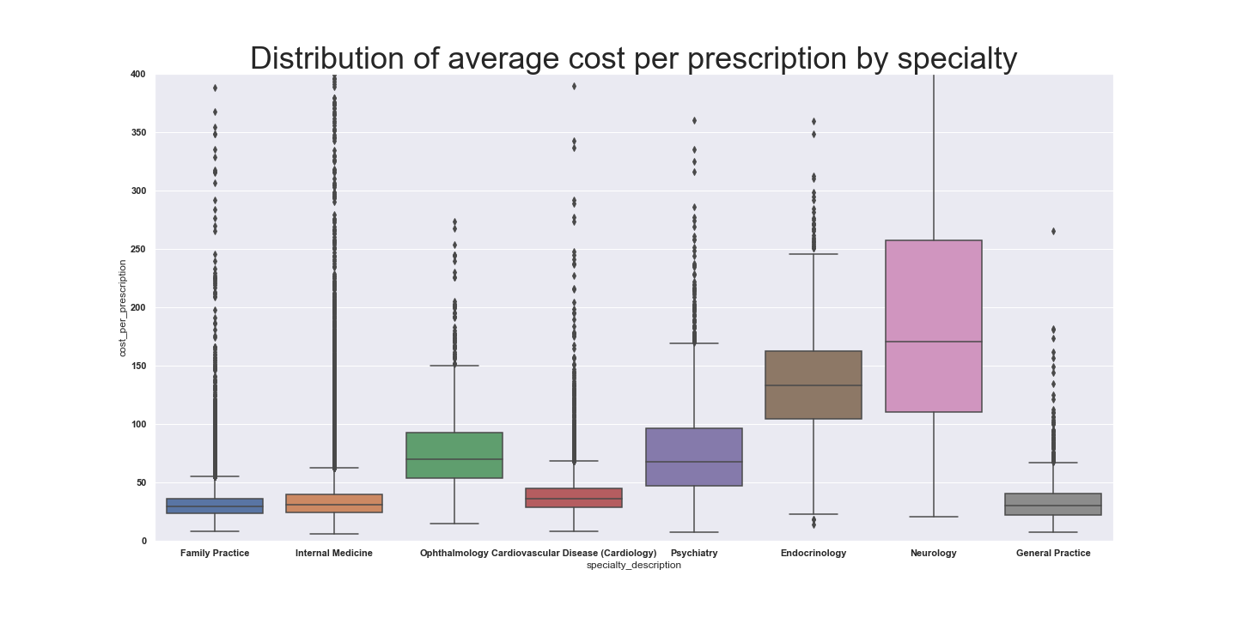
Considerations for Specialties
When making predictions on what doctor’s drug costs could be it was important to make sure our machine learning algorithm’s were taking into consideration physicians specialties.
One reason for this is specialties have such different average cost per prescription because more expensive medications may be commonly used for the specific chronic illnesses that they regularly deal with

Slide 9
Specific Chronic Illnesses effect different specialties differrently
Specialist specifically treat illness that pertain to their specific knowledge. Therefore information about the percentage of patients who have chronic illnesses that pertain to their specialty have a much greater effect on their prescription drug costs than unrelated illnesses. This is another important reason algorithms must differentiate specialties so that they can appropriately quantify the effect of patient illness on drug costs. Following are visual plots demonstrating the relationship.

Slide 10
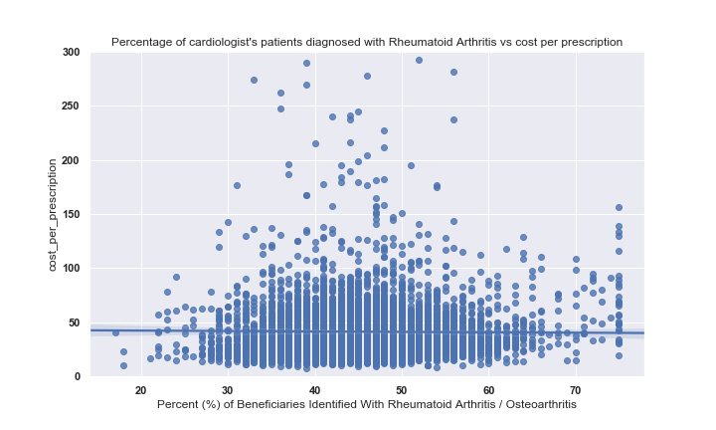
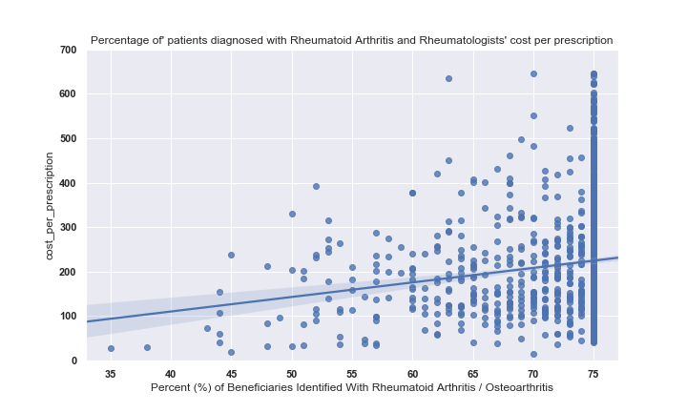
How doctor’s percentage of patients with Arthritis is strong correlated to Rheumatology average drug costs but uncorrelated to drug cost of Cardiologist

Slide 11
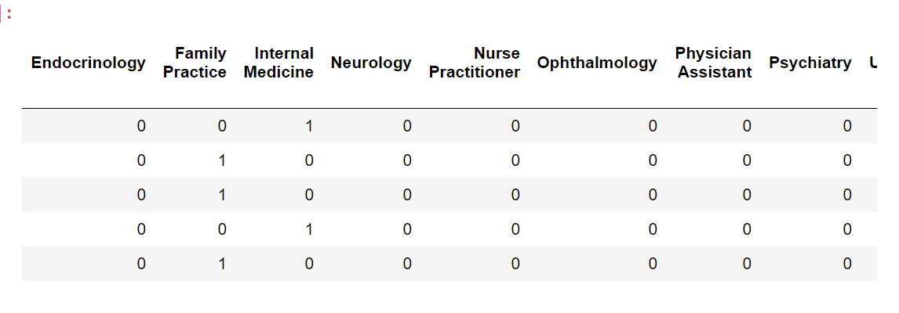
Modifying the data to recognize differences in specialties
The dataset included over seventy different specialties. With that many categorical variables the machine learning algorithm is unable to use the categorical variables effectively.
In order to apply the categorical variables it was necessary to filter specialties so only so many were used at a time.
I did this by filtering the data so that only the 10 specialties with the most doctors with over 3,000 prescriptions were used in the algorithm.
I then created dummy variables so that a new category was created for each specialty.
specialty

Slide 12
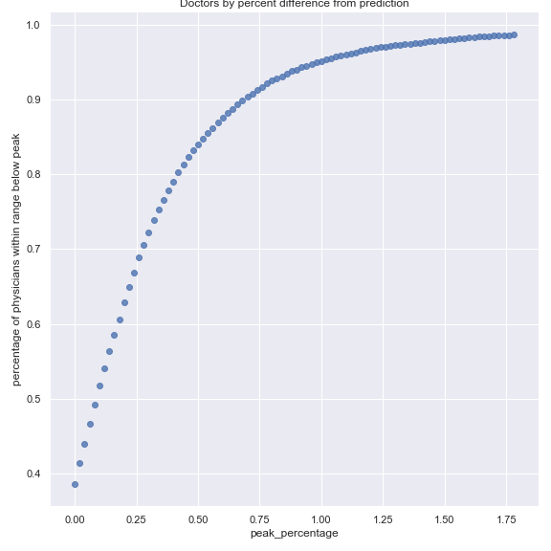
How Effective was Algorithm?
a Coefficient of Determinitation of .65
Within 150 percent of predicted prescription drug costs = .832%
Within 175 percent of predicted prescription drug costs = .911%
Within 200 percent of predicted prescription drug costs = .948%
Within 250 percent of predicted prescription drug costs = .979%
Within 300 percent of predicted prescription drug costs = .989%

