Slide 1
Multi-Omics Pipeline Review
Proteomics Preprocessing · Differential Analysis · Water Quality Exposure
Olink Explore NPX · ComBat Batch Correction · Mann–Whitney U & Wilcoxon · THM Analysis
n=133 participants
Plasma (A–E)
Placenta
Olink NPX (log₂)
Kayson Yao · Xu Lab Rotation · 2026
Notes:
Title slide: Multi-Omics Pipeline Review covering proteomics preprocessing, differential analysis, and water quality analysis.

Slide 2
Proteomics Preprocessing Pipeline
11-step orchestrator · clean_proteomics_data.py
01
Load Raw Files
07
ComBat Correction
collect_olink_files() — all panels per tissue
pycombat empirical-Bayes; mask NaN before, restore after
02
Standardise Missing
08
Missingness Filter
Replace "ORA_OUTSIDE_RANGE" → NaN; flag per-assay QC warnings
Drop if >20% missing overall; Fisher's exact + BH FDR per group
03
QC Mask
09
Half-Min Imputation
Zero-out samples with QC flag; preserve structure
Fill NaN with col_min − 1 (log₂ half-minimum)
04
Panel Normalisation
10
Merge Metadata
Subtract Olink internal bridge sample median per panel
Join Group, SubjectID, batch from Excel (n=133 sheet)
05
Remove Controls
11
Save Outputs
Drop internal Olink control samples from analyte matrix
CSV per tissue + diagnostics plots (PCA, density, boxplots)
06
Pivot Wide
Long NPX → wide (rows=subjects, cols=proteins)
Applies identically to Plasma and Placenta tissues
Notes:
11-step pipeline: load → standardise missing → QC mask → panel norm → remove controls → pivot wide → ComBat → missingness filter → impute → merge metadata → save.

Slide 3
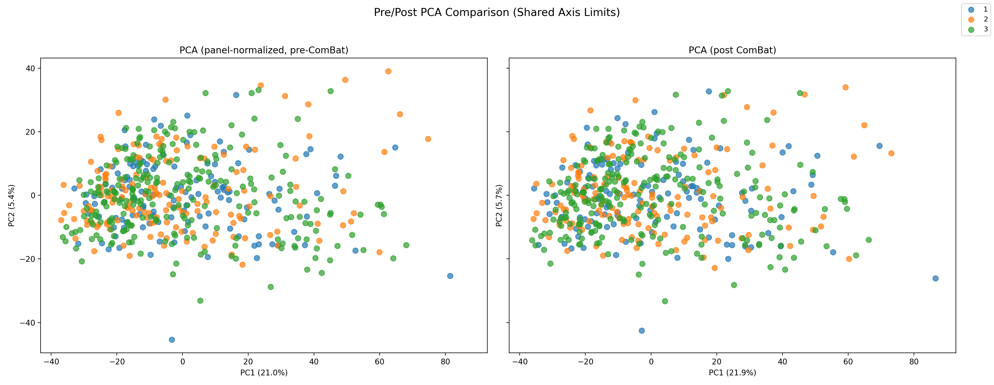
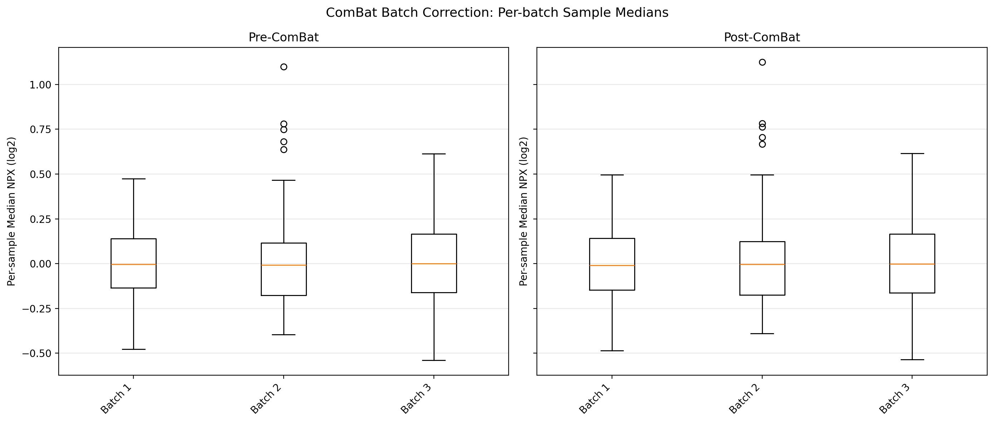
ComBat Batch Correction — Plasma
Problem
3 Olink assay batches with systematic median shifts between runs
Method
pycombat (Python) — empirical Bayes shrinkage of batch means & variances
Key design decisions
• Save NaN mask before correction (median-fill temporari-ly)
• Restore NaN after ComBat so missingness is not inflated
• Batch variable from Excel metadata sheet "n=133 proteomics"
Result
PC1/PC2 batch clustering eliminated; biological variation retained
Assay batch median convergence post-ComBat:
Notes:
ComBat corrects systematic batch shifts using empirical-Bayes. NaN values are temporarily filled with column medians before correction, then the original missingness mask is restored. The PCA comparison shows batch clusters dissolving post-correction.

Slide 4
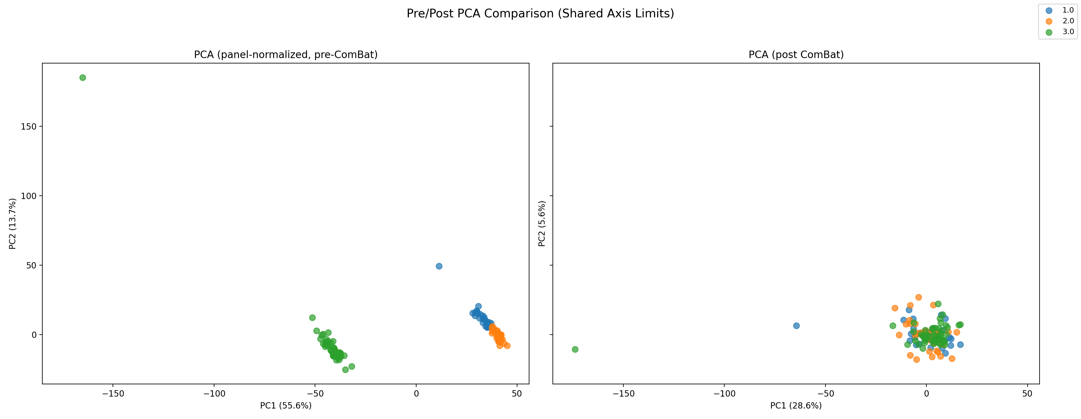
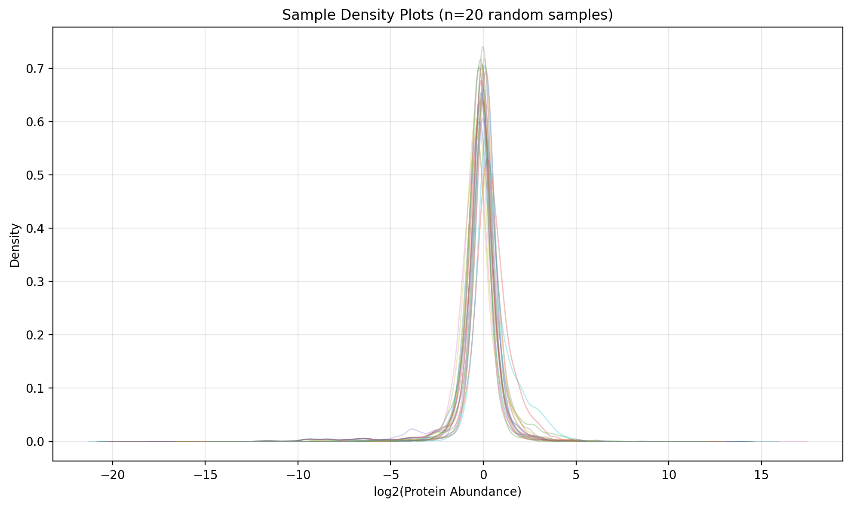
ComBat Batch Correction — Placenta
Same ComBat workflow as plasma.
Placenta is a single cross-sectional tissue (one draw at delivery), so no visit-splitting step applies.
Batch 3 had the fewest samples — smallest group; ComBat handles this via Bayes shrinkage
Panel normalization applied first (before ComBat) to remove inter-panel offset
Missingness cutoff 20% applied identically after correction
Placenta file: proteomics_placenta_cleaned_with_metadata.csv
Sample-level NPX density distribution (post-cleaning):
Each line = one sample
Overlapping distributions confirm no outlier samples post-correction
Notes:
Placenta runs through the identical ComBat pipeline. No visit splitting needed as it is a single cross-sectional sample taken at delivery. Density plot confirms all samples are well-distributed after cleaning.

Slide 5
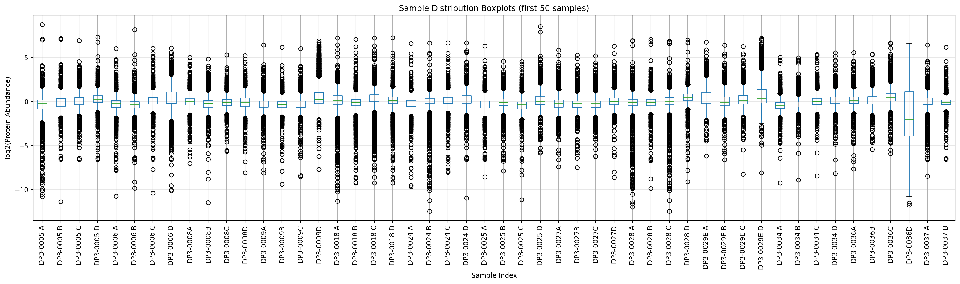
Missingness Filter, Imputation & Post-QC
Global Missingness Filter
Group-Level Check (Fisher's Exact)
Half-Minimum Imputation
Cutoff: 20% (CUTOFF_PERCENT_MISSING=0.20)
For each remaining protein, test whether
Fill remaining NaN with col.min() − 1.0
Drop protein if >20% of all samples are NaN
missingness differs between Control and
In log₂ space = half the minimum value
Applied after ComBat; ensures analytes
Complication (FGR/HDP/sPTB pooled)
Convention: "below detection" rather than
have enough data for statistical testing
BH FDR q<0.05 → flag analyte
absent — preserves rank ordering
Per-sample NPX distribution after all cleaning steps (Plasma):
Notes:
Three-stage missingness handling: (1) global 20% cutoff removes noise-dominated proteins; (2) Fisher's exact detects missingness that is informatively different between groups; (3) half-minimum imputation assigns a detection floor to remaining NaN values.

Slide 6
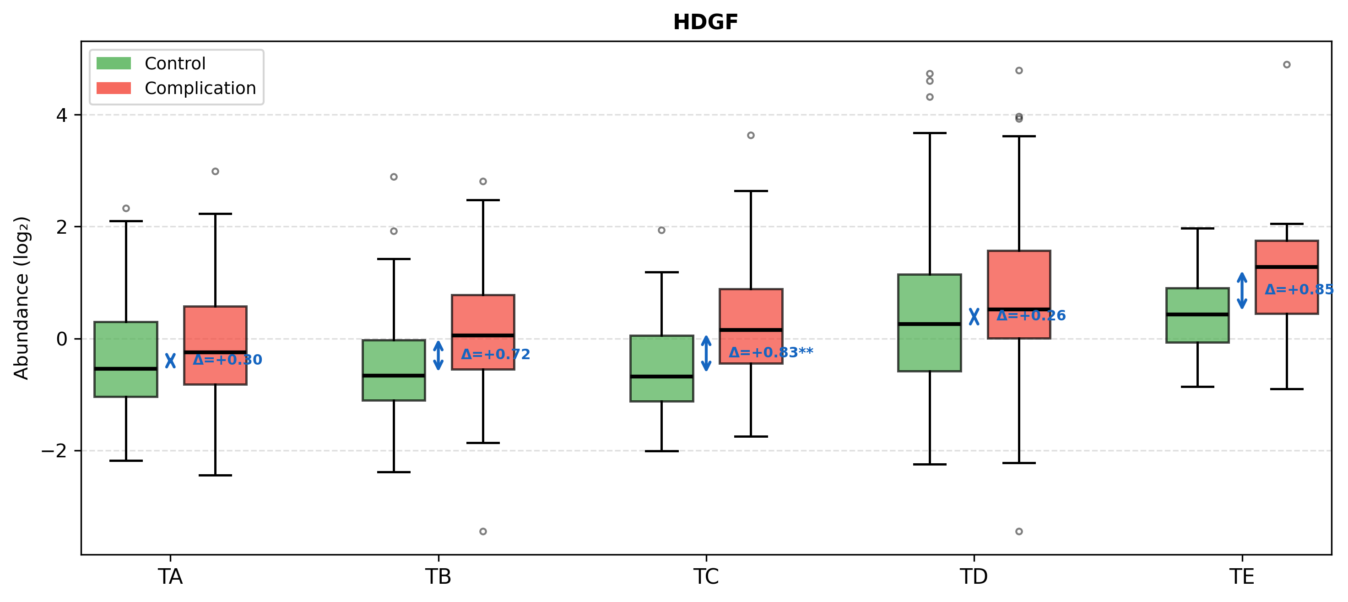
Differential Analysis — Cross-Sectional
Design
Representative significant analyte — HDGF (Plasma timepoint B):
· Control (n≥5) vs. Complication (FGR+HDP+sPTB pooled)
· Run independently at each plasma timepoint (A–E)
· Also run on placenta (single cross-sectional)
Statistical Test
· Mann–Whitney U (two-sided, non-parametric)
· No normality assumption — appropriate for NPX data
· Minimum n=5 non-missing observations per group
Multiple Testing
· Benjamini–Hochberg FDR correction across all proteins
· Significance: q<0.05
Control
Complication
Effect Size Filter
Output summary
· |log₂FC| ≥ log₂(1.5) ≈ 0.585 — only 50% fold change or more
· Results CSV: Control_vs_Complication_differential_results.csv
· Removes statistical but biologically negligible hits
· Top-50 analytes plotted as boxplots per timepoint
· Heatmap (seaborn clustermap, Ward linkage, z-score ±2.5)
· Files: differential_analysis/plasma/cross_sectional/[A–E]/
Notes:
Cross-sectional analysis: Mann-Whitney U with BH FDR (q<0.05) AND |log2FC|>=log2(1.5). Runs independently per timepoint for plasma, and once for placenta. Top 50 significant analytes are plotted as boxplots.

Slide 7
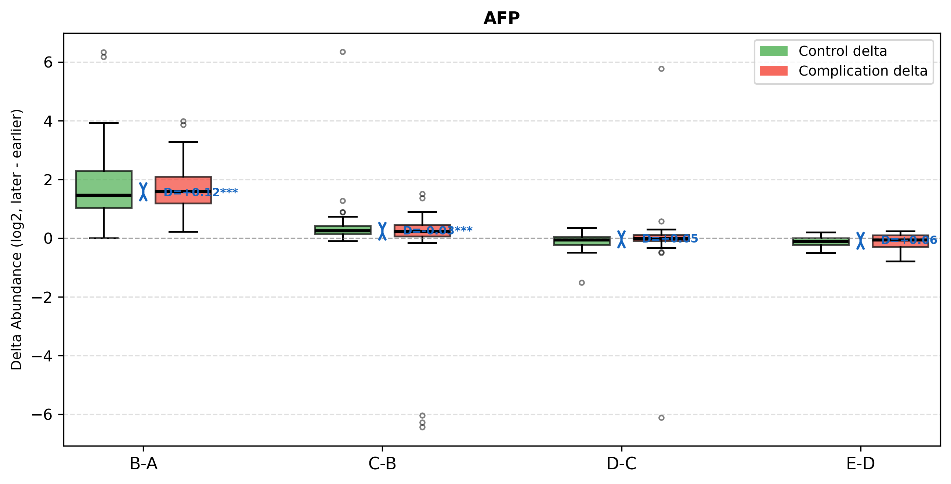
Differential Analysis — Longitudinal
AFP — longitudinal trajectory (Control vs Complication):
A
B–A
B
C–B
C
D–C
D
E–D
E
~T1
~T2
~T3
Delivery
Postnatal
Test:
Wilcoxon signed-rank on within-subject Δ (paired)
Groups:
Control, FGR, HDP, sPTB (individually) + pooled Complication
Pairing:
SubjectID — matched across adjacent timepoints
Transitions:
4 adjacent steps: B–A, C–B, D–C, E–D
Significance:
BH FDR q<0.05 (no fold-change threshold — deltas already directional)
Rationale:
Paired test removes inter-subject variability; captures trajectory change
Output
· CSV: longitudinal_<transition>_<Group>_results.csv (one per transition × group)
· Top-50 longitudinal analytes plotted as multi-timepoint boxplots with per-subject trajectories
· Files: differential_analysis/plasma/longitudinal/ & longitudinal_boxplots/
Notes:
Longitudinal analysis uses Wilcoxon signed-rank on within-subject deltas for each adjacent timepoint pair. Runs separately for Control, FGR, HDP, sPTB, and a pooled Complication group. No fold-change filter — the delta is already direction-specific.

Slide 8
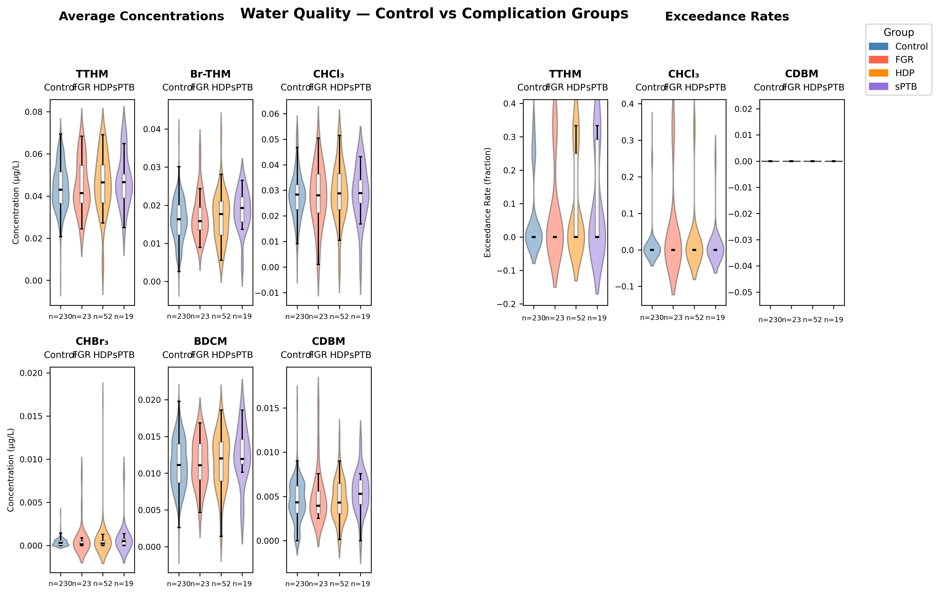
Water Quality Analysis — THM Exposure
Analytes
· AVG: TTHM, Br-THM, CHCl3, CHBr3, BDCM, CDBM
· EXCEED: binary flag (1=exceeds regulatory threshold)
Primary test — Kruskal–Wallis
· Non-parametric one-way ANOVA across groups
· (Control, FGR, HDP, sPTB)
Post-hoc pairwise — KS test
· Kolmogorov–Smirnov for each pair
· Tests full distribution shape (not just medians)
· BH FDR correction across all pairwise tests
Visualisations
· Violin + boxplot per analyte × group
· ECDF curves for distribution comparison
Violin + box distributions: each THM analyte by obstetric group
· Combined multi-panel distribution figure
Outputs
· water_avg_stats_results.csv (KW + KS p-values)
· water_avg_significant_pairs.csv
· water_avg_distribution.png | water_avg_ecdf.png
· Saved to: 04_results_and_figures/survey/water/
Notes:
THM water quality analysis: Kruskal-Wallis tests for group differences across 6 average THM analytes and 3 exceedance flags. KS pairwise post-hoc with BH FDR. Outputs include violin+boxplots and ECDF curves.

Slide 9
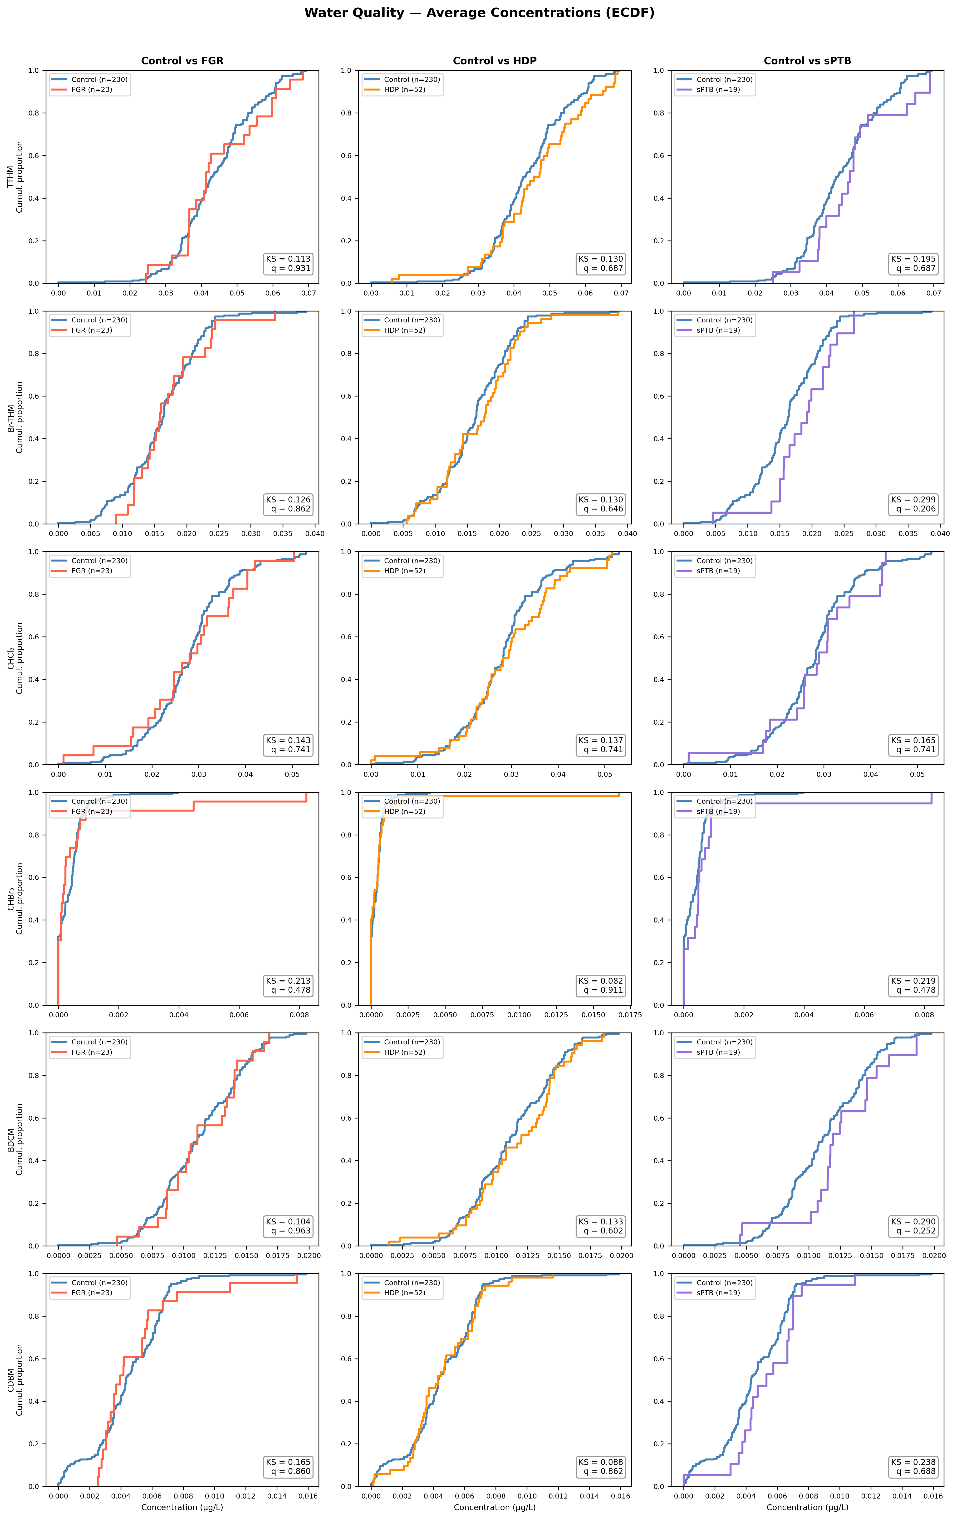
Water Quality — THM Concentrations (ECDF)
What is an ECDF?
The y-axis shows the fraction of participants with exposure at or below x. Curves that overlap indicate similar distributions; a rightward shift means higher exposure in that group. Each row is one THM analyte; each column compares Control vs. one complication group.
Reading the KS annotation
Each panel shows KS (max vertical gap between the two curves) and q (BH FDR-corrected p-value). Crimson text and *** signal significance. All q-values here are >0.05 — no significant difference detected in any comparison.
Key finding
No significant group differences in THM exposure (KW+KS, BH FDR q>0.05 for all 18 comparisons). sPTB shows the largest separation for Br-THM and BDCM (KS≈0.30) but does not survive correction. Likely a power issue given sPTB n=19.
Rows: TTHM, Br-THM, CHCl₃, CHBr₃, BDCM, CDBM (avg concentration µg/L). Columns: Control (n=230) vs FGR (n=23), HDP (n=52), sPTB (n=19).

