Slide 1
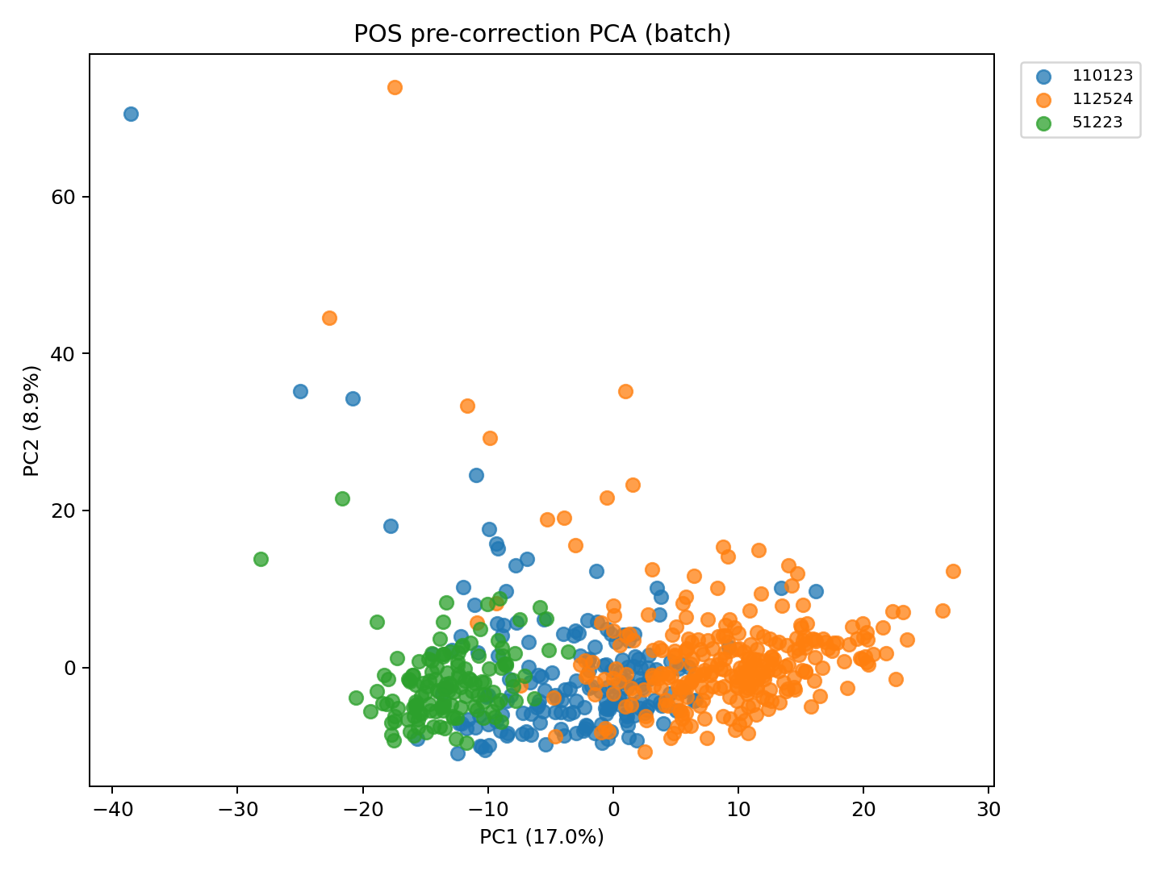
MTBL Plasma · Positive Mode (POS) · Before Batch Correction
Before Correction · Coloured by Batch
ComBat ref.batch=51223, bridge n=20 · Protected covariates: Subgroup, SampleGestAge, GestAgeDelivery · Positive Mode (POS)

Slide 2
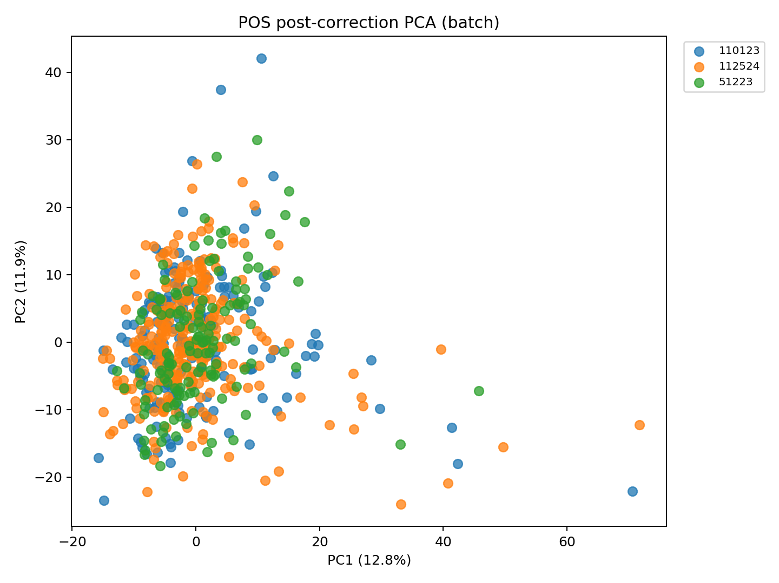
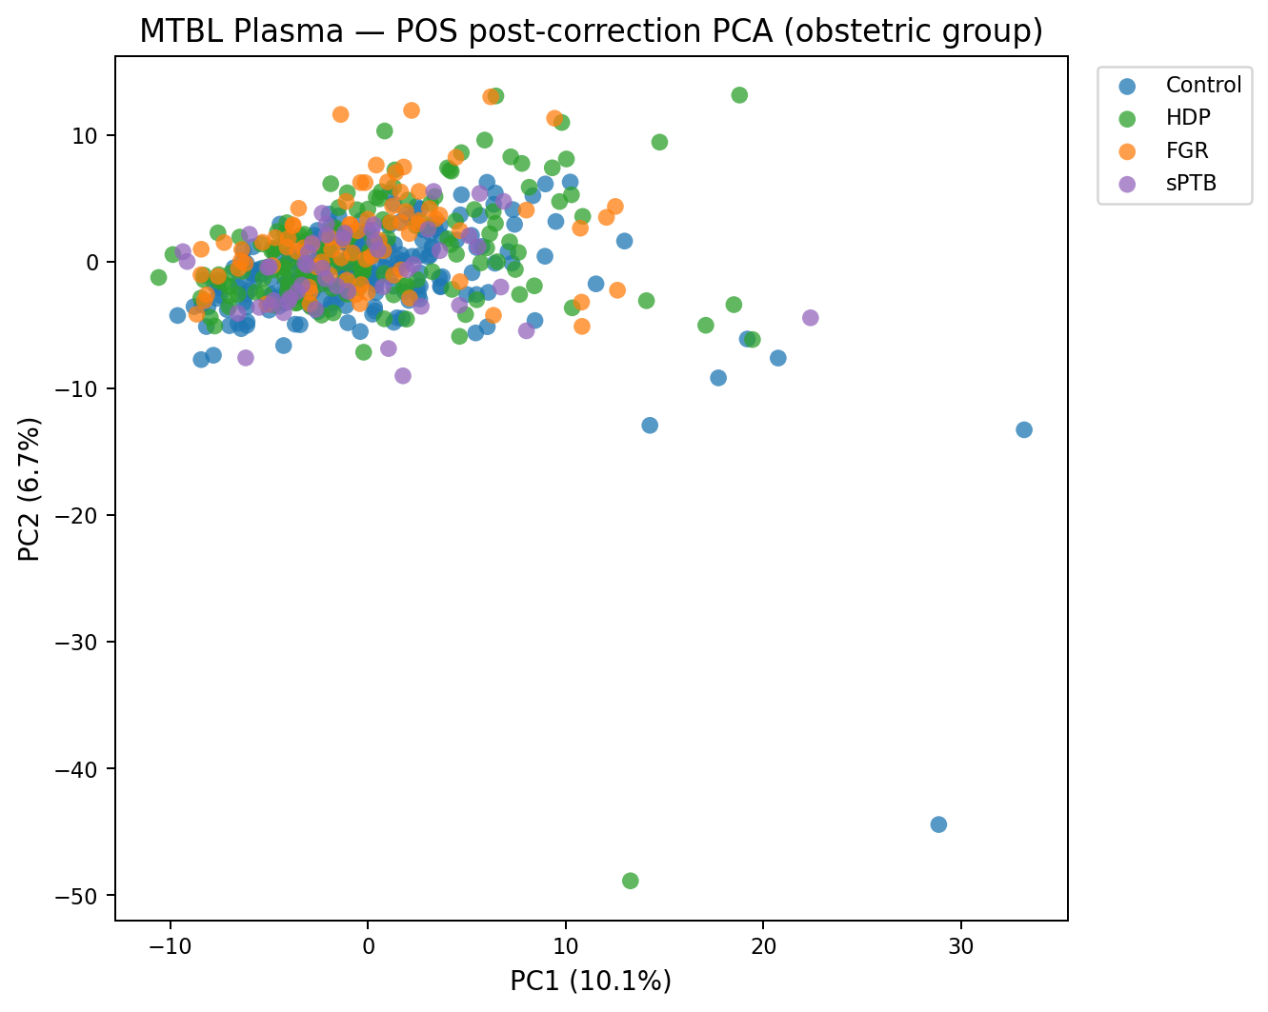
MTBL Plasma · Positive Mode (POS) · After Batch Correction
After Correction · Coloured by Batch
After Correction · Coloured by Obstetric Group
ComBat ref.batch=51223, bridge n=20 · Protected covariates: Subgroup, SampleGestAge, GestAgeDelivery · Positive Mode (POS)

Slide 3
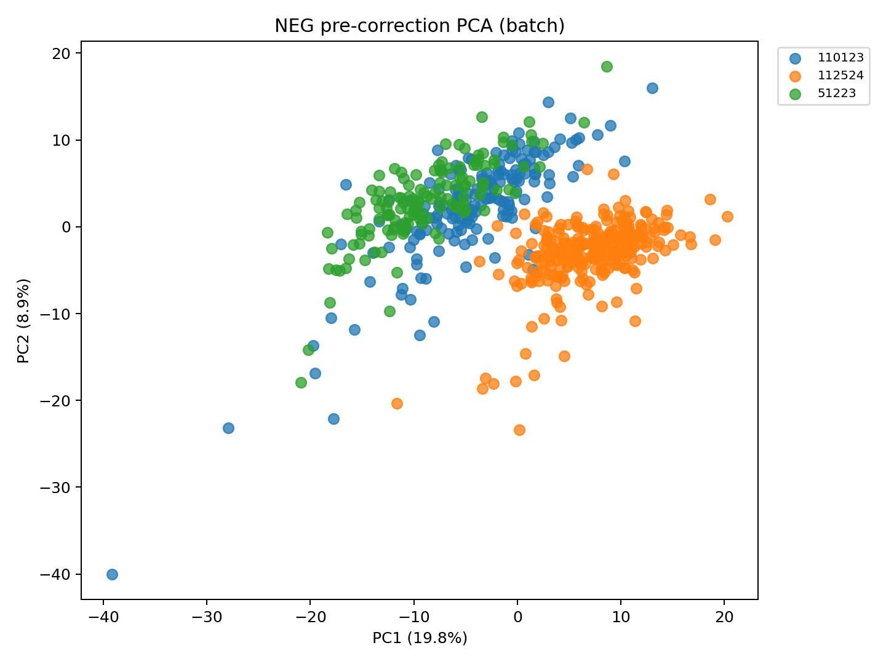
MTBL Plasma · Negative Mode (NEG) · Before Batch Correction
Before Correction · Coloured by Batch
ComBat ref.batch=51223, bridge n=20 · Protected covariates: Subgroup, SampleGestAge, GestAgeDelivery · Negative Mode (NEG)

Slide 4
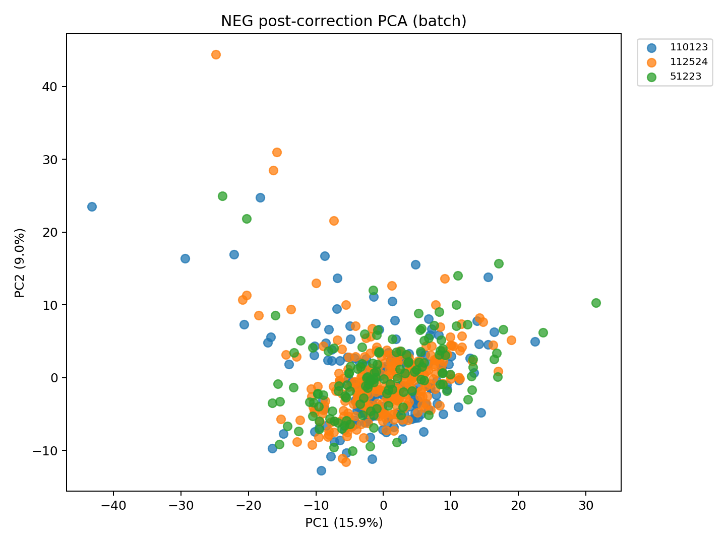
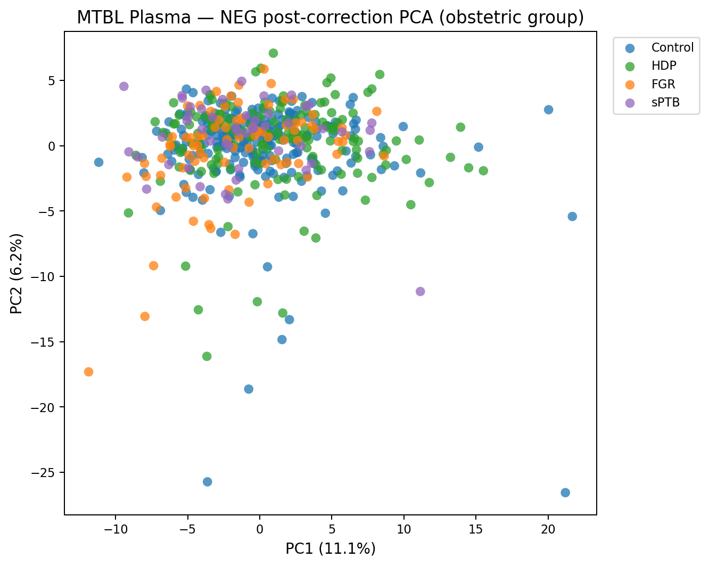
MTBL Plasma · Negative Mode (NEG) · After Batch Correction
After Correction · Coloured by Batch
After Correction · Coloured by Obstetric Group
ComBat ref.batch=51223, bridge n=20 · Protected covariates: Subgroup, SampleGestAge, GestAgeDelivery · Negative Mode (NEG)

Slide 5
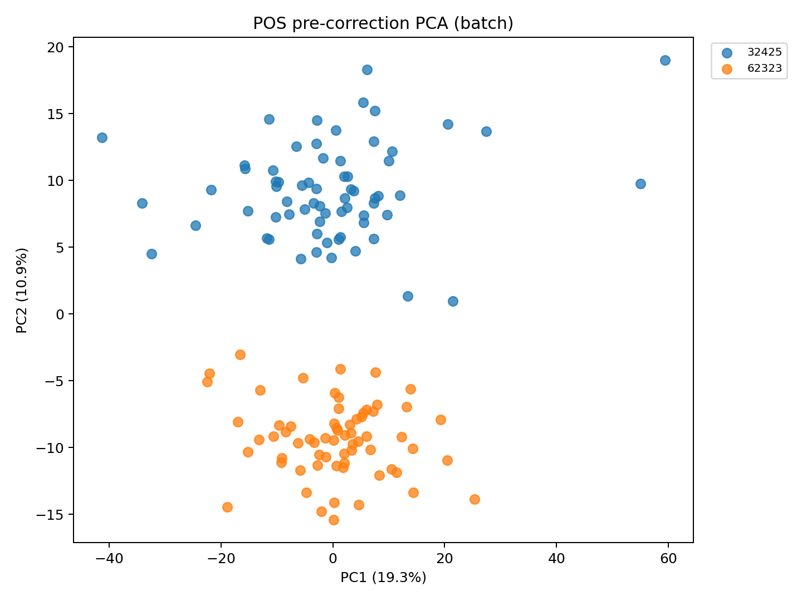
MTBL Placenta · Positive Mode (POS) · Before Batch Correction
Before Correction · Coloured by Batch
ComBat batch correction · Single tissue harvest, no longitudinal timepoints · 112 samples · Positive Mode (POS)

Slide 6
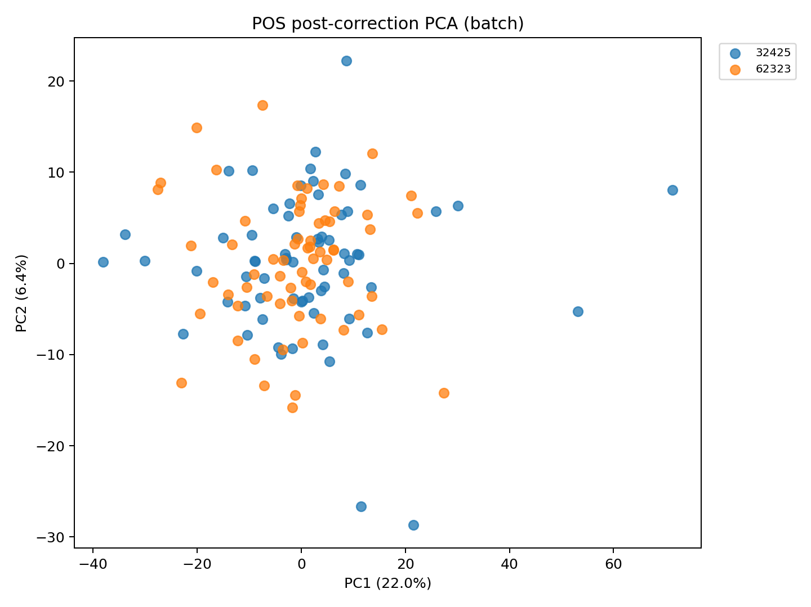
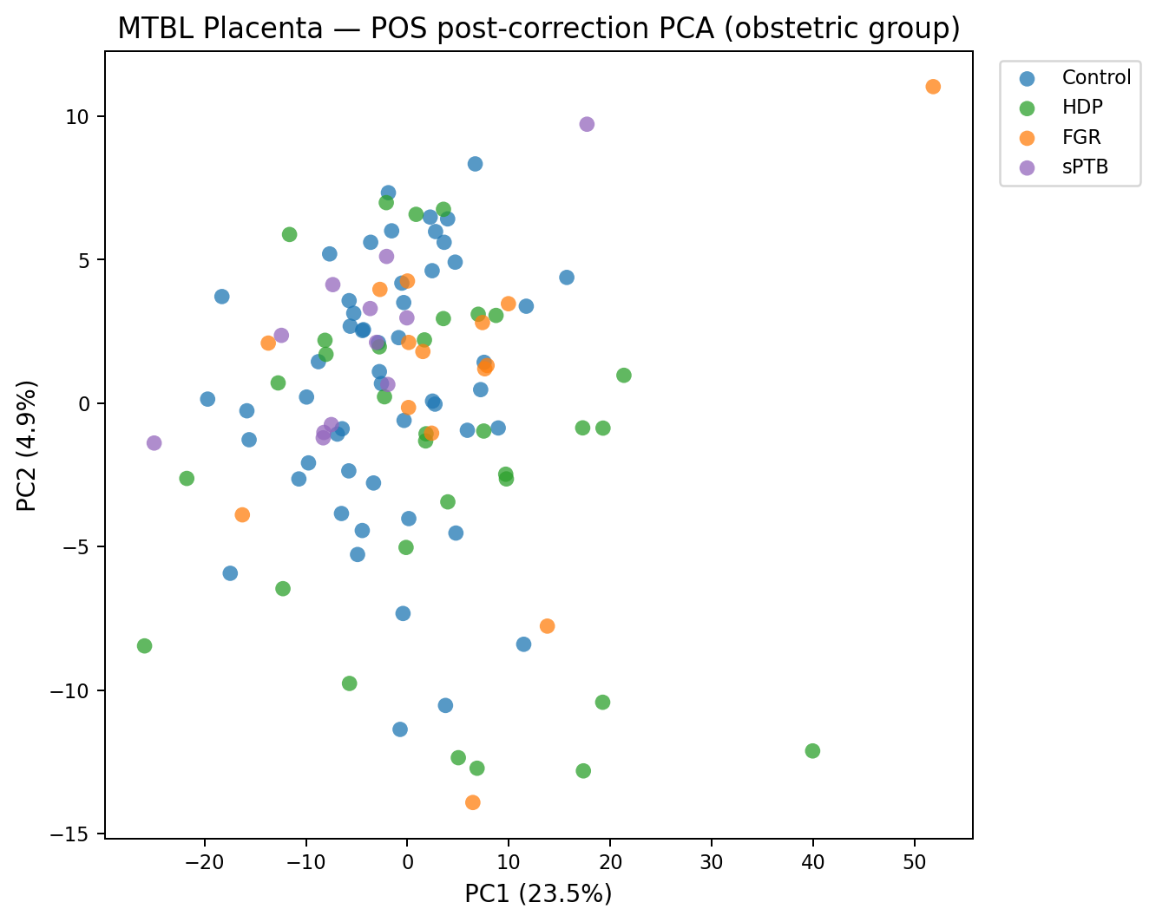
MTBL Placenta · Positive Mode (POS) · After Batch Correction
After Correction · Coloured by Batch
After Correction · Coloured by Obstetric Group
ComBat batch correction · Single tissue harvest, no longitudinal timepoints · 112 samples · Positive Mode (POS)

Slide 7
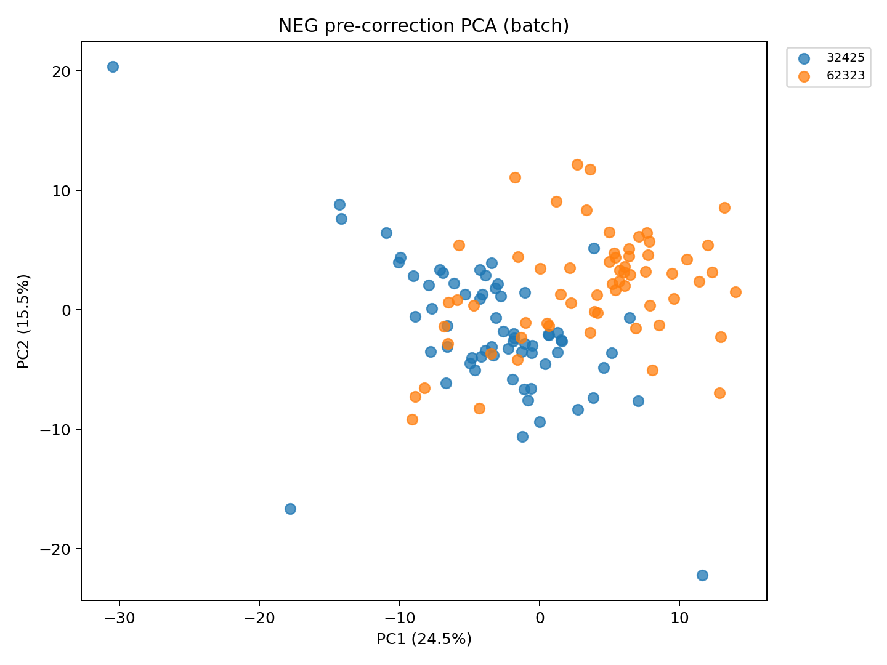
MTBL Placenta · Negative Mode (NEG) · Before Batch Correction
Before Correction · Coloured by Batch
ComBat batch correction · Single tissue harvest, no longitudinal timepoints · 112 samples · Negative Mode (NEG)

Slide 8
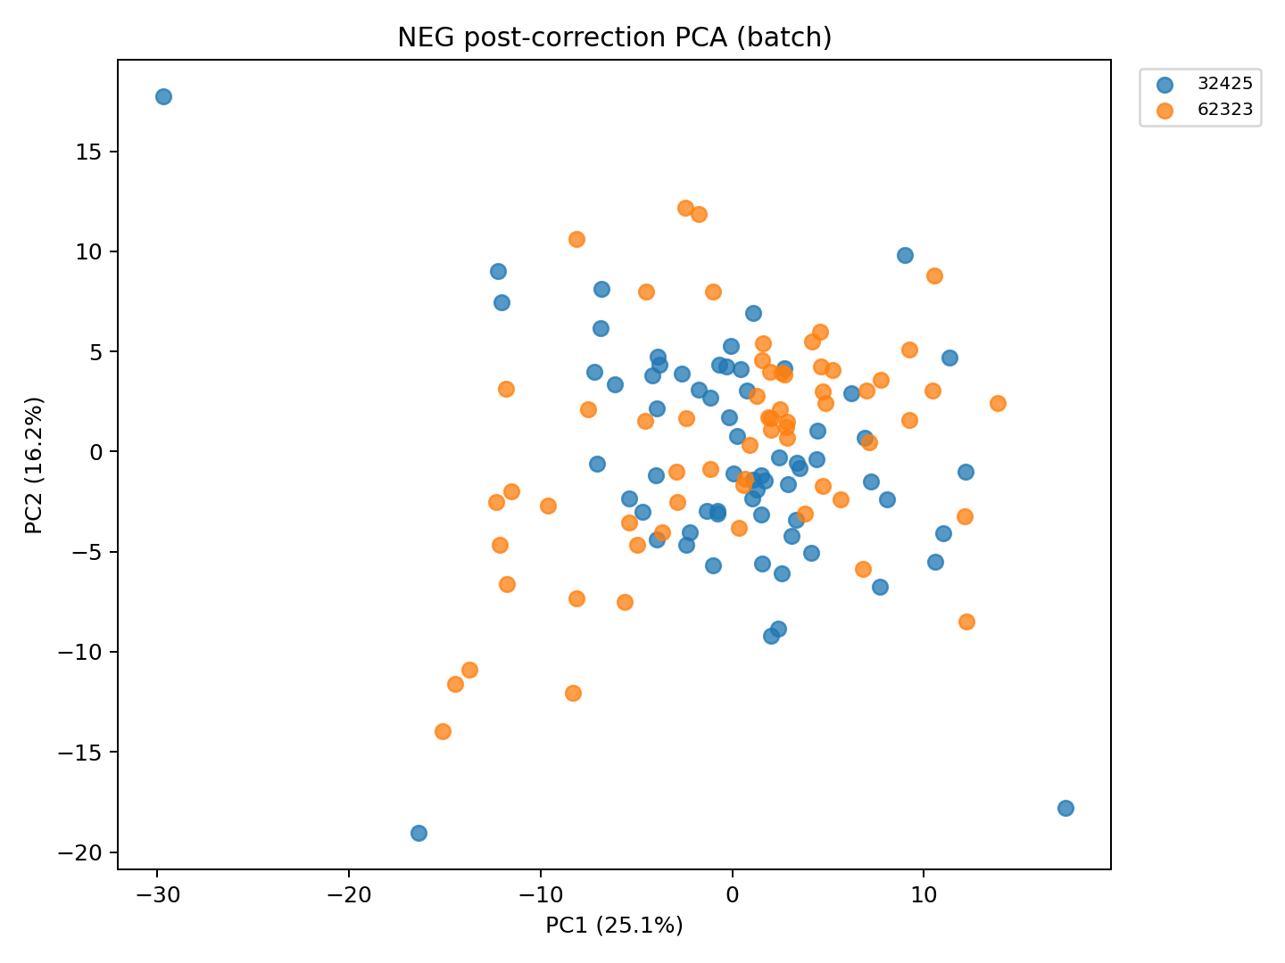
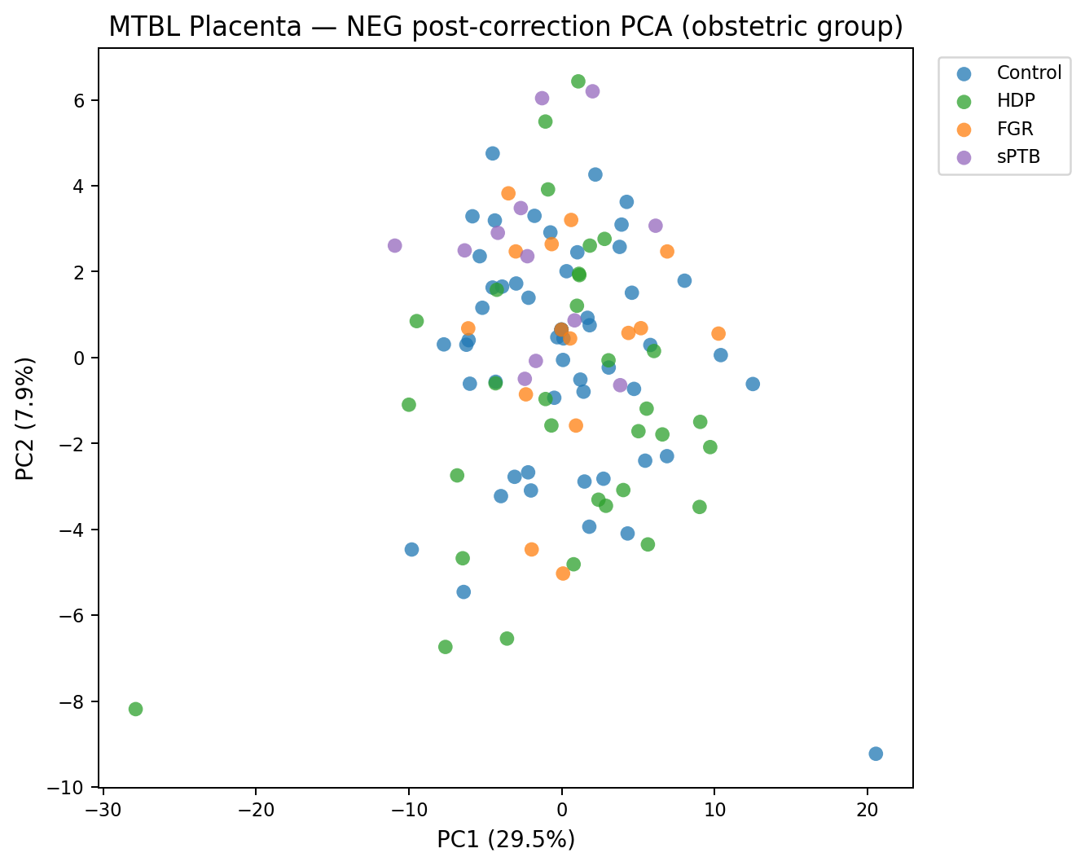
MTBL Placenta · Negative Mode (NEG) · After Batch Correction
After Correction · Coloured by Batch
After Correction · Coloured by Obstetric Group
ComBat batch correction · Single tissue harvest, no longitudinal timepoints · 112 samples · Negative Mode (NEG)

Slide 9
MTBL Plasma · Feature Pipeline
Stage
TP
Features (n)
Dropped (n)
Note
Raw (POS + NEG merged)
—
9,744
—
Pre-processing starting point
Feature missingness filter
—
9,744
0
Exclude features >20% missing in control or complication group. No features failed this threshold.
Sample missingness filter
—
9,744
7 samples
Exclude samples >50% missing across features. Feature count unchanged.
QC-pool RSD filter
—
1,074
8,670
Exclude features with QC RSD >30% in any batch, applied post-ComBat
IQR filter
—
1,074
0
Exclude near-constant and hypervariable features within timepoint. No features failed this threshold.
Deduplication
—
502
572
See dedup breakdown on the following slide
Differential filter (q < 0.05)
all
409
93
Downstream working subset: Control vs Complication cross-sectionally at all timepoints, plus all adjacent longitudinal delta comparisons across groups. q < 0.05, BH-FDR. Any feature significant in at least one test is retained.
The 409-feature set is the working subset used for downstream analyses. Cross-sectional: Mann-Whitney U, Control vs Complication. Longitudinal: Wilcoxon signed-rank on adjacent timepoint deltas. BH-FDR correction applied within each comparison.

Slide 10
MTBL Placenta · Feature Pipeline
Stage
TP
Features (n)
Dropped (n)
Note
Raw (POS + NEG merged)
—
5,435
—
Pre-processing starting point
Feature missingness filter
—
5,435
0
Exclude features >20% missing in control or complication group. No features failed this threshold.
Sample missingness filter
—
5,435
13 samples
Exclude samples >50% missing across features. Feature count unchanged.
QC-pool RSD filter
—
1,081
4,354
Exclude features with QC RSD >30% in any batch, applied post-ComBat
IQR filter
—
1,081
0
Exclude near-constant and hypervariable features. No features failed this threshold.
Deduplication
—
644
437
See dedup breakdown on the following slide
Differential filter (q < 0.05)
all
2
642
Cross-sectional only — placenta is a single collection timepoint, no longitudinal data available. Control vs Complication, Mann-Whitney U + BH-FDR.
112 samples: 53 Control, 32 HDP, 15 FGR, 12 sPTB. Placenta collected at delivery — single cross-section. Two features pass the differential threshold at q < 0.05.

Slide 11
MTBL Plasma · Deduplication Breakdown
Deduplication removes redundant signals from the same compound. Applied to the 1,074 features remaining after QC filtering, yielding 502 unique features with 572 dropped.
Phase
When applied
n dropped
What is dropped
Why
Named within-compound
After named-feature merge
49
Duplicate signals for the same named compound
Multiple peaks sharing the same HMDB/compound name — one representative retained per compound by QC intensity. Sources: chromatographic co-elution, structural isomers with the same annotation, annotation conflicts.
Unnamed — mass + RT
After named-feature merge
22
Unnamed features with identical m/z and retention time
Redundant detections of the same ion with no annotation. Exact m/z + RT match used as identity criterion.
Unnamed — formula + RT
After mass+RT merge
1
Unnamed features with the same molecular formula and RT
Same putative molecular composition at the same elution window — treated as one compound.
Unnamed — adduct graph
After formula+RT merge
500
Adducts, isotope peaks, and in-source fragments
Each molecule produces multiple ions: [M+H]⁺, [M+Na]⁺, [M+K]⁺, ¹³C and ²H isotope peaks, and in-source fragments. Connected by a network within expected mass differences; the highest-abundance node is kept.
TOTAL
—
572
—
—
Phases applied sequentially. The representative feature retained within each group is selected by highest median intensity across QC samples.

Slide 12
MTBL Placenta · Deduplication Breakdown
Deduplication removes redundant signals from the same compound. Applied to the 1,081 features remaining after QC filtering, yielding 644 unique features with 437 dropped.
Phase
When applied
n dropped
What is dropped
Why
Named within-compound
After named-feature merge
99
Duplicate signals for the same named compound
Multiple peaks sharing the same HMDB/compound name — one representative retained per compound by QC intensity. Sources: chromatographic co-elution, structural isomers with the same annotation, annotation conflicts.
Unnamed — mass + RT
After named-feature merge
19
Unnamed features with identical m/z and retention time
Redundant detections of the same ion with no annotation. Exact m/z + RT match used as identity criterion.
Unnamed — formula + RT
After mass+RT merge
4
Unnamed features with the same molecular formula and RT
Same putative molecular composition at the same elution window — treated as one compound.
Unnamed — adduct graph
After formula+RT merge
315
Adducts, isotope peaks, and in-source fragments
Each molecule produces multiple ions: [M+H]⁺, [M+Na]⁺, [M+K]⁺, ¹³C and ²H isotope peaks, and in-source fragments. Connected by a network within expected mass differences; the highest-abundance node is kept.
TOTAL
—
437
—
—
Phases applied sequentially. The representative feature retained within each group is selected by highest median intensity across QC samples.

