Slide 1
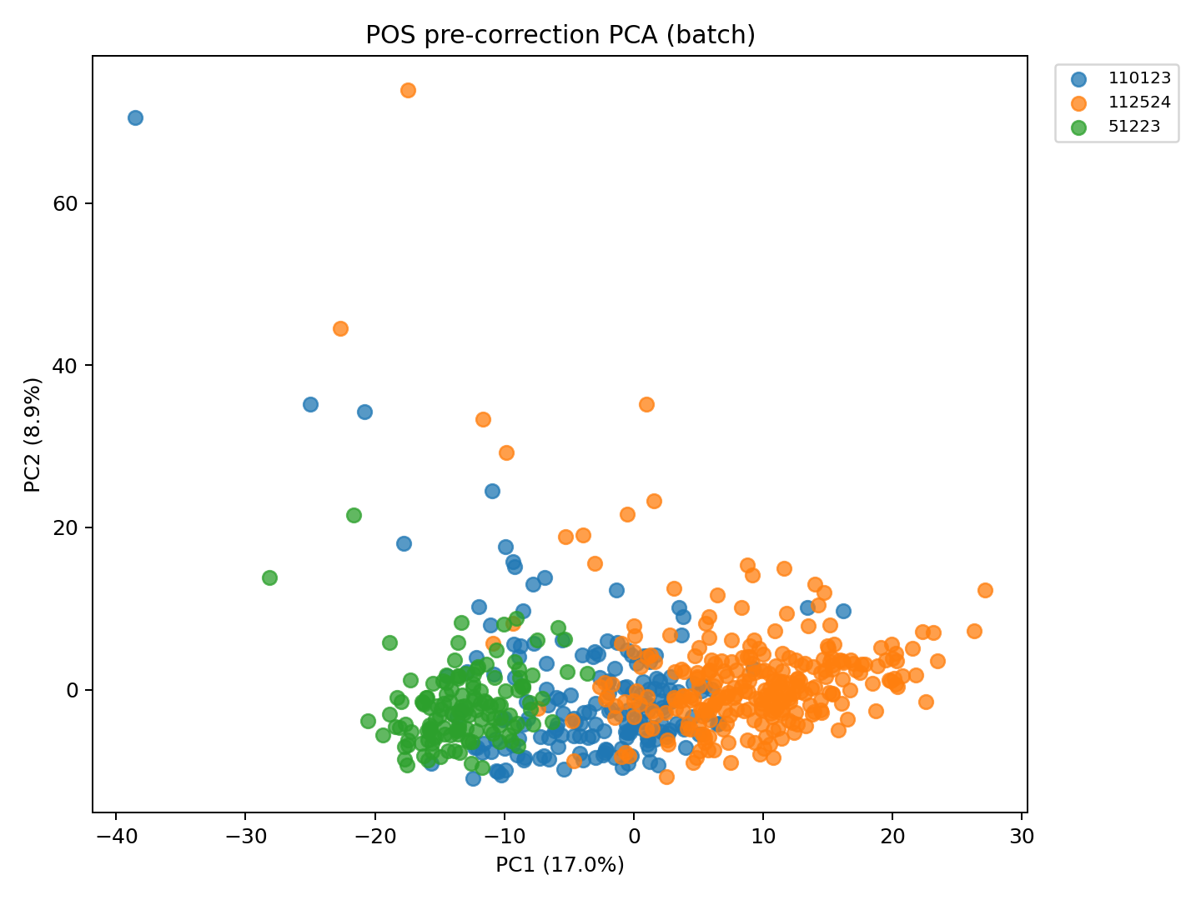
MTBL Plasma · Positive Mode (POS) · Before Batch Correction
Before Correction · Coloured by Batch
ComBat (ref.batch=51223, bridge n=20) · Protected covariates: Subgroup, SampleGestAge, GestAgeDelivery · Positive Mode (POS)

Slide 2
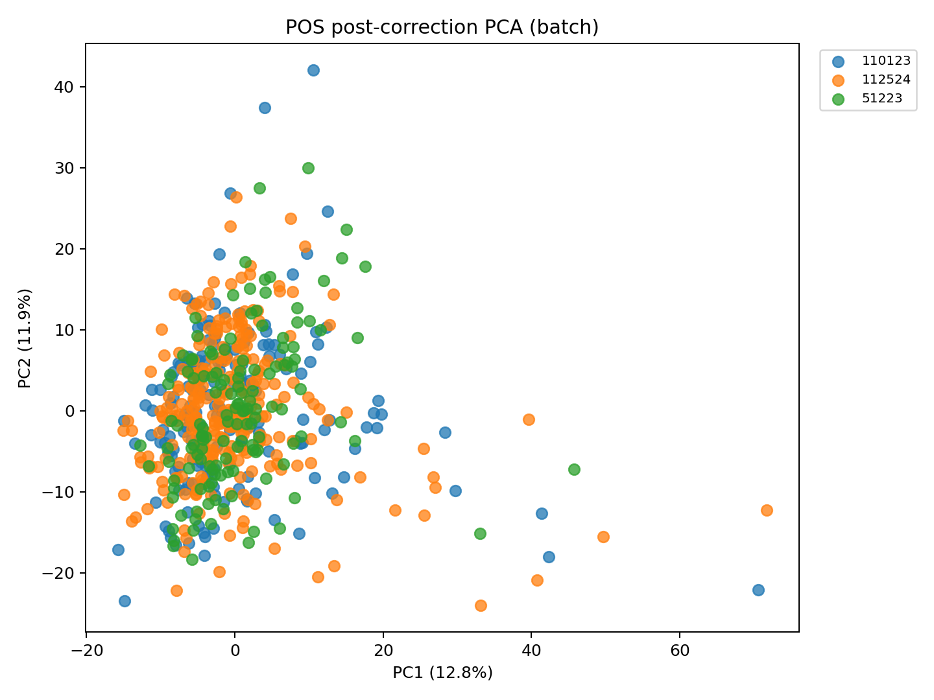
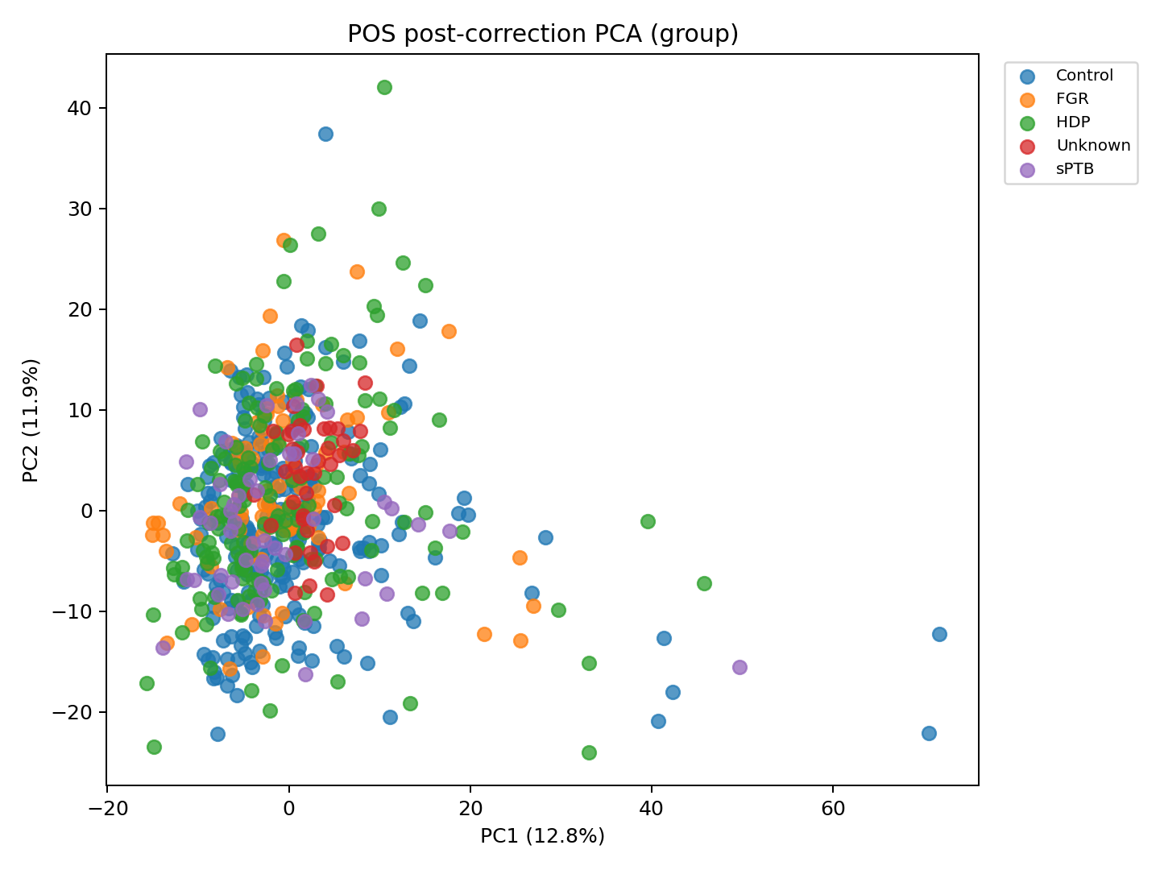
MTBL Plasma · Positive Mode (POS) · After Batch Correction
After Correction · Coloured by Batch
After Correction · Coloured by Group
ComBat (ref.batch=51223, bridge n=20) · Protected covariates: Subgroup, SampleGestAge, GestAgeDelivery · Positive Mode (POS)

Slide 3
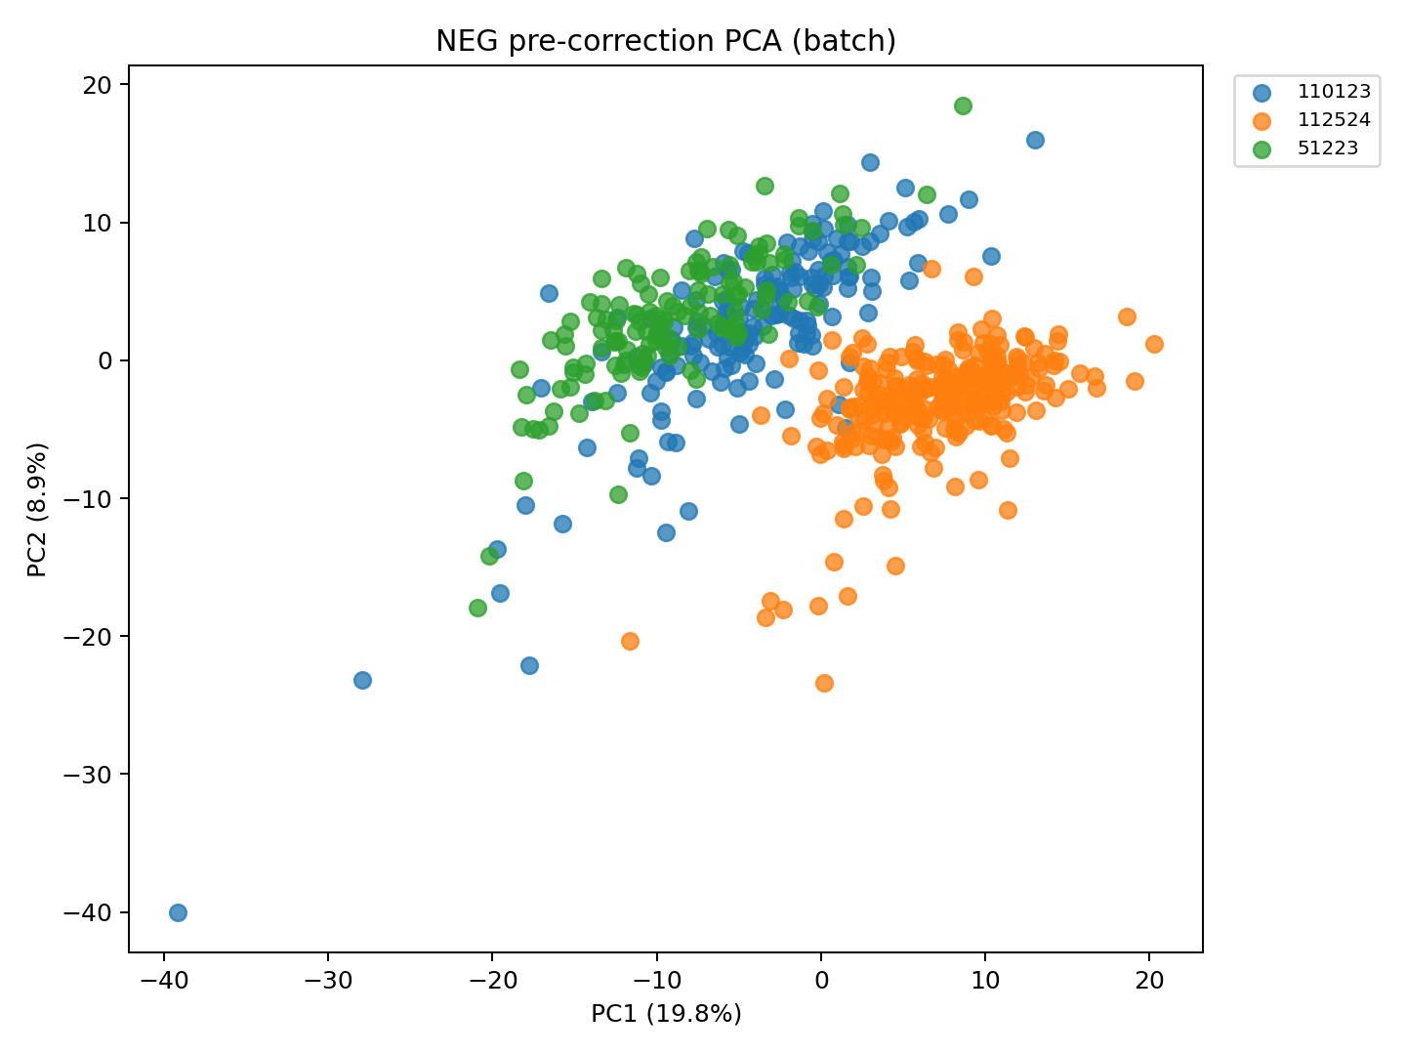
MTBL Plasma · Negative Mode (NEG) · Before Batch Correction
Before Correction · Coloured by Batch
ComBat (ref.batch=51223, bridge n=20) · Protected covariates: Subgroup, SampleGestAge, GestAgeDelivery · Negative Mode (NEG)

Slide 4
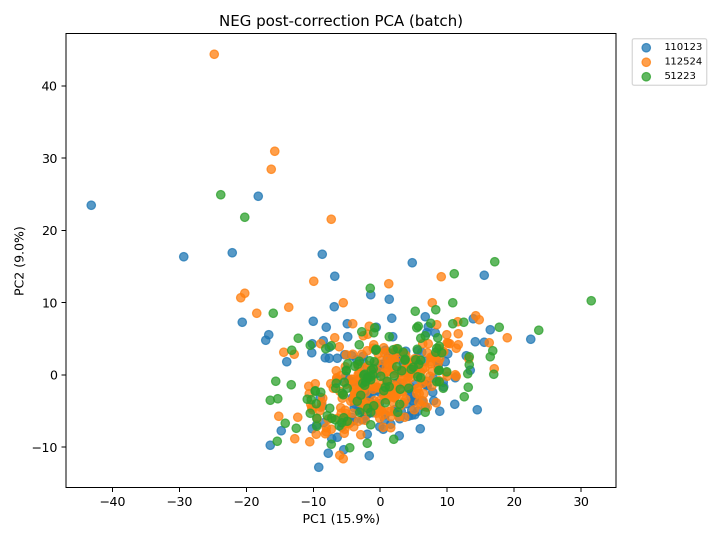
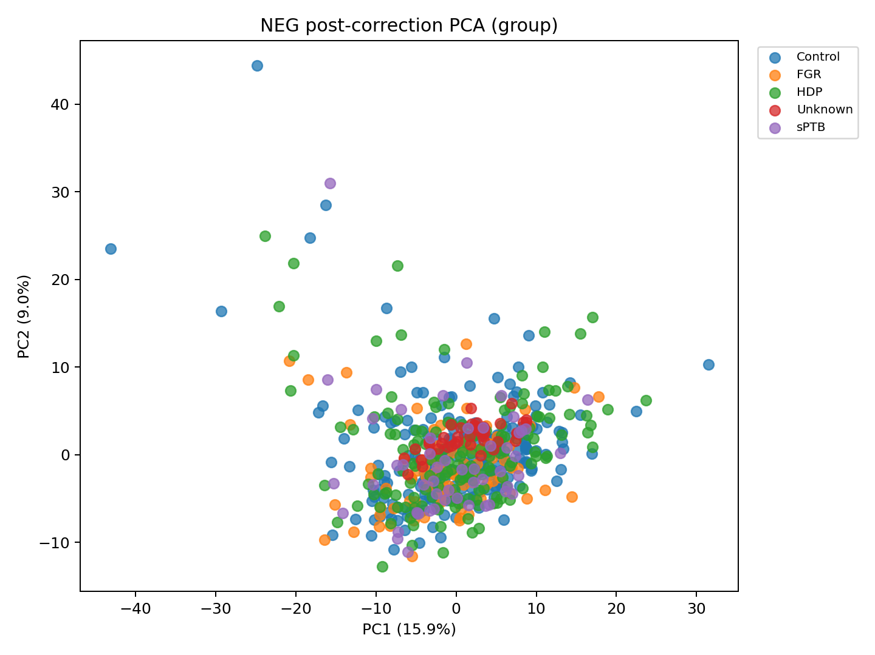
MTBL Plasma · Negative Mode (NEG) · After Batch Correction
After Correction · Coloured by Batch
After Correction · Coloured by Group
ComBat (ref.batch=51223, bridge n=20) · Protected covariates: Subgroup, SampleGestAge, GestAgeDelivery · Negative Mode (NEG)

Slide 5
MTBL Plasma · Feature Pipeline — All Stages
Stage
TP
Features (n)
Dropped (n)
Note
Raw (POS + NEG merged)
—
9,744
—
Starting point before any processing
After QC RSD filter
—
1,074
8,670
Remove features with QC RSD > 30%
After deduplication
—
502
572
See dedup breakdown (next slide)
After differential filter (q < 0.05)
A
40
462
Mann-Whitney U + BH FDR
After differential filter (q < 0.05)
B
72
430
Mann-Whitney U + BH FDR
After differential filter (q < 0.05)
C
68
434
Mann-Whitney U + BH FDR
After differential filter (q < 0.05)
D
49
453
Mann-Whitney U + BH FDR
After differential filter (q < 0.05)
E
43
459
Mann-Whitney U + BH FDR
After LASSO feature selection
A
31
9
Best model: Logistic Regression
After LASSO feature selection
B
66
6
Best model: Logistic Regression
After LASSO feature selection
C
68
0
Best model: Logistic Regression
After LASSO feature selection
D
48
1
Best model: Logistic Regression
After LASSO feature selection
E
4
39
Best model: Random Forest
Per-TP rows (diff filter & LASSO) are independent pipelines — each timepoint uses only its own samples and features. Placenta excluded (only 2 diff-sig features).

Slide 6
MTBL Plasma · Deduplication Breakdown — Stage 3 of Pipeline (Post QC-filter → Pre-Differential)
Deduplication removes redundant signals from the same compound. Applied once to the 1,074 post-QC features, producing 502 unique features (572 dropped total).
Phase
When applied
n dropped
What is dropped
Why
Named within-compound
After named-feature merge
49
Duplicate signals for the same named compound
Multiple peaks with the same HMDB/compound name — keep one representative per compound (highest-QC feature). Causes: chromatographic co-elution, structural isomers sharing the same ID, annotation errors.
Unnamed — mass + RT
After named-feature merge
22
Unnamed features with identical m/z and retention time
Redundant detections of the same ion measured in both polarities or across features with no annotation. Exact m/z + RT match indicates the same molecule.
Unnamed — formula + RT
After mass+RT merge
1
Unnamed features with same molecular formula and RT
Same putative molecular composition appearing at the same elution window — treated as one compound.
Unnamed — adduct graph
After formula+RT merge
500
Adducts, isotope peaks, and in-source fragments linked by network
Each molecule generates multiple ions: [M+H]⁺, [M+Na]⁺, [M+K]⁺, M+1 (¹³C), M+2 (²H) isotopes, and in-source fragments. A graph connects ions within expected mass differences; the highest-abundance node is kept as representative.
TOTAL
—
572
—
—
Phases are applied sequentially. The 'representative' feature kept in each group is the one with the highest median intensity across QC samples.

