Slide 1
Introduction to GIT
jan.schulz@devugees.org

Slide 2
1. Agenda
What is GIT?
History
Collaboration
Feature Branches
Vocabulary
GitHub
Remote Repository Commands
Lets GIT our hands dirty ...
Closer look at Commits
Merging

Slide 3
1. What is GIT?
Version Control System (VCS)
GIT helps us manage our project‘s files

Slide 4

1. What is GIT?
Version Control System (VCS)
GIT helps us manage our project‘s files

Slide 5
1. What is GIT?
What does GIT do, that makes managing our files easier?
History
Collaboration
Feature branches

Slide 6
2. History
GIT keeps track on every change that we make on our files

Slide 7
1. History
Oct. 2017: We have a file banners.css
Dec.2017: We do some changes in banners.css
Jan.2018: Our page breaks for some reason!
We take a look at banners.css from Oct. 2017 and see, that we removed the lines
„ float: left;
padding: 2rem;
margin: 2rem; “

Slide 8
1. History
GIT provides seeing the history of a file
GIT provides reverting changes

Slide 9
1. History
GIT provides seeing the history of a file
GIT provides reverting changes
-> Nothing is ever lost
-> Nothing is ever final

Slide 10
2. Collaboration
Creating something alone:
You
Your Files

Slide 11
2. Collaboration
Creating something alone:
You
Your Files
Creating something in a team:
You
Your Team members
Your Files
Your Team members‘ files

Slide 12
2. Collaboration
Creating something alone:
EASY
Creating something in a team:
NOT SO EASY

Slide 13
2. Collaboration
You want to write a book „mybook.docx“ about
your home country with your friend.

Slide 14
2. Collaboration
You want to write a book „mybook.docx“ about
your home country with your friend.
You: „Can you please check Chapter 4 and write something?“
Your buddy: „Okay, I need two days for that.“

Slide 15
2. Collaboration
Right after sending the Email to your friend ...
Now you see a few typos in your copy of the book and you fix them.
You have an idea of what images you would use for Chapter 1 and you insert them.
Now your friend does not work with the most updated version of your book anymore.

Slide 16
2. Collaboration
After two days your friend sends you back his
copy.
Mybook.docx
With your changes
Mybook.docx
With your friends‘ changes

Slide 17
2. Collaboration
Mybook.docx
With your changes
GIT
MERGE
Mybook.docx
With your friends‘ changes
Mybook.docx

Slide 18
3. Feature Branches
Task #1
-> Redesign Header
Some Website

Slide 19
3. Feature Branches
Task #1
-> Redesign Header
Some Website
Task #2
-> Redesign Footer

Slide 20
Day 1
Task #1
-> Redesign Header
UNDER CONSTRUCTION
Task #2
-> Redesign Footer
UNDER CONSTRUCTION

Slide 21
Day 2
Task #1
-> Redesign Header
UNDER CONSTRUCTION
Task #2
-> Redesign Footer
UNDER CONSTRUCTION

Slide 22
End of Day 2
Task #1
-> Redesign Header
UNDER CONSTRUCTION
Task #2
-> Redesign Footer
AMAZING FOOTER

Slide 23
End of Day 2
Task #1
-> Redesign Header
UNDER CONSTRUCTION
PROBLEM: UPLOADING WEBSITE WITH LUMPY HEADER CODE
Task #2
-> Redesign Footer
AMAZING FOOTER

Slide 24
3. Feature Branches
Header-changes

Slide 25
3. Feature Branches
Header-changes
Footer-changes

Slide 26
3. Feature Branches
Some Website
Header-changes
Footer-changes

Slide 27
3. Feature Branches
UNDER CONSTRUCTION
Header-changes
Footer-changes

Slide 28
3. Feature Branches
Header-changes
Footer-changes
UNDER CONSTRUCTION

Slide 29
3. Feature Branches
UNDER CONSTRUCTION
Header-changes
Footer-changes

Slide 30
3. Feature Branches
Header-changes
Footer-changes
UNDER CONSTRUCTION

Slide 31
3. Feature Branches
Header-changes
Footer-changes
FOOTER IS DONE.
MERGE IT INTO
THE TREE
(=MASTER BRANCH)
AMAZING FOOTER

Slide 32
3. Feature Branches
Header-changes
Footer-changes
FOOTER IS DONE.
MERGE IT INTO
THE TREE
(=MASTER BRANCH)
AMAZING FOOTER

Slide 33
3. Feature Branches
Header-changes
Footer-changes
FOOTER IS DONE.
MERGE IT INTO
THE TREE
(=MASTER BRANCH)
AMAZING FOOTER

Slide 34
3. Feature Branches
Header-changes
Footer-changes
FOOTER IS DONE.
MERGE IT INTO
THE TREE
(=MASTER BRANCH)
AMAZING FOOTER

Slide 35
3. Feature Branches
AMAZING HEADER
Header-changes
HEADER IS DONE.
MERGE IT INTO
THE TREE
(=MASTER BRANCH)
AMAZING FOOTER

Slide 36
3. Feature Branches
AMAZING HEADER
Header-changes
HEADER IS DONE.
MERGE IT INTO
THE TREE
(=MASTER BRANCH)
AMAZING FOOTER

Slide 37
3. Feature Branches
AMAZING HEADER
Header-changes
HEADER IS DONE.
MERGE IT INTO
THE TREE
(=MASTER BRANCH)
AMAZING FOOTER

Slide 38
3. Feature Branches
Header-changes
AMAZING HEADER
HEADER IS DONE.
MERGE IT INTO
THE TREE
(=MASTER BRANCH)
AMAZING FOOTER

Slide 39
3. Feature Branches
AMAZING HEADER
AMAZING FOOTER

Slide 40
Review
What are the three core functions of GIT?

Slide 41
Review
What are the three core functions of GIT?
History
Collaboration
Feature Branches

Slide 42
4. Vocabulary Time-Out
Repository?

Slide 43
4. Vocabulary Time-Out
Repository
Working directory, your project files folder
GIT's job is to keep track of any changes here

Slide 44
4. Vocabulary Time-Out
Repository
Working directory, your project files folder
GIT's job is to keep track of any changes here
Commit?

Slide 45
4. Vocabulary Time-Out
Repository
Working directory, your project files folder
GIT's job is to keep track of any changes here
Commit
GIT does not save changes in its history,
until we actively commit those changes
= "GIT's way of saving"
In a text-editor, we hit "Save" or CTRL+S and
then save it.
In GIT, nothing gets saved into history until
we hit COMMIT

Slide 46
4. Vocabulary Time-Out
Before we commit ... we STAGE!
STAGING = we prepare something,
like if you want to sell a house,
first you have to prepare it,
make it nice and clean then you sell it.

Slide 47
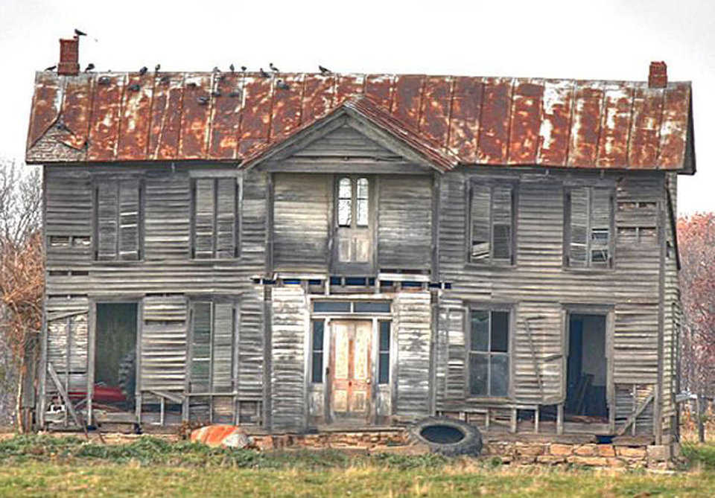
Index.html – before staging

Slide 48

Index.html – staged and ready to commit

Slide 49

Git States
Working
Directory
Modified
Files

Slide 50
Git States
Working
Directory
Modified
Files

Slide 51
Git States
Working
Directory
Modified
Files
Staged
Files

Slide 52
Git States
Working
Directory
Modified
Files
Staged
Files
Commited
Files

Slide 53

Git States
Working
Directory
Modified
Files
Staged
Files
Commited
Files
Remote
Repository

Slide 54
Git States
REMOTE
LOCAL
Working
Directory
Modified
Files
Staged
Files
Commited
Files
Remote
Repository

Slide 55
5. GitHub
= Your Remote Repository on the web
Free: Public Repositories
Premium: Public + Private Repositories
Public: Everybody can see your code
Private: You decide who can see your code
BitBucket.com: Free Private Repositories

Slide 56
6. Remote Repository Commands
Clone
Download an entire remote repository as a local repository
Fork
Download an entire remote repository as another remote repository
Push
Uploading/Pushing our local repository to the remote server
Pull
Downloading/Pulling the remote repository‘s latest changes into our local repository

Slide 57
Closer look at commits
A commit contains:
A state of a directory
A pointer to its antecedent commit
A commit is:
Identified by a ref
HEAD is a pointer that is always pointing at the commit you are currently working on.

Slide 58
Ok ...
8. Lets GIT our hands dirty

Slide 59
Preparations
http://blogs.pdmlab.com/alexander.zeitler/
articles/installing-and-configuring-p4merge-for-
git-on-ubuntu
Let us install P4Merge together ...

Slide 60
Closer look at commits
Main.js
Navbar.js
Index.html

Slide 61
Closer look at commits
HEAD
d8cfdjd
C1
Main.js
Navbar.js
Index.html

Slide 62
Closer look at commits
HEAD
d8cfdjd
C1
Main.js
Navbar.js
Index.html
Main.js*
Navbar.js*
Index.html

Slide 63
Closer look at commits
HEAD
d8cfdjd
gfc33jd
C1
C2
Main.js
Navbar.js
Index.html
Main.js*
Navbar.js*
Index.html

Slide 64
Closer look at commits
HEAD
d8cfdjd
gfc33jd
Pointer
to C1
C1
C2
Main.js
Navbar.js
Index.html
Main.js*
Navbar.js*
Index.html

Slide 65
Closer look at commits
HEAD
d8cfdjd
gfc33jd
Pointer
to C1
C1
C2
Main.js
Navbar.js
Index.html
Main.js*
Navbar.js*
Index.html
Main.js**
Navbar.js*
Index.html*

Slide 66
Closer look at commits
HEAD
d8cfdjd
gfc33jd
23j8ss
Pointer
to C1
Pointer
to C2
C1
C2
C3
Main.js
Navbar.js
Index.html
Main.js*
Navbar.js*
Index.html
Main.js**
Navbar.js*
Index.html*

Slide 67
Closer look at commits
HEAD
d8cfdjd
gfc33jd
23j8ss
Pointer
to C1
Pointer
to C2
C1
C2
C3
Main.js
Navbar.js
Index.html
Main.js*
Navbar.js*
Index.html
Main.js**
Navbar.js*
Index.html*
Main.js**
Navbar.js*
Index.html**

Slide 68
Closer look at commits
HEAD
d8cfdjd
gfc33jd
23j8ss
xyx893
Pointer
to C1
Pointer
to C2
Pointer
to C3
C1
C2
C3
C4
Main.js
Navbar.js
Index.html
Main.js*
Navbar.js*
Index.html
Main.js**
Navbar.js*
Index.html*
Main.js**
Navbar.js*
Index.html**

Slide 69
git add
 | New Files | Modified Files | Deleted Files
git add –u |  | X | X
git add . | X | X
git add -A | X | X | X

Slide 70
Git States
Working
Directory
Staged
Files
Commited
Files
Remote
Repository

Slide 71
git diff
Working
Directory
Staged
Files
Commited
Files
Remote
Repository

Slide 72
git diff HEAD~1
Working
Directory
Staged
Files
Commited
Files
Remote
Repository

Slide 73
git diff --staged
Working
Directory
Staged
Files
Commited
Files
Remote
Repository

Slide 74
git diff master origin/master
Working
Directory
Staged
Files
Commited
Files
Remote
Repository

Slide 75
Our branches so far ...
C1
C2

Slide 76
Our branches so far ...
MASTER
C1
C2

Slide 77
We need a new branch
MYNEWBRANCH
C1
C2
C3
MASTER
C1
C2

Slide 78
We need a new branch
MYNEWBRANCH
C1
C2
C3
Merge
MASTER
C1
C2
C5

Slide 79
Fast Forward Merges
MYNEWBRANCH
C1
C2
C3
Merge
MASTER
C1
C2
C5
FAST FORWARD :
- Git sees two branches as one branch
Only makes sense of no commits have been
done on the master‘s branch meanwhile

Slide 80
Disabled Fast Forward Merges
MYNEWBRANCH
C1
C2
C3
MASTER
Merge
C1
C2
C5
Disabled FAST FORWARD :
- C3 will be merged into C2

Slide 81
Disable Fast Forward Merges / Automatic Merges
MYNEWBRANCH
C1
C2
C3
Merge
MASTER
C1
C2
C3
C4
C5
Disabled FAST FORWARD :
- C3 will be merged into C4

Slide 82
Merge Conflicts
MASTER
C1
Master C1 -> File index.html has been created

Slide 83
Merge Conflicts
MASTER
C1
C2
Master C2 -> We added <h1>Hallo </h1> to index.html on line 1

Slide 84
Merge Conflicts
HALLOMARS
C1
MASTER
C1
C2
HalloMars C1 -> We changed line to <h1>Hallo Mars</h1>

Slide 85
Merge Conflicts
HALLOMARS
C1
MASTER
C1
C2
C3
Master C3 -> We changed line to <h1>Hallo World</h1>

Slide 86
Merge Conflicts
HALLOMARS
Merge-Conflict. Both index.html versions
were commited at least once
each branch
C1
MASTER
C1
C2
C3
Master C4 -> Merge HalloMars C1 into Master C3

Slide 87
Merge Conflicts
HALLOMARS
C1
MASTER
C1
C2
C3
C4
Master C4 -> Decided for Master C3 version.

Slide 88
Reverting Changes
Our goal: we want to get back to C3
HEAD
C1
C2
C3
C4
C5

Slide 89
Reverting Changes
Option 1: Hard Reset
We just move our head back to C3 and ignore the following commits
HEAD
Cut out from the branch, e.g.
C5 is not the latest commit anymore.
C1
C2
C3
C4
C5

Slide 90
Reverting Changes
Option 1: Hard Reset
We just move our head back to C3 and ignore the following commits
HEAD
They exist on the remote branch,
Not on the local branch anymore
C1
C2
C3
C4
C5
Problem: If the commits C4 and C5 are already in the remote repository, pushing does not work anymore!
Only solution here would be re-create remote repo!

Slide 91
Reverting Changes
Option 2: Branching with Checkout
We checkout
HEAD
C1
C2
C3
C4
C5

Slide 92
Reverting Changes
Option 2: Branching with Checkout
We checkout
HEAD
C5 is still the latest commit in
the branch and HEAD is detached
C1
C2
C3
C4
C5
We go back to C3 and start all
over from here again.

Slide 93
Reverting Changes
Option 2: Branching with Checkout
We checkout
HEAD
C5 is still the latest commit in
the branch and HEAD is detached
C1
C2
C3
C4
C5
New
C4
We go back to C3 and start all
over from here again.

Slide 94
Reverting Changes
Option 2: Branching with Checkout
We checkout
HEAD
C5 is still the latest commit in
the branch and HEAD is detached
C1
C2
C3
C4
C5
New
C4
New
C5
We go back to C3 and start all
over from here again.
No problem push remotely

Slide 95
Reverting Changes
Option 3: Reverting
HEAD
C1
C2
C3
C4
C5

Slide 96
Reverting Changes
Option 3: Reverting
A forward-moving undo operation
HEAD
C1
C2
C3
C4
C5
C6
Merges C3 into C5
as a new commit C6
C6 = C3

Slide 97
Git Reset, Revert, Checkout
Command | Scope | Common use cases
git reset | Commit-level | Discard commits in a private branch or throw away uncommited changes
git reset | File-level | Unstage a file
git checkout | Commit-level | Switch between branches or inspect old snapshots
git checkout | File-level | Discard changes in the working directory
git revert | Commit-level | Undo commits in a public branch
git revert | File-level | (N/A)

Slide 98
Reverting Changes
Unstage files
git reset <filename>
git reset .
Undo Changes in the working directory
git checkout -- <filename>
git checkout -- .

Slide 99
7. Remote and Local Repository Commands
LOCAL
REMOTE
COMMIT
RESET
CHECKOUT
ADD
RM
STATUS
DIFF
MERGE
CLONE
FORK
PUSH
PULL

