Slide 1
Flex Box
- Floats
- let us horizontally position block elements
- originally developed to implement Magazin-
style layouts
- floating text around images
- creating layouts was more of a side-effect,
e.g. “hacked” layouts
- no holistic approach to design a whole
layout
- not possible to vertically align items

Slide 2
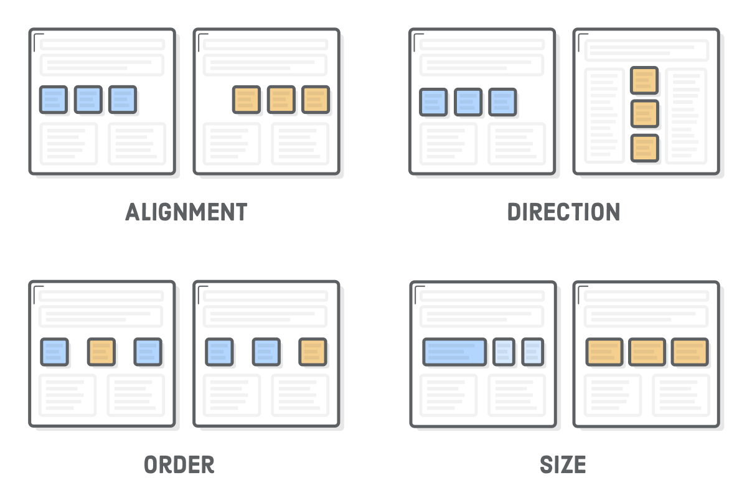

Slide 3
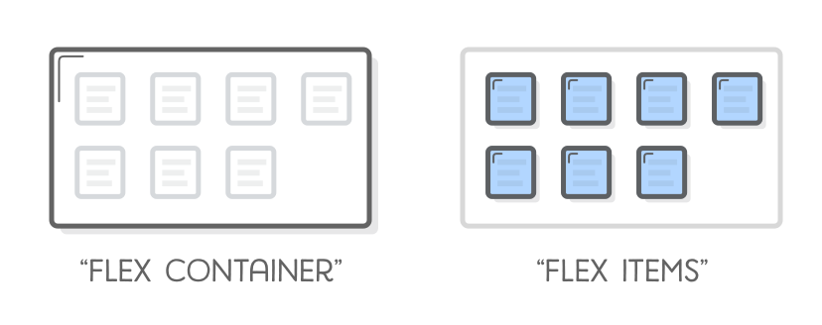
Flex Box
- Flexboxes
- contain of two types: flexitems and flex
containers

Slide 4
Flex Box
- Flexitems
- child of a flex container
- main purpose: let container know the
number of items to arrange
- Flexcontainer
- determine the layout of the flex items

Slide 5
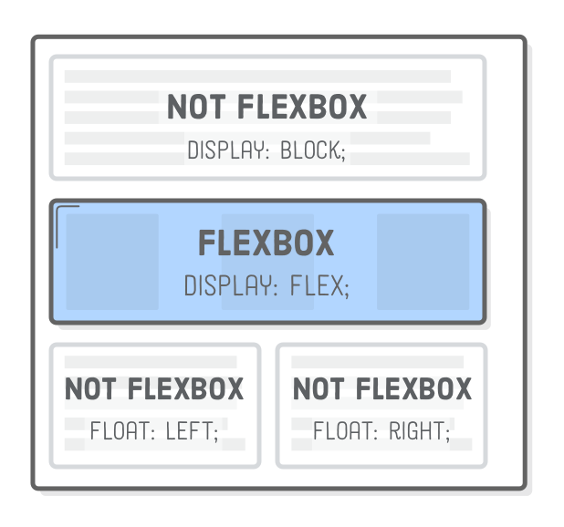
Flex Box

Slide 6
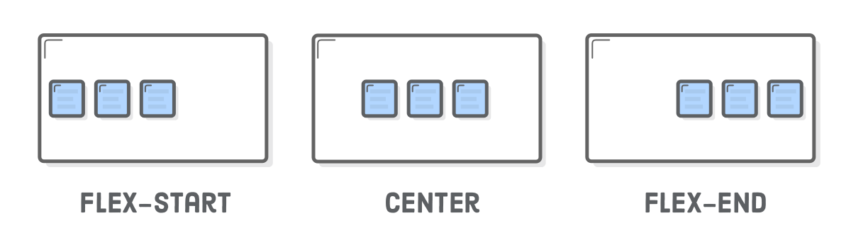
Vertical Alignment of Flex Items

Slide 7
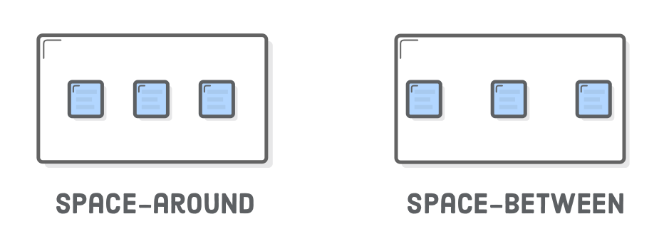
Vertical Alignment of Flex Items

Slide 8
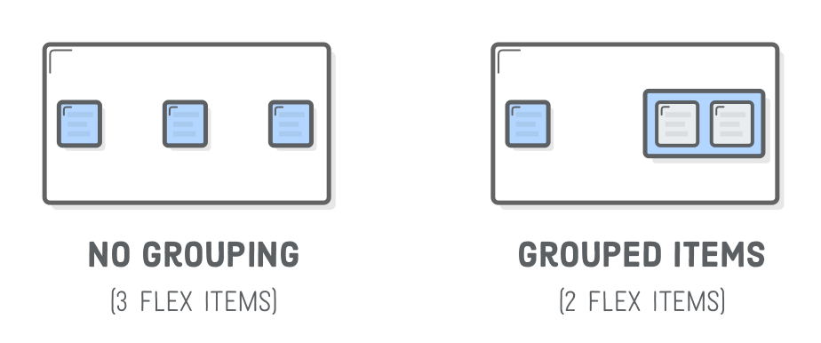
Vertical Alignment of Flex Items

Slide 9
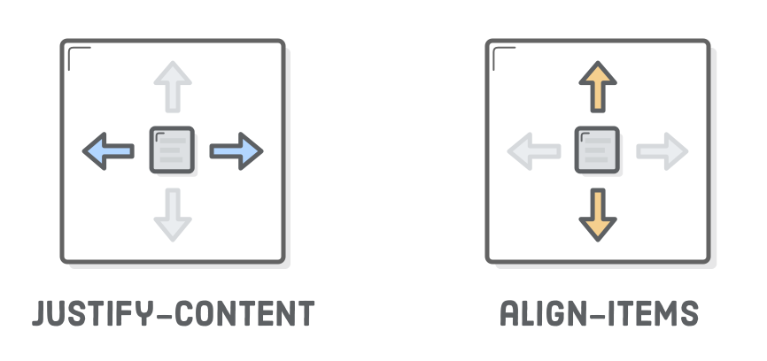
Horizontal Alignment of Flex Items

Slide 10
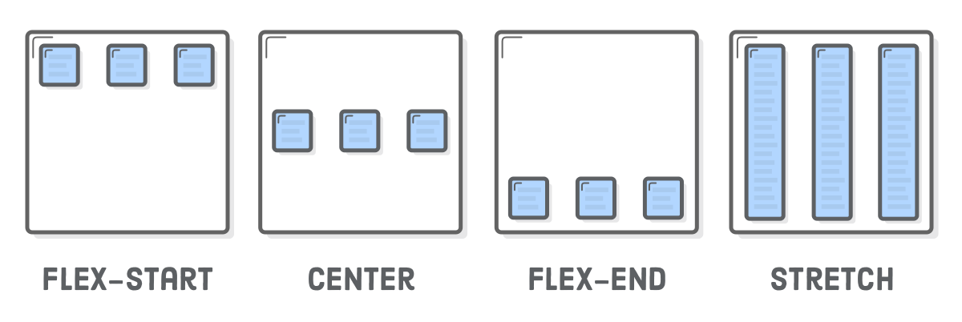
Horizontal Alignment of Flex Items

Slide 11
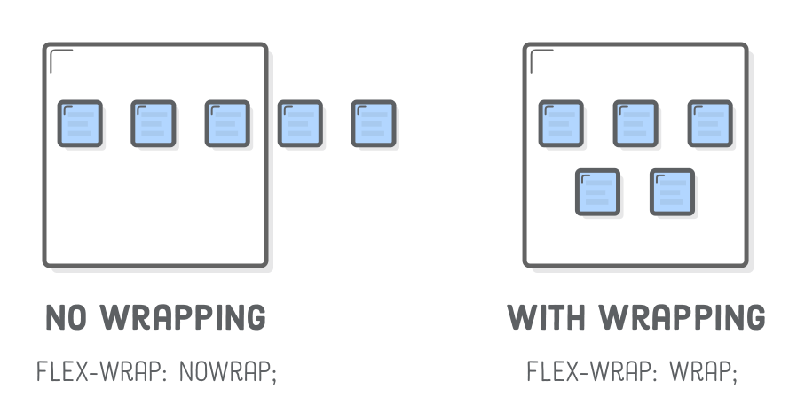
Wrapping Flex Items

Slide 12
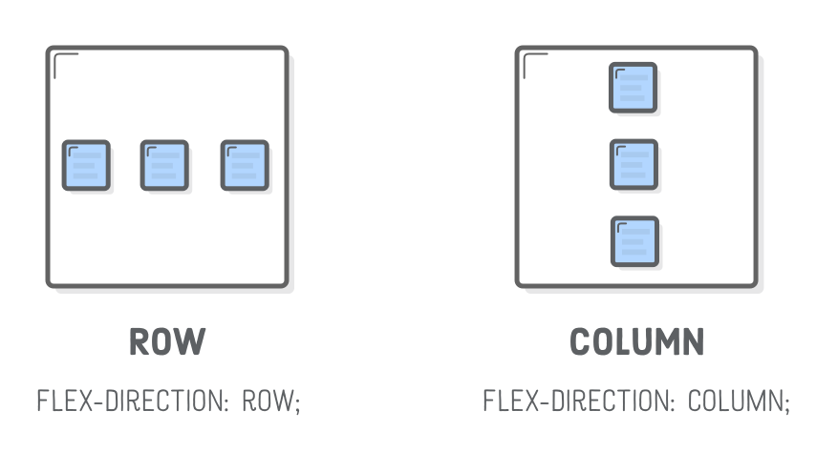
Flex Container Direction

Slide 13
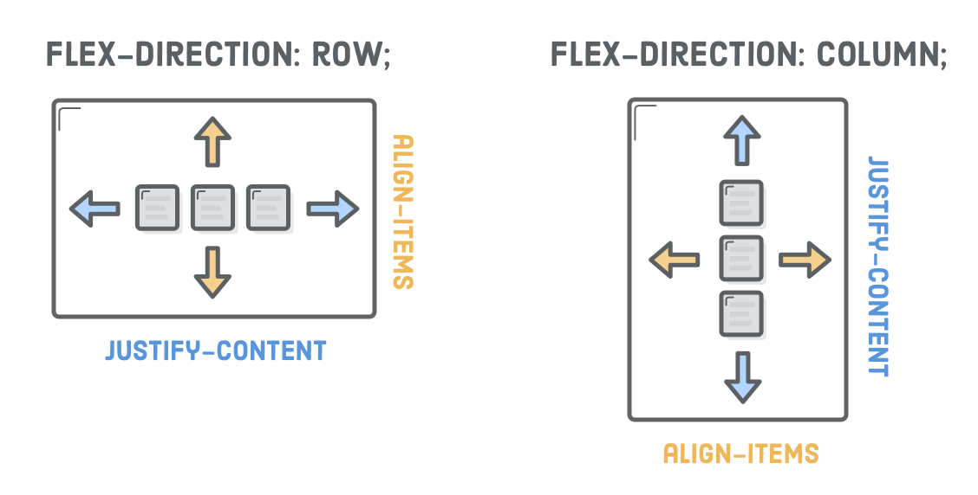
Alignment Considerations

Slide 14
Alignment Considerations
Alignment works vertically, too
center
flex-start (top)
flex-end (bottom)
stretch
baseline

Slide 15
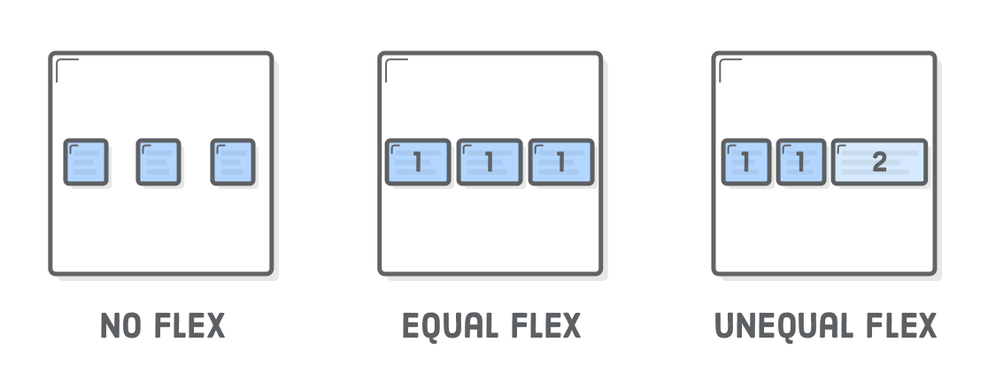
Flexible Items
flex property defines the width of individual items in a flex container
width is flexible, is defined as a weight
- flex = 2, grows twice as fast as items with flex = 1 (default value)

Slide 16
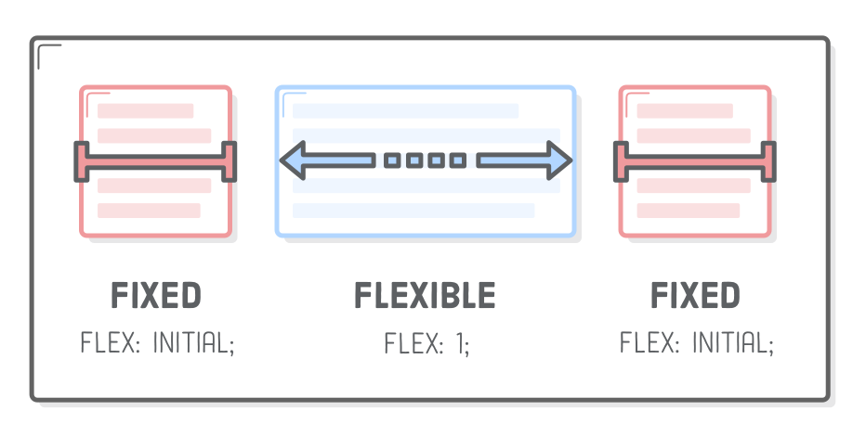
Flexible Items
flex property defines the width of individual items in a flex container
width is flexible, is defined as a weight
- flex = 2, grows twice as fast as items with flex = 1 (default value)

Slide 17
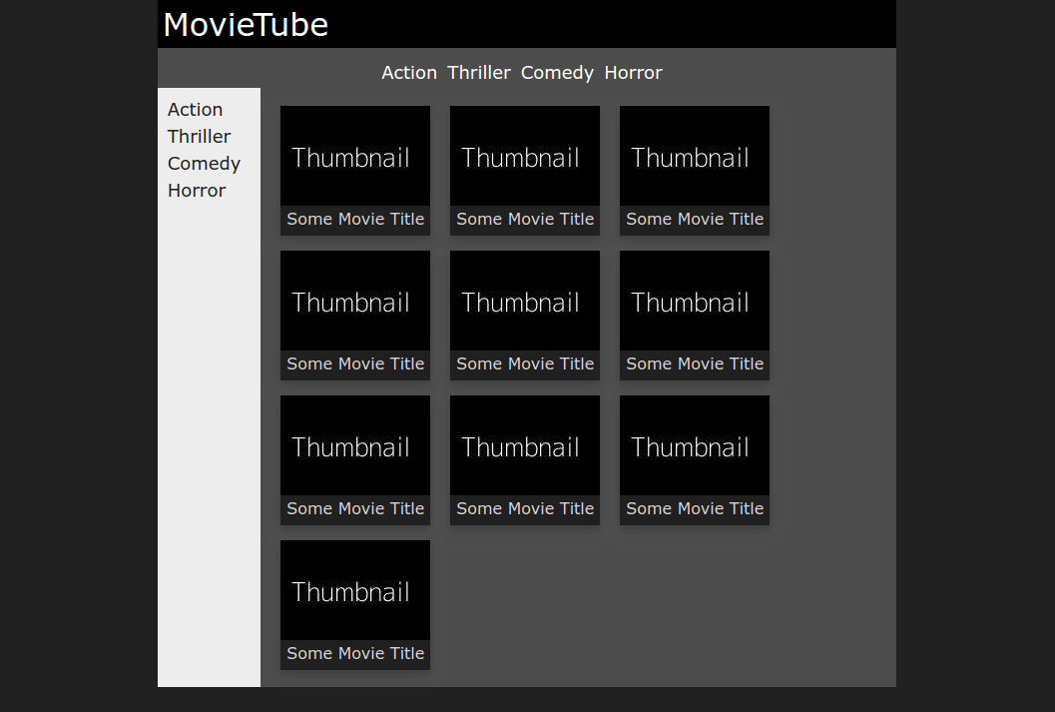
Task: Implement the following layout

Slide 18
Task: Implement the following layout
3 flexboxes

Slide 19
Task: Implement the following layout
#000
#1a1a1a
#4b4b4b

Slide 20
Task: Implement the following layout
Besides the given information, please
Implement a dark shadow for the thumbnail elements
When not being hovered: dark
When hovered: white
All Menu Elements are links, that do not have any text-decoration except underline when hovered
The width of the main container is minimum 600px and else 70%

Slide 21
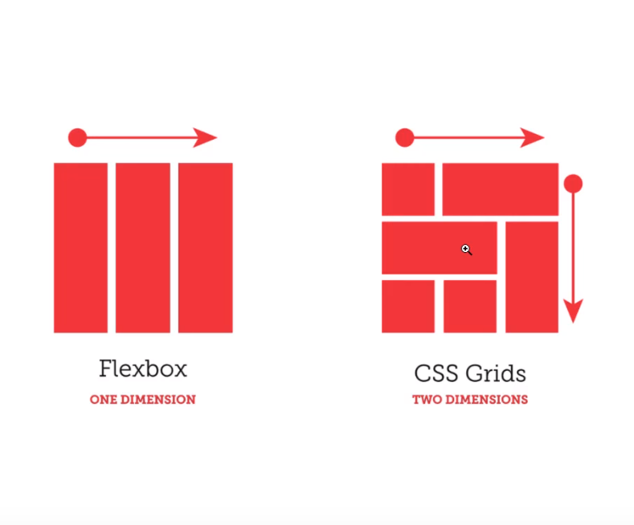
Grids

Slide 22
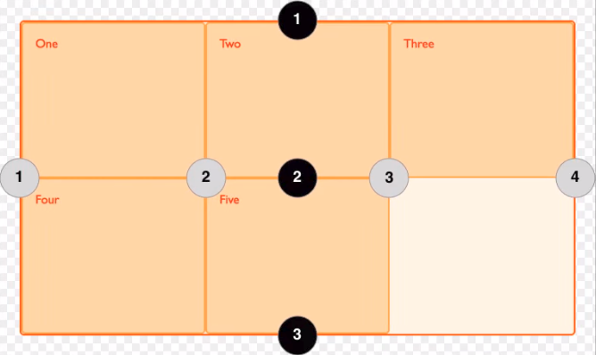
Grids

