Slide 1
Grids
What is CSS Grid
Properties and Values
Grid VS Flexbox

Slide 2
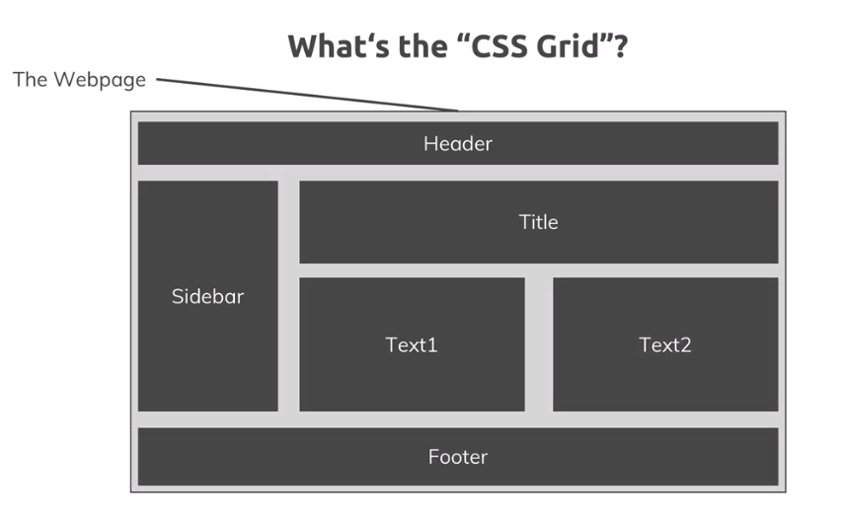

Slide 3
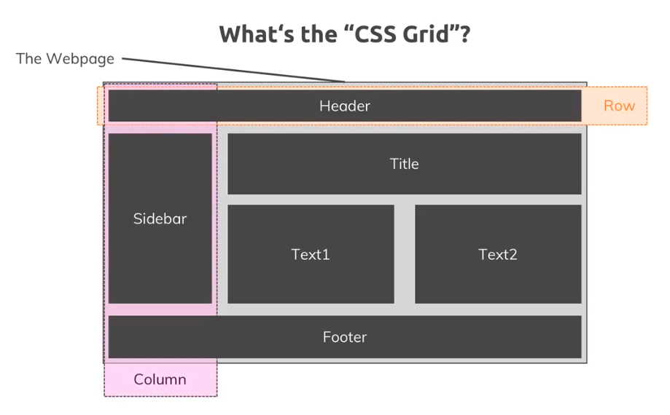

Slide 4
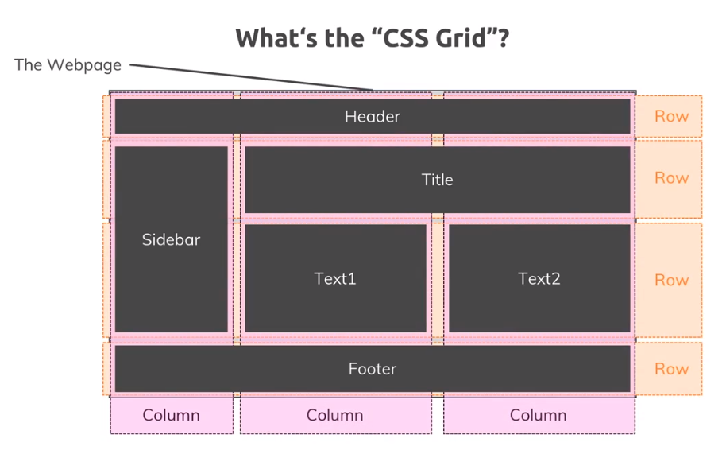

Slide 5
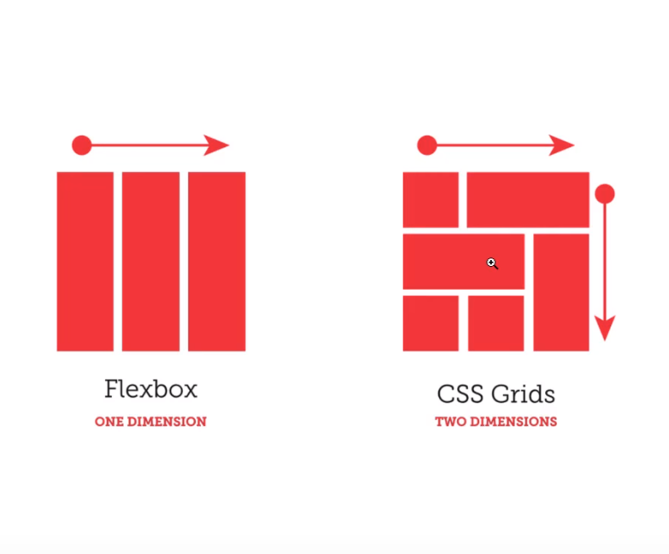
Grids

Slide 6
Grid Practice
Grid Container: Define the layout here
Grid Child: Define the position of the layout elements here

Slide 7
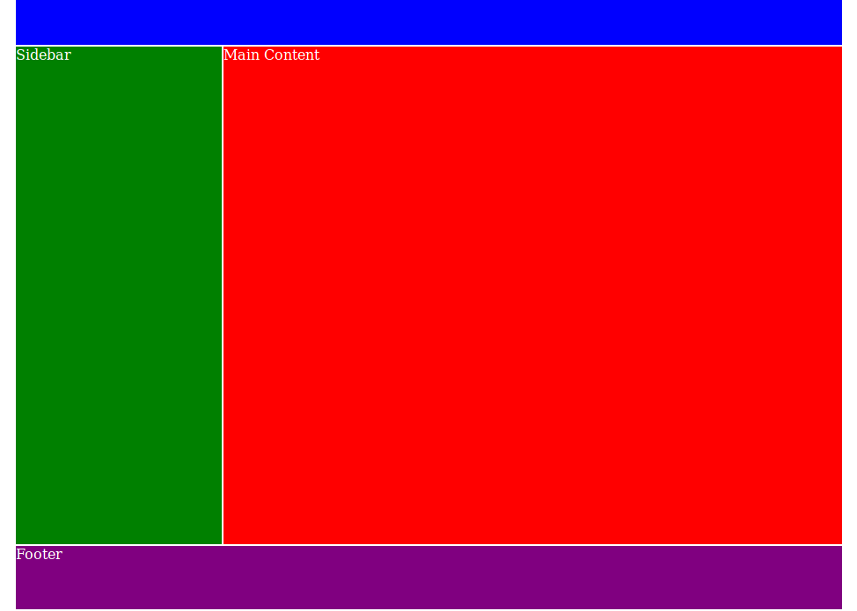
Task: Implement this layout

Slide 8
Task: Implement this layout
blue
red
green
purple

Slide 9
Task: Implement this layout
Please not the gap.
Do not just use divs, use the semantic html tags header, main, aside and footer.

