Slide 1
Flex Box
- Floats
- let us horizontally position block elements
- originally developed to implement Magazin-
style layouts
- floating text around images
- creating layouts was more of a side-effect,
e.g. “hacked” layouts
- no holistic approach to design a whole
layout
- not possible to vertically align items

Slide 2
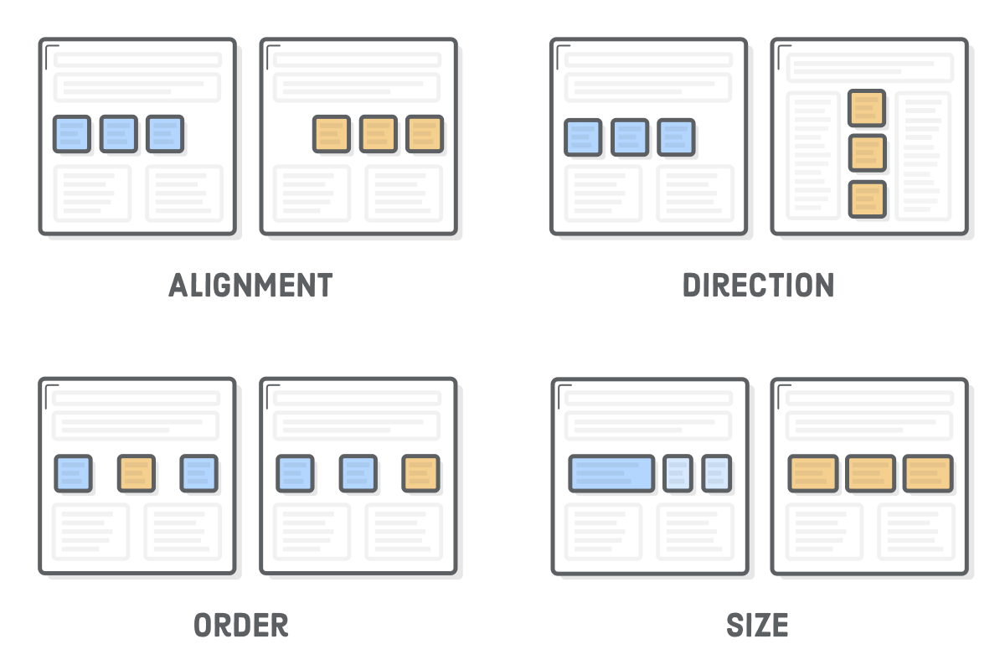

Slide 3
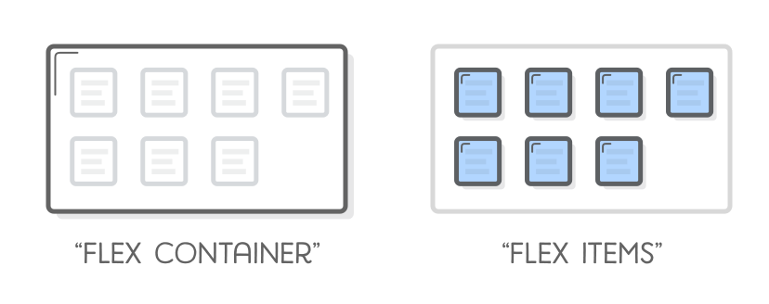
Flex Box
- Flexboxes
- contain of two types: flexitems and flex
containers

Slide 4
Flex Box
- Flexitems
- child of a flex container
- main purpose: let container know the
number of items to arrange
- Flexcontainer
- determine the layout of the flex items

Slide 5
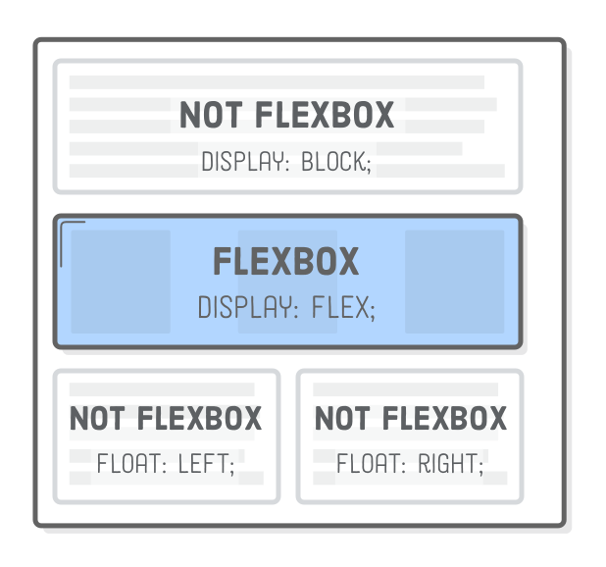
Flex Box

Slide 6
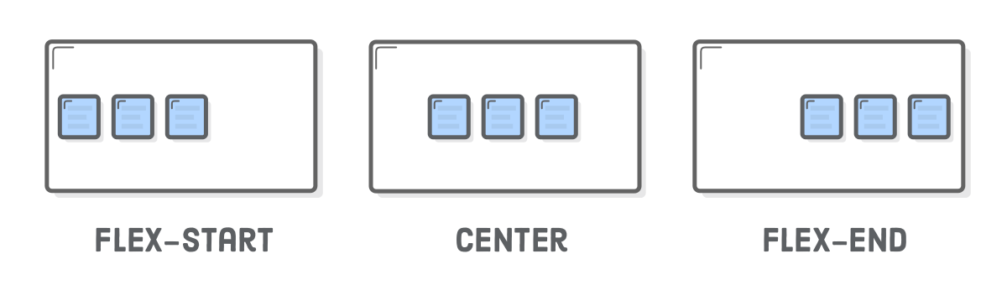
Vertical Alignment of Flex Items

Slide 7
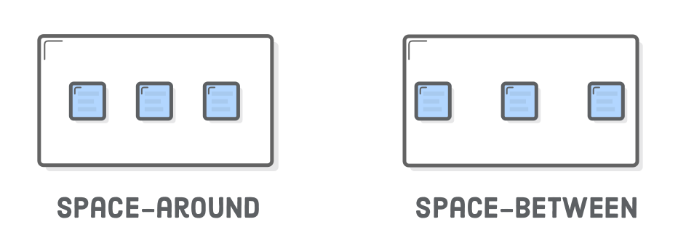
Vertical Alignment of Flex Items

Slide 8
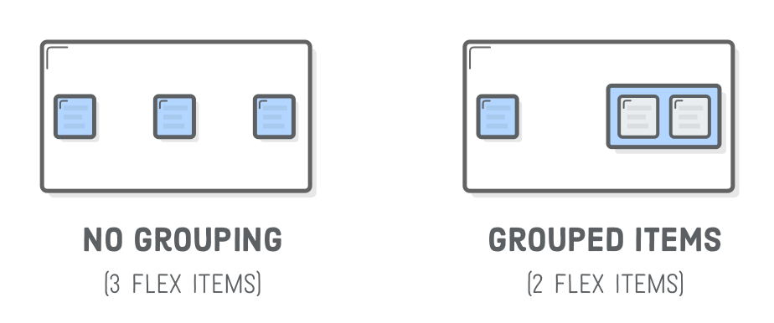
Vertical Alignment of Flex Items

Slide 9
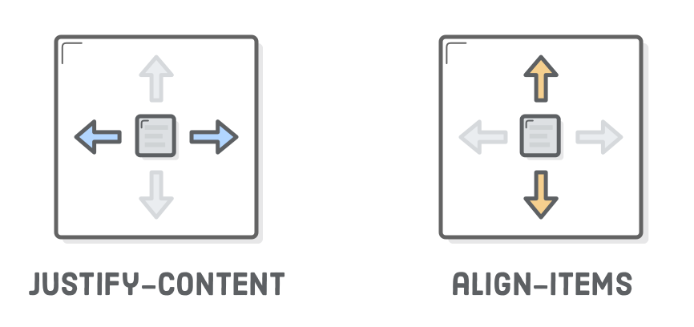
Horizontal Alignment of Flex Items

Slide 10
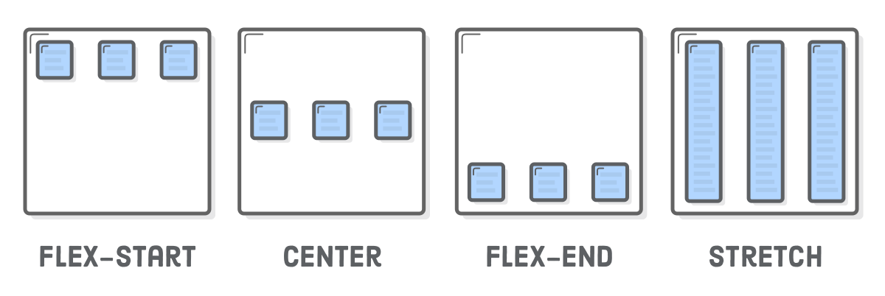
Horizontal Alignment of Flex Items

Slide 11
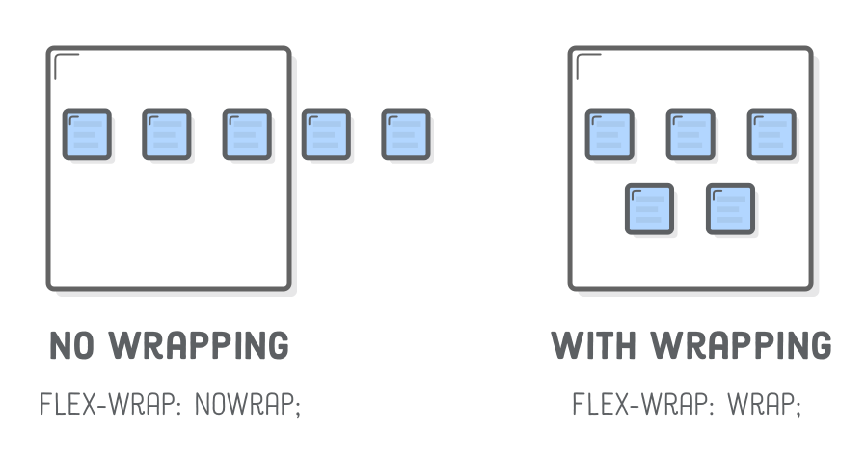
Wrapping Flex Items

Slide 12
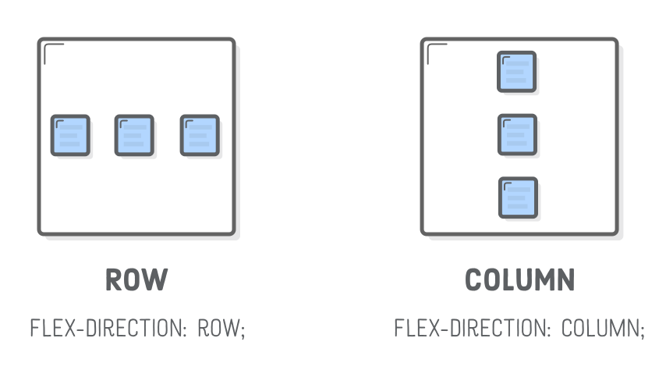
Flex Container Direction

Slide 13
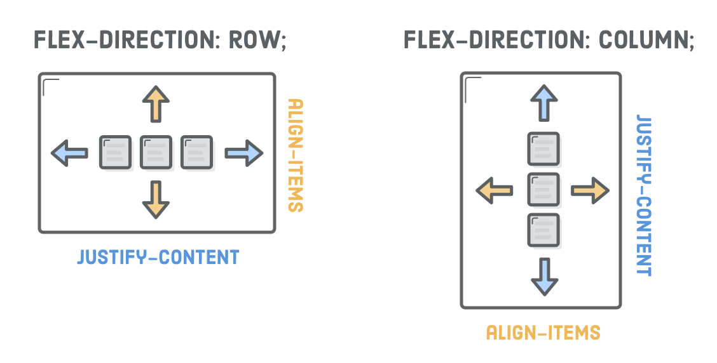
Alignment Considerations

Slide 14
Alignment Considerations
Alignment works vertically, too
center
flex-start (top)
flex-end (bottom)
stretch
baseline

Slide 15
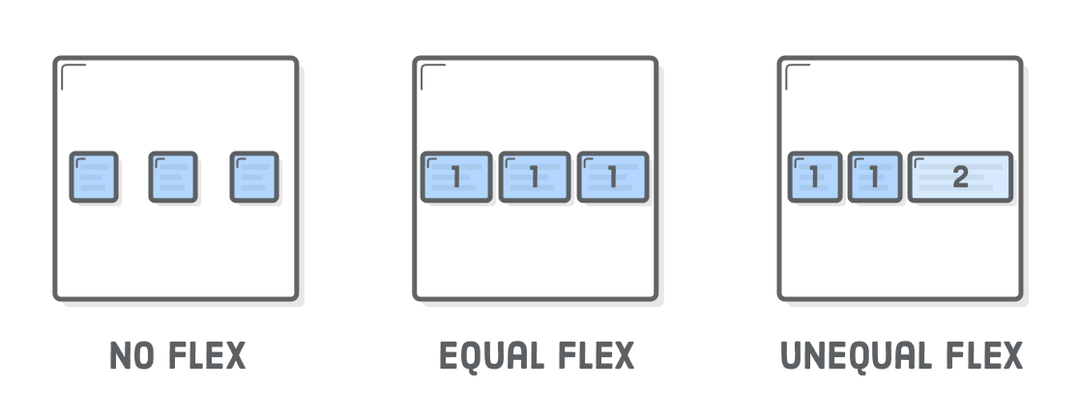
Flexible Items
flex property defines the width of individual items in a flex container
width is flexible, is defined as a weight
- flex = 2, grows twice as fast as items with flex = 1 (default value)

