Slide 1
Responsive Frontend
Development

Slide 2
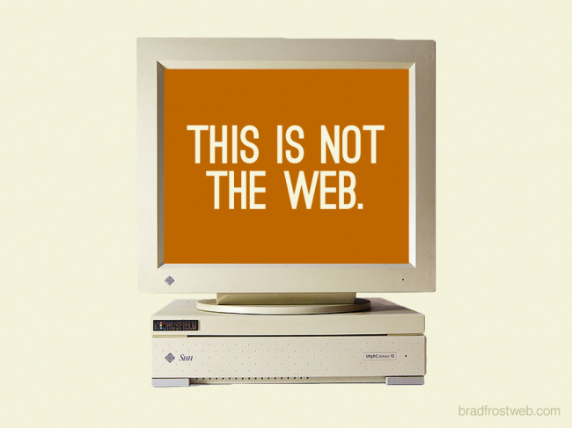

Slide 3
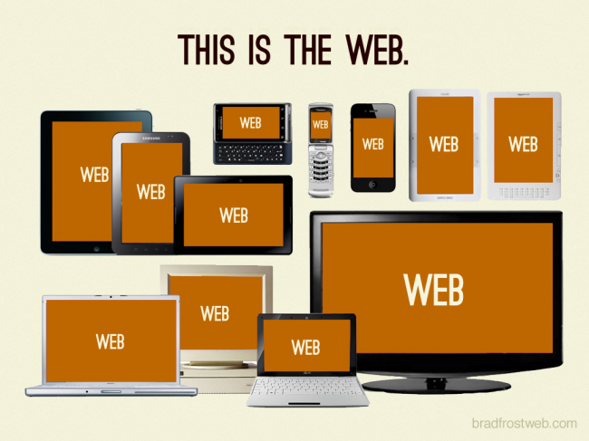

Slide 4


Slide 5
Fixed VS Fluid Layouts
Fixed Layout ?
Fluid/Elastic Layout ?

Slide 6
Fixed VS Fluid Layouts
Fixed Layout
  Many Absolute Pixel Heights/Widths/Margins
Liquid/Fluid/Elastic Layout
  Many Percentages, Auto Heights/Widths/Margins

Slide 7
Responsive VS Adaptive
Responsive
  One fluid Layout for multiple viewport sizes
Adaptive
  Multiple fixed Layouts for multiple viewport sizes

Slide 8
Responsive VS Adaptive
Responsive
  One fluid Layout for multiple viewport sizes
Adaptive
  Multiple fixed Layouts for multiple viewport sizes

Slide 9
Responsive VS Adaptive
Responsive
  One fluid Layout for multiple viewport sizes
Adaptive
  Multiple fixed Layouts for multiple viewport sizes

Slide 10
Responsive Web Development
Looks great on
  Mobile devices
  Desktop devices
Responsive: “Adapts to the device the visitor is using”
  = Different CSS declarations for different
  browser widths
Media Query find out, what browser width is being used

Slide 11
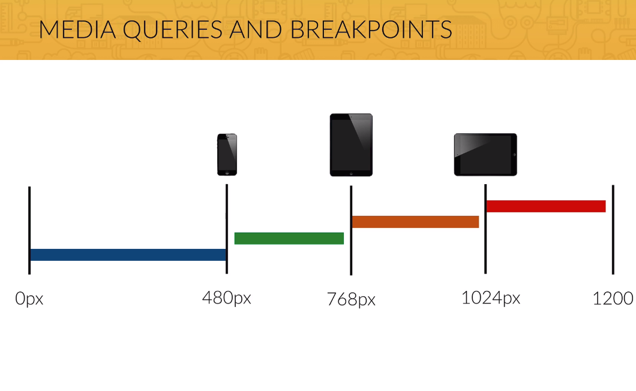

Slide 12
Agenda
1. Hardware Pixel VS Software Pixel
2. The “viewport” <meta> Tag in HTML
3. Media Queries with @media

