Slide 1
Flexbox
The Flexible Box Layout Module, makes it easier to design flexible responsive layout structure without using float or positioning.

Slide 2
Flexbox
The “Flexible Box” or “Flexbox” layout mode offers an alternative to Floats for defining the overall appearance of a web page. Whereas floats only let us horizontally position our boxes, flexbox gives us complete control over the alignment, direction, order, and size of our boxes.

Slide 3
Features
Direction − You can arrange the items on a web page in any direction such as left to right, right to left, top to bottom, and bottom to top.
Order − Using Flexbox, you can rearrange the order of the contents of a web page.
Wrap − In case of inconsistent space for the contents of a web page (in single line), you can wrap them to multiple lines (both horizontally) and vertically.
Alignment − Using Flexbox, you can align the contents of the webpage with respect to their container.
Resize − Using Flexbox, you can increase or decrease the size of the items in the page to fit in available space.

Slide 4
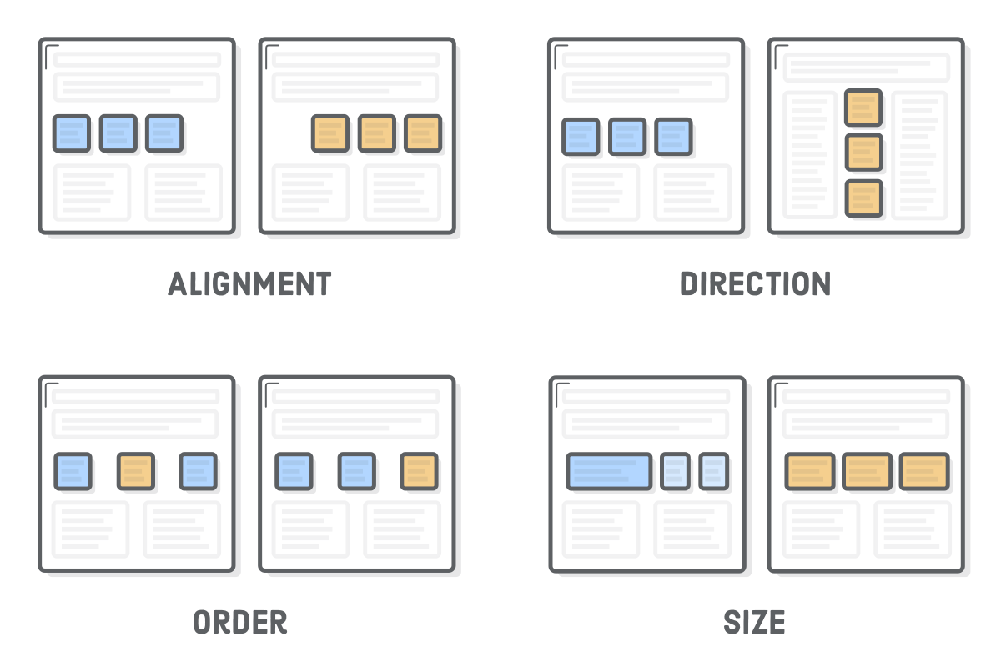
Flexbox

Slide 5
Supporting browsers
Chrome 29+
Firefox 28+
Internet Explorer 11+
Opera 17+
Safari 6.1+
Android 4.4+
iOS 7.1+

Slide 6
Container
First step to use Flexbox is to define a flex container using the display property
Display property accepts two values
  flex − Generates a block level flex container.
  inline-flex − Generates an inline flex container box.
  .container{
    display:flex;
}

Slide 7
Container and Items
Flex container groups flex items together and define how they are positioned
Every HTML element that’s a direct child of a flex container is an “item”.
Designing a complex layout means nesting boxes. Flex items can become flex containers for their own items.

Slide 8
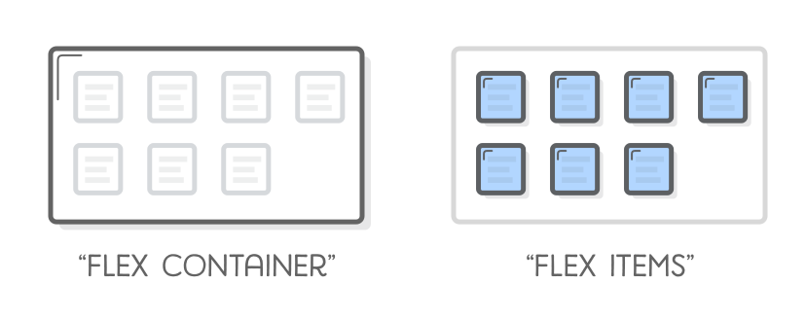
Flex container and items

Slide 9
Flex Direction
This property accepts four values −
row − Arranges the elements of the container horizontally from left to right.
row-reverse − Arranges the elements of the container horizontally from right to left.
column − Arranges the elements of the container vertically from left to right.
column-reverse − Arranges the elements of the container vertically from right to left.

Slide 10
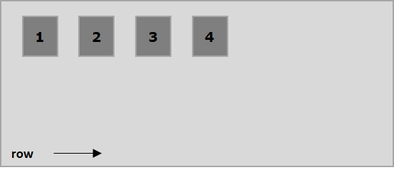
Flex Direction

Slide 11
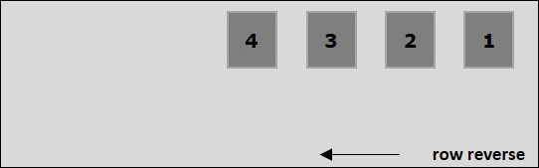
Flex direction

Slide 12
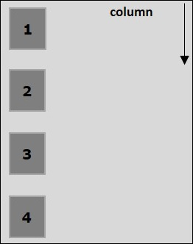
Flex Direction

Slide 13
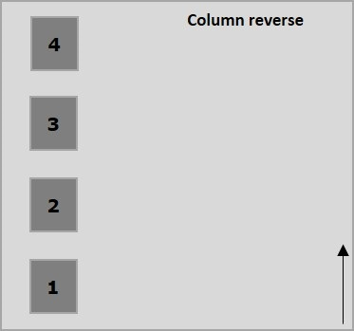
Flex Direction

Slide 14
Flexbox - Flex-Wrap
In case of insufficient space for the container, the rest of the flex items will be hidden
On passing the value wrap to the property flex-wrap, the elements of the container are arranged horizontally from left to right

Slide 15
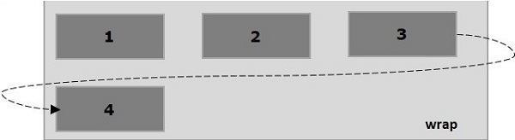
Flexbox - Flex-Wrap

Slide 16
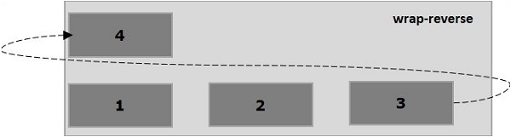
Flexbox - Flex-Wrap

Slide 17
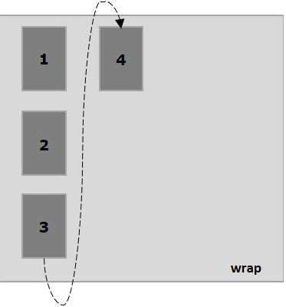
Flexbox - Flex-Wrap

Slide 18
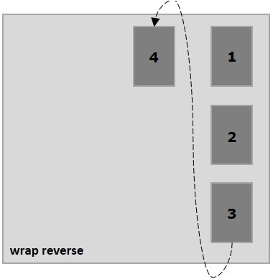
Flexbox - Flex-Wrap

Slide 19
Flexbox - Justifying Contents
Often there is an extra space in the container after arranging the items.
The property justify-content, you can align the contents along the main axis by distributing the extra space as intended
  justify-content: flex-start | flex-end | center | space-between | space-around| space-evenly;

Slide 20
Flexbox - Align Items
The align-items property is same as justify content. But here, the items were aligned across the cross access (vertically)
align-items: flex-start | flex-end | center | baseline | stretch;

Slide 21
Flexbox - Align Content
The align-content property defines the alignment of each line within the container
align-content: flex-start | flex-end | center | space-between | space-around | stretch;

Slide 22
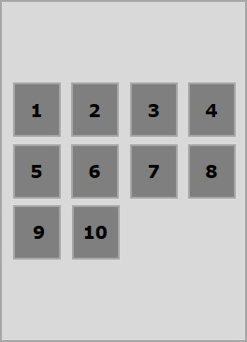
Flexbox - Align Content

Slide 23
Flexbox - Flex-Order
The flex-order property is used to define the order of the flexbox item.

Slide 24
Flexbox - Align Self
This property is similar to align-items, but here, it is applied to individual flex items.
align-self: auto | flex-start | flex-end | center | baseline | stretch;
.box4{align-self:flex-end;}

Slide 25
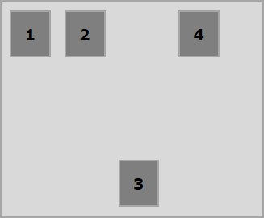
Flexbox - Align Self

Slide 26
Exercises
http://flexboxfroggy.com/

Slide 27
Sources
https://internetingishard.com/html-and-css/flexbox/
https://www.tutorialspoint.com/flexbox/flexbox_flex_containers.htm

