Slide 1
Flex Box
- Floats
- let us horizontally position block elements
- originally developed to implement Magazin-
style layouts
- floating text around images
- creating layouts was more of a side-
effect, e.g. “hacked” layouts
- no holistic approach to design a whole layout
- not possible to vertically align items

Slide 2
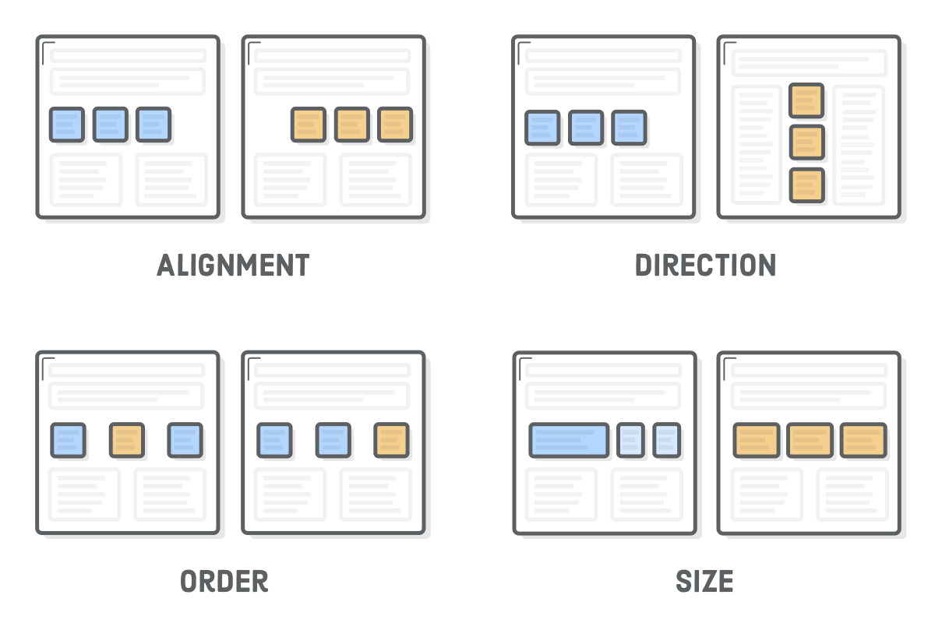

Slide 3
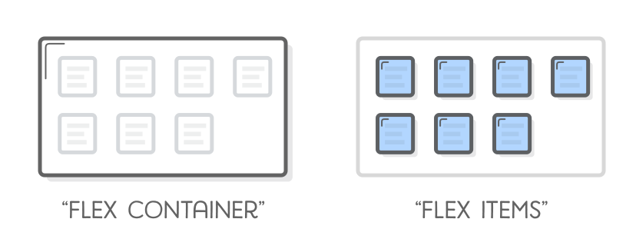
Flex Box
- Flexboxes
- contain of two types: flexitems and flex
Containers

Slide 4
Flex Box
- Flexitems
- child of a flex container
- main purpose: let container know the number
of items to arrange
- Flexcontainer
- determine the layout of the flex items

Slide 5
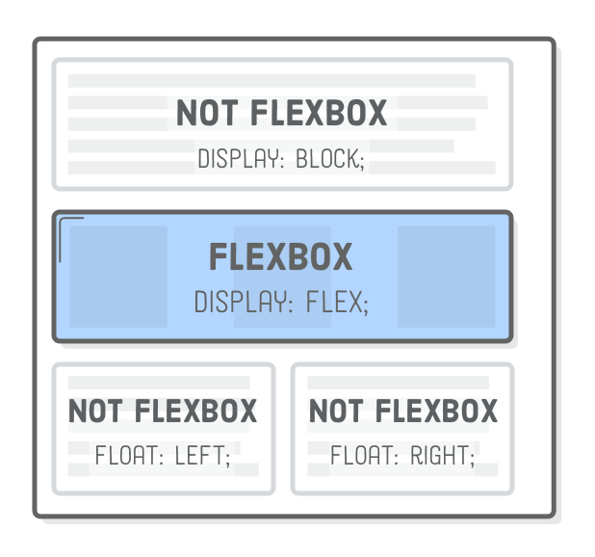
Flex Box

Slide 6
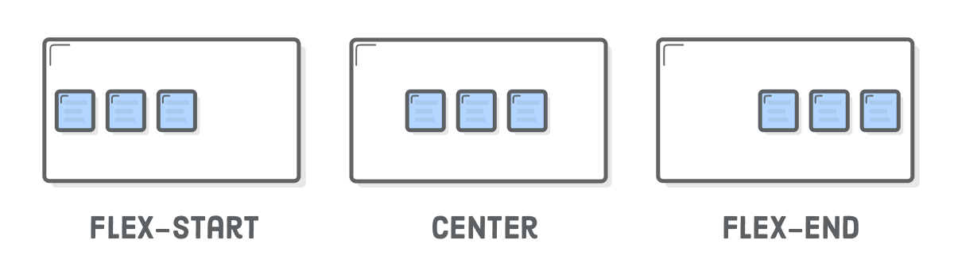
Vertical Alignment of Flex Items

Slide 7
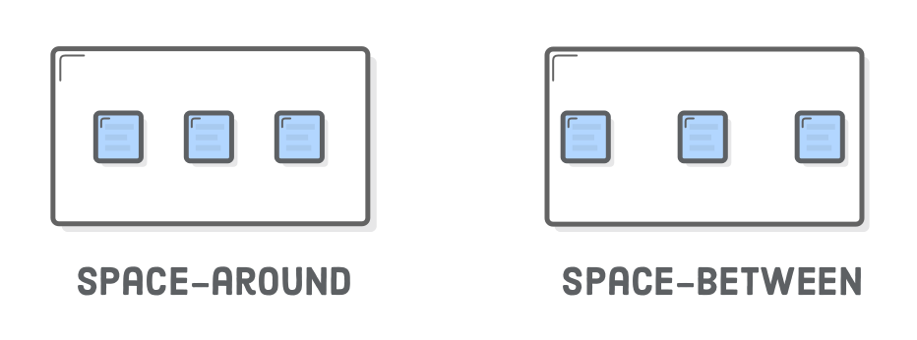
Vertical Alignment of Flex Items

Slide 8
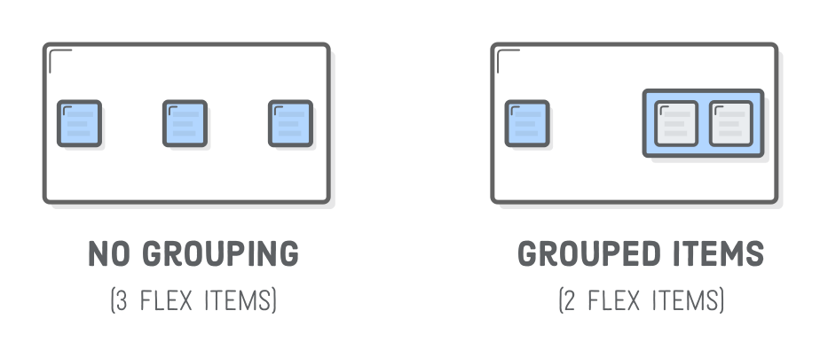
Vertical Alignment of Flex Items

Slide 9
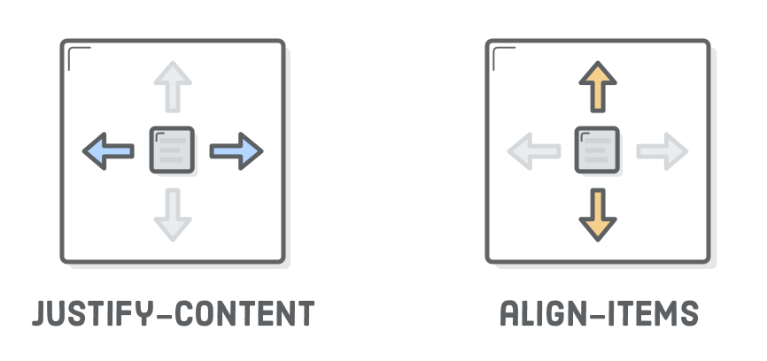
Horizontal Alignment of Flex Items

Slide 10
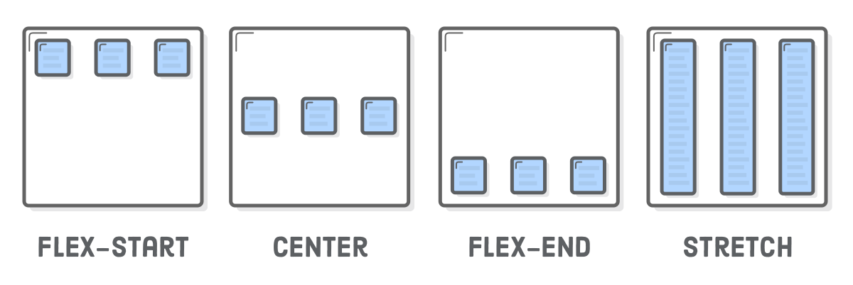
Horizontal Alignment of Flex Items

