Slide 1
Agenda
1. Intro HTML
2. Intro CSS
3. RGB Color Model
4. Selectors
5. Box Models
6. Div Element
7. Float
8. Positioning
9. HTML Tree Structure
10. Web Design
11. Fonts
12. Colors
13. Images
14. Icons

Slide 2
1. Introduction to HTML
HTML: Hypertext Markup Language
HTML documents are described by HTML tags
  <h1>
  <p>
  <a>
Tags mark up the beginning and the end of an element
  <tagname>content</tagname>

Slide 3
2. Introduction to CSS
Cascading Style Sheets
CSS defines how HTML looks like
  HTML is what
  CSS is how

Slide 4
2. Introduction to CSS
3 Ways to import CSS
  1. CSS code inside an HTML tag
  2. CSS code inside an HTML document
  3. CSS code in external file

Slide 5
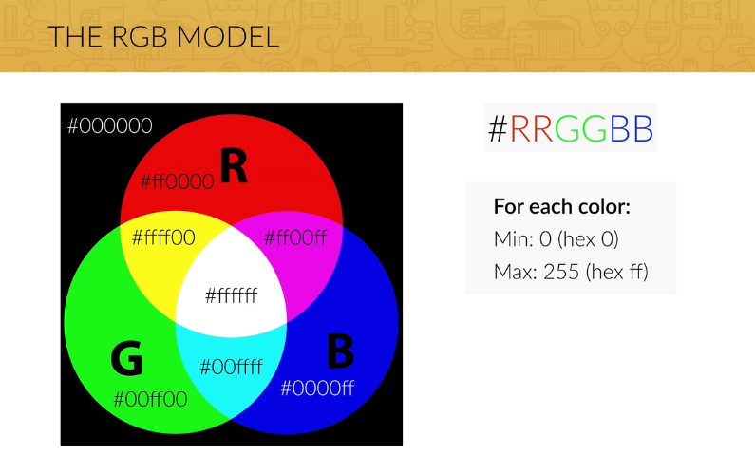
3. RGB Model

Slide 6
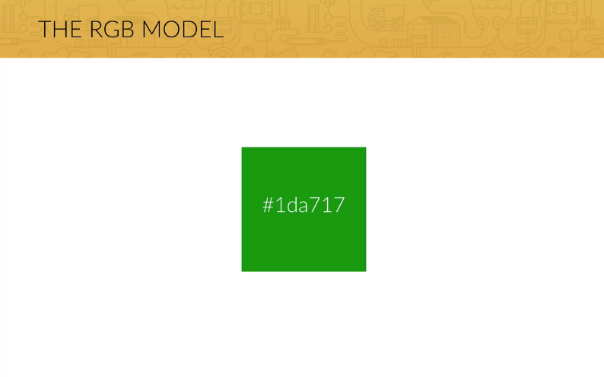
3. RGB Model

Slide 7
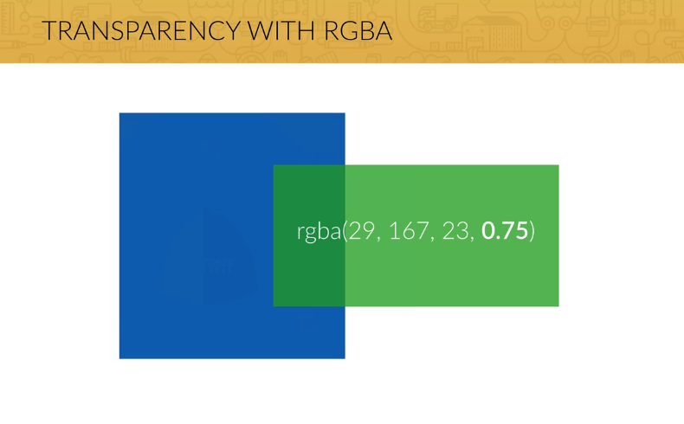
3. RGB Model

Slide 8
4. Selectors
Classes and IDs
  Classes can refer to multiple HTML items
  IDs can only refer to one HTML item

Slide 9
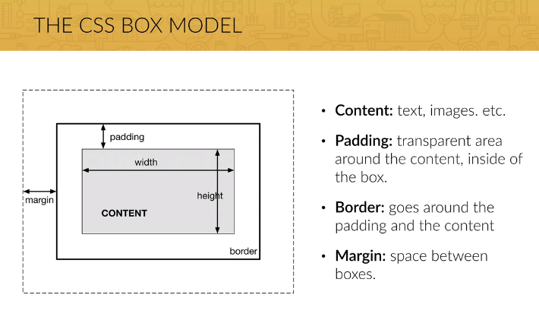
5. Box Model

Slide 10
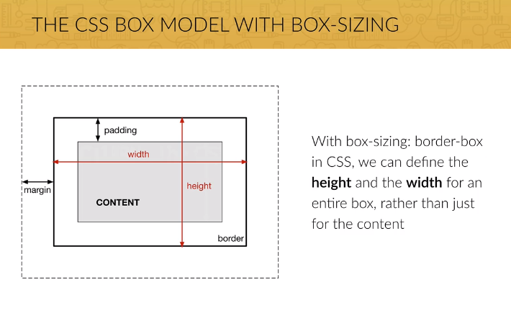
5. Box Model

Slide 11
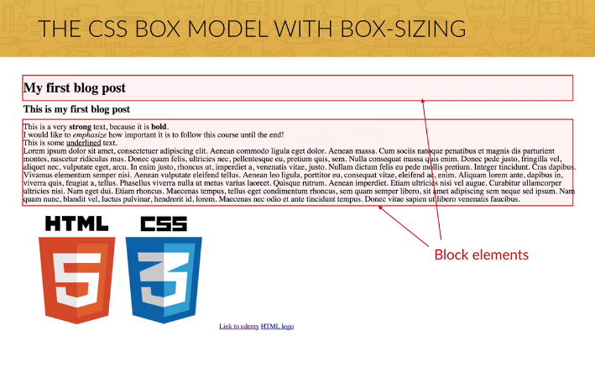
5. Box Model

Slide 12
5. Box Model
Two kinds of elements
  Block: creates a line-break, uses full width of browser
    H1, h2, p, ...
  Inline: does not create a line-break, does not use full width of browser
    strong, em, u, ...

Slide 13
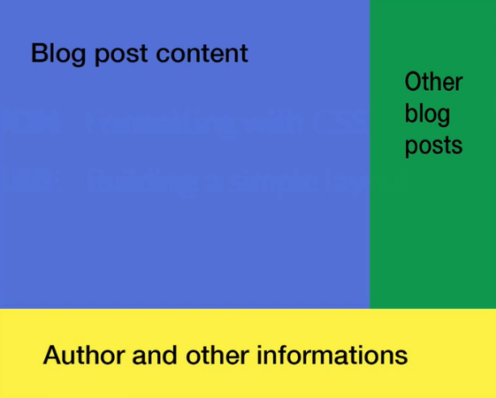

Slide 14
6. DIV Element
DIV: most used element in websites
DIV stands for “divide”
Centering content:
  Margin-left: auto
  Margin-right: auto

Slide 15
7. Float
Pushes an element to
  The left OR
  The right

Slide 16
8. Positioning
Relative
  Parent can be
Absolute
  Parent needs to be positioned relative

Slide 17
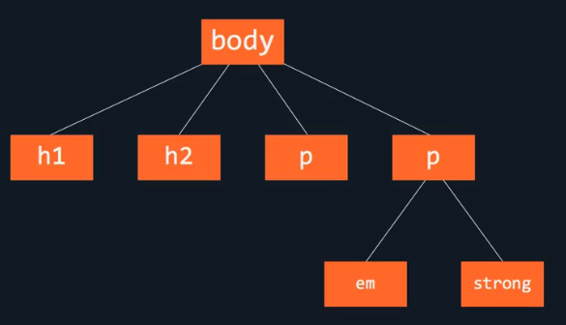
9. HTML Tree Structure

Slide 18
10. Web Design
The Designer creates the look and feel
The Developer builds it.

Slide 19
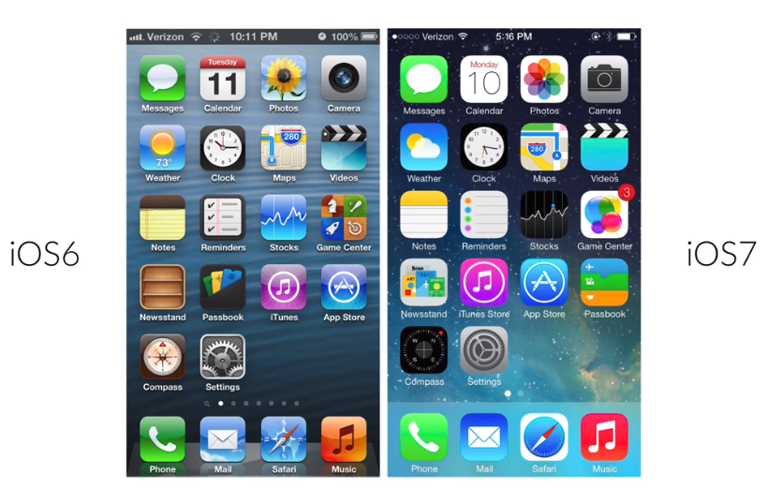
10. Designs

Slide 20
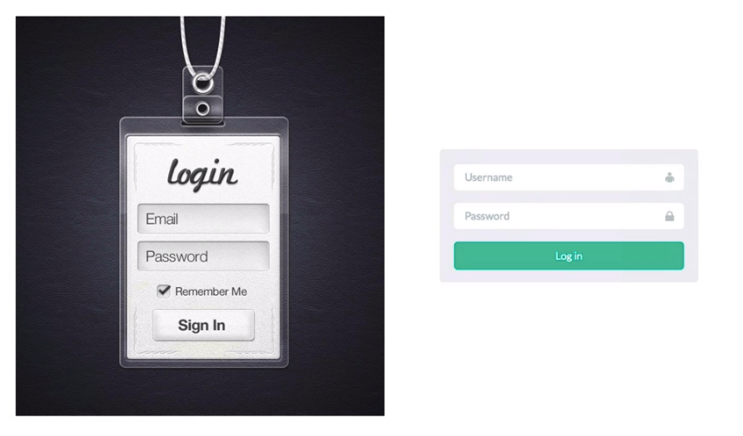
10. Designs

Slide 21
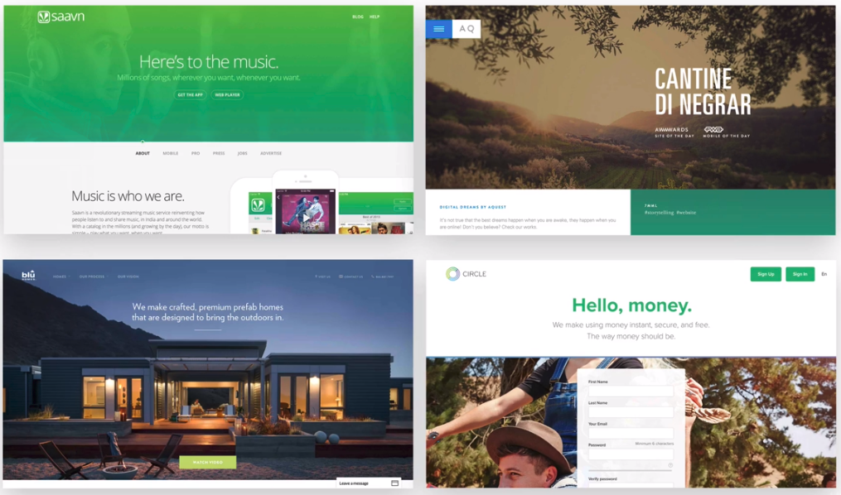
10. Designs

Slide 22
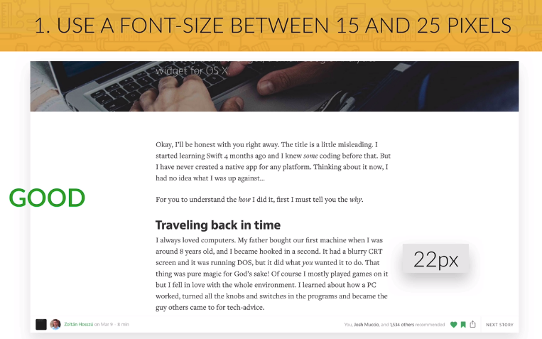
11. Fonts

Slide 23
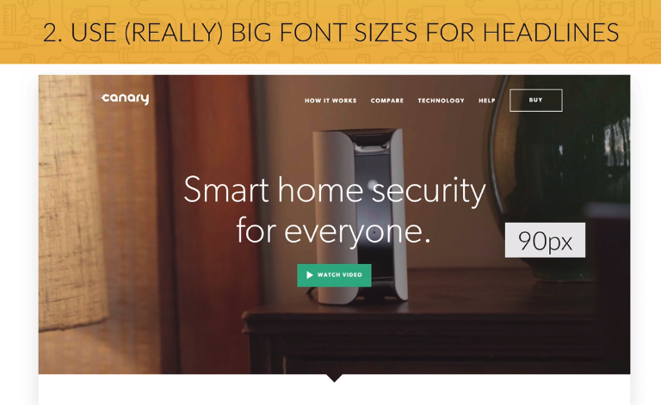
11. Fonts

Slide 24
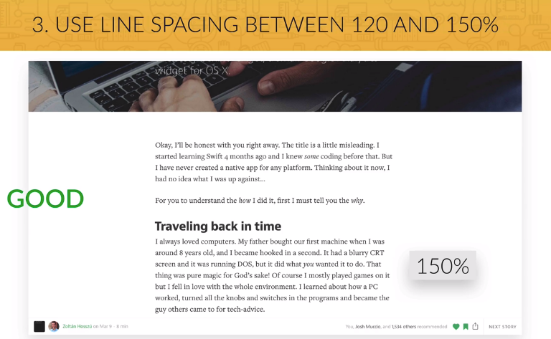
11. Fonts

Slide 25
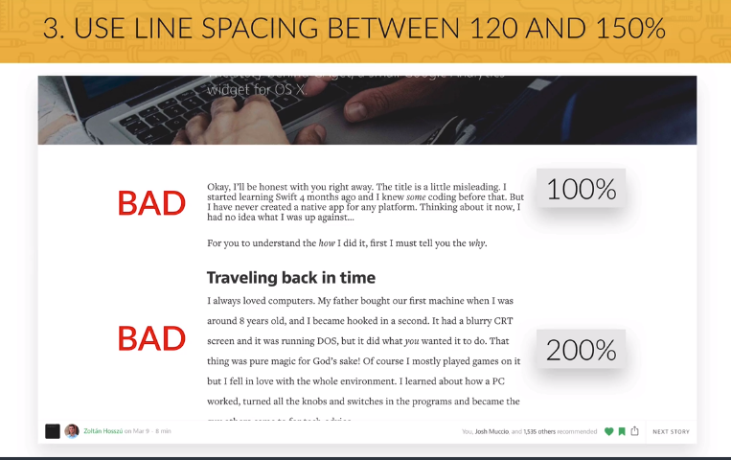
11. Fonts

Slide 26
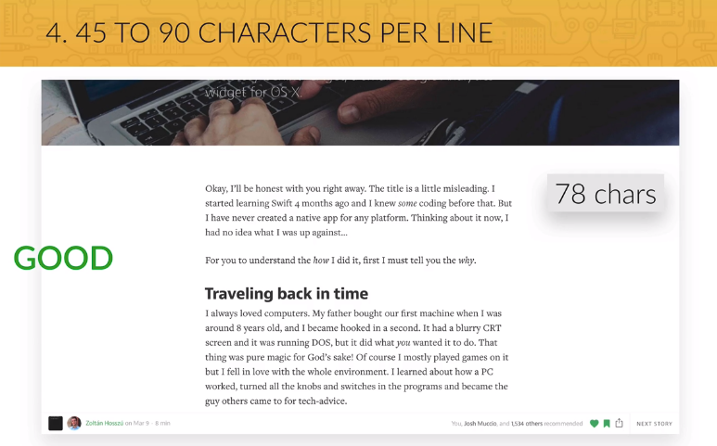
11. Fonts

Slide 27
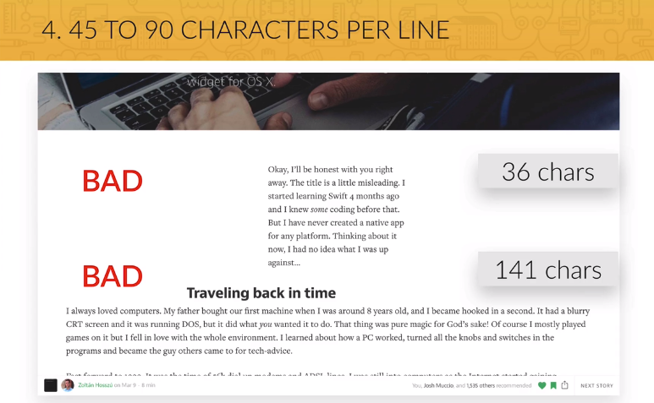
11. Fonts

Slide 28
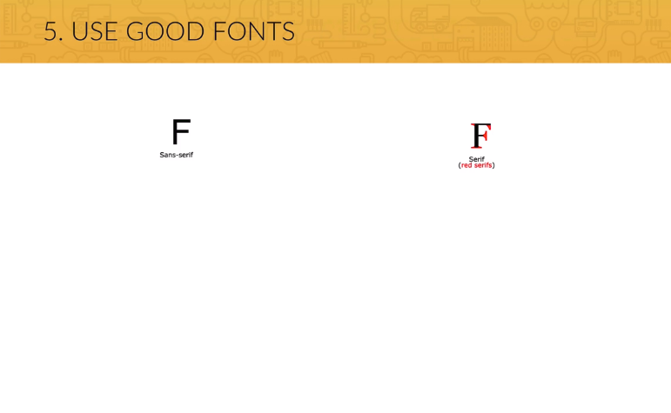
11. Fonts

Slide 29
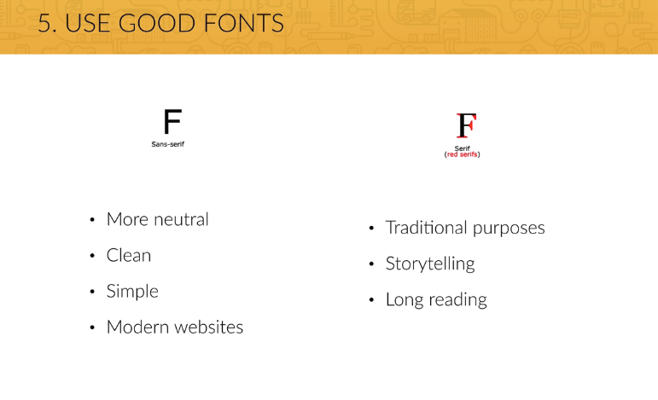
11. Fonts

Slide 30
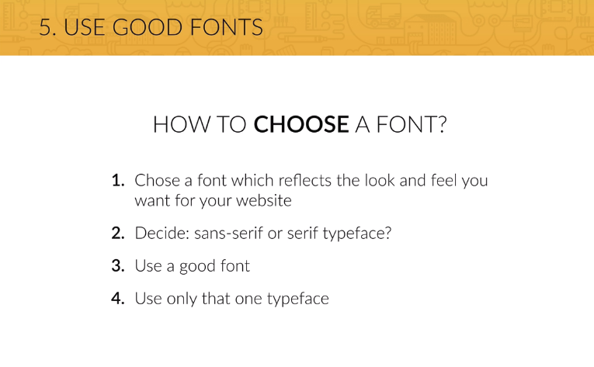
11. Fonts

Slide 31
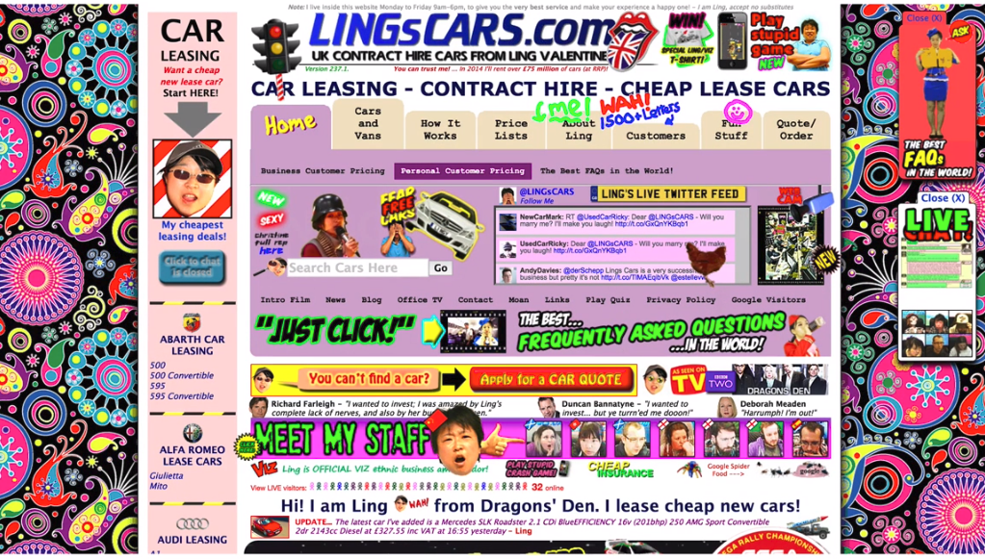
12. Colors

Slide 32
12. Colors
Picking a color for a website means more then picking your favorite color and turning it into a design. It means picking the right color in order to get the desired response from your audience. Color really makes a difference. This happens because there are psychological effects behind each color.

Slide 33
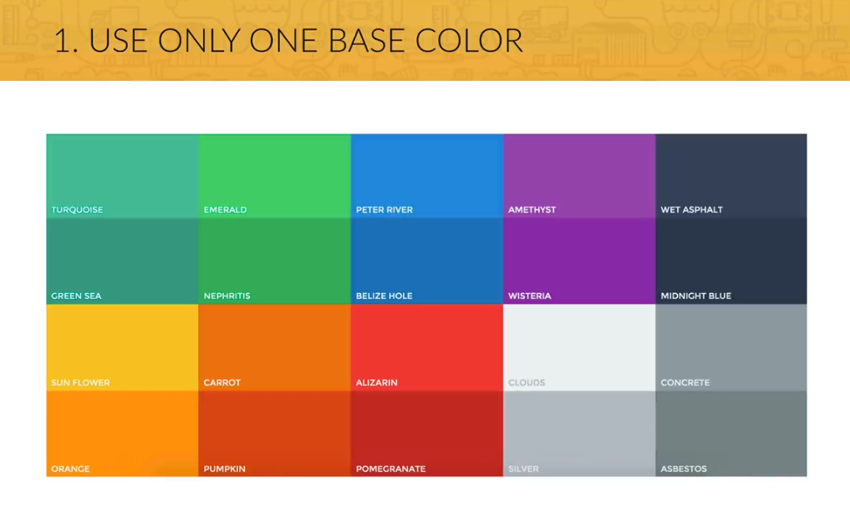
12. Colors

Slide 34
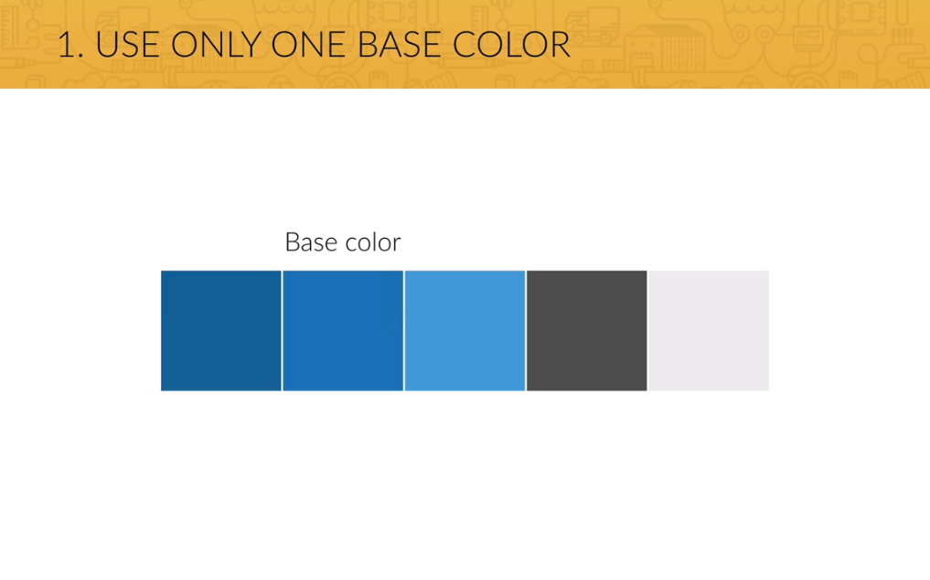
12. Colors

Slide 35
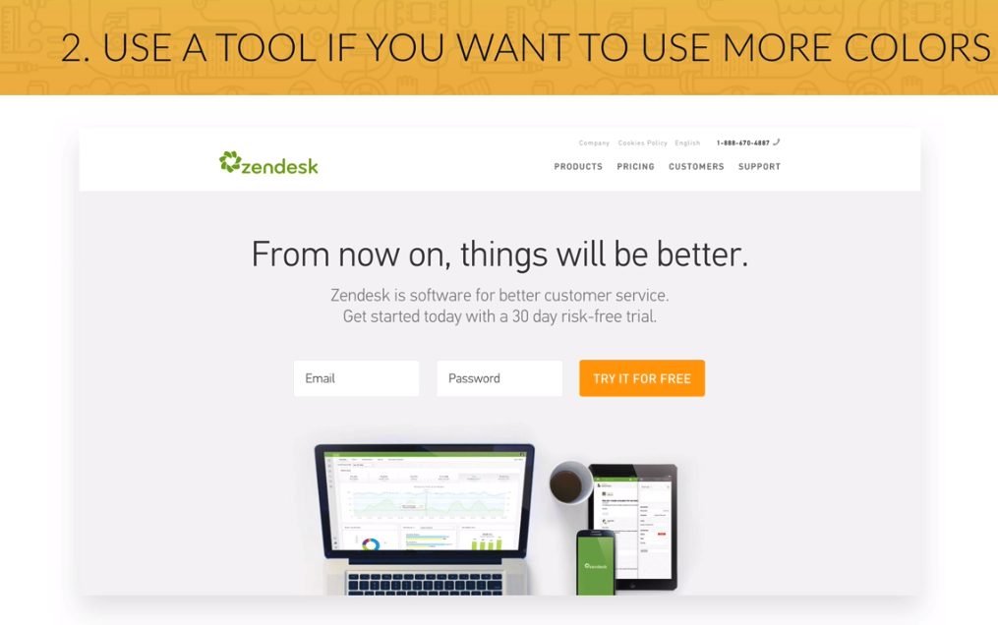
12. Colors

Slide 36
12. Colors
Red is a great color to use when power, passion, strength and excitement want to be transmitted. Brighter tones are more energetic and darker shades are more powerful and elegant.
Orange draws attention without being as overpowering as red. It means cheerfulness and creativity. Orange can be associated with friendliness, confidence, and courage.
Yellow is energetic and gives the feeling of happiness and liveliness. Also, it associates with curiosity, intelligence, brightness, etc.
Green is the color of harmony, nature, life and health. Also, it is often associated with money. In design, green can have a balancing and harmonizing effect.
Blue means patience, peace, trustworthiness, and stability. It is one of the most beloved colors, especially by men. It is associated with professionalism, trust and honor. That's actually why the biggest social networks use blue.
Purple is traditionally associated with power, nobility and wealth. In your design, purple can give a sense of wisdom, royalty, nobility, luxury, and mystery.
Pink expresses romance, passivity, care, peace, affection, etc.
Brown is the color of relaxation and confidence. Brown means earthiness, nature, durability, comfort, and reliability.

Slide 37
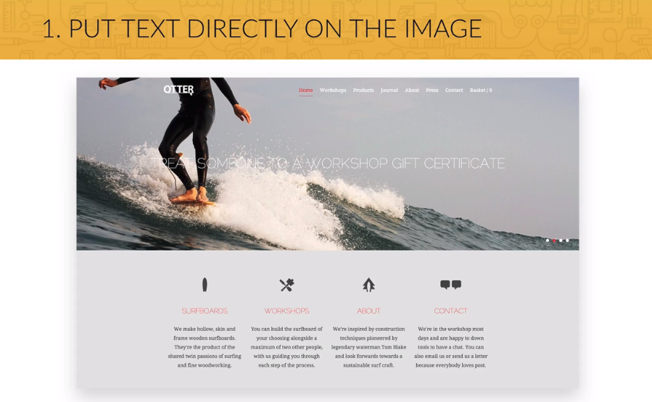
13. Images

Slide 38

13. Images

Slide 39
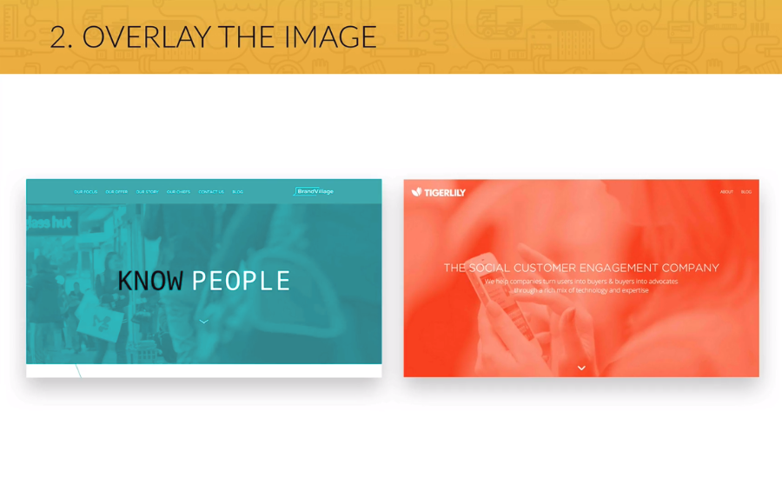
13. Images

Slide 40

13. Images

Slide 41
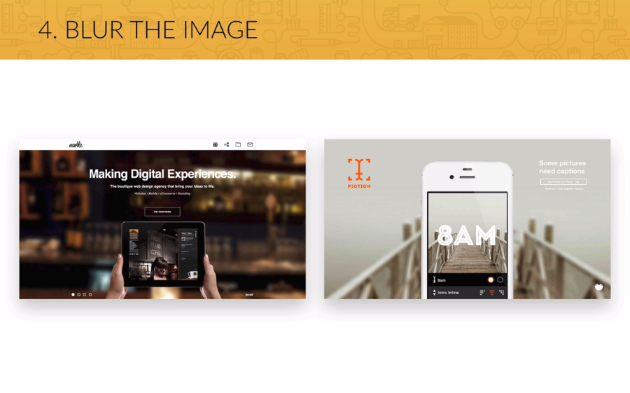
13. Images

Slide 42
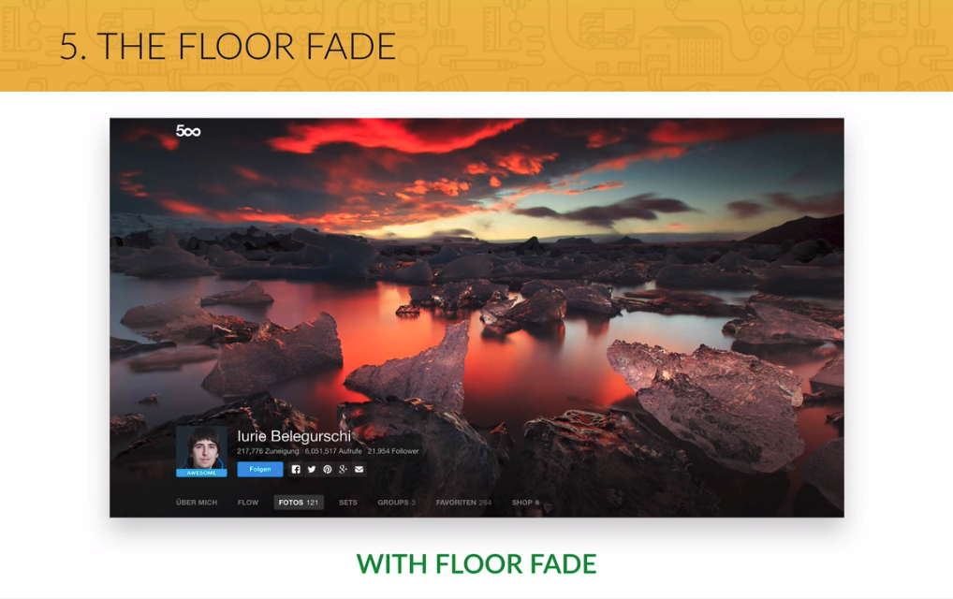
13. Images

Slide 43

14. Icons

Slide 44
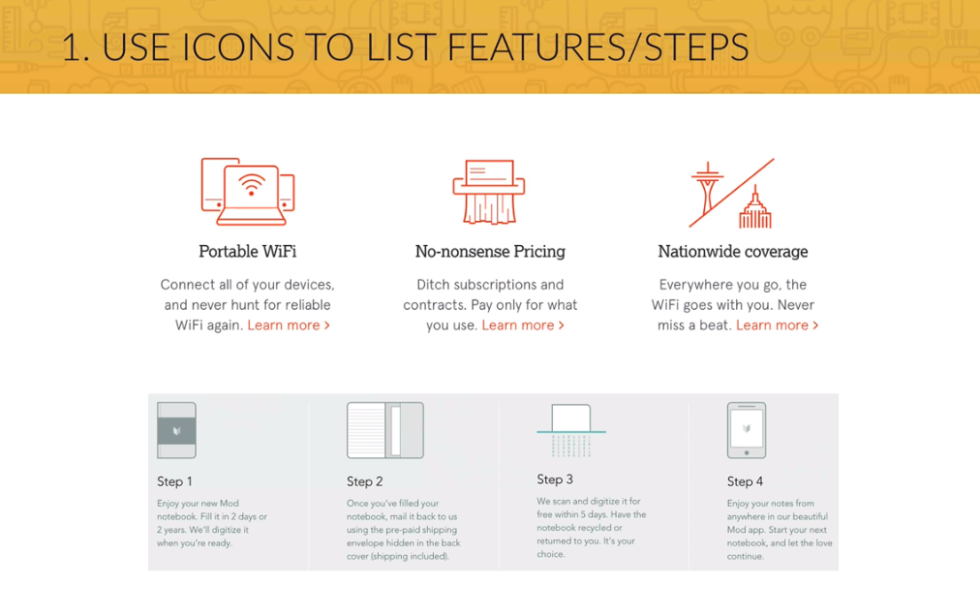
14. Icons

Slide 45
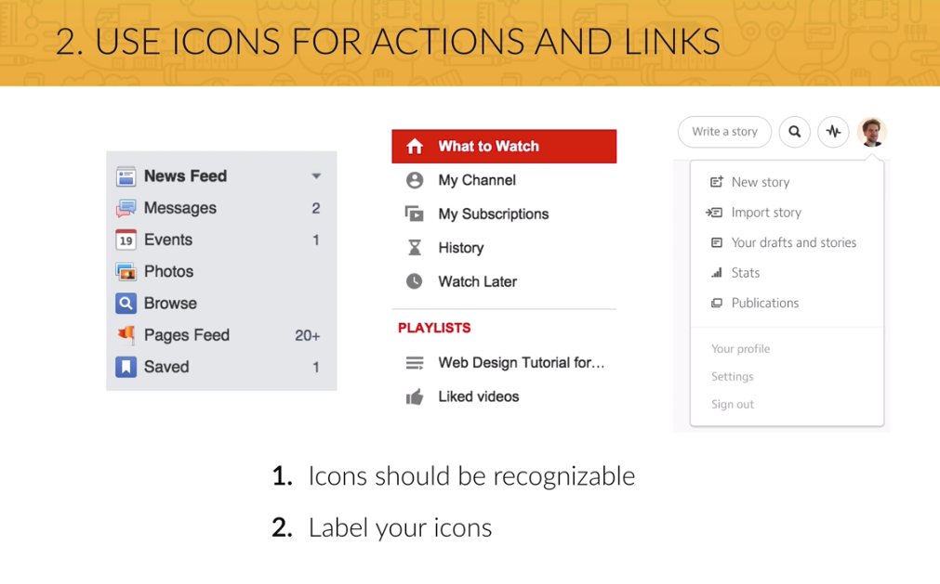
14. Icons

Slide 46
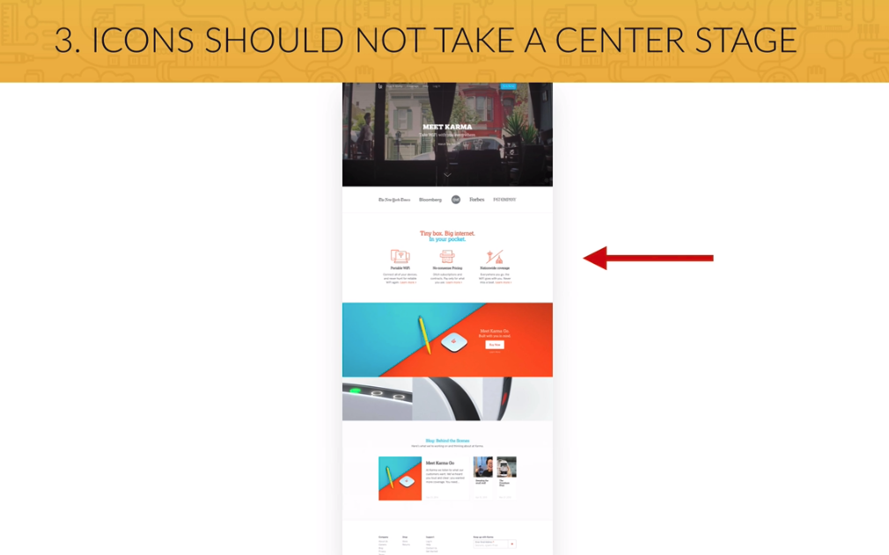
14. Icons

Slide 47
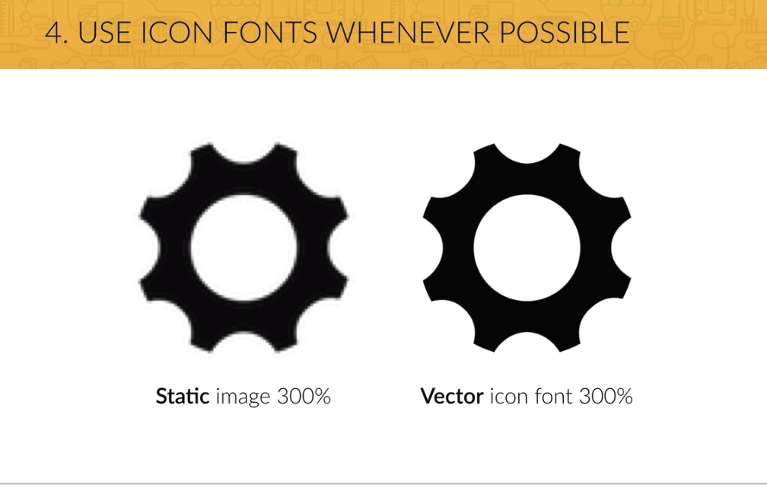
14. Icons

Slide 48
Summary
Most of your content will be text, so beautiful typography is a key element to a good looking website.
Images are getting more and more important in webdesign, so choosing great images and putting text on them is an essential part of your work.
Icons are also a good way of setting a friendly tone for your website, but use them carefully.
The adequate use of whitespace makes a website look professionally designed, so use it a lot, but in the correct way.
Build a layout by defining the visual hierarchy of your content. Whitespace is also important for this.

