Slide 1
Google Maps Project
jan.schulz@devugees.org

Slide 2
Task 1
1 – Pull the latest devugees8 repository
2 – Get an API Key from https://cloud.google.com
3 – Go to jquery/gmproject
4 – Analyze gm_1 – gm_3.html – Try to understand it based on the comments and my explanations. Insert your API Key to test it.
5 – Create the following layout in index.html (next slide)

Slide 3
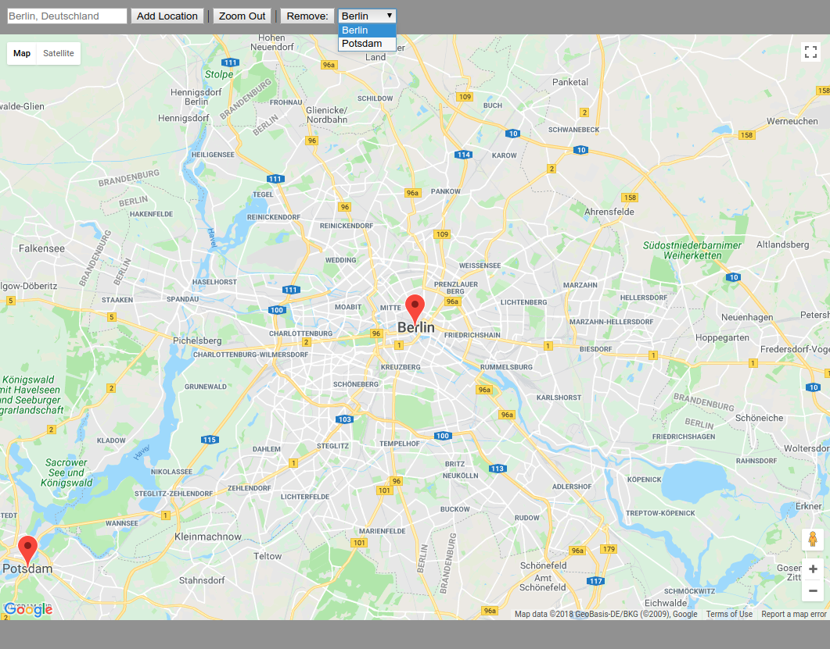

Slide 4
Task 2
6 – Add the following features using Jquery. Before you start, think how you can organize your marker points.

Slide 5
The user can enter a geo code here
Adds the geo code as new marker to the map
Zooms out to zoom level 3
Removes the selected location

Slide 6
Task 3
Extend your app to use a backend with the JQuery AJAX functionality.
1 - Hence, go into the jquery/gmprojectex folder and there install the required node modules using:
$ npm install express body-parser randomstring path
Then, start your server by:
$ node server.js
(you can exit your server by CTRL+C)

Slide 7
Task 3
2 - The files index.html, main.js and style.css are almost empty. Replace these files by your code or integrate your code in them. At the end, it matters that your frontend code works in the new environment.
3 - When the app loads, perform a GET request to /location and retrieve the locations as JSON.
4 - When the user creates a new location, perform a POST request to /location and send a body like { lat: 12.000, lng: 13.000, title: 'Jamaica' }. You will receive an answer like { error:0, location: { id: ‘8rc39dk’, title: ‘Jamaica’, lat: ‘123’, lng: ‘456’ }}. The id field is important to later properly delete a location on the backend.
5 - When the user removes a location, perform a DELETE request to /location like /location/h48ca, whereas "h48ca" is the location id. If a location was deleted, you receive { errorid: 0 }.

