Slide 1
NodeJS Part 2
jan.schulz@devugees.org

Slide 2
Agenda
Middleware
Templates
Relational Databases: SQL

Slide 3
1. Middleware
Middleware: Code that sits between two layers of software
REQUEST
RESPONSE

Slide 4
1. Middleware
Middleware: Code that sits between two layers of software
REQUEST
MIDDLEWARE
RESPONSE

Slide 5
1. Middleware
Middleware: Code that sits between two layers of software
REQUEST
MIDDLEWARE
next()
RESPONSE

Slide 6
1. Middleware
Middleware: creates re-usable ways of dealing with HTTP-requests

Slide 7
2. Templates
A blueprint for HTML-files
Placeholders will be replaced by JavaScript-variables when a template is rendered
<html>
<head></head>
<% if (halloworld) %>
<h2><%=halloworld%></h2>
<% } %>
<body></body>
</html>

Slide 8
2. Templates
Task:
Convert your personal blog to your own NodeJS
server.
1.) Create a static asset /public
2.) Implement a route GET /
3.) Convert your HTML file to an EJS template.
4.) Implement two routes in your app.js
GET /contacts
POST /contacts
for GET /contacts
1. Open a file contacts.json which is in the root folder of the
server.
2. If it does not exist, create it with the initial content “[]“. Otherwise, read its contents and return them
as JSON.
for POST /contacts
1. Open a file contacts.json which is in the root folder of the
server.
2. If it does not exist, create it with the initial content “[]“. Otherwise, read its content and parse it as a
JavaScript object ( an array of objects ).
3. Read the POST body: you should receive 3 variables: name, email and text.
4. Construct an object in which you store name, email and text.
5. Push .4) into the array of 2.)
6. Stringify 5.) as JSON and then save it as contacts.json. (overwrite contacts.json)
5.) Change your IP-address in your $.ajax – Request in your main.js to http://localhost:3000/contacts.
6.) Test it.

Slide 9
EXCOURSE: COMPLEXITY
Becoming a developer is not easy

Slide 10
EXCOURSE: COMPLEXITY
Becoming a developer is not easy
It involves dealing with complexity

Slide 11
EXCOURSE: COMPLEXITY
Becoming a developer is not easy
It involves dealing with complexity
Dealing with complexity:
Divide and Conquer

Slide 12

EXCOURSE: COMPLEXITY
This is complexity. It gives you the feeling of
being overchallenged which is normal.
How can you approach complexity?

Slide 13
EXCOURSE: COMPLEXITY
Divide and Conquer:
Dividing a complex problem into simple problems
will make the complex problem a simple problem.

Slide 14
EXCOURSE: COMPLEXITY
We gather information ...
It is given that:
a,b,x,y > 0
a,b,x,y are natural numbers = { 1,2,3,4, ..., N } without the 0
x + a = 2
b < y
b + 4 = y / 4
b + 1 = 2
... those are all information you need to solve the problem.
Task: Divide and Conquer this problem and solve the equation.

Slide 15
EXCOURSE: COMPLEXITY
Task: Create a route /sum which accepts two
body-parameters x and y and which uses
the method POST. The route /add should
return the sum of x + y as JSON.
I.e. If x = 2 and y = 3, /sum should return
{ “sum“: 5 }
Do not implement it. Analyze this task and until it
appears simple to you! Divide and Conquer!

Slide 16
EXCOURSE: HTTP
Front-End
Back-End

Slide 17
EXCOURSE: HTTP
Front-End
=
HTTP-Client
(Chrome, Firefox, ...)
Back-End
=
HTTP-Server
(NodeJS, PHP, ...)

Slide 18
EXCOURSE: HTTP
What is HTTP?
HTTP: Protocol
Protocol = Set of commands
Most used HTTP-commands
GET: Reading a resource from a server
POST: Creating a new resource on a server
Command is either a ...
REQUEST
RESPONSE

Slide 19
EXCOURSE: HTTP
What is HTTP?
HTTP: Protocol
Protocol = Set of commands
Most used HTTP-commands
GET: Reading a resource from a server
POST: Creating a new resource on a server
Command is either a ...
REQUEST
RESPONSE
How does an HTTP-command look like?

Slide 20
EXCOURSE: HTTP
HEAD
BODY

Slide 21
EXCOURSE: HTTP
HEAD
The request
/GET has an empty body!
BODY

Slide 22
EXCOURSE: HTTP
There are 17 HTTP-REQUESTS
GET -> show me a resource
POST -> create a new resource based on the information in the request‘s body
PUT -> change a resource based on the requests‘ body
DELETE -> delete a resource
...

Slide 23
EXCOURSE: HTTP
There are 50+ HTTP-RESPONSES
200 -> OK, your request was processed completely
304 -> the last 200 was not modified
404 -> resource not found
400 -> bad request, i.e. wrong request head or
body
408 -> timeout, processing the request took too long

Slide 24
EXCOURSE: HTTP
We are dealing with GET and POST requests
GET requests have a head and an empty body
POST requests have a head and an non-empty body

Slide 25
EXCOURSE: HTTP
Client/Server communication example
You open a website www.google.com
HTTP-Client
HTTP-Server
REQUEST: GET /
HEAD: GET /
BODY: (EMPTY)

Slide 26
EXCOURSE : HTTP
Client/Server communication example
You receive an answer from Google.com
HTTP-Client
HTTP-Server
RESPONSE: 200
HEAD: CODE: 200
BODY:
<html>
<head>
</head>
<body>
</body>
</html>

Slide 27
EXCOURSE : HTTP
Client/Server communication example
You post a new contact request to your localhost/contacts
HTTP-Client
HTTP-Server
REQUEST: POST /
HEAD: POST /contacts
BODY:
{
name: “Jan“,
email: jan.schulz@cileria.com,
text: “Hallo World“
}

Slide 28
EXCOURSE : HTTP
Client/Server communication example
You receive an answer from localhost
HTTP-Client
HTTP-Server
RESPONSE: 200
HEAD: CODE: 200
{
errorCode: “0“
}

Slide 29
EXCOURSE: HTTP
What‘s the purpose of browsers like Chrome/Firefox/etc. ?

Slide 30
EXCOURSE: HTTP
What‘s the purpose of browsers like Chrome/Firefox/etc. ?
They
GET the HTML, JavaScript and CSS

Slide 31
EXCOURSE: HTTP
What‘s the purpose of browsers like Chrome/Firefox/etc. ?
They
GET the HTML, JavaScript and CSS
Render a website using HTML and CSS

Slide 32
EXCOURSE: HTTP
What‘s the purpose of browsers like Chrome/Firefox/etc. ?
They
GET the HTML, JavaScript and CSS
Render a website using HTML and CSS
Compile JavaScript and make the website interactive.

Slide 33
EXCOURSE: HTTP
Task: 25 mins
Describe the difference between frontend and backend development.
Describe the difference between JavaScript run in your browser and JavaScript run on your NodeJS-server.
Describe the difference between $.get() (Jquery) and app.get() (NodeJS).
Do you have access on your DOM-elements in your NodeJS – application?
Do you have access to the filesystem (i.e. “/home/user/halloworld.txt“) from our frontend code?

Slide 34
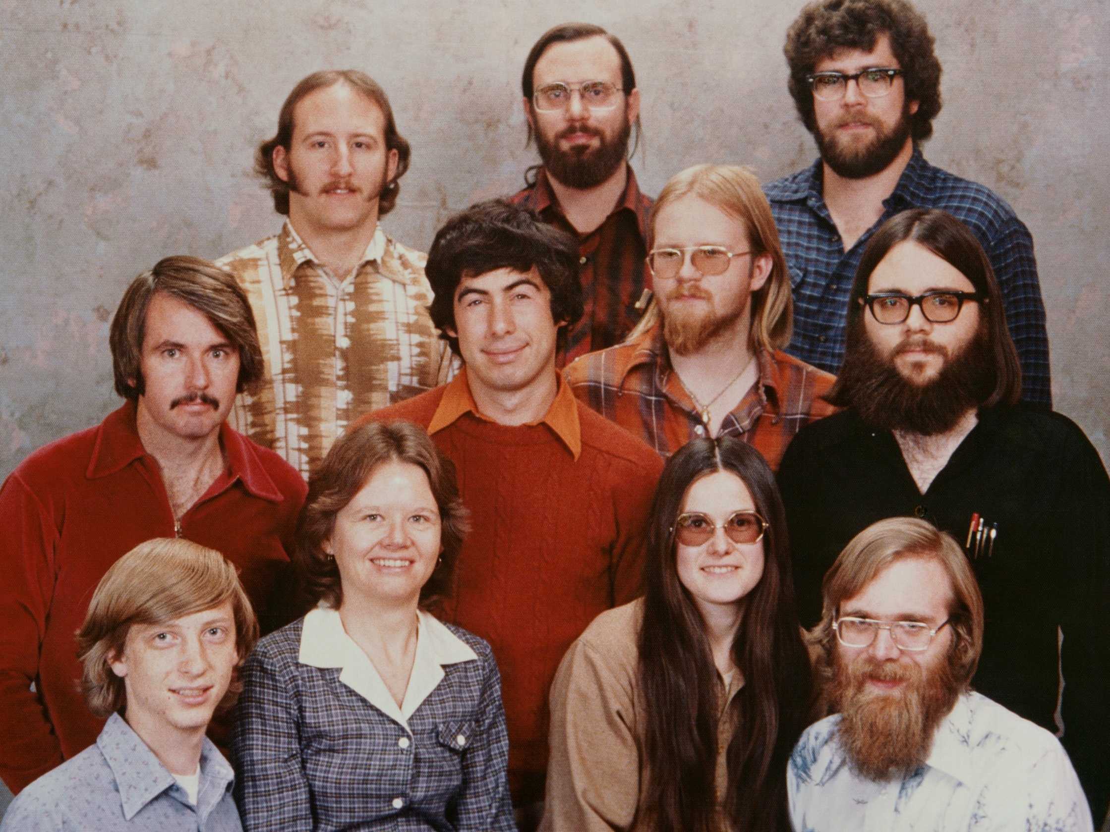
EXCOURSE: Teamwork

Slide 35
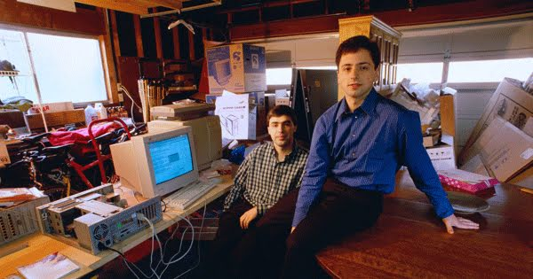
EXCOURSE: Teamwork

Slide 36

EXCOURSE: Teamwork

Slide 37
EXCOURSE: Teamwork
It is only fun working with excellent people.

Slide 38
EXCOURSE: Teamwork

Slide 39
EXCOURSE: Teamwork
However, Hard-Skills are a precondition.
Without any Hard-Skills, Soft-Skills become meaningless. The team does not need you.
=> The 5th Weel. No success.
Without any Soft-Skills, the team does not want you and takes the first chance of getting rid of you.
=> The person non-grata. Low success.

Slide 40
EXCOURSE: Teamwork
Perfect Developer:
Excellent Communicator
+
Very Good Developer

Slide 41

EXCOURSE: Teamwork
What does this picture tell you?

Slide 42
3. Relational Databases - SQL
Relational Database:
ID | Firstname | Lastname
17 | John | Doe

Slide 43
3. Relational Databases - SQL
Relational Database:
ID | Firstname | Lastname
17 | John | Doe
Person | Street | Number
17 | Main Street | 2

Slide 44
3. Relational Databases - SQL
Relational Database:
ID | Firstname | Lastname
17 | John | Doe
Person | Street | Number
17 | Main Street | 2
Task: How would this look as JavaScript Object?

Slide 45
3. Relational Databases - SQL
{
firstname: ‘John‘,
lastname: ‘Doe‘,
address: {
street: ‘Main Street‘,
number: 2
}
}

Slide 46
3. Relational Databases - SQL
Task:
Implement two routes for your personal blog NodeJS server.
GET /contact
Lists all of your contact requests
POST /contact
Creates a new contact request.
Note: Create a MySQL database and a table for this.

