Slide 1
NodeJS Part 4
Jan.schulz@devugees.org

Slide 2
1. Agenda
Build-Tools
Scaffolding
ECMA Script 2015/2016
Cross Origin Response Header
Our Backend
Sending Mails in Node

Slide 3
1. Build-Tools
A Build-Tool is a NodeJS module that helps us
to automate tasks.

Slide 4
1. Build-Tools
1. Chrome & Firefox do not understand SASS and
LESS ...
2. Uglify + Minify
Minify JS = ...
Uglify = ...
3. Live-Reload ...
4. Show JS-Errors ...
5. Front & Backend Development is separated
6. Incompatibility to ES2016
i.e. ‘import‘ not supported by older browsers

Slide 5
1. Build-Tools
1. Chrome & Firefox do not understand SASS and
LESS ... Transpile it to CSS
2. Uglify + Minify
Minify JS = Make the source code size small
Uglify = Make the source code unreadable
3. Live-Reload ... Run a livereload server
4. Show JS-Errors ... Fix JS errors faster
5. Front & Backend Development is separated ...
npm run can start them both using one command
6. Incompatibility to ES2016
i.e. ‘import‘ not supported by older browsers
Transpile to previous verson

Slide 6
1. Build-Tools
7. Bundling:
index.js
carousel.js
product-grid.js

Slide 7
1. Build-Tools
7. Bundling:
index.js
carousel.js
bundle.js
product-grid.js
WHY ?

Slide 8
1. Build-Tools
7. Bundling:
Without bundling, the browser has to load 3 files one by one.
SLOW!
Loading 1 file is FASTER.
index.js
carousel.js
bundle.js
product-grid.js

Slide 9
1. Build-Tools
Webpack
Gulp
Browserify
NPM scripts
Grunt
They are quite similar. It comes down to personal preference.

Slide 10
1. Build-Tools
Webpack ← We learn Webpack
Gulp
Browserify
NPM scripts
Grunt

Slide 11
2. Scaffolding
?

Slide 12

2. Scaffolding

Slide 13
2. Scaffolding
Scaffolding: Building an app with a shared preset of configuration.
Other people may build their apps with the same preset as you

Slide 14
2. Scaffolding
Scaffolding: Building an app with a shared preset of configuration.
Other people may build their apps with the same preset as you
Neutrino is Scaffolding for Webpack.

Slide 15
3. ECMA Script 2015/2016
ECMA-Script 2016 is JavaScript with new features shown by new syntaxes

Slide 16
3. ECMA Script 2015/2016
Arrow Functions, mostly used for anonymous callback functions
Reduce verbosity
Not used for function constructors
sayWhat( function() { return ‘what‘; } );
=
sayWhat( ( ) => { return ‘what‘; } );

Slide 17
3. ECMA Script 2015/2016
Arrow Functions can also have names
var x = () => { return ‘hallo world‘; }
=
var x = function() { return ‘hallo world‘; }

Slide 18
3. ECMA Script 2015/2016
Importing other frontend modules
import halloWorld from ‘./halloworld.js‘;
Since we Webpack-Bundling, we avoid to
include by <script> Tag.
Webpack will generate the HTML file with one
<script src=“bundle.js“> for us.

Slide 19
3. ECMA Script 2015/2016
Exporting frontend modules
export default function halloWorld() {
$(‘body‘). html(‘hallo world‘);
}
(default means one function per module)

Slide 20
3. ECMA Script 2015/2016
const: Illegal to reassign identifier, legal to mutate
const x = 1;
x = 2;
const obj = {};
obj.x = 1;
obj.y = 2;
obj = {hallo: ‘world‘};

Slide 21
3. ECMA Script 2015/2016
var and let: Legal to reassign variable and to
mutate
var x = 1;
x = 2;
var obj = {};
obj.x = 1;
obj.y = 2;
obj = {hallo: ‘world‘};

Slide 22
3. ECMA Script 2015/2016
var and let
for(var i=0;i<10;i++) {
// i exists here
}
// i exists here

Slide 23
3. ECMA Script 2015/2016
var and let
for(let i=0;i<10;i++) {
// i exists here
}
// i does NOT exists here

Slide 24
3. ECMA Script 2015/2016
Destructuring
var obj = {x:1, y:2}
var { x } = obj;
=
var obj = {x:1,y:2}
var x = obj.x;

Slide 25
4. Cross Origin Resource Sharing
Cross Origin Response Headers (CORS) are part of the HTTP – response of a server.
It allows responding to HTTP-Clients which are outside of the current domain.
Examples for domains?

Slide 26
4. Cross Origin Resource Sharing
Cross Origin Response Headers (CORS) are part of the HTTP – response of a server.
It allows responding to HTTP-Server which are outside of the current domain.
Examples for domains?
youtube.com, google.com, facebook.com, localhost
Example for subdomains?
WWW.youtube.com, API.youtube.com, API.facebook.com

Slide 27
4. Cross Origin Resource Sharing
CORS prevents servers from sending data to unauthorized HTTP-Clients, i.e.
HTTP-Client does
AJAX on
www.facebook.com
Backend
www.facebook.com
Facebook Frontend
Facebook
Backend

Slide 28
4. Cross Origin Resource Sharing
CORS prevents servers from sending data to unauthorized HTTP-Clients, i.e.
Checked by our browser
HTTP-Client does
AJAX on
Localhost
Backend
www.facebook.com
Localhost
Frontend
Facebook
Backend

Slide 29
4. Cross Origin Resource Sharing
Domains can also be separeted by ports
In our case we will develop on a
frontend with port 5000
Backend with port 9090
Therefore, we will enable all CORS
When we deliver our Devugees-Shop, we will only have one port 80

Slide 30
5. Online-Shop
Let‘s integrate Express ...
5000
9090
Frontend
Backend

Slide 31
5. Online-Shop
Task:
1. Implement database access for the routes
/products and /categories to our online shop.
2. Use the database to create a new category “Smart Phone“ and add 6 new products:
- Samsumg Galaxy S6, S7, S8
- Iphone 10, 11 and 12
3. Find a new picture and integrate it.

Slide 32
5. Online-Shop
Task:
4. Until we implement signup and login, we will load a testuser from the database into our localStorage.
Therefore, randomly select one user from the database when the document loads and put the data into the localStorage.

Slide 33
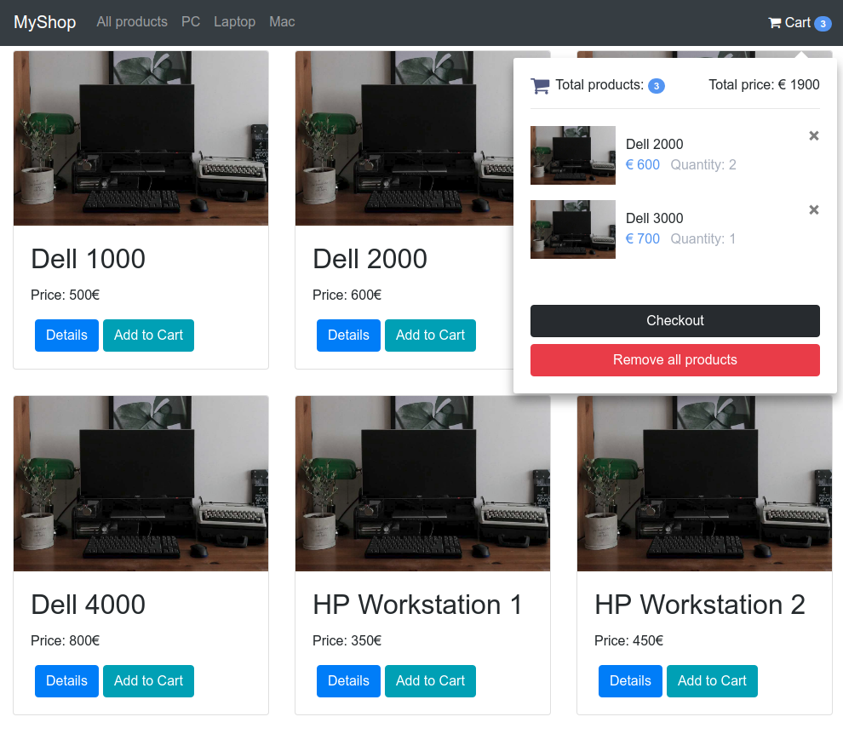
5. Online-Shop
Order-Process

Slide 34
5. Online-Shop
Order-Process
Choose Products

Slide 35
5. Online-Shop
Order-Process
Choose Products
Go to Cart

Slide 36
5. Online-Shop
Order-Process
Choose Products
Go to Cart
Go to checkout

Slide 37
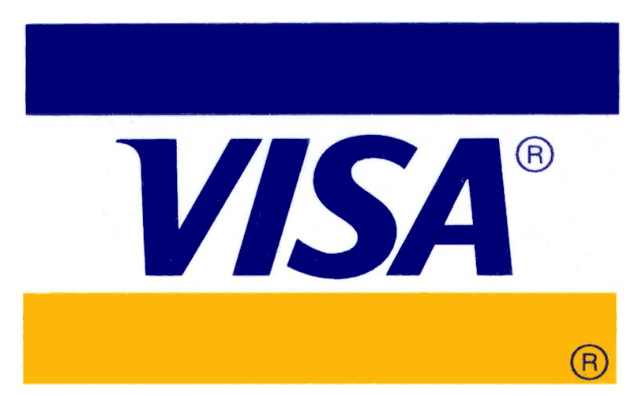


5. Online-Shop
Choose Payment:
Total Price: 1200,00 €
Confirm Address:
localStorage
Hans Meier
Mustestreet 20
13353 Berlin
Buy

Slide 38
5. Online-Shop
Checkout-Process
Choose Payment Method

Slide 39
5. Online-Shop
Checkout-Process
Choose Payment Method
Confirm
Address

Slide 40
5. Online-Shop
Checkout-Process
Choose Payment Method
Confirm
Address
Buy

Slide 41
5. Online-Shop
Task:
1. Create a new table “payment_method“. What
fields do we need? What is the relation to the order table?
Insert four payment methods VISA, SEPA, Bitcoin and PayPal.

Slide 42
5. Online-Shop
Task:
2. Create a new POST route /order that creates a
new order. What tables are affected as well?
Think of the SQL-statements carefully.

Slide 43
ES2016 - class
class is the new syntax for defining a function constructor inclusively prototype-chain in ES2016
Is based on the languages Java, C# and C++
Its not a new concept -> just a new syntax.

Slide 44
6. Email-Notifications
Email-Notifications are an essential part of each web-services.
Examples?

Slide 45
6. Email-Notifications
Email-Notifications are an essential part of each web-services.
Examples?
- Account Registration
- Account Activation
- Transactions (New orders, new messages, new payments etc.)
- Last Login IP (Facebook, Google, Online- Banking, Crypto-Wallets, etc.)
- Newsletters
- News

Slide 46
6. Email-Notifications
SMTP: Send Mail Transfer Protocol
A server that sends out Emails to Email recipients

Slide 47
6. Email-Notifications
SMTP: Send Mail Transfer Protocol
A server that sends out Emails to Email recipients
POP3/IMAP
A server that receives emails
Difference between POP3 and IMAP
POP3 makes the

Slide 48
6. Email-Notifications
Email Clients
A program that connects to an IMAP/POP3 server and an SMTP server in order to receive and send emails
Examples?

Slide 49
6. Email-Notifications
Email Clients
A program that connects to an IMAP/POP3 server and an SMTP server in order to receive and send emails
Examples?
Microsoft Outlook
Mozilla Thunderbird
Gmail.com -> WebClient
Yahoo.com -> WebClient
...

Slide 50
6. Email-Notifications
IMAP/POP3
SMTP
Receive
Send
Email-Client

Slide 51
6. Implementing Email-Notifications
Task:
Set all email addresses of each shop customer to your private email address.
Create new Gmail email (i.e. devugees_shop2017@gmail.com) address which we want to use for notifying our Shop-Customers.

Slide 52
6. Implementing Email-Notifications
Task:
Create a node module mailnotifier which exports one function sendMail(recipientAddress, subject, body) that sends an email to recipientAddress, when an order has been placed.
Subject: “Your Order at Devugees-Shop“
Body:
„Dear $FIRSTNAME,
Thank you for your order of $ORDER_VALUE.
We which you a nice day.
Your Devugees-Shop Team.“

Slide 53
7. Adding Config-Files
Since we do not want to store our email-server or database passwords/etc. in our source, we may store them in config-files that will initially be loaded when the server starts
We do were store them?

Slide 54
7. Adding Config-Files
Since we do not want to store our email-server or database passwords/etc. in our source, we may store them in config-files that will initially be loaded when the server starts
We do were store them?
Lets store them in the home-folder of the current user via

