Slide 1
NodeJS Part 5
jan.schulz@devugees.org

Slide 2
Agenda
Protected Routes
Authentication & Authorization
HTTP Authentication
HTTP Authorization
JSON WebTokens – JWT

Slide 3
1. Protected Routes
Routes in our Express-App look like this:
/
/api
/customers
...

Slide 4
1. Protected Routes
Routes in our Express-App look like this:
/
/api
/customers
...
What if we want to protect them from certain users? I.e. users, that are unknown to us.

Slide 5
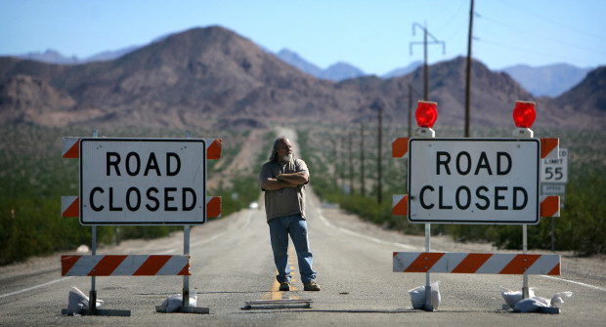

Slide 6
1. Protected Routes
The guy asks for username and password!

Slide 7
1. Protected Routes
The guy asks for username and password!
You say your username is “hallo“ and your password is “world“.

Slide 8
1. Protected Routes
The guy asks for username and password!
You say your username is “hallo“ and your password is “world“.
The guy looks up “hallo“ and “world“ in his database and finds you.

Slide 9
1. Protected Routes
The guy asks for username and password!
You say your username is “hallo“ and your password is “world“.
The guy looks up “hallo“ and “world“ in his database and finds you.
You are now authenticated as known user and you get your ticket which authorizes you to drive along the road.

Slide 10
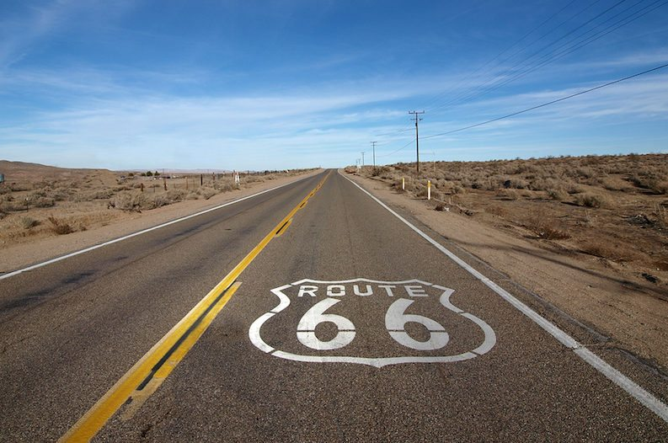

Slide 11
2. Authentication & Authorization
Authentication: is the process of verifying that the
user is somebody the system knows.
Authorization: is the process of verifying that the
user has access to something the system owns.
Ticket: A proof that the users is authorized. Mostly
it is a token.

Slide 12
3. HTTP Authentication
USER
HTTP
SERVER

Slide 13
3. HTTP Authentication
USER
HTTP
SERVER
POST /login
{
username: ‘hallo‘,
password: ‘world‘
}

Slide 14
3. HTTP Authentication Flow
USER
HTTP
SERVER
POST /login
{
username: ‘hallo‘,
password: ‘world‘
}
RESPONSE /login
{
token: ‘fDjbn8fnVn‘
}

Slide 15
3. HTTP Authentication
USER
HTTP
SERVER
POST /login
{
username: ‘hallo‘,
password: ‘world‘
}
RESPONSE /login
{
token: ‘fDjbn8fnVn‘
}
<- TICKET HERE

Slide 16
3. HTTP Authorization
USER
HTTP
SERVER
GET /customers
HEADER: authorization Bearer fDjbn8fnVn

Slide 17
3. HTTP Authorization
USER
HTTP
SERVER
GET /customers
HEADER: authorization Bearer fDjbn8fnVn
<- TICKET HERE

Slide 18
3. HTTP Authorization
USER
HTTP
SERVER
GET /customers
HEADER: authorization Bearer fDjbn8fnVn
RESPONSE /customers
<HTML>
<body>...</body>
</HTML>

Slide 19
4. JSON WebTokens
Tokens need to be encrypted.
Why?

Slide 20
4. JSON WebTokens
Tokens need to be encrypted.
The server needs to make sure the token is created by the server itself.
Hackers may fake tokens in order to get authorization.
SIGNATURE/KEY to
Encrypt
Decrypt
... the data

