Slide 1
JavaScript
For Beginners
Part 1
jan.schulz@devugees.org

Slide 2
Agenda
1. Introduction to JavaScript
2. Variables & Data-Types
3. If / Else Statements
4. Boolean Logic
5. Switch Statement
6. First Coding Challenge
7. Functions
8. Arrays
9. Objects
10. Loops
11. Second Coding Challenge

Slide 3
1. Introduction to JavaScript
JavaScript is a lightweight, cross-platform, object-oriented computer programming language
JavaScript is one of the tree core technologies of web development
JavaScript is most commonly used as a part of webpages
Today, JavaScript can be used in different places:
Client-side: JavaScript was traditionally only used in the browser
Server-side: Thanks to node.js, we can use JavaScript on the server as well
JavaScript is what made modern web-development possible:
Dynamic effects and interactivity
Modern web applications that we can interact with

Slide 4
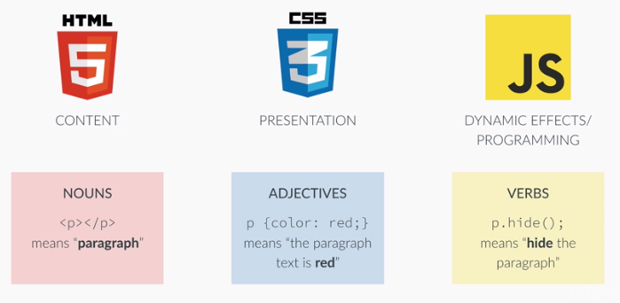
1. Introduction to JavaScript

Slide 5
2. Variables & Data-Types
Variable: A container in which we can store a value in order to use it later again in our code
1) Create a folder
2) Create a index.html
3) Create a main.js

Slide 6
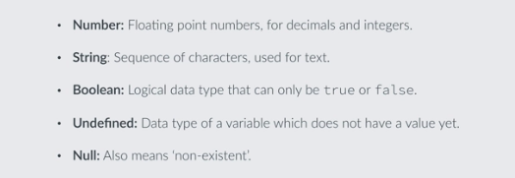
2. Variables & Data-Types

Slide 7
2. Variables & Data-Types
Operator Precedence
https://developer.mozilla.org/de/docs/Web/JavaScript/Reference/Operators/Operator_Precedence

Slide 8
3. If / Else Statements
if ( conditional statement ) {
do something;
} else {
do something else;
}

Slide 9
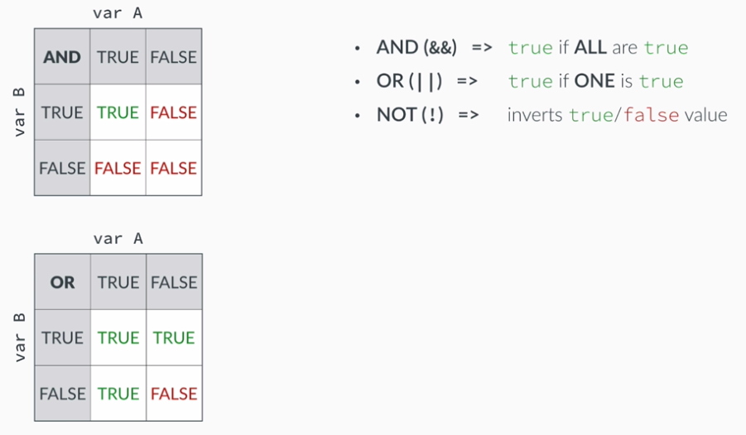
4. Boolean Logic

Slide 10
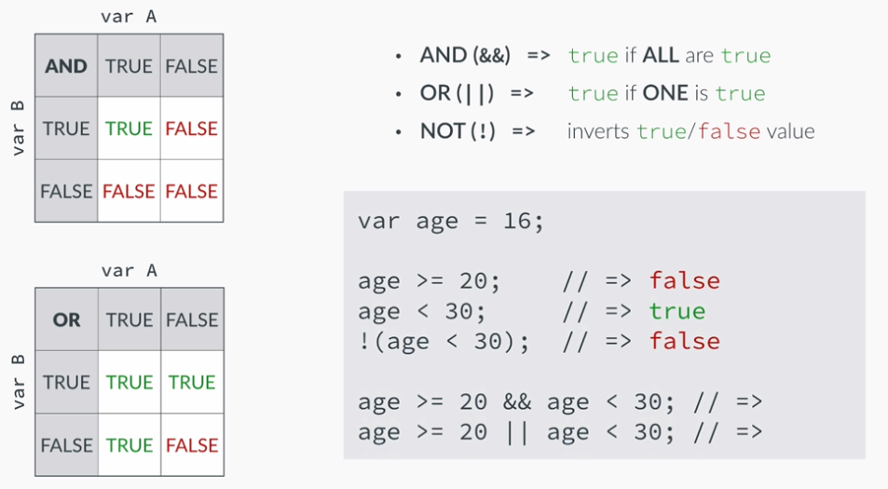
4. Boolean Logic

Slide 11
5. Switch Statements
switch( conditional statement ) {
case expression:
do something;
break;
case another expression:
do something else;
break;
default:
do something different else;
break;
}

Slide 12
6. Coding Challenge
John and a friend invented a simple game where the player with the highest value of his height (in centimeters) plus five times his age wins (what a silly game :)
1. Create variables for the heights and ages of two friends and assign them some values
2. Calculate their scores
3. Decide who wins and print the winner to the console. Include the score in the string that you output to the console. Don't forget that there can be a draw (both players with the same score).
4. EXTRA: Add a third player and now decide who wins. Hint: you will need the && operator to take the decision. If you can't solve this one, just watch the solution, it's no problem :)

Slide 13
7. Functions
Re-Usable piece of code
Containers that hold lines of code
Functions CAN return results
DRY principle: Don’t repeat yourself
function doubleMe( x ) {
return 2 * x;
}

Slide 14
8. Arrays
A list of things, e.g. values
var names = [‘John’, ‘Jane’, ‘Mark’];

Slide 15
9. Objects
A set of key-value pairs
Do not have particular order like in Arrays
var obj = {
name: ‘John’,
lastName: ‘Smith’,
age: 26
}

Slide 16
10. Loops
Repeat tasks
Using loops:
while( statement ) {
do something;
}
Or
for(expression; statement; expression) {
do something;
}

Slide 17
11. Second Coding Challenge
1. Create an array with some years where persons were born
2. Create an empty array (just [] )
3. Use a loop to fill the array with the ages of the persons
4. Use another loop to log into the console whether each person is of full age (18 or older), as well as their age
5. Finally, create a function called printFullAge which receives the array of years as an argument, executes the steps 2., 3. and 4. and returns an array of true/false boolean values: true if the person is of full age (>= 18 years) and false if not (< 18 years)
6. Call the function with two different arrays and store the results in two variables: full_1 and full_2
Example input: [1965, 2008, 1992]
Example output: [true, false, true]
Hint: you can use a loop not only to read from an array, like y[i], but also to set values in an array, like y[i] = ... You can also use the specific array methods.

