Slide 1
JavaScript Beginner Course Part2
jan.schulz@devugees.org

Slide 2
Agenda
What happens to our code?
Execution contexts and the Execution Stack
Hoisting
Scoping
Scoping VS Execution Stacks
this - Variable

Slide 3


Slide 4
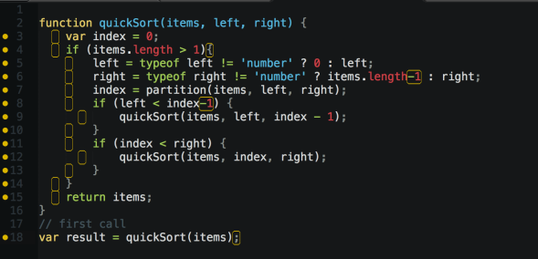
1. What happens to our code?
JAVASCRIPT
CODE

Slide 5
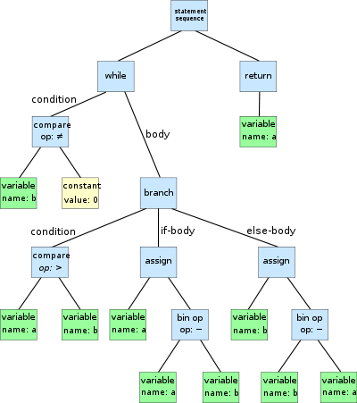
1. What happens to our code?
JAVASCRIPT
CODE
PARSER

Slide 6
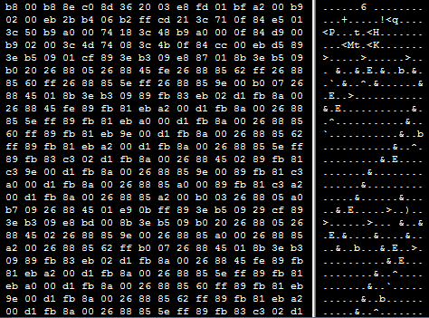
1.What happens to our code?
JAVASCRIPT
CODE
PARSER
RUNTIME
COMPILER

Slide 7
2. Execution contexts and Execution Stack
Execution Context is a Box/ Container/ Wrapper
EXECUTION CONTEXT
JAVASCRIPT
CODE

Slide 8
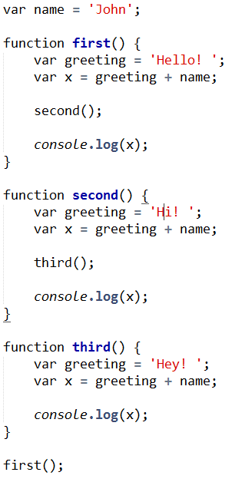
2. Execution contexts and execution stack
Global Execution Context
Execution Stack

Slide 9
2. Execution contexts and execution stack
Global Execution Context
Execution Stack

Slide 10
2. Execution contexts and execution stack
Global Execution Context
Execution Stack

Slide 11
2. Execution contexts and execution stack
Global Execution Context
Execution Stack

Slide 12
2. Execution contexts and execution stack
Execution Context
first()
Global Execution Context
Execution Stack

Slide 13
2. Execution contexts and execution stack
Execution Context
first()
Global Execution Context
Execution Stack

Slide 14
2. Execution contexts and execution stack
Execution Context
first()
Global Execution Context
Execution Stack

Slide 15
2. Execution contexts and execution stack
Execution Context
first()
Global Execution Context
Execution Stack

Slide 16
2. Execution contexts and execution stack
Execution Context
second()
Execution Context
first()
Global Execution Context
Execution Stack

Slide 17
2. Execution contexts and execution stack
Execution Context
second()
Execution Context
first()
Global Execution Context
Execution Stack

Slide 18
2. Execution contexts and execution stack
Execution Context
second()
Execution Context
first()
Global Execution Context
Execution Stack

Slide 19
2. Execution contexts and execution stack
Execution Context
third()
Execution Context
second()
Execution Context
first()
Global Execution Context
Execution Stack

Slide 20
2. Execution contexts and execution stack
Execution Context
third()
Execution Context
second()
Execution Context
first()
Global Execution Context
Execution Stack

Slide 21
2. Execution contexts and execution stack
Execution Context
third()
Execution Context
second()
Execution Context
first()
Global Execution Context
Execution Stack

Slide 22
2. Execution contexts and execution stack
Execution Context
third()
Execution Context
second()
Execution Context
first()
Global Execution Context
Execution Stack

Slide 23
2. Execution contexts and execution stack
Execution Context
second()
Execution Context
first()
Global Execution Context
Execution Stack

Slide 24
2. Execution contexts and execution stack
Execution Context
second()
Execution Context
first()
Global Execution Context
Execution Stack

Slide 25
2. Execution contexts and execution stack
Execution Context
first()
Global Execution Context
Execution Stack

Slide 26
2. Execution contexts and execution stack
Global Execution Context
Execution Stack

Slide 27
2. Execution contexts and execution stack
Execution Context is a Box /Container /Wrapper
EXECUTION CONTEXT
= OBJECT
JAVASCRIPT
CODE

Slide 28
2. Execution contexts and execution stack
Global Execution Context
GLOBAL EXECUTION CONTEXT
= WINDOW
OBJECT
JAVASCRIPT
CODE
- Code that is not inside any of our functions
- Associated with the global object

Slide 29
2. Execution contexts and execution stack
Each Execution Context consists of three Parts ...
GLOBAL EXECUTION CONTEXT
VARIABLE OBJECT
SCOPE CHAIN
„this“ - variable

Slide 30
2. Execution contexts and execution stack
Parts of an Execution Context
When e.g. Google Chrome compiles your JS – Code:
GLOBAL EXECUTION CONTEXT
HOISTING
Before the code is executed line by line, the code is analyzed by e.g. Google Chrome which makes
function declarations
variable declarations
available!
VARIABLE OBJECT
SCOPE CHAIN
„this“ - variable

Slide 31
3. Hoisting
„A variable can be declared after it has been used.“
Before Execution, the code is analyzed by the JavaScript Parser of declarations of functions and variables
x = “world“;
var x;
hello( x );
function hello(p) {
console.log( “hallo “ + p );
}

Slide 32
3. Hoisting
„A variable can be declared after it has been used.“
Before Execution, the code is analyzed by the JavaScript Parser of declarations of functions and variables
x = “world“;
var x;
hello( x );
function hello(p) {
console.log( “hallo “ + p );
}
Variable Object has
One new property x which is undefined
And
One new function which is hello(p)

Slide 33
3. Hoisting
When Chrome executes the code
x is set to “world“
Hello(x) is called
„A variable can be declared after it has been used.“
Before Execution, the code is analyzed by the JavaScript Parser of declarations of functions and variables
x = “world“;
var x;
hello( x );
function hello(p) {
console.log( “hallo “ + p );
}
Variable Object has
One new property x which is undefined
And
One new function which is hello(p)

Slide 34
4. Scoping
Scoping answers the question
„Where can we access a certain variable?“
Each new function creates a scope
The space/environment in which the variables
it defines are accessible

Slide 35
4. Scoping
Parts of an Execution Context
GLOBAL EXECUTION CONTEXT
VARIABLE OBJECT
Contains
Variable Objects of
all parents
SCOPE CHAIN
„this“ - variable

Slide 36
4. Scoping
What is a „parent“ and a „child“
var g = 5;
function parent() {
var x = 1;
function child1() {
var z = 1 + x + g;
console.log(“z is “ + z);
}
function child2() {
var z = 2 + x + g;
console.log(“z is “ + z);
}
}

Slide 37
4. Scoping
What is a „parent“ and a „child“
var g = 5;
function parent() {
var x = 1;
function child1() {
var z = 1 + x + g;
console.log(“z is “ + z);
}
function child2() {
var z = 2 + x + g;
console.log(“z is “ + z);
}
}
parent()
child1()
child2()

Slide 38
4. Scoping
What is a „parent“ and a „child“
var g = 5;
function parent() {
var x = 1;
function child1() {
var z = 1 + x + g;
console.log(“z is “ + z);
}
function child2() {
var z = 2 + x + g;
console.log(“z is “ + z);
}
}
GLOBAL SCOPE

Slide 39
4. Scoping
What is a „parent“ and a „child“
var g = 5;
function parent() {
var x = 1;
function child1() {
var z = 1 + x + g;
console.log(“z is “ + z);
}
function child2() {
var z = 2 + x + g;
console.log(“z is “ + z);
}
}
GLOBAL SCOPE
parent() scope
g = 5
x = 1

Slide 40
4. Scoping
What is a „parent“ and a „child“
var g = 5;
function parent() {
var x = 1;
function child1() {
var z = 1 + x + g;
console.log(“z is “ + z);
}
function child2() {
var z = 2 + x + g;
console.log(“z is “ + z);
}
}
GLOBAL SCOPE
parent() scope
g = 5
x = 1
child1() scope
g = 5
x = 1
z = 1 + x + g
child2() scope
g = 5
x = 1
z = 2 + x + g

Slide 41
5. Scoping VS Execution Stacks
What is the difference between
execution stack
and
scope chain
?

Slide 42
5. Scoping VS Execution Stacks
Execution Stack:
Order in which functions are called.
Scope Chain:
Order in which functions are written lexically.

Slide 43
6. this - Variable
Each Execution Context has
Function Call
this is the global object
(the window object in the browser)
Method Call
this is the points to the object that is calling the method
this depends on the function/method it is in !
GLOBAL EXECUTION CONTEXT
VARIABLE OBJECT
SCOPE CHAIN
„this“ - variable

