Slide 1
React
Jan.schulz@devugees.org

Slide 2
Agenda
Introduction
Set-Up
Components
JSX

Slide 3
1. Introduction
React
Client Side JavaScript framework
Created & maintained by Facebook
Used to build dynamic user interfaces
Renders everything as a component
Often to referred as the „V“ in MVC

Slide 4
1. Introduction
React ...
Makes JavaScript easier ... for complex apps
Organizes your UI
Reusability
Scalability & Efficiency
Lighter than most frameworks
GET A JOB

Slide 5
1. Introduction
React is used in
Facebook
Facebook App (React Native)
AirBnB
Tinder
Udemy
Instagram
Yahoo Mail

Slide 6
1. Introduction
Requirements:
NodeJS
Visual Studio Code
ES7 React/Redux/GraphQL/React-Native snippets
Chrome Extension
React Developer Tools
Redux Developer Tools

Slide 7
2. Setup
create-react-app is a predefined Webpack config
$ sudo npm install –g create-react-app

Slide 8
2. Setup
package.json
Manifest that info about the application
Public folder
Entry point to the entire application
In index.html, there is root-div, where React renders the entire app into

Slide 9
3. Components
Thinking in React-Way

Slide 10
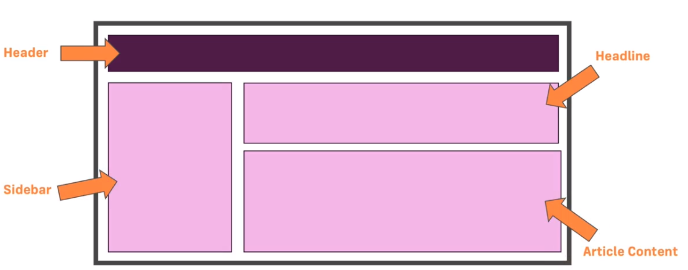
3. Components
Components:

Slide 11
3. Components
Components:
Each component contains its separate container of code
We do not build our web app as one bigger picture
Why?

Slide 12
3. Components
Components:
Each component contains its separate container of code
We do not build our web app as one bigger picture
Why? – It makes our code more manageable, more maintanable and more reusable
A react component is like a custom HTML element

Slide 13
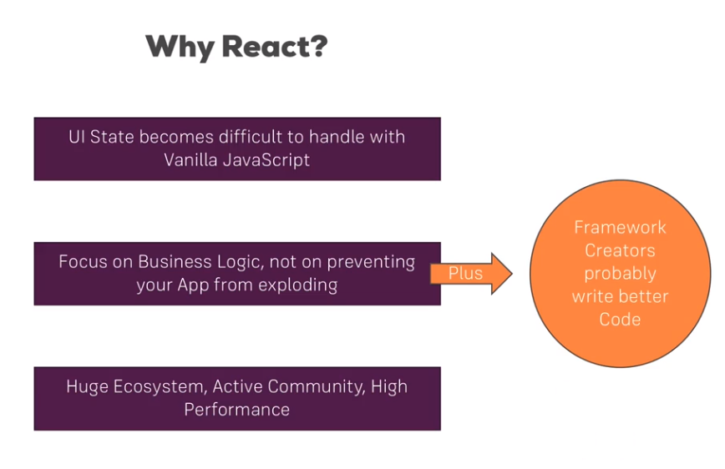
3. Components

Slide 14
3. Components
<APP>
<NAV>
<MAIN>
<FOOTER>

Slide 15
3. Components
Stateful Components
Have a state object
Return JSX
Functional Components
Do not have a state object
Return JSX

Slide 16
4. JSX
basically HTML in JavaScript
Will be transpiled into JavaScript by Babel (as Webpack plugin)

Slide 17
5. Props & State
Props
Data passed down from parent component to child component
PARENT
DATA
CHILD

Slide 18
5. Props & State
State
Private data of a component
MyComponent
state = {
active: true,
x: 5
}

Slide 19
6. Communication between multi-layered components
Props Drilling
Context API
Redux

Slide 20
6. Communication between multi-layered components
Props Drilling = Not efficient
APP
DATA
B
DATA
C

Slide 21
6. Communication between multi-layered components
Context API = A component, that shares its state with other components
APP
CHILD

