Slide 1
React Part 1
jan.schulz@devugees.org

Slide 2
1. Agenda
Introduction
Hallo World
Reasons to use React
Core Concepts

Slide 3
1. Introduction
React is a JS library for building user interfaces.
React Apps run on the browser
User interfaces are split into components

Slide 4
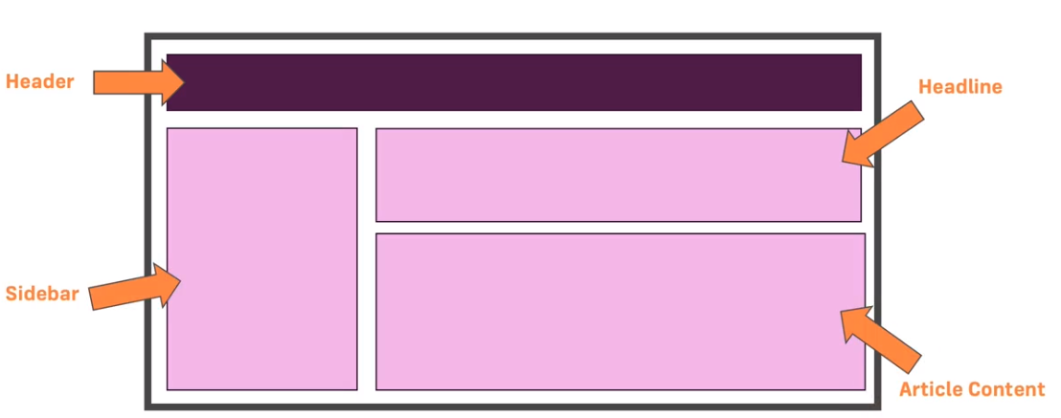
1. Introduction
Components:

Slide 5
1. Introduction
Components:
Each component contains its separate container of code
We do not build our web app as one bigger picture
Why?

Slide 6
1. Introduction
Components:
Each component contains its separate container of code
We do not build our web app as one bigger picture
Why? – It makes our code more manageable, more maintanable and more reusable
A react component is like a custom HTML element

Slide 7
2. Hallo World
[coding]

Slide 8
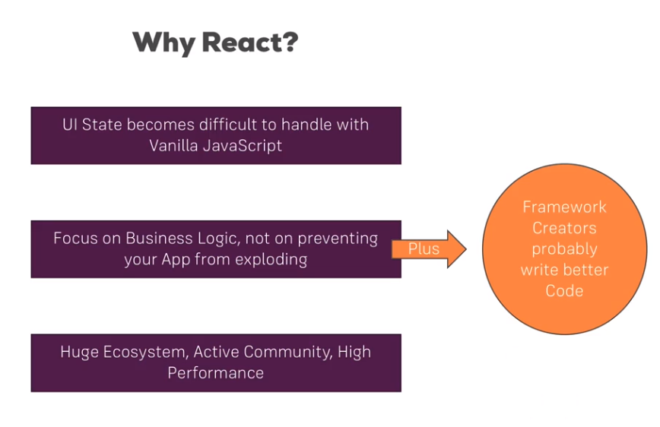
3. Reasons for using React

Slide 9
3. Reasons for using React
Creating Mobile Apps with React Native, which is quite similar to React
Supports both iOS and Android environments

Slide 10
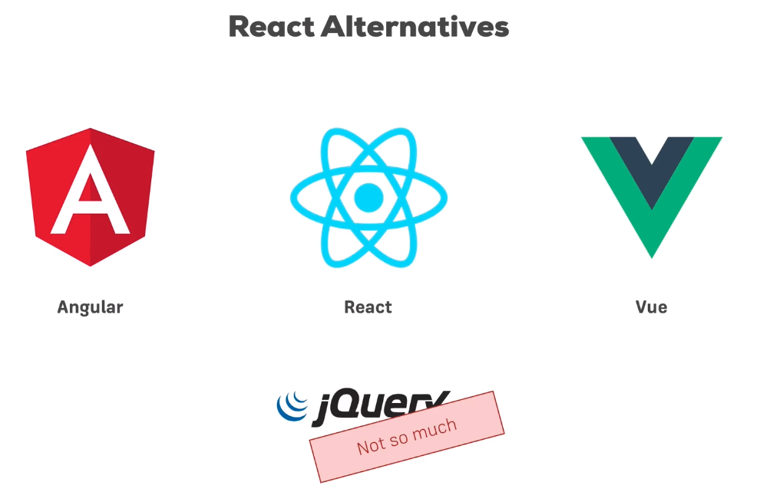
3. Reasons for using React

Slide 11
4. Components
Best Practice, one component will be rendered -> the App-component
All other components are part of the App-component
Every component has one job: return JSX that can be rendered
JSX is a mixture between HTML and JS

Slide 12
4. Components
<APP>
<NAV>
<MAIN>
<FOOTER>

Slide 13
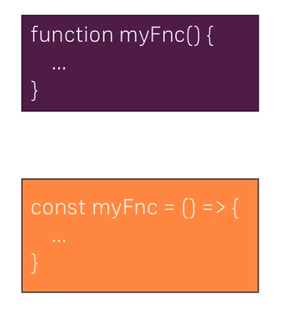
ES6 Excourse: Arrow Function VS Function
Big Difference:
The „this“-keyword will always
keep its context.

Slide 14
6. Props and States
Props and States are core concepts of React
Changes in props and states trigger React to re-render components and update the DOM
Props
Allow you to pass data from a parent component to a child component
States
Allow you to change the component from within

Slide 15
7. Events
https://reactjs.org/docs/events.html#supported-events
Similar to Jquery

Slide 16
8. Stateful VS Stateless Components
Components defined by Arrow functions
Components defined by class extends Component
Use as often as possible
They do not manipulate the
application state
Purpose: Only render to DOM
Only a few selected components
i.e. App, and components which
are allowed to change the
application state
Purpose: Render and change the state

Slide 17
9. Passing Method References between Components
App
changeName()
<Person click=“changeName“>
Person
onClick=click

Slide 18
10. Task
Create a new React app with create-react-app and name it task1
Create TWO new components: UserInput and UserOutput
UserInput should hold an input element, UserOutput two paragraphs
Output multiple UserOutput components in the App component (any paragraph texts of your choice)
Pass a username (of your choice) to UserOutput via props and display it there
Add state to the App component (=> the username) and pass the username to the UserOutput component
Add a method to manipulate the state (=> an event-handler method)
Pass the event-handler method reference to the UserInput component and bind it to the input-change event
Ensure that the new input entered by the user overwrites the old username passed to UserOutput
Add two-way-binding to your input (in UserInput) to also display the starting username
Add styling of your choice to your components/ elements in the components - both with inline styles and stylesheets

Slide 19
ES6 Excourse: Rest and Spread Operators
Spread & Rest Operators: can be placed where multiple arguments, elements or variables are expected

Slide 20
11. Rendering Lists & Conditional Content
Certain parts of the HTML need to be displayed conditionally by JSX
Lists will be rendered using the map method

Slide 21
12. Task
Create a new React app with create-react-app and name it task2
Create an input field (in App component) with a change listener which outputs the length of the entered text below it (e.g. In a paragraph)
Create a new component (=> Validation Component) which receives the text length as a prop.
Inside the ValidationComponent, either output „Text too short“ or „Text long enough“ depending on the text length (e.g. Take 5 as a minimum length)
Create another component (=> CharComponent) and style it as an inline box (=> display: inline-block, padding 16px, text-align: center, margin: 16px, border: 1px solid black)
Render a list of CharComponents where each CharComponent receives a different letter of the entered text (in the initial input field) as a prop
When you click a CharComponent, it should be removed from the entered text
Hint: Keep in mind that JavaScript strings are basically arrays!

Slide 22
12. Task
You'll also need to transform a string into a real array and then join it back into a string again to complete task 5 of the assignment.
You can split a string into an array of its characters with the split('') method. By passing just an empty string, it's split after every character.
You may then re-create a string from that array by using join('') - again, joining with an empty string as a separator.

Slide 23
13. Component Lifecycles
Each component has a lifecycle which consists of different parts. Each part is triggered („hooked“) by a component method
Methodname | When
componentWillMount | Immediately before initial rendering
componentDidMount | Immediately after initial rendering
componentWillReceiveProps(nextProps) | Component receives new props
shouldComponentUpdate (returns true oder false) | Before rendering, after receiving new props or state
componentWillUpdate (will be called when 4. returns true or undefined) | Before rendering, after receiving new props or state
componentDidUpdate | Immediately before removing component from DOM

Slide 24
13. Component Lifecycles
Task: Create an app with two stateful
components App and Picture and
(Using Reactstrap 4)
The app consists of two divs left and right. On the left side, there is one button labeled as „New Image“. On the right side, there is a block if pictures inside Picture components.
App should contain a list of Picture components. Each picture has a random id between 1 and 1000 that relates to the picsum address (https://picsum.photos/100/100/?image=15 where as 15 would be the random number) and a unique key that is a random string with length of 5.
When the user clicks on „New Image“, a new random image is being loaded from Picsum API having measures of 100x100. The picture is loaded inside the Picture component which is stateful. Also please use the URL: https://picsum.photos/100/100/?image=15. Randomize the last part, e.g. The 15 might be a random number between 1 and 1000.
In the picture component, implement all methods componentWillMount, componentDidMount, componentWillReceiveProps, shouldComponentUpdate, componentWillUpdate, componentDidUpdate
All lifecycles methods should contain a console.log() containing the current part of the Picture‘s component.
Each Picture has two buttons. 1. one deletes the picture, and 2. changes the picture‘s URL from picsum to another random picture. Therefore, please think how you can solve this problem using the lifecycle of your Picture component! Be aware of the upward and downward communication between App and Picture component.
Add an event onError for the image inside of the Picture component. If a picture fails to load, the App component should destroy it.

Slide 25


13. Component Lifecycles
Add Image
X
+
X
+

Slide 26
13. Component Lifecycles
App
Picture
Two stateful components.
What happens in the picture component,
when we update the state in the App component?

Slide 27
14. Async/Await
Async/Await is an evolutionary next step away from Callback Hell
Callbacks → Callbacks
Promises → .Then and .Catch
Async/Await → Async functions, inside await statements

Slide 28
14. Async/Await
Callbacks are functions.
functions which will be called in response to events
Events: Ajax Request is done, Database query is done etc.
Promises are objects.
Objects that store information whether or not those events have happened yet
If they have happened, what is their outcome

Slide 29
14. Async/Await
Callbacks are passed as arguments
Defined independently of the functions they are called from
Promises are returned
Defined inside the functions they are called from

Slide 30
14. Async/Await
Callbacks handle success and failure
callback({err: ‘user not found‘}) -> Error callback
callback(null) -> No Error callback
Promises do not handle anything by default
Do not handle anything by default
Success and Failure handlers are attached later

Slide 31
14. Async/Await
Callbacks might be called multiple times
One callback can be used multiple times
Promises are returned by one function which represents one event
Either this one event has succeeded or failed

Slide 32
14. Async/Await
Async/Await is syntactic sugar for Promises
AsyncAwait is another set of keywords that substitute the syntax .then() and .catch()
„Looks synchronous“

