Slide 1
Authentication & Authorization in NodeJS Web Applications
jan.schulz@devugees.org

Slide 2
Agenda
Protected Routes
Authentication & Authorization
Sessions -> Authentication & Authorization
JSON WebTokens -> Authentication & Authorization
JWT Signatures
Comparison Sessions VS JSON WebTokens
Password Hashes
Activation Links
Password Resets

Slide 3
1. Protected Routes
Routes in our Express-App look like this:
/
/api
/customers
...

Slide 4
1. Protected Routes
Routes in our Express-App look like this:
/
/api
/customers
...
What if we want to protect them from certain users? I.e. users, that are unknown to us.

Slide 5
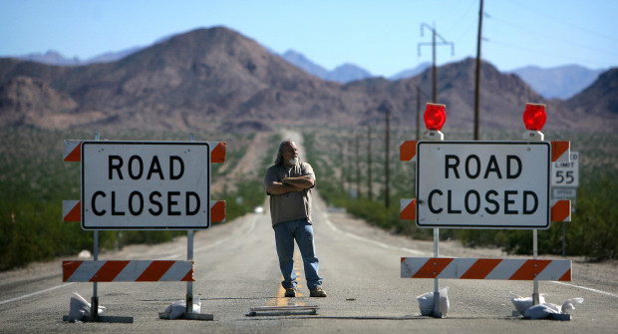

Slide 6
1. Protected Routes
The guy asks for username and password!

Slide 7
1. Protected Routes
The guy asks for username and password!
You say your username is “hallo“ and your password is “world“.

Slide 8
1. Protected Routes
The guy asks for username and password!
You say your username is “hallo“ and your password is “world“.
The guy looks up “hallo“ and “world“ in his database and finds you.

Slide 9
1. Protected Routes
The guy asks for username and password!
You say your username is “hallo“ and your password is “world“.
The guy looks up “hallo“ and “world“ in his database and finds you.
You are now authenticated as known user and you get your ticket which authorizes you to drive along the road.

Slide 10
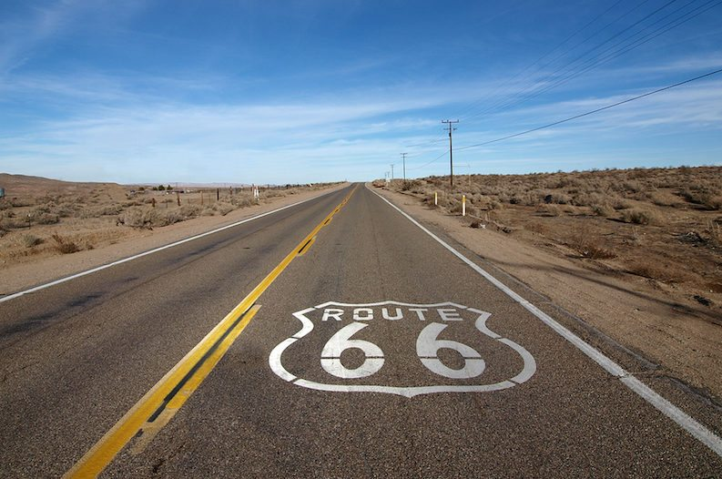

Slide 11
2. Authentication & Authorization
Authentication: is the process of verifying that the
user is somebody the system knows.
Authorization: is the process of verifying that the
user has access to something the system owns.
Ticket: A proof that the users is authorized. Mostly
it is a token.

Slide 12
2. Authentication & Authorization
Request: HTTP packet sent from client to server („One coffee please“)
Response: HTTP packet sent back from server to client after it received a Request („There you go – here it is“)

Slide 13
2. Authentication & Authorization
Request: HTTP packet sent from client to server („One coffee please“)
Response: HTTP packet sent back from server to client after it received a Request („There you go – here it is“)
Transaction: One pair of Request and Response („One coffee please“ – „There you go – here it is“)

Slide 14
2. Authentication & Authorization
Request: HTTP packet sent from client to server („One coffee please“)
Response: HTTP packet sent back from server to client after it received a Request („There you go – here it is“)
Transaction: One pair of Requests and Responses („One coffee please“ – „There you go – here it is“)
Session: A set of transactions
„One coffee please“ – „There you go – here it is“)
„One latte please“ – „Okay – here it is“)
„One espresso please“ – „Okay.“)

Slide 15
3. Sessions Authentication
USER
HTTP
SERVER
session = {}

Slide 16
3. Sessions Authentication
USER
HTTP
SERVER
HEADER: Cookies: SID: 12345679
POST /login
{
username: ‘hallo‘,
password: ‘world‘
}
session = {}

Slide 17
3. Sessions Authentication
USER
HTTP
SERVER
HEADER: Cookies: SID: 12345679
POST /login
{
username: ‘hallo‘,
password: ‘world‘
}
session = {}
HEADER: Cookies: SID: 12345679
RESPONSE /login
{
result: ‘login successfull‘
}

Slide 18
3. Sessions Authentication
USER
HTTP
SERVER
HEADER: Cookies: SID: 12345679
POST /login
{
username: ‘hallo‘,
password: ‘world‘
}
session = {
user: ‘jan‘,
admin: 1
};
HEADER: Cookies: SID: 12345679
RESPONSE /login
{
result: ‘login successfull‘
}

Slide 19
3. Sessions Authentication
USER
HTTP
SERVER
HEADER: Cookies: SID: 12345679
POST /login
{
username: ‘hallo‘,
password: ‘world‘
}
session = {
user: ‘jan‘,
admin: 1
};
HEADER: Cookies: SID: 12345679
RESPONSE /login
{
result: ‘login successfull‘
}
The session is a
server-side object
that saves info
about the trans-
actions with the
client

Slide 20
3. Sessions Authentication
USER
HTTP
SERVER
session = {
user: ‘jan‘,
admin: 1
};
HEADER: Cookies: SID: 12345679
GET /customers
The cookie-id
identifies the
session and sticks
for the rest of the
session, until the
user or server
deletes it

Slide 21
3. Sessions Authentication
USER
HTTP
SERVER
session = {
user: ‘jan‘,
admin: 1
};
HEADER: Cookies: SID: 12345679
GET /customers
HEADER: Cookies: SID: 12345679
RESPONSE /customers
<head>..</head>
<body>
The cookie-id
identifies the
session and sticks
for the rest of the
session, until the
user or server
deletes it

Slide 22
4. JSON WebToken Authentication
USER
HTTP
SERVER

Slide 23
4. JSON WebToken Authentication
USER
HTTP
SERVER
POST /login
{
username: ‘hallo‘,
password: ‘world‘
}

Slide 24
4. JSON WebToken Authentication
USER
HTTP
SERVER
POST /login
{
username: ‘hallo‘,
password: ‘world‘
}
RESPONSE /login
{
token: ‘fDjbn8fnVn‘
}

Slide 25
4. JSON WebToken Authentication
USER
HTTP
SERVER
POST /login
{
username: ‘hallo‘,
password: ‘world‘
}
RESPONSE /login
{
token: ‘fDjbn8fnVn‘
}
<- TICKET HERE

Slide 26
4. JSON WebToken Authorization
USER
HTTP
SERVER
GET /customers
HEADER: authorization Bearer fDjbn8fnVn

Slide 27
4. JSON WebToken Authorization
USER
HTTP
SERVER
GET /customers
HEADER: authorization Bearer fDjbn8fnVn
<- TICKET HERE

Slide 28
4. JSON WebToken Authorization
USER
HTTP
SERVER
GET /customers
HEADER: authorization Bearer fDjbn8fnVn
RESPONSE /customers
<HTML>
<body>...</body>
</HTML>

Slide 29
5. JWT Signatures
Tokens need to be digitally signed.
Why?

Slide 30
5. JWT Signatures
Tokens need to be digitally signed.
The server needs to make sure the token is created by the server itself.
Hackers may fake tokens in order to get authorization.
SIGNATURE/KEY to
Encrypt
Decrypt
... the data

Slide 31
5. JWT Signatures
jwt.sign()
“hallo world“

Slide 32
5. JWT Signatures
xy0g8dfgjdfkdfmcngdfgdfklghdfoigj
jwt.sign()
“hallo world“

Slide 33
5. JWT Signatures
xy0g8dfgjdfkdfmcngdfgdfklghdfoigj
jwt.verify()

Slide 34
5. JWT Signatures
xy0g8dfgjdfkdfmcngdfgdfklghdfoigj
jwt.verify()
“hallo world“

Slide 35
6. Comparison Sessions VS JSON WebTokens
Sessions | JSON WebTokens
Identified by Cookie-Ids | Identified by Tokens
Conveyed in the Header of the HTTP Request and Responses | Conveyed in the Header of the HTTP Request
Automatically saved in the browser | Manually saved in the browser or another HTTP-Client (i.e. localStorage)
Best Application is Websites | Best Application is RESTful APIs

Slide 36
7. Password Hashes
Storing passwords as they are is not secure

Slide 37

7. Password Hashes
Storing passwords as they are is not secure

Slide 38
7. Password Hashes
Hash is a mathematical function, that is irreversible
“mypassword“
hash(“mypassword“)

Slide 39
7. Password Hashes
Hash is a mathematical function, that is irreversible
“mypassword“
hash(“mypassword“)
“7dfmnCBNgfjgfjc“

Slide 40
7. Password Hashes
Hash is a mathematical function, that is irreversible
“7dfmnCBNgfjgfjc“

Slide 41

7. Password Hashes
Hash is a mathematical function, that is irreversible
“7dfmnCBNgfjgfjc“

Slide 42
8. Activation Links
What is the purpose of activation links?

Slide 43
8. Activation Links
What is the purpose of activation links?
The proof that you are who you claim to be.
Identified by the email-address

Slide 44
8. Activation Links
User Signs Up
User Receives Email
With Activation Link
User clicks on Activation Link
User is activated

Slide 45
9. Password Reset
User clicks on „Forgot my password“
He enters his email address in a form
and submits it
He receives an email with a password reset
link
If the passwords match, the
password will be changed to the new one
He enters two passwords in the form
He follows the link
http://localhost:5000/
resetpassword=8djvjx

