Slide 1
Introduction to Databases
MySQL
jan.schulz@devugees.org

Slide 2
Agenda
Definition
SQL Commands
Primary Keys
Foreign Keys
Table Joins

Slide 3
1. Definition
SQL is Structured Query Language, which is a computer language for storing, manipulating and retrieving data stored in relational database.
SQL is the standard language for Relation Database System. All relational database management systems like “MySQL, MS Access, Oracle, Sybase, Informix, postgres and SQL Server” use SQL as standard database language.

Slide 4
1. Definition
What do you think is a „database“?
What do you think means „relational“?
What do you think is a „relational database“?

Slide 5
1. Definition
Database: At its core, a place on your hard-drive or in your memory where data is stored.
    JSON flatfiles, CSV-files, Textfiles, Binary Files (Images...)
Usually, a system is wrapped around and gives users access to this data, which is stored in database specific format.
- MySQL
- MS-SQL
- Oracle
- Postgres
- ...

Slide 6
1. Definition
Database: At its core, a place on your hard-drive or in your memory where data is stored.
    JSON flatfiles, CSV-files, Textfiles, Binary Files (Images...)
Usually, a system is wrapped around and gives users access to this data, which is stored in database specific format.
- MySQL ← we learn this
- MS-SQL
- Oracle
- Postgres
- ...

Slide 7
1. Definition
Firstname | Lastname | Age
Max | Müller | 30
Sandra | Meier | 25
Column Names: Firstname, Lastname, Age
Column Values Row 1: Max, Müller, 30
Column Values Row 2: Sandra, Meier, 25
How would you represent that in JSON ?

Slide 8
1. Definition
Relational: Concerning the way two or more things (more concrete: tables) are connected with each other

Slide 9
1. Definition
Relational Database: A database, where one data-entity can be connected to another data-entity
Example:
  A customer has one address.
  What, if he has two addresses?

Slide 10
Max has one address
Firstname | Lastname | Street | Postal | City
Max | Müller | Lychener Straße 1 | 10403 | Berlin

Slide 11
Max has two addresses
Firstname | Lastname | Street | Postal | City
Max | Müller | Lychener Straße 1 | 10403 | Berlin
Max | Müller | Karl-Marx-Allee 18 | 10243 | Berlin
Problem?

Slide 12
Max has two addresses
Firstname | Lastname | Street | Postal | City
Max | Müller | Lychener Straße 1 | 10403 | Berlin
Max | Müller | Karl-Marx-Allee 18 | 10243 | Berlin
Problem = Redundancy. Max Müller exists twice. Having
millions of customers uses too much disk-space.

Slide 13
Max has two addresses
Table: Customers
Id | Firstname | Lastname
1 | Max | Müller
Table: Addresses
CustomerId | Street | Postal | City
1 | Lychener Straße 1 | 10403 | Berlin
1 | Karl-Marx-Allee 18 | 10243 | Berlin

Slide 14
Task
Take a blank piece of paper and think of your
own web-project that you would like to
implement.
1. What data would you store on your server?
2. How would you name your tables?
If you dont come up with an own idea of a web
project, think of an online-shop.

Slide 15
2. SQL
SQL stands for Structured Query Language, which is a computer language for storing, manipulating and retrieving data stored in relational databases.
It is grouped into four language areas:
  Data Definition Language (DDL)
  Data Manipulation Language (DML)
  Data Query Language (DQL)

Slide 16
2. SQL
Data Definition Language (DDL)
Command | Description
CREATE | Creates a new table
ALTER | Modifies the structure of a table
DROP | Deletes a table

Slide 17
2. SQL
Data Manipulation Language (DML)
Command | Description
INSERT | Creates a new row
UPDATE | Updates a row
DELETE | Deletes a row

Slide 18
2. SQL
Data Query Language (DML)
Command | Description
SELECT | Selects a row

Slide 19
2. SQL
Conditional Select Queries
SELECT
*
FROM
TABLENAME
WHERE
ATTRIBUTENAME = ATTRIBUTEVALUE

Slide 20
2. SQL
Conditional Select Queries with multiple conditions
SELECT
*
FROM
TABLENAME
WHERE
ATTRIBUTENAME1 = ATTRIBUTEVALUE1
AND ATTRIBUTENAME2 = ATTRIBUTEVALUE1

Slide 21
2. SQL
Conditional Select Queries with multiple conditions
SELECT
*
FROM
TABLENAME
WHERE
ATTRIBUTENAME1 = ATTRIBUTEVALUE1
OR ATTRIBUTENAME2 = ATTRIBUTEVALUE1

Slide 22
2. SQL
Conditional Delete Queries with multiple
conditions
DELETE
FROM
TABLENAME
WHERE
ATTRIBUTENAME1 = ATTRIBUTEVALUE1
OR ATTRIBUTENAME2 = ATTRIBUTEVALUE1

Slide 23
2. SQL
Conditional Delete Queries with multiple
conditions
DELETE
FROM
TABLENAME
WHERE
ATTRIBUTENAME1 = ATTRIBUTEVALUE1
OR ATTRIBUTENAME2 = ATTRIBUTEVALUE1

Slide 24
2. SQL
Conditional Update Queries with multiple
conditions
UPDATE
TABLENAME
SET ATTRIBUTENAME1 = ATTRIBUTEVALUE1
WHERE ATTRIBUTENAME2 = ATTRIBUTEVALUE2

Slide 25
3. Primary Keys
A primary keys identifies a table. Common examples for a key is an ID
Examples:
  Personalausweis ID
  Bank Account Number
  Credit Card Number
  ...

Slide 26
3. Primary Keys
Id | Firstname | Lastname | Age
1 | Max | Mueller | 32
2 | Sandra | Meier | 25
3 | Robert | Schulz | 20
4 | Bob | Smith | 35
5 | Max | Mueller | 32
In MySQL, we can create Ids that increment automatically.

Slide 27
4. Foreign Keys
A foreign key identifies a table whose existence depends on another table
Examples:
  A user with one or multiple addresses
    Address does not exist without a customer
  A voter with one or multiple votes
    Votes do not exist without a voter
  A customer with one or multiple orders
    An order does not exist without a customer

Slide 28
4. Foreign Keys
Id | Firstname | Lastname | Age
1 | Max | Mueller | 32
2 | Sandra | Meier | 25
3 | Robert | Schulz | 20
4 | Bob | Smith | 35
5 | Max | Mueller | 32
UserId | OrderValue | NumberItems
1 | 150€ | 3
1 | 200€ | 1
2 | 50€ | 1
3 | 300€ | 2
5 | 100€ | 2

Slide 29
5. Table Joins
Table Joins connect two or more tables with each other and results in one table

Slide 30
5. Table Joins
Id | Firstname | Lastname | Age
1 | Max | Mueller | 32
2 | Sandra | Meier | 25
3 | Robert | Schulz | 20
4 | Bob | Smith | 35
5 | Max | Mueller | 32
UserId | OrderValue | NumberItems
1 | 150€ | 3
1 | 200€ | 1
2 | 50€ | 1
3 | 300€ | 2
5 | 100€ | 2
+
Id | Firstname | Lastname | Age | OrderValue | NumberItems
1 | Max | Mueller | 32 | 150€ | 3
1 | Max | Mueller | 32 | 200€ | 1
2 | Sandra | Meier | 25 | 50€ | 1
3 | Robert | Schulz | 20 | 300€ | 2
4 | Bob | Smith | 35 | NULL | NULL
5 | Max | Mueller | 32 | 100€ | 2
=

Slide 31
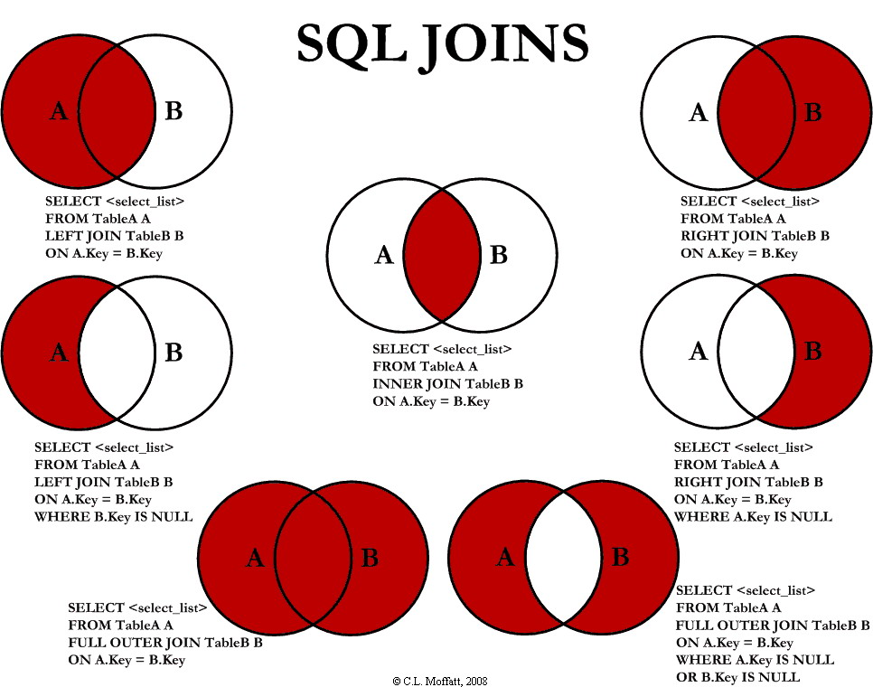
5. Table Joins

Slide 32
5. Table Joins
SELECT
a.*, b.*
FROM
Table1 a
JOIN
Table2 b
ON
a.id = b.Table1Id

Slide 33
Task
Create a MySQL version of your JSON-flatfiles database.
Create a database „productsserver“.
Create two tables „products“ and „product_types“. Think of what attributes these tables should have.
Introduce three product_types: „Movie“, „Book“ and „Music“
Fill the products-table with example data.

Slide 34
Task
Change the backend code of your Products
Server to use MySQL database instead of JSON
flatfiles.
5) Integrate

