Slide 1
Introduction to Databases Part 2: MongoDB
ashok.dudhat@devugees.org

Slide 2
What is NOSQL?
A variety of technologies that are alternatives to Tables and Structured Query Language (SQL). Stands for Not Only SQL.
NoSQL is a non-relational database management systems, different from traditional relational database management systems in some significant ways. It is designed for distributed data stores where very large scale of data storing needs (for example Google or Facebook which collects terabits of data every day for their users). These type of data storing may not require fixed schema, avoid join operations and typically scale horizontally.

Slide 3
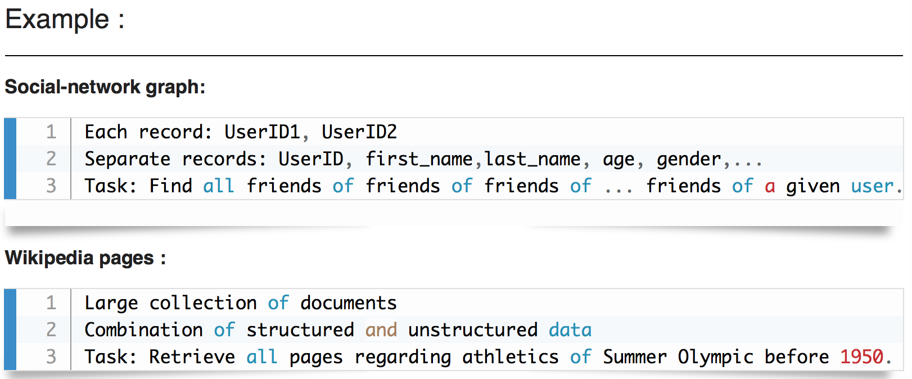
Why NoSQL?
In today’s time data is becoming easier to access and capture through third parties such as Facebook, Google+ and others.
Personal user information, social graphs, geo location data, user-generated content and machine logging data are just a few examples where the data has been increasing exponentially.
To avail the above service properly, it is required to process huge amount of data. Which SQL databases were never designed. The evolution of NoSql databases is to handle these huge data properly.

Slide 4
The Big Picture Differences
The Language
Think of a town - we’ll call it Town A - where everyone speaks the same language. All of the businesses are built around it, every form of communication uses it - in short, it’s the only way that the residents understand and interact with the world around them. Changing that language in one place would be confusing and disruptive for everyone.
Now, think of another town, Town B, where every home can speak a different language. Everyone interacts with the world differently, and there’s no “universal” understanding or set organization. If one home is different, it doesn’t affect anyone else at all.

Slide 5
SQL databases
SQL databases use structured query language (SQL) for defining and manipulating data. On one hand, this is extremely powerful: SQL is one of the most versatile and widely-used options available, making it a safe choice and especially great for complex queries. On the other hand, it can be restrictive. SQL requires that you use predefined schemas to determine the structure of your data before you work with it. In addition, all of your data must follow the same structure.
This can require significant up-front preparation, and, as with Town A, it can mean that a change in the structure would be both difficult and disruptive to your whole system.

Slide 6
NoSQL database
A NoSQL database, on the other hand, has dynamic schema for unstructured data, and data is stored in many ways: it can be column-oriented, document-oriented, graph-based or organized as a KeyValue store. This flexibility means that:
You can create documents without having to first define their structure.
Each document can have its own unique structure.
The syntax can vary from database to database.
You can add fields as you go.

Slide 7
The Scalability
In most situations, SQL databases are vertically scalable, which means that you can increase the load on a single server by increasing things like CPU, RAM or SSD.
NoSQL databases, on the other hand, are horizontally scalable. This means that you handle more traffic by sharding, or adding more servers in your NoSQL database.
It’s like adding more floors to the same building versus adding more buildings to the neighborhood.
The latter can ultimately become larger and more powerful, making NoSQL databases the preferred choice for large or ever-changing data sets.

Slide 8
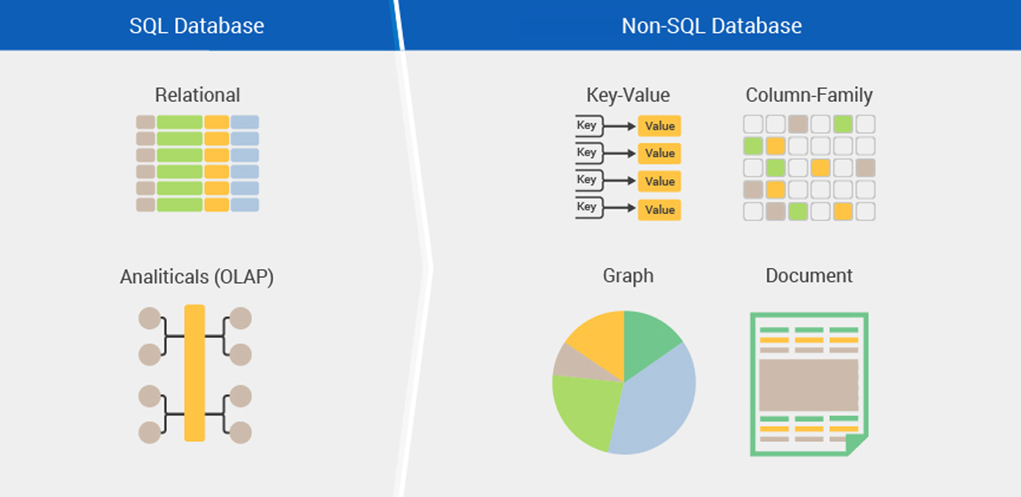
The Structure
SQL databases are table-based, while NoSQL databases are either document-based, key-value pairs, graph databases or wide-column stores.

Slide 9
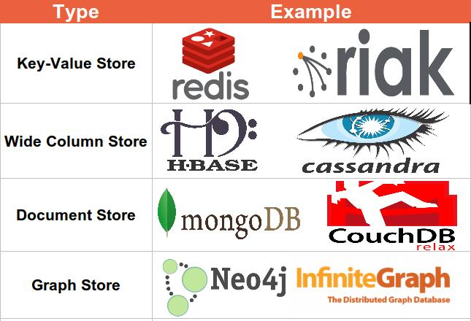
Examples of NoSQL

Slide 10
Core NOSQL Systems
Riak API: tons of languaes, JSON, Protocol: REST, Query Method: MapReduce term matching , Scaling: Multiple Masters; Written in: Erlang, Concurrency: eventually consistent (stronger then MVCC via Vector Clocks).
Redis API: Tons of languages, Written in: C, Concurrency: in memory and saves asynchronous disk after a defined time. Append only mode available. Different kinds of fsync policies. Replication: Master / Slave, Misc: also lists, sets, sorted sets, hashes, queues.
Hadoop / HBase API: Java / any writer, Protocol: any write call, Query Method: MapReduce Java / any exec, Replication: HDFS Replication, Written in: Java, Concurrency
Cassandra massively scalable, partitioned row store, masterless architecture, linear scale performance, no single points of failure, read/write support across multiple data centers & cloud availability zones. API / Query Method: CQL and Thrift, replication: peer-to-peer, written in: Java, Concurrency: tunable consistency, Misc: built-in data compression, MapReduce support, primary/secondary indexes, security features.
MongoDB API: BSON, Protocol: C, Query Method: dynamic object-based language & MapReduce, Replication: Master Slave & Auto-Sharding, Written in: C++,Concurrency: Update in Place. Misc: Indexing, GridFS, Freeware + Commercial License.
CouchDB API: JSON, Protocol: REST, Query Method: MapReduceR of JavaScript Funcs, Replication: Master Master, Written in: Erlang, Concurrency: MVCC.
Neo4J API: lots of langs, Protocol: Java embedded / REST, Query Method: SparQL, nativeJavaAPI, JRuby, Replication: typical MySQL style master/slave, Written in: Java, Concurrency: non-block reads, writes locks involved nodes/relationships until commit.
Infinite Graph (by Objectivity) API: Java, Protocol: Direct Language Binding, Query Method: Graph Navigation API, Predicate Language Qualification, Written in: Java (Core C++), Data Model: Labeled Directed Multi Graph, Concurrency: Update locking on subgraphs, concurrent non-blocking ingest, Misc: Free for Qualified Startups.

Slide 11
SQL vs NoSQL: MySQL vs MongoDB
MySQL: The SQL Relational Database
The following are some MySQL benefits and strengths:
Maturity: MySQL is an extremely established database, meaning that there’s a huge community, extensive testing and quite a bit of stability.
Compatibility: MySQL is available for all major platforms, including Linux, Windows, Mac, BSD and Solaris. It also has connectors to languages like Node.js, Ruby, C#, C++, Java, Perl, Python and PHP, meaning that it’s not limited to SQL query language.
Cost-effective: The database is open source and free.
Replicable: The MySQL database can be replicated across multiple nodes, meaning that the workload can be reduced and the scalability and availability of the application can be increased.
Sharding: While sharding cannot be done on most SQL databases, it can be done on MySQL servers. This is both cost-effective and good for business.

Slide 12
SQL vs NoSQL: MySQL vs MongoDB
MongoDB: The NoSQL Non-Relational Database.
The following are some of MongoDB benefits and strengths:
Dynamic schema: As mentioned, this gives you flexibility to change your data schema without modifying any of your existing data.
Scalability: MongoDB is horizontally scalable, which helps reduce the workload and scale your business with ease.
Manageability: The database doesn’t require a database administrator. Since it is fairly user-friendly in this way, it can be used by both developers and administrators.
Speed: It’s high-performing for simple queries.
Flexibility: You can add new columns or fields on MongoDB without affecting existing rows or application performance.

Slide 13
In Short : RDBMS vs NoSQL
RDBMS
- Structured and organized data.
- Structured query language (SQL).
- Data and its relationships are stored in separate tables.
- Data Manipulation Language, Data Definition Language.
- Tight Consistency.
NoSQL
- Stands for Not Only SQL.
- No declarative query language.
- No predefined schema.
- Key-Value pair storage, Column Store, Document Store, Graph databases.
- Eventual consistency rather ACID property (Atomic, Consistency, Isolation, Durable).
- Unstructured and unpredictable data.
- Prioritises high performance, high availability and scalability.
- BASE Transaction (Basically Available Soft state Eventual consistency).

Slide 14
Which Database Is Right For Your Business?
MySQL is a strong choice for any business that will benefit from its pre-defined structure and set schemas. For example, applications that require multi-row transactions - like accounting systems or systems that monitor inventory - or that run on legacy systems will thrive with the MySQL structure.
MongoDB, on the other hand, is a good choice for businesses that have rapid growth or databases with no clear schema definitions. More specifically, if you cannot define a schema for your database, if you find yourself denormalizing data schemas, or if your schema continues to change - as is often the case with mobile apps, real-time analytics, content management systems, etc.- MongoDB can be a strong choice for you.

Slide 15
Production Deployment Examples
There is a large number of companies using NoSQL.
Google
Facebook
Mozilla
Adobe
Foursquare
LinkedIn
Digg
McGraw-Hill Education
Vermont Public Radio

Slide 16
Document Oriented databases
A collection of documents.
Data in this model is stored inside documents.
A document is a key value collection where the key allows access to its value.
Documents are not typically forced to have a schema and therefore are flexible and easy to change.
Documents are stored into collections in order to group different kinds of data.
Documents can contain many different key-value pairs, or key-array pairs, or even nested documents.

Slide 17
Comparison between Classic relational model and Document model
MySQL (Relational Model) | MongoDB (Document Model)
Tables | Collections
Rows | Documents
Columns | Key/value pairs
Joins | Embedded documents, $lookup & $graphLookup
GROUP_BY | Aggregation Pipeline
ACID Transactions | ACID Transactions
Secondary Index | Secondary Index

Slide 18
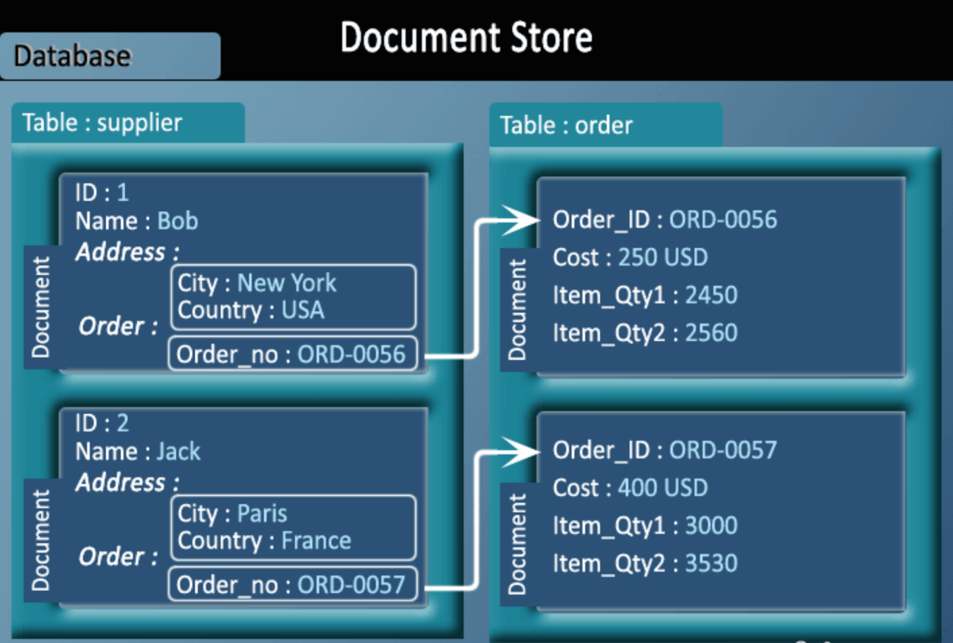
Pictorial Presentation

Slide 19
Introduction : MangoDB
Document: „A record in a MongoDB collection and the basic unit of data in MongoDB. Documents look like JSON objects but exist as BSON“.
BSON
{
“title“: “Article two“,
“category“: “Education“,
“body“: “this is the body“
}

Slide 20
Documents
BSON is JSON saved binarily
{
“title“: “Article two“,
“category“: “Education“,
“body“: “this is the body“
}
We do not have a JSON file, we have binary BSON file. Not human-readable.

Slide 21
Documents
BSON is JSON saved binarily
{
“title“: “Article two“,
“category“: “Education“,
“body“: “this is the body“
}
We do not have a JSON file, we have binary BSON file. Not human-readable.
Each document is JSON which is saved as a BSON file.

Slide 22
Collections
Collection: A group of MongoDB documents. Typically, all documents in a collection have a similar related purpose.

Slide 23
Collections
Collection: A group of MongoDB documents. Typically, all documents in a collection have a similar related purpose.
Collection: Users
{name: ‘andrew‘}
{name: ‘kelly‘}
{name: ‘john‘}

Slide 24
Collections
Database: Shop
Collection: Products
Collection: Users
{name: ‘andrew‘}
{madeby: ‘john‘, sum: 100}
{name: ‘john‘}
{madeby: ‘kelly‘, sum: 120}
{name: ‘kelly‘}

Slide 25
Biggest difference between SQL and MongoDB
SQL
MongoDB
JOINS
REFERENCES

Slide 26
Installation : MongoDB
sudo apt-get update
sudo apt-get install –y mongodb-org
sudo systemctl start mongod
sudo systemctl status mongod

Slide 27
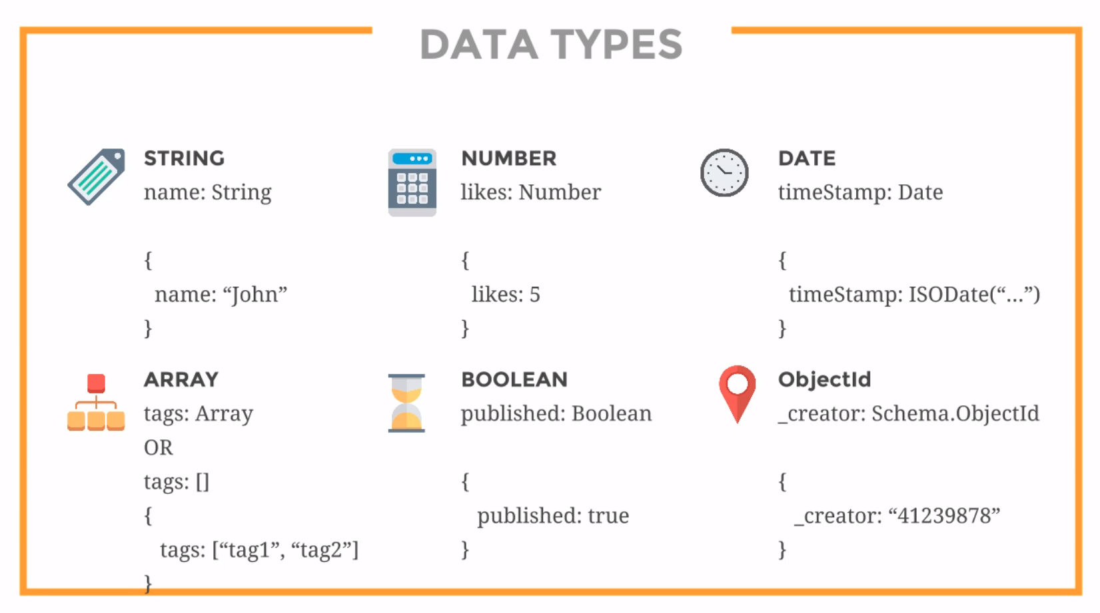
Data-Types

Slide 28
Mongo Shell
Let Create Database, Collection, Document and play with some function/queries…

Slide 29
Quiz
How do we access the shell?
A: by typing ‘mongodb‘
B: by typing ‘mongo‘
C: by loading the browser
D: by typing ‘mongo start‘

Slide 30
Quiz
How do we access the shell?
A: by typing ‘mongodb‘
B: by typing ‘mongo‘
C: by loading the browser
D: by typing ‘mongo start‘

Slide 31
Quiz
2. How do we add a new document if the to-be-updated document is not found?
A: $set
B: $in
C: upsert=true
D: $upsert=true

Slide 32
Quiz
2. How do we add a new document if the to-be-updated document is not found?
A: $set
B: $in
C: upsert=true
D: $upsert=true

Slide 33
Quiz
What command do we use to indicate which database we want to access?
A: use
B: show
C: find
D: list

Slide 34
Quiz
What command do we use to indicate which database we want to access?
A: use
B: show
C: find
D: list

Slide 35
Quiz
4. What method is used to display our documents in a clean and organized way?
A: insert
B: find
C: pretty
D: clean
E: style

Slide 36
Quiz
4. What method is used to display our documents in a clean and organized way?
A: insert
B: find
C: pretty
D: clean
E: style

Slide 37
Quiz
5. Which one of these is not one of the 6 main data types commonly used within the model of our collection?
A: String
B: Boolean
C: Number
D: Date
E: Buffer
F: Array

Slide 38
Quiz
5. Which one of these is not one of the 6 main data types commonly used within the model of our collection?
A: String
B: Boolean
C: Number
D: Date
E: Buffer
F: Array

Slide 39
Task
1.Create a new database “medialib“ that is
supposed to save infos about videos and songs.
both are saved in the same collection
“mediaitem“. Find 5 proper keys (title and type is a
must, whereas type can either be „movie“ or
„song“) and add 3 songs and 3 movies.
2. Write a function/query list Titles that lists all titles and
types of each item in your collection. Therefore, take a
look at the collection.count() method.

Slide 40
Node.js + MongoDB
Install MongoDB Driver
$ npm install mongodb

Slide 41
Import require package
Node.js can use this module to manipulate MongoDB databases:
var mongo = require(‘mongodb');

Slide 42
Creating a Database
To create a database in MongoDB, start by creating a MongoClient object, then specify a connection URL with the correct ip address and the name of the database you want to create.
MongoDB will create the database if it does not exist, and make a connection to it.
var MongoClient = require('mongodb').MongoClient;
var url = "mongodb://localhost:27017/testdb";
MongoClient.connect(url, function(err, db) {
if (err) throw err;
console.log("Database created!");
db.close();
});

Slide 43
Creating a Collection
To create a collection in MongoDB, use the createCollection() method:
Create a collection called “customers":
var MongoClient = require('mongodb').MongoClient;
var url = "mongodb://localhost:27017/";
MongoClient.connect(url, function(err, db) {
if (err) throw err;
var dbo = db.db("testdb");
dbo.createCollection("customers", function(err, res) {
if (err) throw err;
console.log("Collection created!");
db.close();
});
});
Important: A collection in MongoDB is the same as a table in MySQL. In MongoDB, a collection is not created until it gets content! MongoDB waits until you have inserted a document before it actually creates the collection.

Slide 44
Insert Document : Insert One
To insert a record, or document as it is called in MongoDB, into a collection, we use the insertOne() method.
The first parameter of the insertOne() method is an object containing the name(s) and value(s) of each field in the document you want to insert. It also takes a callback function where you can work with any errors, or the result of the insertion:
Insert a document in the "customers" collection:
var MongoClient = require('mongodb').MongoClient;
var url = "mongodb://localhost:27017/";
MongoClient.connect(url, function(err, db) {
if (err) throw err;
var dbo = db.db("testdb");
var myobj = { name: "Company Inc", address: "Highway 37" };
dbo.collection("customers").insertOne(myobj, function(err, res) {
if (err) throw err;
console.log("1 document inserted");
db.close();
});
});
Important: A document in MongoDB is the same as a record in MySQL. If you try to insert documents in a collection that do not exist, MongoDB will create the collection automatically.

Slide 45
Insert Document : Insert Many
To insert multiple documents into a collection in MongoDB, we use the insertMany() method.
The first parameter of the insertMany() method is an array of objects, containing the data you want to insert.
Insert multiple documents in the "customers" collection:
var MongoClient = require('mongodb').MongoClient;
var url = "mongodb://localhost:27017/";
MongoClient.connect(url, function(err, db) {
if (err) throw err;
var dbo = db.db("testdb");
var myobj = [
{ name: 'John', address: 'Highway 71'},
{ name: 'Peter', address: 'Lowstreet 4’},
{ name: 'Amy', address: 'Apple st 652'},
{ name: 'Hannah', address: 'Mountain 21'},
{ name: 'Michael', address: 'Valley 345'},
{ name: 'Sandy', address: 'Ocean blvd 2'},
{ name: 'Betty', address: 'Green Grass 1'},
{ name: 'Richard', address: 'Sky st 331'},
{ name: 'Susan', address: 'One way 98'},
{ name: 'Vicky', address: 'Yellow Garden 2'},
{ name: 'Ben', address: 'Park Lane 38'},
{ name: 'William', address: 'Central st 954'},
{ name: 'Chuck', address: 'Main Road 989'},
{ name: 'Viola', address: 'Sideway 1633'}
];
dbo.collection("customers").insertMany(myobj, function(err, res) {
if (err) throw err;
console.log("Number of documents inserted: " + res.insertedCount);
db.close();
});
});

Slide 46
The _id Field
If you do not specify an _id field, then MongoDB will add one for you and assign a unique id for each document.
In the example above no _id field was specified, and as you can see from the result object, MongoDB assigned a unique _id for each document.
If you do specify the _id field, the value must be unique for each document:
Insert three records in a "products" table, with specified _id fields:
var MongoClient = require('mongodb').MongoClient;
var url = "mongodb://localhost:27017/";
MongoClient.connect(url, function(err, db) {
if (err) throw err;
var dbo = db.db(“testdb");
var myobj = [
{ _id: 154, name: 'Chocolate Heaven'},
{ _id: 155, name: 'Tasty Lemon'},
{ _id: 156, name: 'Vanilla Dream'}
];
dbo.collection("products").insertMany(myobj, function(err, res) {
if (err) throw err;
console.log(res);
db.close();
});
});
When executing the insertMany() method, a result object is returned. The result object contains information about how the insertion affected the database.

Slide 47
Find
In MongoDB we use the find and findOne methods to find data in a collection.
Just like the SELECT statement is used to find data in a table in a MySQL database.

Slide 48
Find Data : Find One
To select data from a collection in MongoDB, we can use the findOne() method.
The findOne() method returns the first occurrence in the selection.
The first parameter of the findOne() method is a query object. In this example we use an empty query object, which selects all documents in a collection (but returns only the first document).
Find the first document in the customers collection:
var MongoClient = require('mongodb').MongoClient;
var url = "mongodb://localhost:27017/";
MongoClient.connect(url, function(err, db) {
if (err) throw err;
var dbo = db.db("testdb");
dbo.collection("customers").findOne({}, function(err, result) {
if (err) throw err;
console.log(result.name);
db.close();
});
});

Slide 49
Find Data : Find All
To select data from a table in MongoDB, we can also use the find() method.
The find() method returns all occurrences in the selection.
The first parameter of the find() method is a query object. In this example we use an empty query object, which selects all documents in the collection.
No parameters in the find() method gives you the same result as SELECT * in MySQL.
Find all documents in the customers collection:
var MongoClient = require('mongodb').MongoClient;
var url = "mongodb://localhost:27017/";
MongoClient.connect(url, function(err, db) {
if (err) throw err;
var dbo = db.db("testdb");
dbo.collection(“customers").find({}).toArray(function(err, result) {
if (err) throw err;
console.log(result);
db.close();
});
});

Slide 50
Find Data : Find Some
The second parameter of the find() method is an object describing which fields to include in the result.
This parameter is optional, and if omitted, all fields will be included in the result.
Return the fields "name" and "address" of all documents in the customers collection:
var MongoClient = require('mongodb').MongoClient;
var url = "mongodb://localhost:27017/";
MongoClient.connect(url, function(err, db) {
if (err) throw err;
var dbo = db.db("testdb");
dbo.collection("customers").find({}, { _id: 0, name: 1, address: 1 }).toArray(function(err, result) {
if (err) throw err;
console.log(result);
db.close();
});
});
You are not allowed to specify both 0 and 1 values in the same object (except if one of the fields is the _id field). If you specify a field with the value 0, all other fields get the value 1, and vice versa: Set only { address: 0 } and check the result.
To exclude the _id field, you must set its value to 0: Set the { _id: 0, name: 1 } and check the result.
Also please check the result by set { _id: 0 } and { name: 1, address: 0 }.

Slide 51
Filter the Result
When finding documents in a collection, you can filter the result by using a query object.
The first argument of the find() method is a query object, and is used to limit the search.
Find documents with the address "Park Lane 38”:
var MongoClient = require('mongodb').MongoClient;
var url = "mongodb://localhost:27017/";
MongoClient.connect(url, function(err, db) {
if (err) throw err;
var dbo = db.db("testdb");
var query = { address: "Park Lane 38" };
dbo.collection("customers").find(query).toArray(function(err, result) {
if (err) throw err;
console.log(result);
db.close();
});
});

Slide 52
Filter With Regular Expressions
You can write regular expressions to find exactly what you are searching for.
Regular expressions can only be used to query strings.
To find only the documents where the "address" field starts with the letter "S", use the regular expression /^S/:
Find documents where the address starts with the letter “S":
var MongoClient = require(‘mongodb').MongoClient;
var url = "mongodb://localhost:27017/";
MongoClient.connect(url, function(err, db) {
if (err) throw err;
var dbo = db.db("testdb");
var query = { address: /^S/ };
dbo.collection("customers").find(query).toArray(function(err, result) {
if (err) throw err;
console.log(result);
db.close();
});
});

Slide 53
Sort the Result
Use the sort() method to sort the result in ascending or descending order.
The sort() method takes one parameter, an object defining the sorting order.
Sort the result alphabetically by name:
var MongoClient = require('mongodb').MongoClient;
var url = "mongodb://localhost:27017/";
MongoClient.connect(url, function(err, db) {
if (err) throw err;
var dbo = db.db("testdb");
var mysort = { name: 1 };
dbo.collection("customers").find().sort(mysort).toArray(function(err, result) {
if (err) throw err;
console.log(result);
db.close();
});
});
Also Check, Using the value -1 in the sort object to sort descending.
{ name: 1 } // ascending
{ name: -1 } // descending

Slide 54
Delete Document : Delete One
To delete a record, or document as it is called in MongoDB, we use the deleteOne() method.
The first parameter of the deleteOne() method is a query object defining which document to delete.
Note: If the query finds more than one document, only the first occurrence is deleted.
Delete the document with the address "Mountain 21”:
var MongoClient = require('mongodb').MongoClient;
var url = "mongodb://localhost:27017/";
MongoClient.connect(url, function(err, db) {
if (err) throw err;
var dbo = db.db("testdb");
var myquery = { address: 'Mountain 21' };
dbo.collection("customers").deleteOne(myquery, function(err, obj) {
if (err) throw err;
console.log("1 document deleted");
db.close();
});
});

Slide 55
Delete Document : Delete Many
To delete more than one document, use the deleteMany() method.
The first parameter of the deleteMany() method is a query object defining which documents to delete.
Delete all documents were the address starts with the letter “O":
var MongoClient = require('mongodb').MongoClient;
var url = "mongodb://localhost:27017/";
MongoClient.connect(url, function(err, db) {
if (err) throw err;
var dbo = db.db("testdb");
var myquery = { address: /^O/ };
dbo.collection("customers").deleteMany(myquery, function(err, obj) {
if (err) throw err;
console.log(obj.result.n + " document(s) deleted");
db.close();
});
})

Slide 56
The Result Object
The deleteMany() method returns an object which contains information about how the execution affected the database.
Most of the information is not important to understand, but one object inside the object is called "result" which tells us if the execution went OK, and how many documents were affected.
The result object looks like this:
{ n: 2, ok: 1 }

Slide 57
Update Document: Update One
You can update a record, or document as it is called in MongoDB, by using the updateOne() method.
The first parameter of the updateOne() method is a query object defining which document to update.
Note: If the query finds more than one record, only the first occurrence is updated.
The second parameter is an object defining the new values of the document.
Update the document with the address "Valley 345" to name="Mickey" and address="Canyon 123”:
var MongoClient = require('mongodb').MongoClient;
var url = "mongodb://127.0.0.1:27017/";
MongoClient.connect(url, function(err, db) {
if (err) throw err;
var dbo = db.db("testdb");
var myquery = { address: "Valley 345" };
var newvalues = { $set: {name: "Mickey", address: "Canyon 123" } };
dbo.collection("customers").updateOne(myquery, newvalues, function(err, res) {
if (err) throw err;
console.log("1 document updated");
db.close();
});
});
When using the $set operator, only the specified fields are updated:

Slide 58
Update Document: Update Many
To update all documents that meets the criteria of the query, use the updateMany() method.
Update all documents where the name starts with the letter “S":
var MongoClient = require('mongodb').MongoClient;
var url = "mongodb://127.0.0.1:27017/";
MongoClient.connect(url, function(err, db) {
if (err) throw err;
var dbo = db.db("testdb");
var myquery = { address: /^S/ };
var newvalues = {$set: {name: "Minnie"} };
dbo.collection("customers").updateMany(myquery, newvalues, function(err, res) {
if (err) throw err;
console.log(res.result.nModified + " document(s) updated");
db.close();
});
});

Slide 59
The Result Object
The updateOne() and the updateMany() methods return an object which contains information about how the execution affected the database.
Most of the information is not important to understand, but one object inside the object is called "result" which tells us if the execution went OK, and how many documents were affected.
The result object looks like this:
{ n: 1, nModified: 2, ok: 1 }

Slide 60
Limit the Result
To limit the result in MongoDB, we use the limit() method.
The limit() method takes one parameter, a number defining how many documents to return.
Limit the result to only return 5 documents:
var MongoClient = require('mongodb').MongoClient;
var url = "mongodb://localhost:27017/";
MongoClient.connect(url, function(err, db) {
if (err) throw err;
var dbo = db.db("testdb");
dbo.collection("customers").find().limit(5).toArray(function(err, result) {
if (err) throw err;
console.log(result);
db.close();
});
})

Slide 61
Join Collections
MongoDB is not a relational database, but you can perform a left outer join by using the $lookup stage.

Slide 62
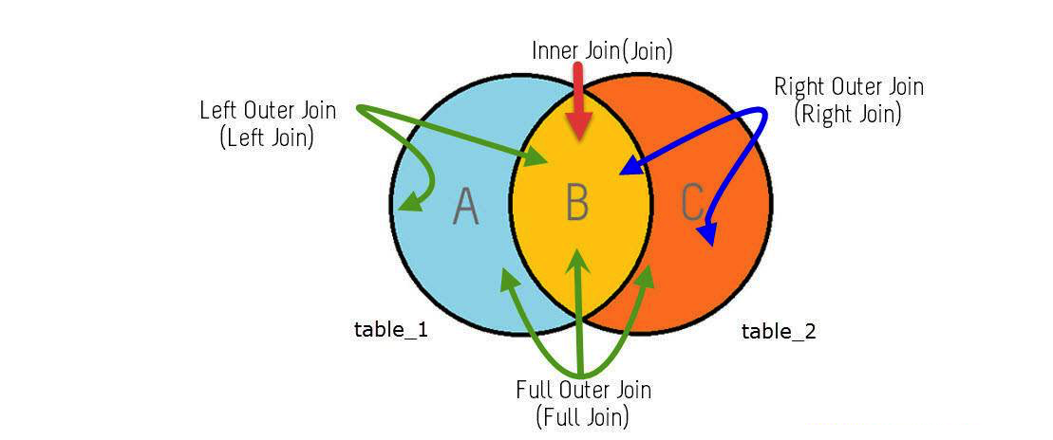
Joins

Slide 63


Slide 64
Join Collections
The $lookup stage lets you specify which collection you want to join with the current collection, and which fields that should match.
Consider you have a "orders" collection and a "products" collection:
orders :
[
{ _id: 1, product_id: 154, status: 1 }
]
products :
[
{ _id: 154, name: 'Chocolate Heaven' },
{ _id: 155, name: 'Tasty Lemons' },
{ _id: 156, name: 'Vanilla Dreams' }
]

Slide 65
Join the matching "products" document(s) to the "orders" collection:
var MongoClient = require('mongodb').MongoClient;
var url = "mongodb://127.0.0.1:27017/";
MongoClient.connect(url, function(err, db) {
if (err) throw err;
var dbo = db.db("testdb");
dbo.collection('orders').aggregate([
{ $lookup:
{
from: 'products',
localField: 'product_id',
foreignField: '_id',
as: 'orderdetails'
}
}
]).toArray(function(err, res) {
if (err) throw err;
console.log(JSON.stringify(res));
db.close();
});
});

