Slide 1
A Very Brief Introduction to Coroutines

Slide 2
What are they?

Slide 3
What coroutines are handy for
State machines
Pipelines
Cooperative multitasking

Slide 4
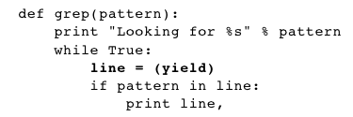
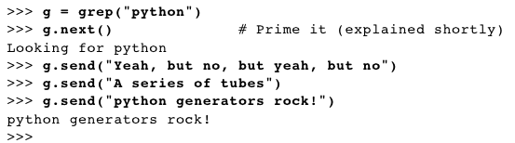
Coroutines in Python

Slide 5
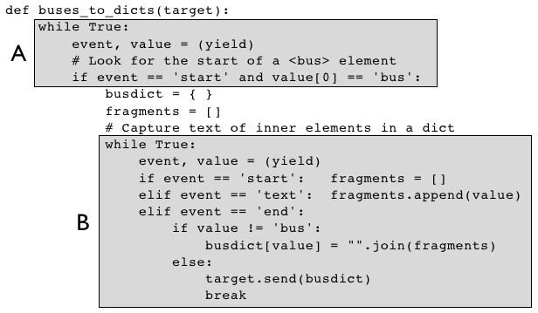
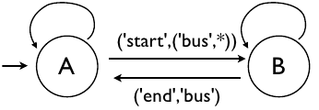
State machine!

Slide 6
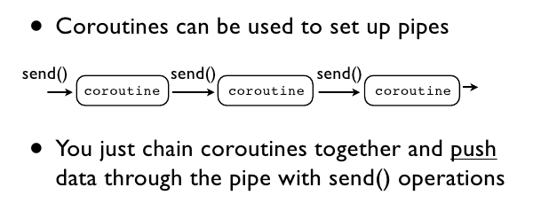
Pipeline

Slide 7
Cooperative multitasking
def t1():
while True:
yield
# do stuff
def t2():
while True:
yield
# do stuff
t1 = t1()
t2 = t2()
t1.next()
t2.next()
tasks = [t1, t2]
while True:
for t it tasks:
t.next()

Slide 8
http://www.dabeaz.com/coroutines/

