Slide 1
WnSOJ
Author: Rakhmetulla Akram

Slide 2
Introduction
Many who are professionally involved in programming may have heard of sports programming. For solving problems of sports programming there are “Online Judges”, i.e. a site with an archive of tasks and a testing system.
WnSOJ - is one such platform. The difference between this platform and others is that:
The server and testing system are written using the capabilities of the Python language. One of the most important advantages of a testing system is a quick solution check, even if the processor is weak. Also, the server and the testing system work independently, thanks to the multiprocessing library.
In addition to the archive of tasks, users can find, as well as publish/edit/delete job.

Slide 3
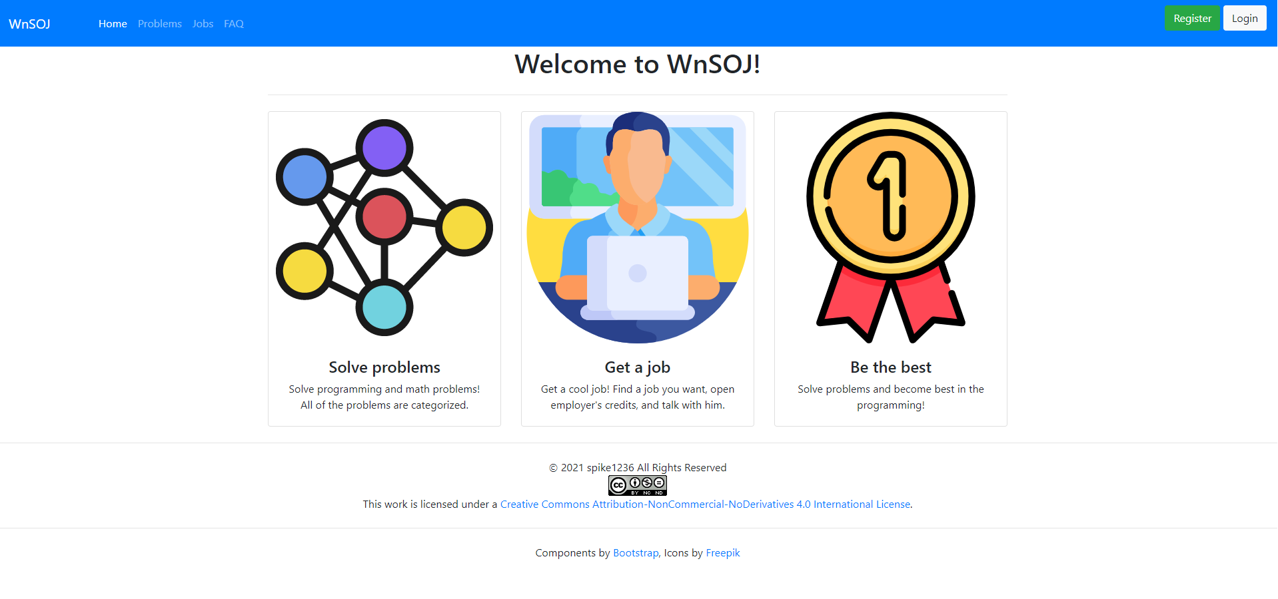
Main page screenshot

Slide 4
Project architecture
The server is written using the Flask framework. The WT Forms component was used to support the forms. A database is also used to store information.
To support the database, the SQLAlchemy library and its capabilities were used. Implemented 4 class tables; 4 many-to-many models; 4 one-to-many models.
The testing system is written using a libraries subprocess and psutil.
The multiprocessing library was used to make parallelism between server and testing system.
Additional libraries: PIL, zipfile, io, datetime, os.

Slide 5
Interface components
To create the interface, the capabilities of Bootstrap and JQuery were used. Also following plugins were used:
CodeMirror - for displaying the code
MathJax - for writing mathematical expressions
Zero-MD - for displaying Markdown files

Slide 6
Capabilities. Problems and submissions
To submit solution you need to be signed in system. You can register or sign in into existing account and submit solutions to problems. System will automatically test your solution and report verdict, max used time and max used memory. As mentioned above, one of the pluses of testing system is that it is well optimized - it fastly tests solution and reports verdict, even if your computer's processor is slow.
Also, each problem has an editorial and solution in C++ language.
Administrators can add new problems.

Slide 7
Capabilities. Job search
In the platform you can also find or publish/edit/delete job. There are 2 types of accounts:
Common account - these users can find job and communicate with employers by email or phone. Open job that you liked, read the description and if job suits you, communicate with employer by email or phone.
Business account - these users or companies can publish, edit or delete jobs, also find and communicate by email or phone with other users. Publish job, edit it if it is need, and just wait until some qualified specialist will communicate with you by email or phone number.
Also, administrators can add new job and edit/remove any other job.

Slide 8
Capabilities. Profile
In the profile, you can see user's username, email, phone number and statistics about problems: last 10 submissions and verdicts statistics.
Also, if this is a business account, you can use the filter to view the works of this particular employer.
Also you can change icon and password in your account.

Slide 9
Capabilities. API
Also, platform is rich for API. In API you can request:
users list and user by id
jobs list and job by id
submissions list and submission by id
problems list and problem by id
API is located by url http://127.0.0.1:5000/api/v1

Slide 10
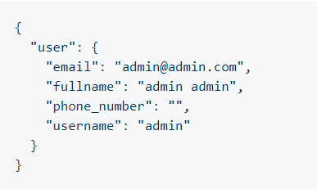
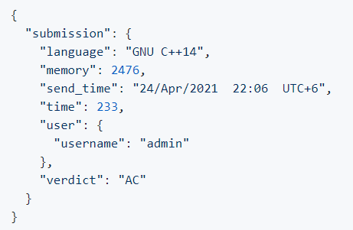
API examples
Request: http://127.0.0.1:5000/api/v1/user/1
Answer:
Request: http://127.0.0.1:5000/api/v1/submission/1
Answer:

Slide 11
Conclusion
It turned out to be an excellent platform for solving problems and finding a job. Many different libraries and components have been used.
Thanks for attention!
Project licensed under a Creative Commons Attribution-NonCommercial-NoDerivatives 4.0 International License.

