Slide 1
React: Rethinking Best Practices
Pete Hunt @floydophone
Notes:
No fb

Slide 2
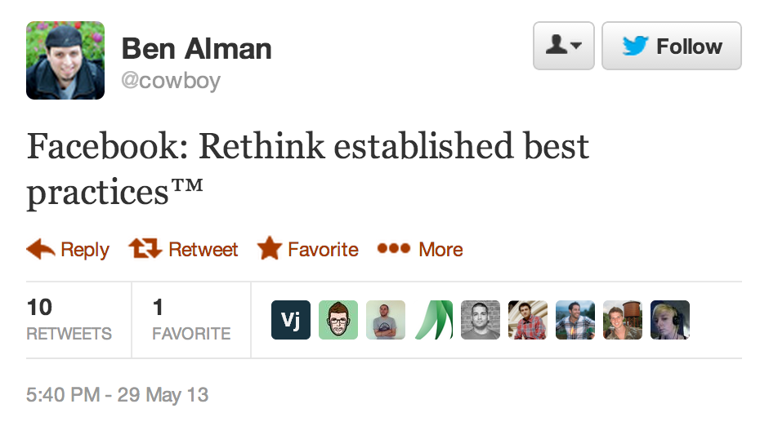
Notes:
Sarcastic
Not a tutorial

Slide 3
Give it five minutes.
http://37signals.com/svn/posts/3124-give-it-five-minutes

Slide 4
Meet React.
A library for creating user interfaces.

Slide 5
Meet React.
Renders your UI and responds to events.

Slide 6
Meet React.
AKA: The V in MVC

Slide 7
Meet React.
Plays nicely with your stack, whatever it may be.

Slide 8
Rethinking Best Practices
Prerequisite
Combine DOM generation and display logic
React’s design
Re-render the whole app on every update
React’s implementation
Virtual DOM and synthetic events

Slide 9
1. Build components, not templates.
Notes:
Or: mixing markup and display logic

Slide 10
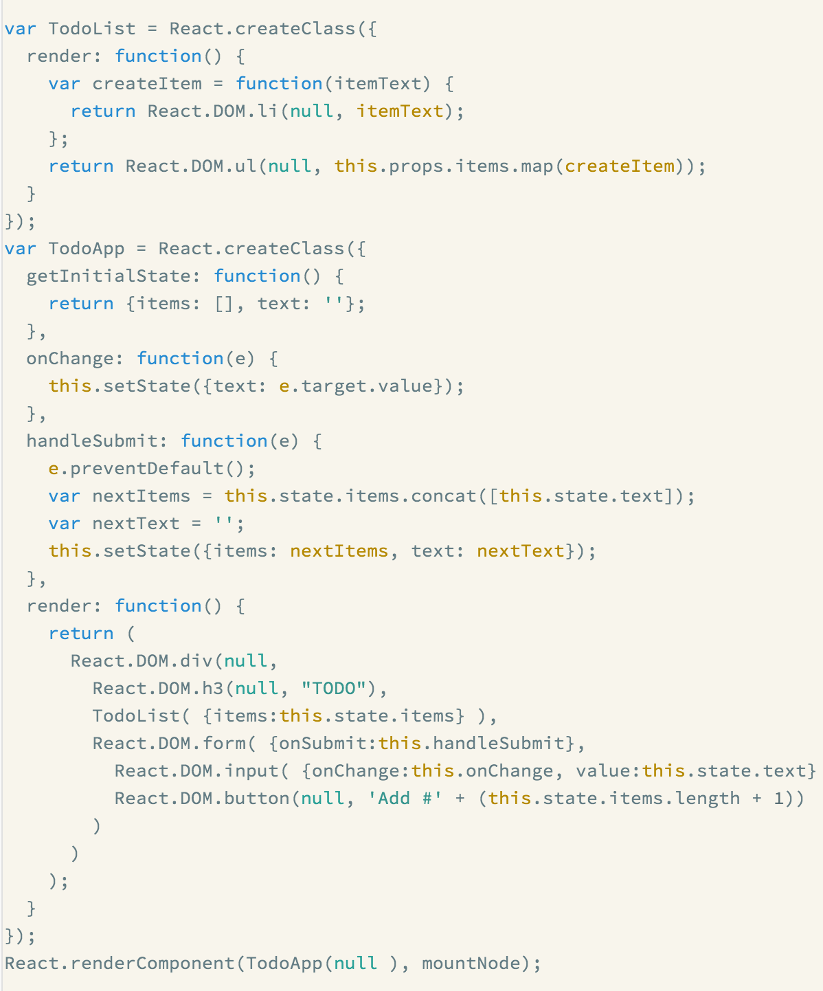
Notes:
Or: mixing markup and display logic

Slide 11
We all like separation of concerns, right?

Slide 12
Separation of concerns:
Reduce coupling, increase cohesion.

Slide 13
Coupling is:
“The degree to which each program module relies on each of the other modules.”
http://en.wikipedia.org/wiki/Coupling_(computer_science)

Slide 14
Cohesion is:
“The degree to which elements of a module belong together.”
http://en.wikipedia.org/wiki/Cohesion_(computer_science)

Slide 15
Templates encourage a poor separation of concerns.
So are Angular-style directives.

Slide 16
“View model” tightly couples template to display logic.
[{“price”: “7.99”, “product”: “Back scratcher”, “tableRowColor”: “rgba(0, 0, 0, 0.5)”}]

Slide 17
Display logic and markup are inevitably tightly coupled.
How do you find DOM nodes?

Slide 18
Display logic and markup are highly cohesive.
They both show the UI.

Slide 19
Templates separate technologies, not concerns.
And they do it by being deliberately underpowered.

Slide 20
Symptoms that your front-end technology is underpowered:
Reliance on primitive abstractions (like {{> }} and {{#each }}).
Notes:
PARTIALS

Slide 21
Symptoms that your front-end technology is underpowered:
Inventing lots of new concepts (that already exist in JavaScript).

Slide 22
From the Angular directives docs: “However isolated scope creates a new problem: if a transcluded DOM is a child of the widget isolated scope then it will not be able to bind to anything. For this reason the transcluded scope is a child of the original scope, before the widget created an isolated scope for its local variables. This makes the transcluded and widget isolated scope siblings.”
http://docs.angularjs.org/guide/directive

Slide 23
The framework cannot know how to separate your concerns for you.
It should only provide powerful, expressive tools for the user to do it correctly.
Notes:
Jab ember?

Slide 24
This tool is a React component.
A highly cohesive building block for UIs loosely coupled with other components.

Slide 25
Use components to separate your concerns.
With the full power of JavaScript, not a crippled templating language.

Slide 26
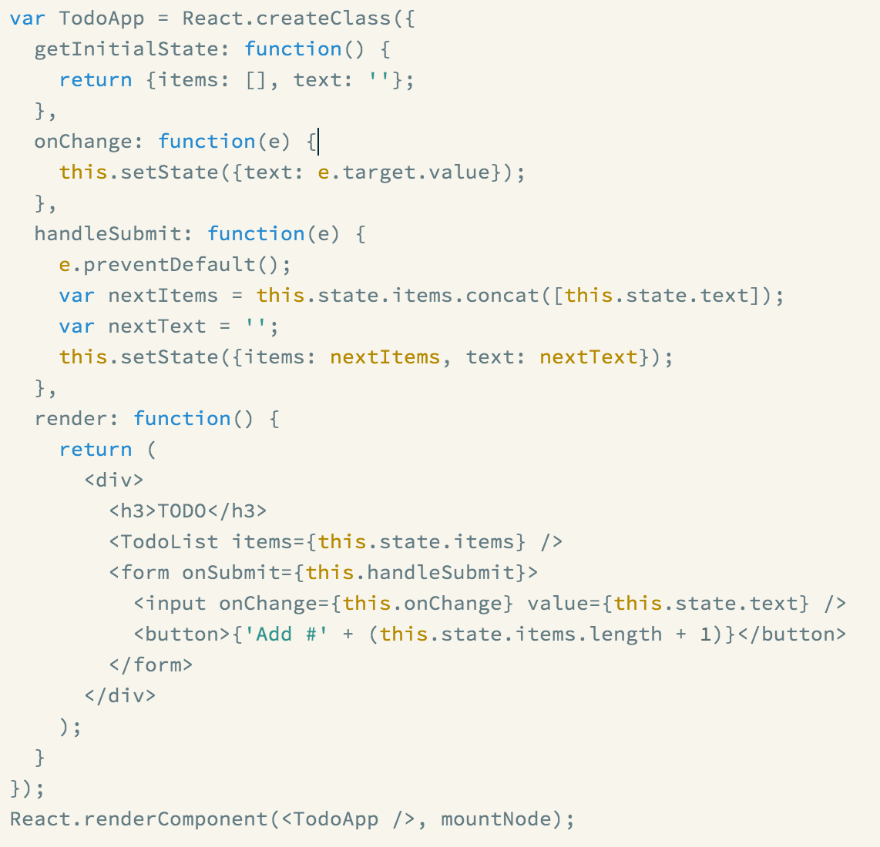
Abstraction
Composition
Expressivity
Notes:
Dismiss syntax

Slide 27
Components are reusable.

Slide 28
Components are composable.

Slide 29
Components are unit testable.
They are, after all, units.

Slide 30
What about spaghetti code?
Notes:
“You want me to generate my markup in JavaScript!?”

Slide 31
Just don’t write spaghetti code.
Keep your components small.

Slide 32
Just don’t write spaghetti code.
Only put display logic in your components.

Slide 33
Just don’t write spaghetti code.
“With great power comes great responsibility” – Uncle Ben in Spiderman

Slide 34
What about XSS?

Slide 35
React.DOM.a( {href: ‘http://instagram.com/floydophone’}, ‘@floydophone on Instagram’ );

Slide 36
What about working with designers?

Slide 37
JSX is an optional preprocessor to let you use HTML-like syntax.
<a href=“http://instagram.com/floydophone”> @floydophone on Instagram </a>

Slide 38
JSX is an optional preprocessor to let you use HTML-like syntax.
React.DOM.a(
{href: ‘http://instagram.com/floydophone’}, ‘@floydophone on Instagram’ )

Slide 39
With JSX, it’s easy for designers to contribute code.

Slide 40
The accessibility of templates and the power of JavaScript.

Slide 41
2. Re-render the whole app on every update
The key design decision that makes React awesome.

Slide 42
Building UIs is hard because there is so much state.
Lots of UI elements · Design iteration · Crazy environments · Mutable DOM · User input · etc etc

Slide 43
Data changing over time is the root of all evil.

Slide 44
“Our intellectual powers are rather geared to master static relations and our powers to visualize processes evolving in time are relatively poorly developed. For that reason we should do (as wise programmers aware of our limitations) our utmost to shorten the conceptual gap between the static program and the dynamic process, to make the correspondence between the program (spread out in text space) and the process (spread out in time) as trivial as possible” – Dijkstra

Slide 45
In the 90s it was easier.
Just refresh the page when the data changes.
Notes:
----- Meeting Notes (8/22/13 16:30) -----
which places in the page do i have to update my like count

Slide 46
When the data changes, React re-renders the entire component.

Slide 47
That is, React components are basically just idempotent functions.
They describe your UI at any point in time, just like a server-rendered app.
Notes:
----- Meeting Notes (8/22/13 16:30) -----
easy to unit test

Slide 48
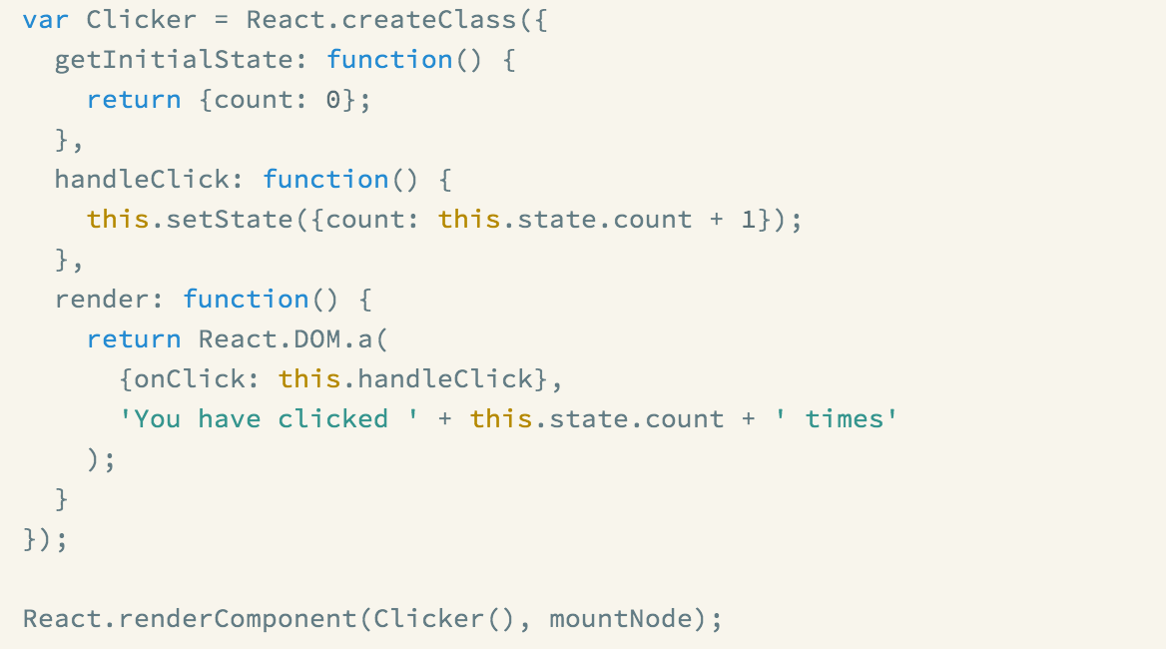
Notes:
----- Meeting Notes (9/9/13 12:00) -----
nowhere in this example is the dom node for count explicitly updated

Slide 49
Re-rendering on every change makes things simple.
Every place data is displayed is guaranteed to be up-to-date.

Slide 50
Re-rendering on every change makes things simple.
No magical data binding.

Slide 51
Re-rendering on every change makes things simple.
No model dirty checking.

Slide 52
Re-rendering on every change makes things simple.
No more explicit DOM operations – everything is declarative.

Slide 53
“Re-render on every change? That seems expensive.”
“And doesn’t it mess up form fields and scroll position?”

Slide 54
3. Virtual DOM
Makes re-rendering on every change fast.

Slide 55
You can’t just throw out the DOM and rebuild it on each update.
It’s too slow and you’ll lose form state and scroll position.

Slide 56
So we built a virtual DOM (and events system).
Optimized for performance and memory footprint

Slide 57
On every update…
React builds a new virtual DOM subtree
…diffs it with the old one
…computes the minimal set of DOM mutations and puts them in a queue
…and batch executes all updates

Slide 58
React’s architecture looks a lot like the Doom 3 engine

Slide 59
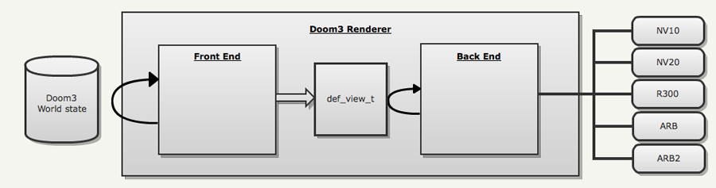
http://fabiensanglard.net/doom3/renderer.php

Slide 60
GFX card
Game state / input
Game logic
Scene IR
Render OpenGL ops
http://fabiensanglard.net/doom3/renderer.php

Slide 61
Browser
App state / events
React components
Virtual DOM
Compute DOM operations
http://fabiensanglard.net/doom3/renderer.php

Slide 62
It’s fast!
Because the DOM is slow!

Slide 63
It’s fast!
Computes minimal DOM operations

Slide 64
It’s fast!
Batched reads and writes for optimal DOM performance

Slide 65
It’s fast!
Usually faster than manual DOM operations

Slide 66
It’s fast!
Automatic top-level event delegation (with cross-browser HTML5 events)

Slide 67
It’s fast!
Provides hooks for custom update logic (though they’re almost never used)
Notes:
Two-way data binding talk

Slide 68
It’s fast!
Can do all this at 60fps, even in a (non-JIT) UIWebView on the iPhone.

Slide 69
The virtual DOM lets us do fun things.
It can run in Node.js (new in 0.4)

Slide 70
The virtual DOM lets us do fun things.
Optimizations based on app structure

Slide 71
The virtual DOM lets us do fun things.
Testability for free

Slide 72
The virtual DOM lets us do fun things.
SVG, VML and <canvas> support

Slide 73
The virtual DOM lets us do fun things.
Running the whole app in a Web Worker (experimental)

Slide 74
Key takeaways

Slide 75
Components, not templates.

Slide 76
Re-render, don’t mutate.

Slide 77
Virtual DOM is simple and fast

Slide 78
Thanks for Rethinking Best Practices with me!
http://reactjs.org/
#reactjs on Freenode IRC
reactjs on Google Groups

