Slide 1
Economic Crisis Prediction: Early Warning Systems for Banking Crises
Evaluating the Interpretability–Performance Trade-off Under Structural Non-Stationarity
Pavlos Papachristos
MSc Artificial Intelligence · Supervisor: Dr Steph Paladini
PP24589
August 2026
Notes:
~25 sec. Introduce yourself and the title. One-sentence framing: this project asks why ML early-warning systems that look excellent on paper keep failing when tested honestly on the future - and whether interpretability costs anything in the process.

Slide 2
Contents
1. Introduction — Research question and hypotheses (H1–H3)
2. Methodology — Data, four model classes, two-stage evaluation design
3. Results — Discrimination — Stage 1 and Stage 2 performance; ROC/PR; 2007 country ranking
4. Results — Sentiment (H1) — matched pairwise decomposition: algorithm effect vs sentiment effect
5. Results — Mechanism & Training-Window Instability — EBM shape functions and regime instability
6. Results — Strict Prospective Validation — Strict temporal splits; structural break evidence
7. Results — Robustness — Multiple-testing correction, LOCO, hyperparameter sweep
8. Conclusions — Central thesis, recommendations, limitations and future work
1
Notes:
~15 sec. One breath over the agenda: introduction and hypotheses, methods, four results blocks - discrimination, sentiment, mechanism, prospective validation and robustness - then conclusions.

Slide 3
Introduction
Research Question and Hypotheses
The core problem: Models credited with predicting a crisis have usually already learned from that era. Tested under strictly forward-looking conditions, performance collapses — is the fix more data, a better model, or the framework itself?
Research question (gap: Beutel, List & von Schweinitz, 2019): under what structural conditions do ML-based early-warning systems fail to deliver genuinely prospective performance — and why does a model trained on one crisis era fail when the next, structurally different one arrives?
– H1 — Does language add signal? Do central-bank communications (FinBERT sentiment) improve crisis prediction beyond what macro-financial data already contains?
– H2 — If it matters, it should show. If sentiment carries real signal, sentiment features should rank among the model’s most influential predictors.
– H3 — The price of transparency. Does choosing a model whose reasoning we can read (EBM) cost accuracy compared with black-box alternatives?
One rule governs every number in this talk: the model never sees anything dated after the moment of prediction.
2
Notes:
~55 sec. Open with the core problem: a model credited with 'predicting' 2008 has usually already learned from that era - the honest test is train on the past, predict the future. Then the research question: why does a model trained on one crisis era fail when the next, structurally different one arrives? Then the three hypotheses as plain questions - does language add signal; if it matters it should show; the price of transparency. Close with the one rule: the model never sees anything dated after the moment of prediction.

Slide 4
Methodology
A Two-Stage Pipeline with Four Model Classes
– Data: JST Macrohistory R6 — 18 economies; 41 macro features (lags 1–3, demeaned). Target_h2 = 1 if crisis onset within the next two years.
– Text layer: 16,622 BIS central-bank speeches → FinBERT → 20 sentiment features (14 intended; a feature-selection pattern captured 6 further lag-3/derived columns — a labelling discrepancy only, no validity impact, §3.3).
– Models: M1 Logistic · M2 Random Forest · M2.5 EBM (interpretable) · M3 XGBoost + FinBERT.
– Validation: employs expanding-window cross-validation, plus strict temporal splits, LOCO (Leave-One-Country-Out), and calibration analysis.
Stage 1: 27 folds (1992–2018, 4-yr burn-in).
Stage 2: 12 folds (2007–2018); 2019–20 held out in both stages.
Two Evaluation Stages:
Stage 1 — extended panel: panel 1989–2020, 37 labels → 19 onsets → 3 episodes; scored 1993–2018, 28 positives of which 93% are GFC — broader than Stage 2, still an upper bound.
Stage 2 — 2007 GFC case study: 26 positive labels, ~11 effective positives in one GFC episode — cross-sectional ranking, an upper bound for performance, not a direct measure of prospective performance.
Aim: Can an interpretable non-linear model predict banking crises under forward-looking evaluation — and if not, why does generalisation fail?
3
Notes:
~45 sec. Walk data, models, validation quickly. Stress the Stage 1 / Stage 2 distinction - Stage 2 is a single-episode ranking exercise; every Stage 2 number is an upper bound. This pre-empts the most common examiner challenge. If asked how many independent episodes: the 37 positive labels are 19 distinct onsets - the two-year horizon assigns up to two labels per onset - clustering into three systemic episodes: early-1990s European/Nordic (6 onsets), Japan 1997 (1), and the GFC 2007-08 (12, i.e. roughly two-thirds). Three regimes, not thirty-seven observations - which is the constraint the whole thesis is about. Table 4.4 already counts onsets rather than labels. If pressed on Stage 1 versus Stage 2: the panel is multi-episode but the SCORED sample is not - 467 observations, 28 positives, 1993-2018, and 26 of those 28 are the GFC. The early-1990s cluster falls inside the burn-in and is never scored. So Stage 1 is broader than Stage 2 in training history, not a fully independent multi-episode test. I state this in 4.1.

Slide 5
Results — Discrimination
Stage 1 (scored 1993–2018, 28 positives): the Interpretable Model Leads
Model | Features | AUROC [95% CI] | AUPRC | Lift
M1 Logistic (lag1) | 19 | 0.606 [0.477, 0.739] | 0.139 | 2.3×
M2 Random Forest | 41 | 0.636 [0.484, 0.781] | 0.224 | 3.7×
M2.5 EBM (interpretable) | 41 | 0.753 [0.649, 0.855] | 0.273 | 4.5×
– +0.117 AUROC gap, EBM vs RF, on identical features — DeLong z = −3.35; survives country-cluster bootstrap (95% CI [+0.068, +0.175], LOCO jackknife sd 0.007) but not year-block resampling (CI [−0.011, +0.248]).
– 4.5× base-rate lift on precision–recall (scored base rate 6.0%, 28/467) — highest of the Stage 1 models.
– Caveat: all expanding-window figures are upper bounds; and 93% of scored positives are GFC, so this is a within-regime result (§4.1, §4.2).
4
Notes:
~35 sec. Headline: the natively interpretable EBM posts the highest Stage 1 point estimates on identical features. Lead with the ROBUST reading, not the naive one: the pooled DeLong test is significant but panel dependence invalidates its standard error; country-resampling supports the gap, year-resampling does not. H3's presumed trade-off is not observed in-regime. If asked about 19 vs 41 features: 19 is the lag-1 slice of the same 41 set; the bridge logistic M1b on all 41 features scores AUROC 0.646 / AUPRC 0.145 - it catches the RF (0.636) but not the EBM (0.753), so the gap is non-linearity, not feature count. On the clustered inference: pooled panel predictions breach DeLong's independence assumption, so I re-ran it as a cluster bootstrap, 5000 replicates. Resampling countries, the gap holds - CI 0.068 to 0.175, p=0.0002 - and a leave-one-country-out jackknife moves it only between 0.101 and 0.127. Resampling years, it does not - CI spans zero. That is not a weakness in the finding, it locates it: the EBM advantage is a stable CROSS-COUNTRY regularity, but 93 per cent of scored positives are the GFC, so it is a within-regime result. My own headline is subject to the non-stationarity the thesis identifies.

Slide 6
Results — Discrimination
Stage 2 (2007 GFC single-episode case study): Same Pattern
Model | Features | AUROC [95% CI] | AUPRC | Lift
M2-matched RF | 41 | 0.939 [0.897, 0.970] | 0.343 | 6.7×
M2.5-matched EBM | 41 | 0.960 [0.927, 0.988] | 0.532 | 10.4×
M3 XGBoost + FinBERT | 61 | 0.932 [0.875, 0.979] | 0.411 | 8.0×
M4 E1-EBM ensemble | — | 0.955 | 0.433 | 8.5×
– 0.532 EBM AUPRC — 10.4× the scored base rate (5.1%, 11/215); highest of any single model.
– p = 0.097 EBM vs RF DeLong — not statistically separable within one episode (11 positive observations in the evaluated 2007 fold).
– Ensemble: posts the lowest Brier of any configuration (0.056) but does not beat the EBM on AUROC or AUPRC — a probability-accuracy gain (Brier), not a discrimination gain.
Single fold — country ranking only, not prospective performance. All four rows are computed on the same scored sample: 215 observations, 11 positives, 5.1% base rate (Table 4.6). Lift is AUPRC over that scored prevalence.
5
Notes:
~30 sec. Same pattern in the 2007 cross-section: EBM leads every single model on AUPRC at 0.532. Two honest caveats: within a single episode the EBM-RF difference is not separable (p=0.097), and the ensemble smooths calibration at the cost of precision-recall. This transparent assessment sets the stage for the subsequent slides. Note the lift column now uses the SCORED prevalence (5.1%, 11/215) rather than the full-panel 8.15% - the AUPRC no-skill baseline is the prevalence in the evaluated sample. The correction runs in our favour: the EBM's lift is 10.4x, not 6.5x.

Slide 7
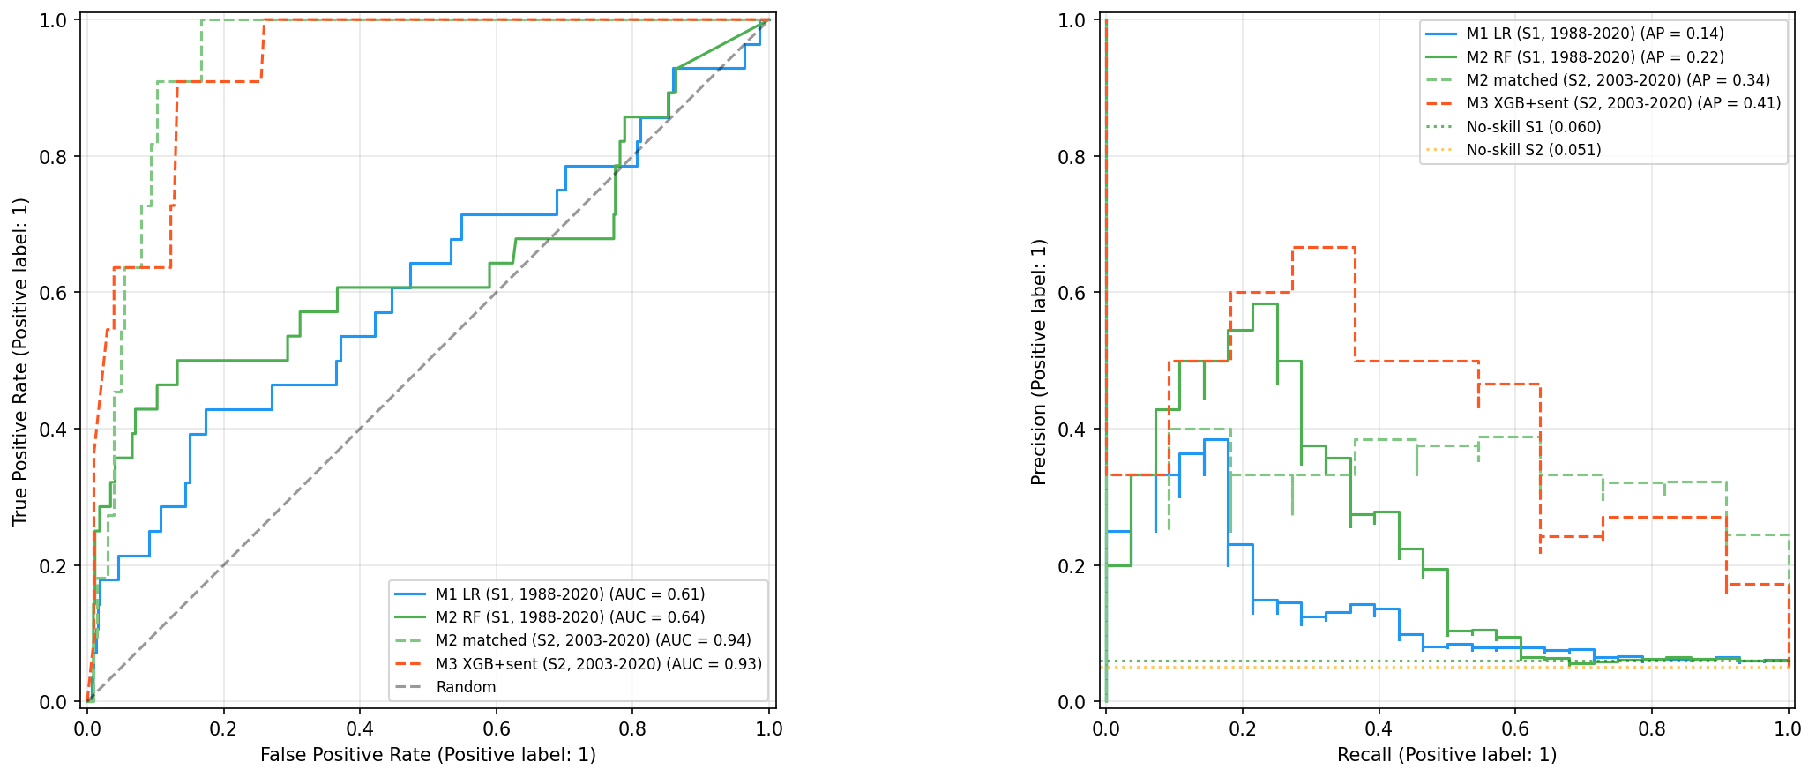
Results — Discrimination
ROC and Precision–Recall Curves (Figure 4.1)
Figure 4.1 — Solid: Stage 1 — 467 scored observations, 28 positives, 1993–2018; broader training window but GFC-dominated scored evaluation. Dashed: Stage 2 — 215 scored, 11 positives; single-episode case study. The contrast is itself part of the argument: the broader window is more informative than the single-episode case study; strict temporal validation is the genuinely prospective test.
6
Notes:
~25 sec. Point at the solid Stage 1 curves - modest and realistic - versus the dashed Stage 2 curves compressed toward the corner because the evaluation is concentrated on one well-understood crisis.

Slide 8
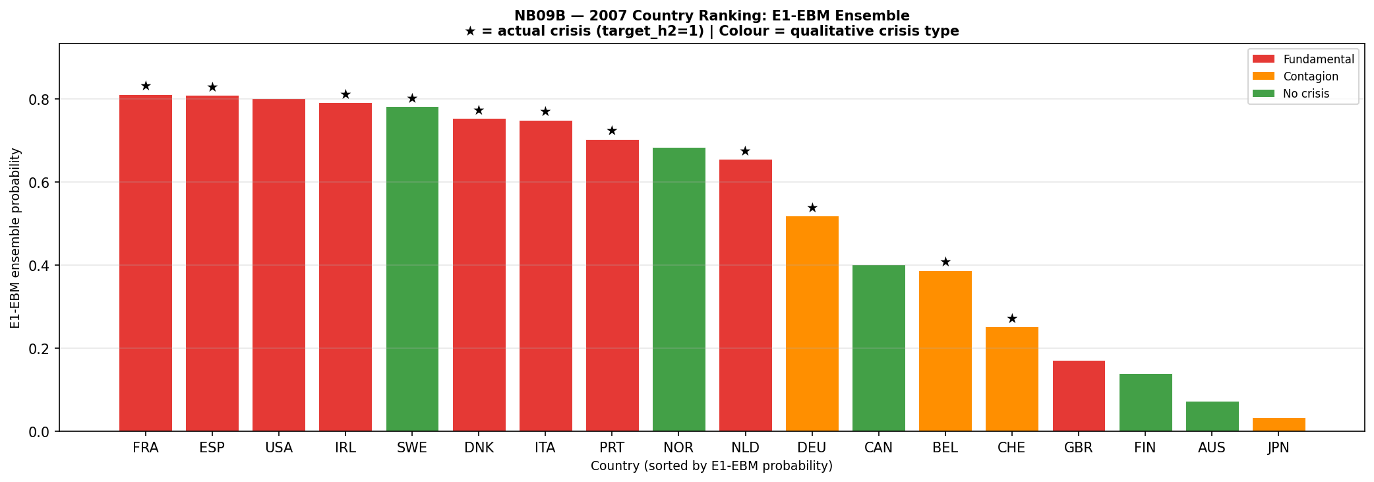
Results — Discrimination
The 2007 Country Ranking (Figure 4.11)
Figure 4.11 — E1-EBM ranking, coloured by qualitative crisis type (★ = positive under the JST two-year target).
– Fundamental 0.695 > Contagion 0.395 > No-crisis 0.325 (exploratory, post-hoc) — the ranking tracks domestic credit-cycle precursors, on which the model was trained.
– Spain flagged on credit growth of 19.8% p.a. (E1-EBM 0.810); UK low at 0.171 (rank 15) — not a false negative (target_h2 = 0), but a qualitative scope limit: funding-channel fragility lies outside the macro feature set (§5.4).
7
Notes:
~35 sec. The ranking shows informative failure: fundamental domestic credit-boom crises at the top around 0.8; the ordering is Fundamental > Contagion > No-crisis - the ranking tracks domestic credit-cycle precursors the model trained on, and this crisis-type read is explicitly exploratory and post-hoc. Spain versus UK makes the logic legible - Spain flagged on a classic domestic credit boom (19.8% p.a.); the UK is not a missed crisis (target_h2 = 0) but a scope limit, its funding-channel fragility outside the feature set. If asked about Sweden (rank 5, 0.783): crisisjst=1 in 2008 - a TRUE positive, not a false positive.

Slide 9
Results — Sentiment (H1)
Does Sentiment Help? Matched Pairwise Decomposition (§4.2.1)
The published M3-vs-M2 comparison changes algorithm and features at once; the added cells partially separate algorithm-class from feature-set differences, but do not form a fully orthogonal factorial design.
8
Notes:
~30 sec. At first glance sentiment appears to help: M3 beats the macro-only RF. But that comparison changes two things at once. So I fitted the missing cells of the matched pairwise set - every combination of algorithm and feature set on the same 2007 cross-section.

Slide 10
Results — Sentiment (H1)
Isolated Effects: More Consistent with Algorithm Class than Sentiment
– +0.043 algorithm effect — EBM vs XGBoost, feature set fixed at 61 (directional; no independent CI).
– −0.078 sentiment effect — EBM, adding sentiment. Bootstrap 95% CI [−0.292, +0.187] spans zero: statistically insignificant, directional — and negative.
– 0 / 156 sentiment Granger tests surviving Benjamini–Hochberg or Bonferroni correction (§4.9.4) — corroboration independent of any model.
H1 verdict: not confirmed. M3’s raw AUPRC edge (0.411 vs 0.343) is directionally observed but statistically unconfirmed (bootstrap 95% CI [−0.130, +0.312] spans zero); the apparent gain over RF is more consistent with a change in algorithm class than an incremental effect from sentiment data; the isolated sentiment contribution is directionally negative.
9
Notes:
~35 sec. Holding features fixed, EBM beats XGBoost by 0.043 - an algorithm effect. Holding the algorithm fixed, adding sentiment REDUCES AUPRC by 0.078, CI spans zero. And upstream, zero of 156 sentiment Granger tests survive correction. Verdict on H1: not confirmed. If you want the memorable line, deliver it AFTER the formal conclusion, not instead of it: an algorithm effect wearing a sentiment costume.

Slide 11
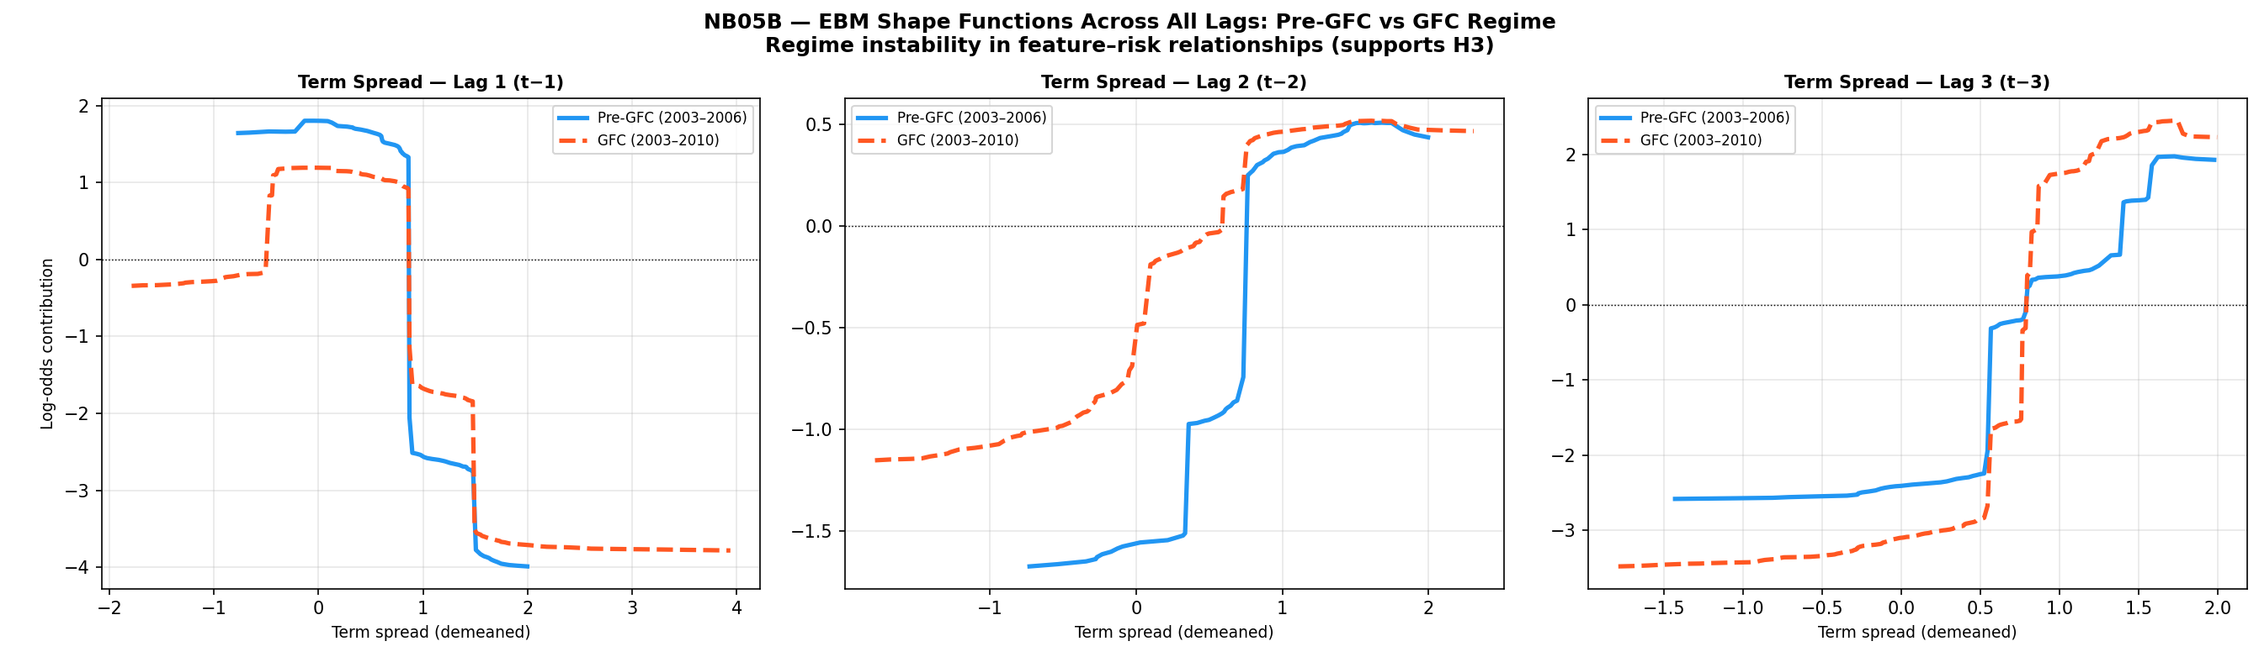
Results — Mechanism & Training-Window Instability
Shape Functions: the Same Value Flips Sign (Figure 4.7)
– Divergent fits: risk mappings learned on the early GFC-run-up window (blue, 2003–2006) differ from those learned on the GFC-inclusive window (red, 2003–2010) across all examined lags, most clearly in the lag-3 term-spread function.
– Term-spread sign inversion: the same feature value is risk-reducing in one training window and risk-increasing in the other — a sign inversion no single static model can capture.
– Direct evidence: shape functions ARE the model, so the instability is a property of the fitted model itself — not an artefact of a post-hoc explanation tool like SHAP. The two windows are nested, so this is training-window instability; the disjoint cross-regime test is Appendix A (NB11: pre-GFC 1989–2002 vs GFC-inclusive).
– Separate H2 result — H2 not supported: no sentiment feature in the top-5 by SHAP or EBM native importance (five appear in M3’s SHAP top-20); importance is led by term spread (term_spread_lag3 = 1.717) and credit.
10
Notes:
~50 sec. The intellectual core. Walk the lag-3 panel: the early-run-up curve (blue, 2003-06) rises monotonically; the GFC-inclusive curve (red, 2003-10) reverses it at high spread values - the two curves cross at moderate positive spreads. Same value, opposite risk contribution. Because shape functions are the model itself, this directly demonstrates instability in what the fitted model learns - not attribution noise; note these are nested training windows (2003–06 vs 2003–10), so Figure 4.7 shows training-window instability, with the disjoint cross-regime comparison in Appendix A (NB11); together with the credit-growth break test it is consistent with a shifting data-generating process, though sample-driven model variance cannot be excluded. It also answers H2: importance is all macro.

Slide 12
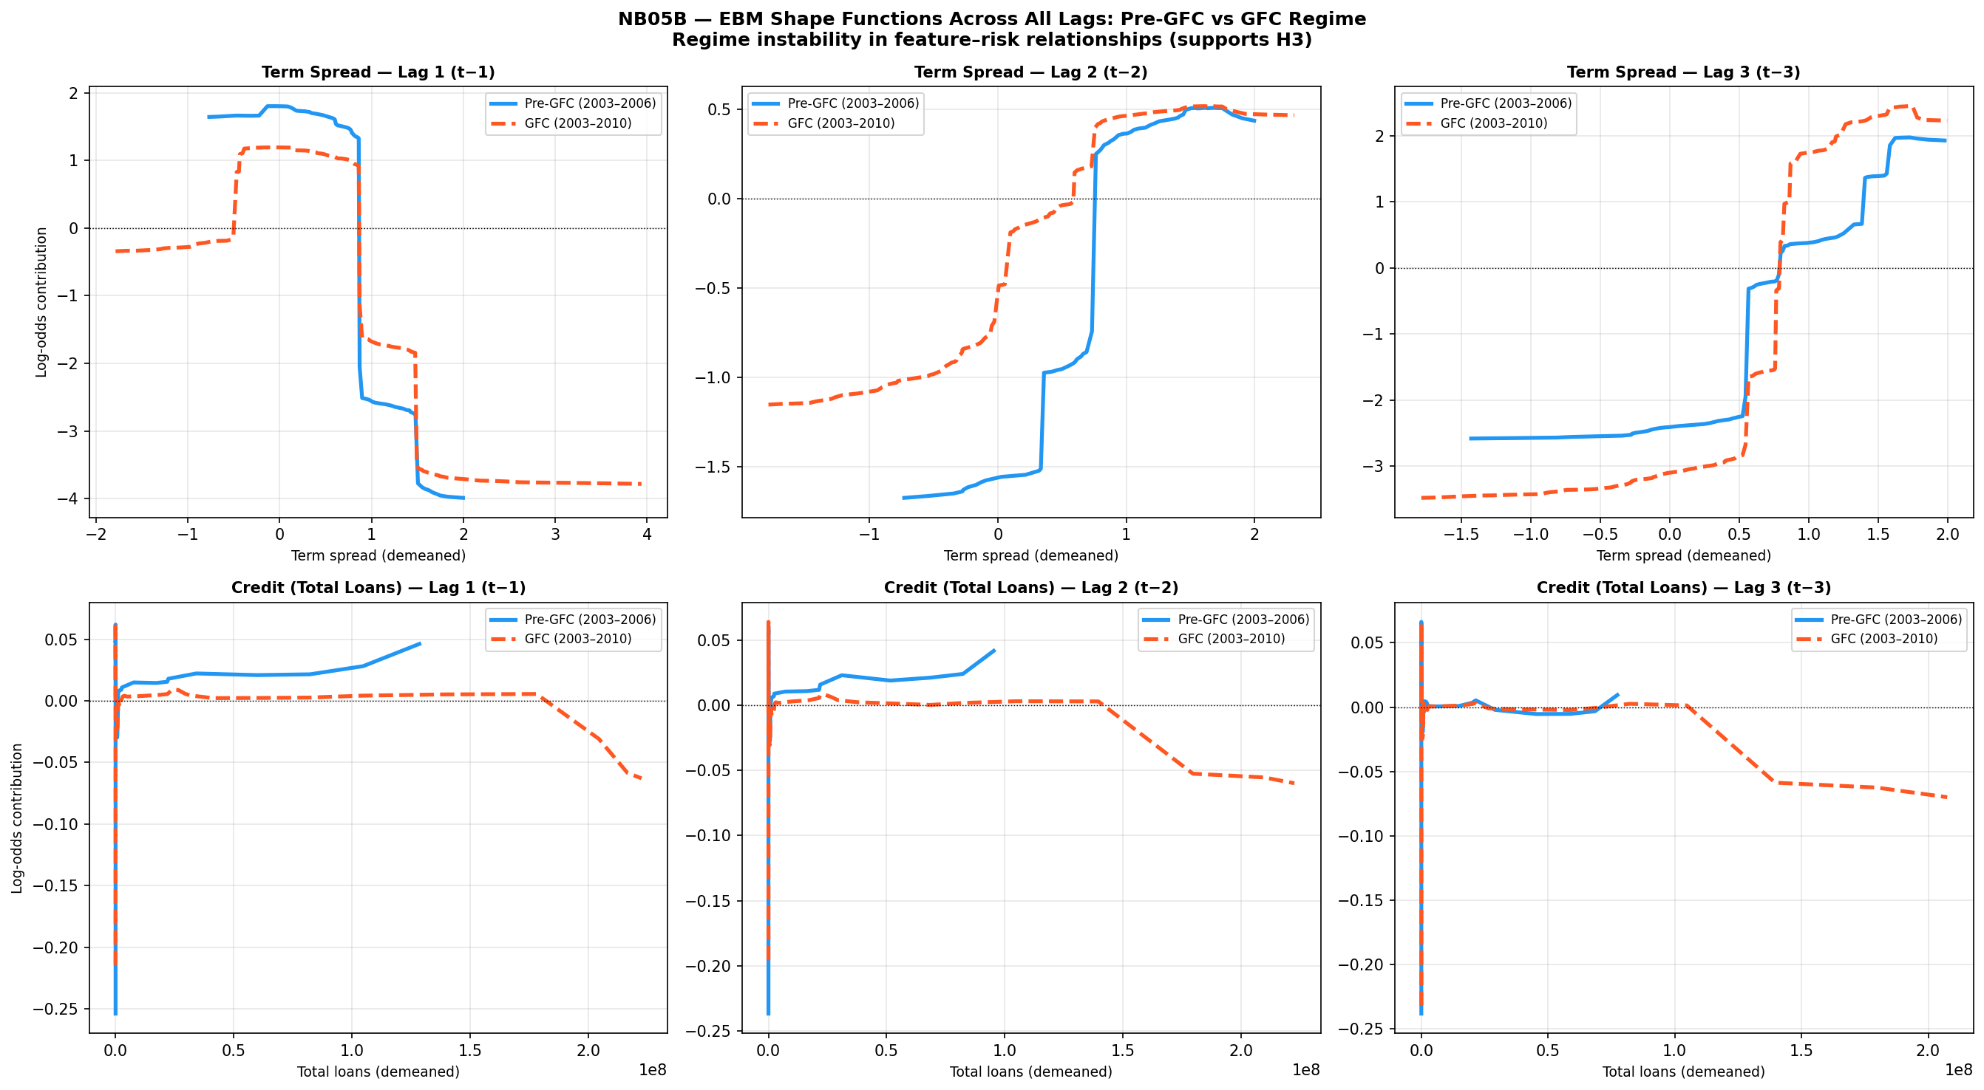
Results — Mechanism & Training-Window Instability
Full Shape-Function Comparison, All Lags (Figure 4.7)
Figure 4.7 — top row: term spread, lags 1–3; bottom row: credit (total loans), lags 1–3. Training-window instability in the feature–risk relationships supports the H3 refinement.
11
Notes:
~30 sec. The full six-panel view: the pattern is systematic across lags and features, not cherry-picked - term spread on top, credit below, and the two training windows disagree everywhere it matters.

Slide 13
Results — Strict Prospective Validation (H3 refined)
Strict Temporal Splits: More of the Same Data Is Not the Answer (Table 4.4)
Split | Train | Test | Train / test onsets | RF AUROC | EBM AUROC | 0.75 bench
A: Pre-Nordic | 1989–90 | 1991–97 | 5 / 1 | 0.572 ✗ | 0.752 ✓* | EBM only*
B: Pre-GFC extended | 1989–2002 | 2003–11 | 6 / 13 | 0.481 ✗ | 0.333 ✗ | Both fail
C: Pre-GFC short | 2003–05 | 2006–09 | 0 / — | — | — | skipped: 0 train pos.
– Key finding (§6.2.1): prospective failure is not an artefact of insufficient training data — M2 trained on the full pre-GFC history (1989–2002, Nordic cluster and Japan 1997 included) still scores 0.481, below random.
– 0.333 EBM Split B — the more flexible fit falls furthest: directionally consistent with regime-specific overfitting (one thin split; stated as directional).
– In plain terms: the collapse is consistent with a shift in the underlying feature–risk relationships, rather than insufficient training history alone.
*Split A rests on a single test positive — reported for completeness, not a distributional estimate (Table 4.4). Split B is the only split with enough test cases to be informative, and its six training positives keep the EBM–RF gap directional.
12
Notes:
~35 sec. The decisive test: train pre-2003, predict the GFC. Lead with 6.2.1 - more data is not the answer: even trained on the full pre-GFC history - 1989-2002, Nordic cluster and Japan 1997 included - the RF performs below random. The EBM, being more flexible, fails more dramatically - directionally consistent with flexibility amplifying overfitting to a specific regime; six training positives cannot confirm it statistically. The collapse is consistent with a shift in the underlying feature-risk relationships rather than insufficient training history alone.

Slide 14
Results — Strict Prospective Validation (H3 refined)
Why It Fails: Structural Break Evidence
– p = 0.0066 Chow-type likelihood-ratio structural break in credit growth at 2007 — genuine coefficient sign reversals (§4.9.7).
– Supporting instability (not a break test): term-spread β differs in sign across lag horizons (lag-1 −0.646, lag-3 +0.630, both p < 0.01) — a distributed-lag sign difference independent of any ML model, not direct evidence of regime change (§4.9.5).
– Term spread @2007: LR = 4.209, p = 0.379 — directionally suggestive, underpowered.
– 0 scored observations 2019–20: reported performance is unaffected by COVID-period observations; the collapse is GFC-specific, not pandemic noise.
H3 verdict — original (pre-specified): partially supported, not monotonic — the linear-to-black-box step shows a trade-off, but the EBM shows interpretability and strong in-regime estimates can coexist. Exploratory extension: the EBM's larger Split B collapse is directionally consistent with flexibility-related overfitting, but is not confirmatory. Evidence is most consistent with structural non-stationarity, though sparse samples and model variance cannot be excluded.
13
Notes:
~30 sec. The interpretation is corroborated formally: credit growth breaks at 2007 with p=0.0066 and genuine sign reversals. And there is no COVID contamination - zero scored observations in 2019-20 by construction. H3 verdict: partially supported, non-monotonic; the flexibility refinement is data-driven and exploratory, not confirmatory (Table 4.7).

Slide 15
Results — Robustness
Multiple-Testing Correction and Robustness Checks
– 1 / 84 macro Granger tests survive Bonferroni & Benjamini–Hochberg: USA credit growth lag-3 (p = 0.000015) is the sole survivor (§4.9.1); none of the five term_spread_lag3 country results survives. Everything else is treated as suggestive at most.
– Median 0.967 LOCO EBM AUROC across 15 held-out countries (mean 0.893) — the expanding-window ranking is not driven by any single country — but this is cross-country generalisation within the historical sample, not the cross-regime robustness that strict temporal validation still fails; the median is the honest summary because 11 of 15 countries carry a single crisis onset.
– Range 0.0071 EBM AUROC across 5 hyperparameter configurations — the headline EBM result is stable across the five tested configurations (Appendix B.2).
14
Notes:
~25 sec. Three results protect the headline claims: one of 84 Granger tests survives correction; LOCO median 0.967 across held-out countries; and the hyperparameter sweep moves AUROC by 0.007 - essentially flat. Brisk and factual - these are the robustness checks that bound the headline claims.

Slide 16
Results — Granger Causality
Granger Causality: Do the Predictors Lead Crisis Onset?
– Why run it — a model-independent check of whether a predictor’s own lagged values improve the prediction of crisis onset beyond the panel’s existing information (F-test on lagged coefficients, demeaned features). It guards against reading in-sample ML attribution (SHAP / EBM importance) as genuine predictive signal.
– 84 macro tests — credit growth and term spread, each at lags 1–3, across 14 of 18 countries (4 dropped: a constant crisis indicator makes the F-test uncomputable). 16 reach nominal 5% significance vs ≈4.2 expected by chance, with term-spread significance clustering at lag 3 (5 countries).
– 1 / 84 survive correction — under Bonferroni (α/m ≈ 0.000595) and Benjamini–Hochberg (q = 0.05), only USA credit growth at lag 3 survives (p = 0.000015, clearing the threshold ≈40×). None of the five term_spread_lag3 results survives, so the lag-3 concentration is descriptive — consistent with EBM importance (1.717) but not confirmation; the shape-function reversal (§4.7.3) is the stronger evidence.
– 0 / 156 sentiment tests survive — FinBERT sentiment on the 2003–2020 panel: 17 of 156 nominally significant (vs 7.8 expected), none surviving BH or Bonferroni. This corroborates the H1 “not confirmed” verdict independently of any model (§4.9.4).
15
Notes:
~40 sec. This slide unpacks the Granger battery that sits under the one-liners on the sentiment and robustness slides.
Rationale first: Granger causality is a model-independent test — does a predictor's own past improve the crisis forecast beyond what the panel already contains? It is the guard against reading in-sample SHAP or EBM importance as if it were predictive signal.
Macro battery: credit growth and term spread, lags 1-3, 14 of 18 countries (four dropped because a constant crisis series makes the F-test uncomputable) = 84 tests. 16 clear the uncorrected 5% bar against about 4.2 expected by chance — so without correction you cannot say which are real.
After Bonferroni and Benjamini-Hochberg, exactly one survives: US credit growth at lag 3, p=0.000015, about 40x inside the threshold. Crucially, none of the five term_spread_lag3 countries survives — so the lag-3 term-spread concentration that matches EBM's top feature (1.717) is a descriptive within-sample pattern, not a confirmed relationship. The shape-function sign reversal in 4.7.3 is the stronger evidence.
Sentiment: 156-test family, 17 nominally significant vs 7.8 expected, zero survive either correction — an independent corroboration of the H1 'not confirmed' verdict.
If asked why Granger on a binary target: it is used as an auxiliary screen (F-test on lagged predictor coefficients), not the primary evidence; the ML discrimination and the shape functions carry the argument, and the divergence between them is itself the point (4.9.8).

Slide 17
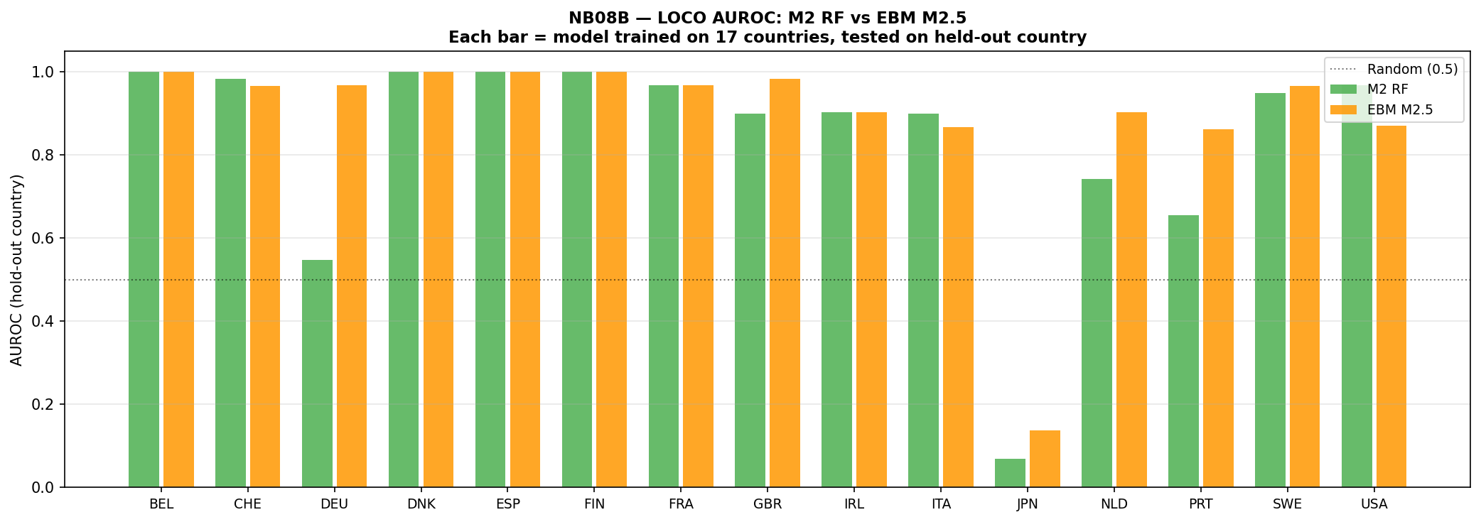
Results — Robustness
Cross-Country Generalisation: LOCO (Figure 4.3)
Figure 4.3 — Leave-one-country-out AUROC, RF (green) vs EBM (orange). EBM leads where events are informative: NLD 0.903 vs 0.742, DEU 0.968 vs 0.548, PRT 0.862 vs 0.655. Both near-random in JPN; AUS/CAN/NOR excluded (no hold-out events). Bars at 1.0 (BEL, DNK, ESP, FIN) are trivial single-event rankings — 11 of 15 countries carry a single hold-out onset, hence the median (0.967) as the honest summary.
16
Notes:
~15 sec. Visually: the EBM leads clearly where the held-out country has informative events - the Netherlands, Germany, Portugal - and both models are near-random in Japan.

Slide 18
Conclusions
Structural Non-Stationarity, Rather Than Model Choice, Best Explains EWS Failure
– No interpretability penalty in-regime: the EBM beats the black-box RF on identical features (Stage 1 DeLong p < 0.001) and tops M3’s point estimates.
– Flexibility, not interpretability, is the likely liability: under strict temporal validation both models fail; the more flexible fit degrades furthest (0.333 vs 0.481, directional — six training positives).
– Sentiment adds no confirmed signal: the apparent gain is more consistent with an algorithm-class effect than an incremental sentiment effect; 0/156 tests survive correction.
– The glass box is the diagnosis: shape-function sign inversions make instability in the learned feature–risk mapping directly observable — motivating regime-conditional design (Appendix A).
Framing (§5.2): the relationship between macroeconomic indicators and crisis risk is not stable over time — it is non-stationary. Crisis prediction is therefore a problem of modelling under distribution shift.
17
Notes:
~50 sec. Answer the research question in one sentence, from memory, looking at the examiners: EWS failure is most consistent with structural non-stationarity in the data-generating process rather than model choice. Then the four takeaways. Close with the 5.2 framing: crisis prediction sits within non-stationary ML under distribution shift. All five objectives met: O1 panel extension, O2 model sequence, O3 EBM regime-stability, O4 algorithm-controlled sentiment and ensemble evaluation, O5 distribution-shift implications. Four contributions (see backup slide): empirical - more history does not fix prospective failure; methodological - quantifying expanding-window bias vs strict temporal; interpretability - shape functions expose regime misspecification with no post-hoc step; theoretical - primary evidence the failure is structural non-stationarity.

Slide 19
Conclusions
Four Recommendations for EWS Design (§5.6)
1. Mandatory prospective validation — prospective validation across crisis regimes must be a required evaluation step — expanding-window metrics alone overstate readiness, as Split B shows.
2. Prioritise interpretable models — use interpretable non-linear models (EBM) as diagnostic benchmarks and candidate models rather than presumptively superior forecasters: no in-regime cost on identical features, plus diagnostic visibility — but EBM degrades furthest in the one informative strict split.
3. Use ensembles for probability accuracy — on the common 215-observation sample the ensemble posts the lowest Brier (0.056) but dilutes precision–recall (AUPRC 0.433 vs the EBM's 0.532) — an exploratory probability-accuracy benefit, not demonstrated prospective reliability.
4. Require multi-episode validation for sentiment — claims about sentiment's predictive power must be validated across structurally distinct crisis episodes before deployment — the apparent gain was more consistent with an algorithm-class effect than an incremental sentiment effect; 0/156 tests survive correction, and the completed topic-sentiment extension adds zero incremental gain.
Supervisory takeaway: read the shape functions, not just the scores — the glass box shows when a prediction should not be trusted.
18
Notes:
~30 sec. Count the four on your fingers: mandatory prospective validation; interpretable non-linear models as primary candidates; ensembles for calibration, not discrimination; multi-episode validation before sentiment is deployed. If probed on Rec 3: model disagreement is 2.8x higher at crisis observations (0.348 vs 0.125, M2m-EBM; 4.10.2) - ensembles help exactly where individual-model uncertainty peaks (Holopainen and Sarlin motivation).

Slide 20
Conclusions
Limitations and the Path Forward
– Thin crisis samples — 37 Stage 1 labels = 19 onsets = 3 episodes, and 93% of scored positives are GFC; even the EBM–RF gap survives country- but not year-resampling (§4.2). No result is established across regimes.
– Single-episode Stage 2 — framed as an upper bound throughout.
– English-only FinBERT model — untagged non-English/translated share in the corpus; an unresolved measurement limitation (§3.2, §5.7).
– In-sample isotonic calibration — ECE parity is a fitting artefact; flagged as a methodological caveat (§4.8).
Future work — regime-conditional EWS (Appendix A): every regime-specific model in the prototype stayed below the 0.75 benchmark (binding constraint: 11–26 positives per regime); what it nonetheless reveals is that the feature hierarchy shifts from term-spread (pooled) to CPI/debt dominance (pre-GFC). Two further extensions (§5.8): add cross-border bank-exposure / financial-network features to model contagion-driven crises (the UK/contagion scope gap revealed by the Spain–UK comparison); and detect regimes from data by clustering shape functions.
19
Notes:
~25 sec. Own the limitations plainly - thin events, single-episode Stage 2, English-only sentiment, calibration caveat - then pivot: the Appendix A prototype shows the feature hierarchy genuinely shifts across regimes; the constraint is sample size; the answer is data-driven regime detection. If probed on FinBERT: it only reads English; BIS coverage is mostly but not entirely English, and language was untagged at corpus construction, so the non-English share is unquantifiable - an unresolved limitation, not a filter we applied. Measurement error is structured by country, so H1's null means THIS measurement added nothing, not that central-bank language carries nothing. No validated multilingual FinBERT existed and translation distorts tone - and the null held in sentiment's best-case setting (predominantly English corpus, GFC-concentrated sample, isolated effect negative at -0.078). Further limitations if asked (5.7): crisis-label heterogeneity - the target conflates fundamental, contagion and exogenous episodes; uneven cross-country corpus volume and register; bootstrap CIs understate uncertainty under panel dependence (descriptive only - the disagreement analysis is the better-grounded characterisation). If asked why no LSTM/recurrent models (new 5.7 scope limitation): the comparison spans logistic, tree ensembles and a boosted GAM, not recurrent architectures (Tölö 2020), so the prospective-failure finding holds for the architectures tested, not for ML as a class. But the shape-function reversals (4.7.3) and the credit-growth break (4.9.7) show the feature-outcome mapping itself inverts - a sequence model learns dependency structure within a mapping; it does not repair a mapping whose sign reverses. Running a recurrent model through the Split B design is left to future work.

Slide 21
Q&A
Thank You — Questions Welcome
Read as a model-validation exercise, the central finding is a limit on domain of use: each model is fit for purpose within the regime that trained it, and no choice of algorithm moved that limit.
Interpretability’s contribution is to validation rather than accuracy: the EBM’s shape functions show which relationships the model relies on, and the structural-break evidence shows when they stopped holding (§6.4).
Supporting material: Appendix A (regime-conditional prototype) · Appendix B (notebook inventory & robustness).
20
Notes:
~10 sec. Pause after 'misspecification', deliver the legibility line, then stop. Likely questions: Stage 2 upper bound; Split B gap is directional; NB05A 61-vs-55 feature-count correction (documentation error only); why sentiment failed; how regime-conditional design works operationally. Also be ready for: alternative horizons - the 1-year and 3-year horizons (h1, h3) are infeasible on Stage 2, with insufficient positives under every horizon definition, a structural consequence of 2007 concentration (4.4); literature position - Beutel, List and von Schweinitz set the validation gap, Holopainen and Sarlin motivate the ensemble, Lou et al. is the EBM foundation, Ho, Moench and Steeley point to topic features (Rec 4); MSc AI requirement - end-to-end NLP pipeline (FinBERT on 16,622 speeches), interpretable ML, and distribution-shift analysis (1.5, 6.3); ethics - public secondary data, no human participants, seeds fixed at 42, full code on GitHub (3.2); generative-AI use was declared in 3.2 (literature-search support, code assistance, drafting) with all analysis and results author-verified.

Slide 22
Sources
Sources and Attribution (Backup)
Source | Location | Content used
Dissertation_V_49 | Abstract (p.5) | Core-problem framing; closing thesis
Dissertation_V_49 | §1.3 (p.7) | Research aim, question and hypotheses H1–H3
Dissertation_V_49 | §3.2–§3.5, Table 3.1 | Data sources, model specifications, validation design
Dissertation_V_49 | Tables 4.1–4.2 (p.21–23) | Stage 1 / Stage 2 model comparison results
Dissertation_V_49 | §4.2.1 (p.25) | matched pairwise algorithm-vs-feature decomposition
Dissertation_V_49 | Table 4.4 (p.27), §4.5.1 | Strict temporal validation (Splits A–C)
Dissertation_V_49 | Figure 4.7 (p.33) | EBM shape functions across two nested training windows
Dissertation_V_49 | §4.9.1, §4.9.4–§4.9.7 (p.35–38) | Multiple-testing corrections; panel logistic; structural break test
Dissertation_V_49 | Figures 4.1, 4.3, 4.11 | ROC/PR curves; LOCO; 2007 country ranking
Dissertation_V_49 | §6.2.1, §5.6, §6.4 (p.51–60) | Key conclusions, recommendations, closing reflection
All figures and tables are reproduced from Dissertation_V_49; all metrics computed in the accompanying notebooks (Appendix B inventory).
21
Notes:
Backup slide - not presented. Source attribution for every claim in the deck, by dissertation section, table and figure.

Slide 23
Conclusions
Original Contributions of This Work (Backup)
Contribution | What is original | Anchor evidence
Empirical | Extending training history does not resolve prospective failure | Split B: both models below random (§6.2.1)
Methodological | Quantifies expanding-window evaluation bias vs strict temporal results | §4.1 upper bounds vs §4.5 Split B collapse
Interpretability | EBM shape functions expose training-window instability — no post-hoc step | Figure 4.7 sign inversions (§4.7.3)
Theoretical | Convergent, mechanism-level evidence consistent with structural non-stationarity rather than algorithm choice; sparse-sample instability not excluded | Structural break §4.9.7 + panel logistic §4.9.5
Backup slide — not presented. Four contributions per §1.4, with primary anchor evidence.
22

