Slide 1
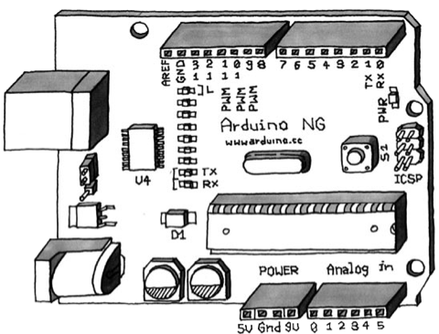
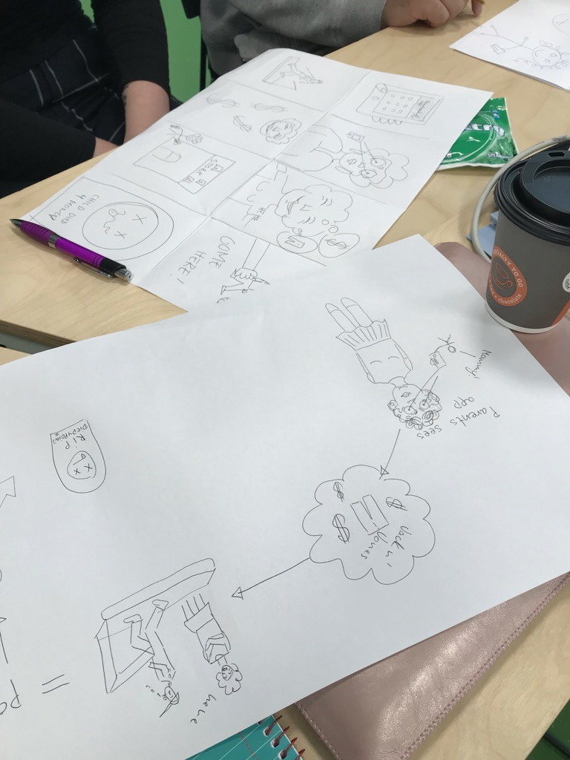
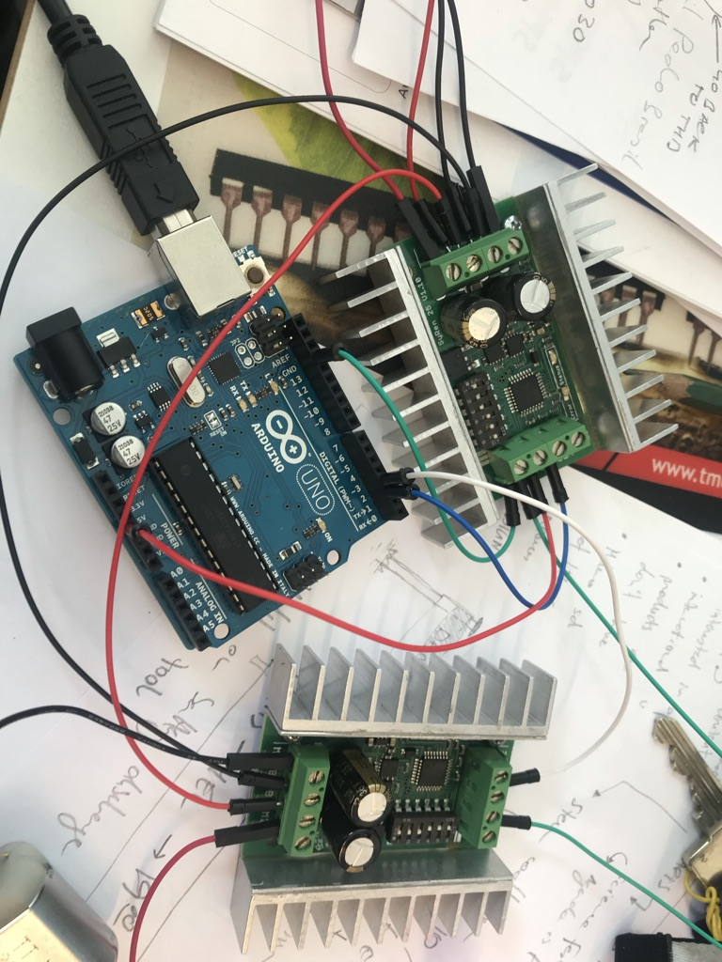
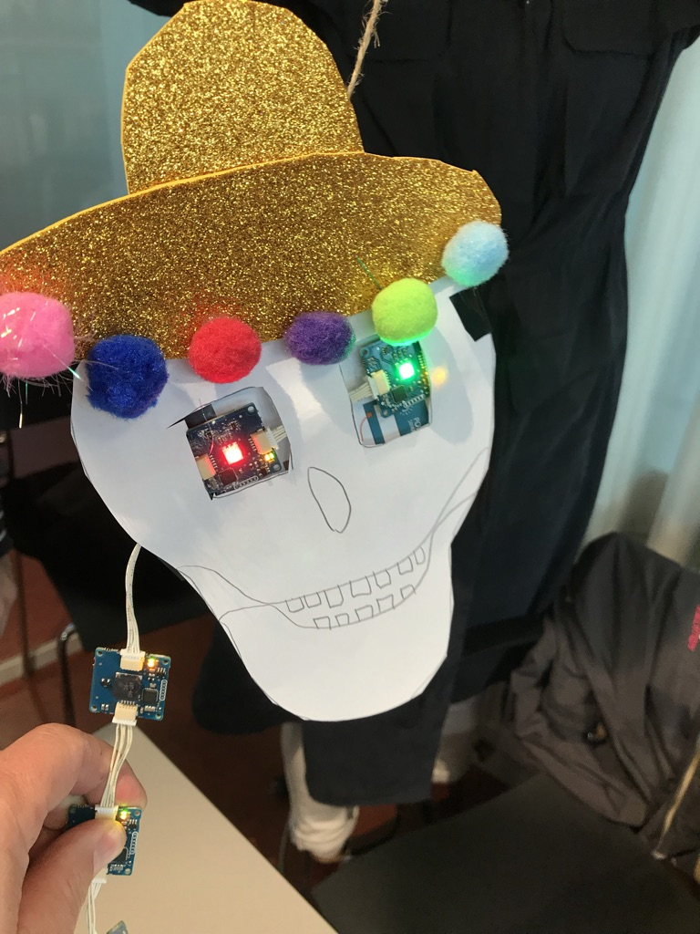
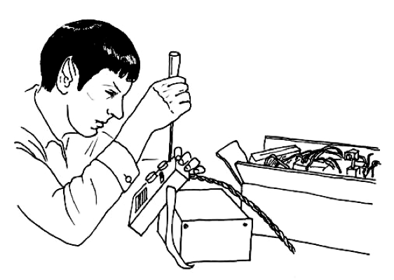
Mini Hackathon – Interactive Toys
Explore the world of physical computing
A playful hackathon with Arduino
Meet people and microcontrollers
Arduino, What is that?
Feel it – Tinker it

