Slide 1
Emergence of Grounded Compositional Language in Multi-Agent Populations

Slide 2
Learning to Communicate
How does human language come about ?
Training agents to invent a language.
investigate if, and how, grounded compositional language can emerge as a means to achieve goals in multi-agent populations.

Slide 3
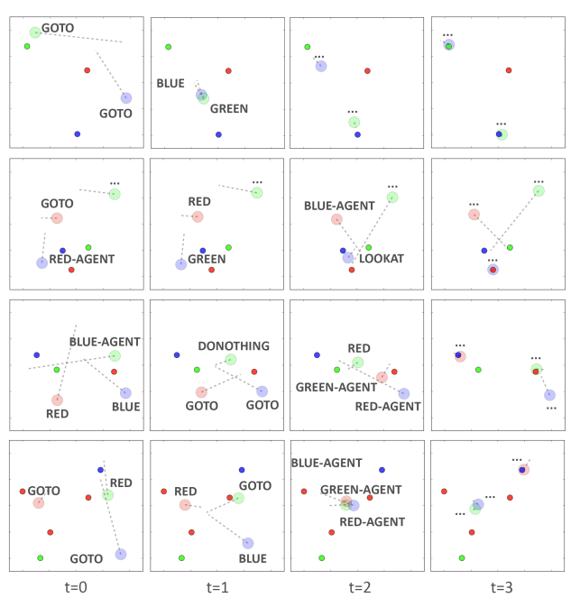
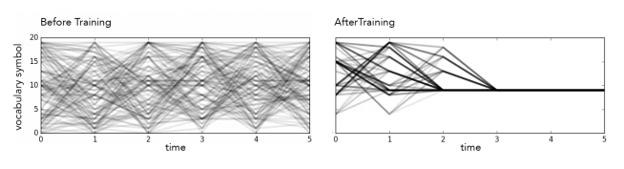
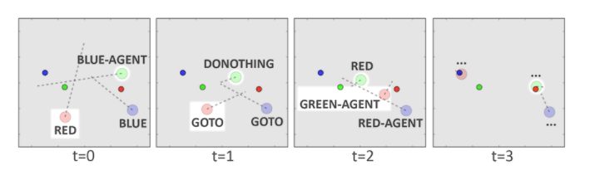
Experiments

Slide 4








Problem Formulation
a set of actions: 、a set of observations:
Initial states are determined by a distribution
State transitions :
rewards:
observations:
stochastic policy:
discrete communication actions (messages formed of separate, word-like symbols) sent over a differentiable communication channel.

Slide 5
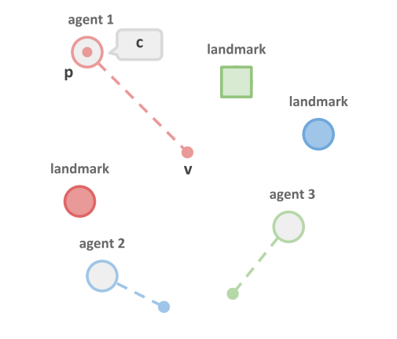


Grounded Communication Environment
1. N agents and M landmarks,a physical location、descriptive p physical characteristics.
2. x: physical state of an entity.
3. c: verbal communication symbols c, discrete elements of an a abstract symbol vocabulary C of size K. one-hot vector.
4. at training time to assign meaning to these symbols.
5. cost to making an utterance.
6. goals: vector g、 private.
7. m: recurrent memory bank,private recurrent neural network.
8. action: u、c.

Slide 6
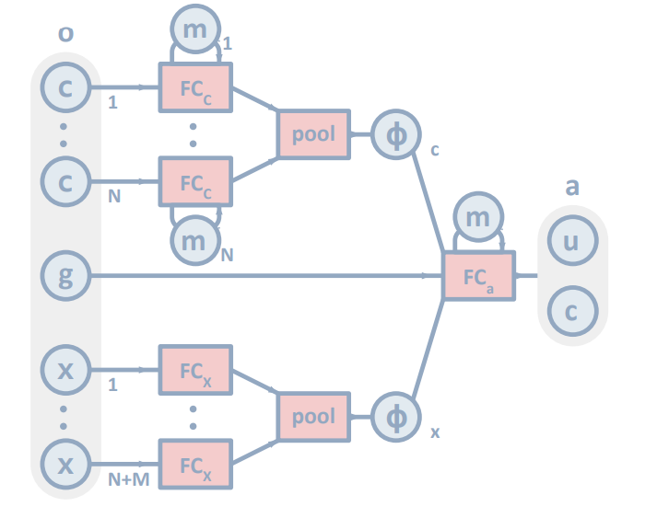
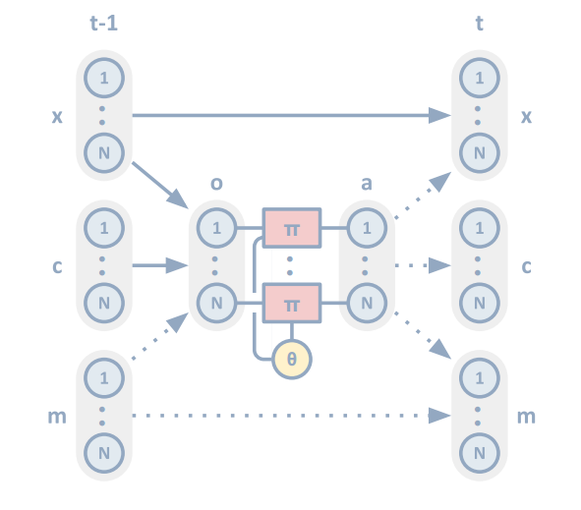



Policy Architecture

Slide 7
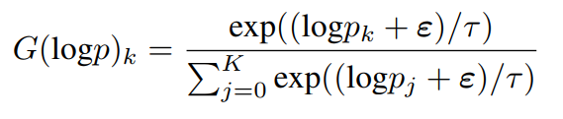





Policy Learning with Backpropagation

