Slide 1
Multi-Agent Actor-Critic for Mixed Cooperative-Competitive Environments
MADDPG
2017.10 叶雪梅

Slide 2
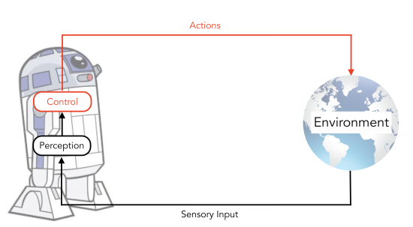
Agenda
Introduction and Overview
A sample of MADDPG
Principles of MADDPG
Experiment
COMA

Slide 3
Type of Multi-Agent Systems
Cooperative:
Shared team reward
Coordination problem
Problem:
1.each agent's policy is changing as training progresses.
2.the environment becomes non-stationary from the perspective of any individual agent,not explainable by changes in the agent’s own policy.
3.learning stability challenges.
4.deep Q-learning : the straightforward use of past experience replay.
5.Policy gradient : high variance.
Competitive:
Zero-sum games
Individual opposing reward
Minimax equilibria
Mixed:
General-sum games
Nash equilibria

Slide 4
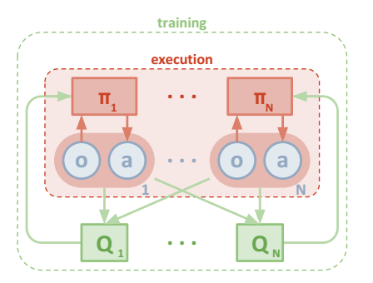
Main Idea
centralized training with decentralized execution.
critic is augmented with extra information about the policies of other agents, while the actor only has access to local information.
After training is completed, only the local actors are used at execution phase.
while competitive training provides a natural curriculum for learning, agents must also exhibit cooperative behavior at execution time.

Slide 5
A sample of MADDPG

Slide 6
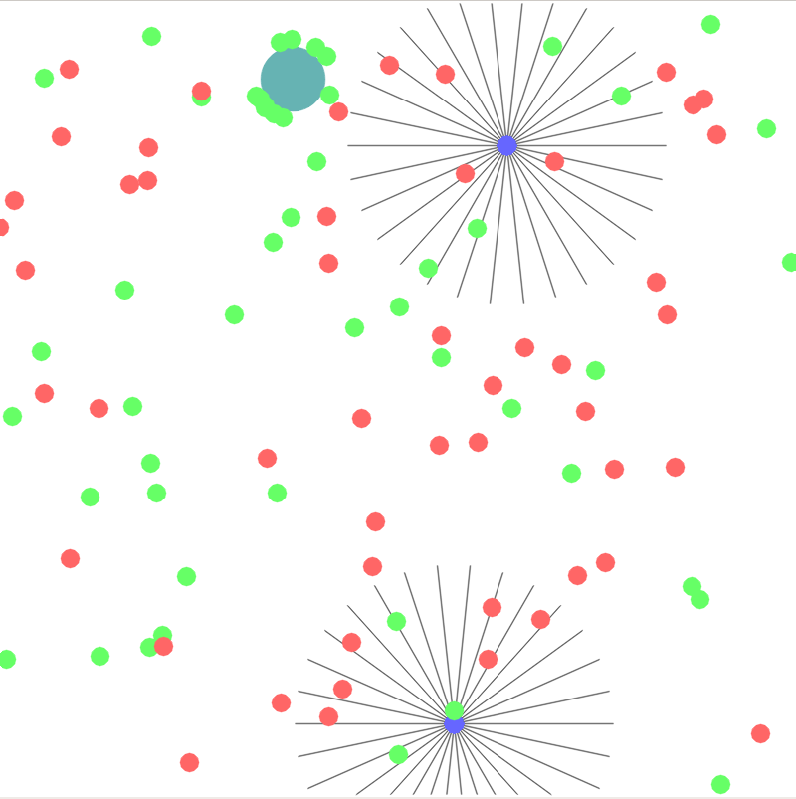
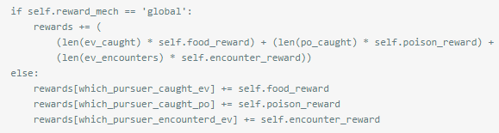
Scenario
Evaders、(food_reward = 10)
Obstacles
posion (posion _reward = -1)
Pursuers、cooperate for food (encounter_reward = 0.01)
reward : FloatTensor of size n_co_agent * max_step

Slide 7
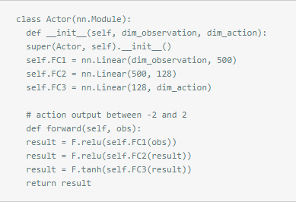
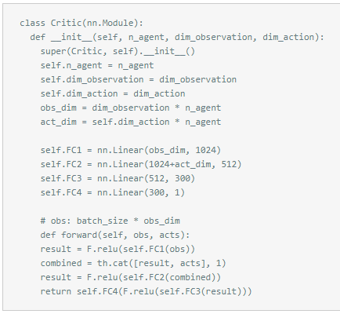

Setting
observation：
extract features from environment. FloatTensor of size 2X213.
action:
change position and velocity FloatTensor of size 2X2.

Slide 8
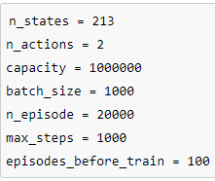
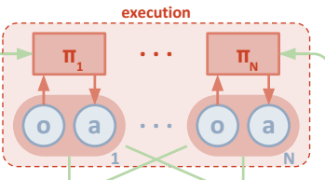
Let the game begin
initalize : include obs，total_reward
each step in one episode, for each agent i, select action w.r.t. the current policy and exploration,Execute actions a and observe reward r and new state x', Store (x,a, r,x') in replay buffer D.
N is a random process for action exploration.when complete episodes_before_train,get enough reply buffer,
then you can train it.

Slide 9




Training Process
For each agent sample a random minibatch of S samples from D.
as shown in the figure,input samples into critic Q,get Q-value,feedback Q-value to actor.

Slide 10
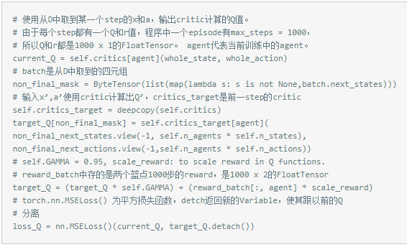
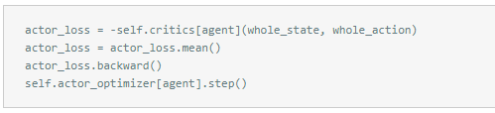
Training Process

Slide 11
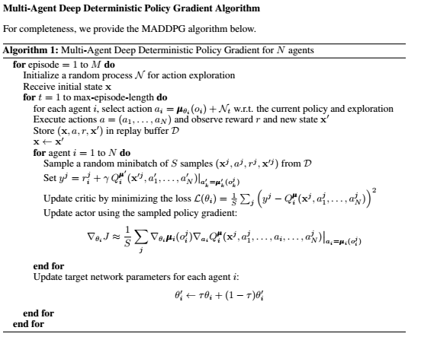
Algorithm

Slide 12
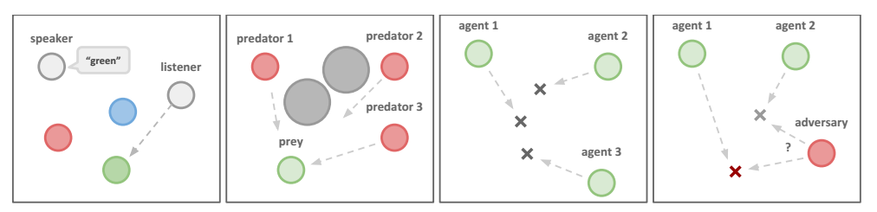
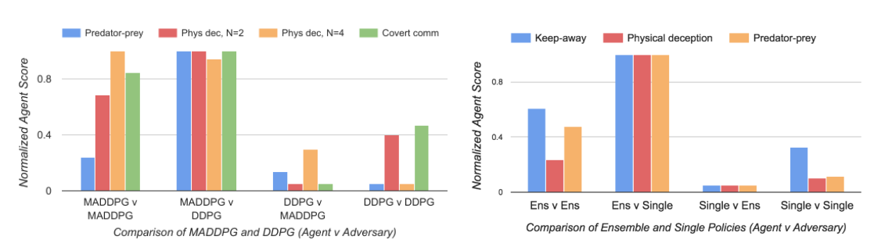
Experiments

Slide 13
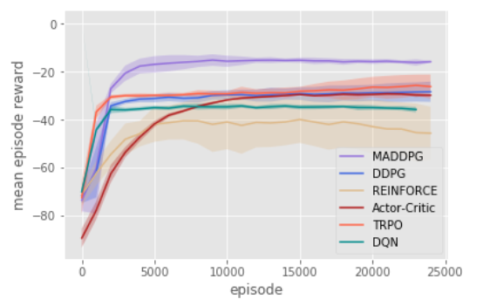
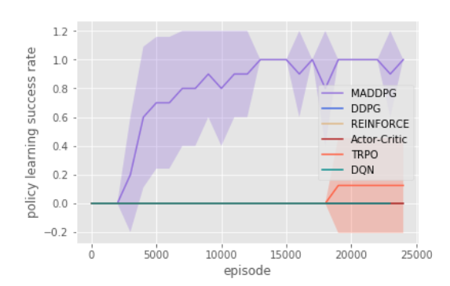
Experiments

Slide 14
Counterfactual Multi-Agent Policy Gradients COMA

Slide 15
Innovations
Centralised critic: stabilise learning to coordinate
COMA uses a centralised critic to estimate the Q-function and decentralised actors to optimise the agents‘policies.
Counterfactual baseline: tackle multi-agent credit assignment
multi-agent credit assignment, it uses a counterfactual baseline that marginalises out a single agent‘s action, while keeping the other agents’actions fixed.
Efficient critic representation: scale to large NNs
uses a critic representation that allows the counterfactual baseline to be computed efficiently in a single forward pass.

Slide 16
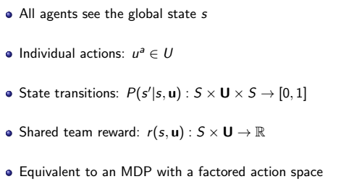
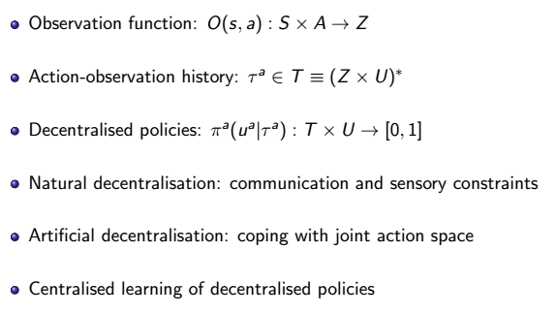
Multi-Agent MDP

Slide 17
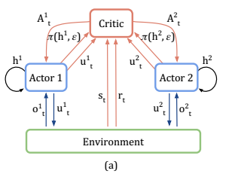

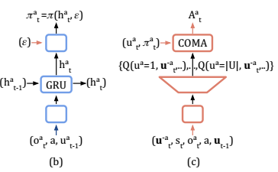
Training Process
Action probabilities are produced from the final layer, z：
linearly from 0.5 to 0.02 across 750 training episodes.
The actor consists of 128-bit gated recurrent units (GRUs) that use fully connected layers both to process the input and to produce the output values from the hidden state.
The centralised critic is a feedforward network with multiple ReLU layers combined with fully connected layers.
Efficient Critic Representation

Slide 18
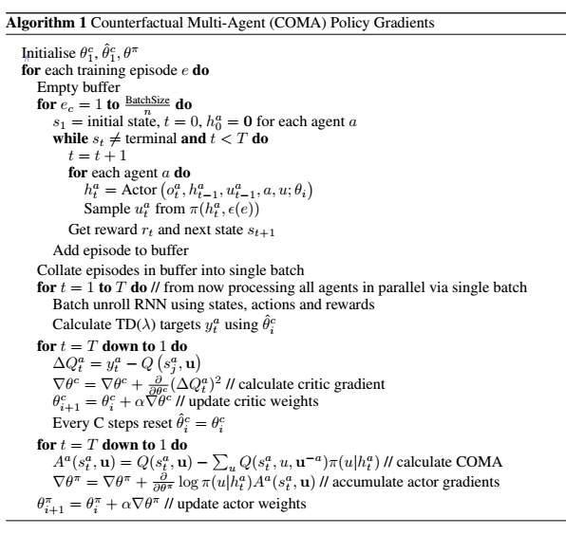
Algorithm

Slide 19
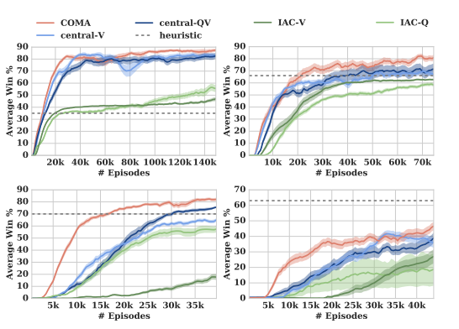
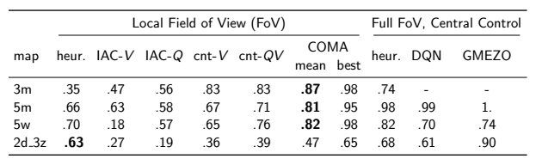
Centralised Performance && Results (3m, 5m, 5w, 2d-3z)
Mean win rates averaged across final 1000 evaluation episodes for the different maps.

Slide 20
Compare With MADDPG
COMA learn a single centralized critic for all agents, MADDPG learn a centralized critic for each agent, allowing for agents with differing reward functions including competitive scenarios.
MADDPG consider environments with explicit communication between agents.
COMA combine recurrent policies with feed-forward critics, whereas MADDPG use feed-forward policies (although MADDPG are applicable to recurrent policies).
MADDPG learn continuous policies whereas COMA learn discrete policies.

