Slide 1
5. Distributed objects and remote invocation
Road Map
5.1. Introduction
5.2. Communication between distributed objects
5.3. Remote procedure call (RPC)

Slide 2
5.1. Introduction
Programming models for distributed programs/applications: applications composed of cooperating programs running in several different processes. Such programs need to invoke operations in other processes.
RPC – client programs call procedures in server programs, running in separate and remote computers (e.g., Unix RPC)
Extended from procedure call
RMI – extensions of object-oriented programming models to allow a local method (of a local object) to make a remote invocation of objects in a remote process (e.g., Java RMI)
Objected oriented version of RPC

Slide 3
5.1. Introduction
Middleware
A suite of API software that uses underlying processes and communication (message passing) protocols to provide its higher level abstracts such as remote invocations and events
 E.g., remote method invocation abstraction is based on the request-reply protocol discussed in 4.4
The middleware provides location transparency, protocol abstraction, OS, and hardware independence, and multi-language support
Applications RMI, RPC and events
Middleware layers
Request reply protocol
External data representation
Operating System

Slide 4
5.1. Introduction
An important aspect of middleware: provision of location transparency and independence from the details of communication protocols, OS and hardware
Location transparency: RPC, RMI, EBP
Protocol transparency: protocols supporting the middleware abstractions are independent of underlying transport protocols
 request-reply protocol can be built on top of lower-level TCP or UDP
OS: all three paradigms could run on top of any OS platform
Hardware transparency: Issues with different data representations, conversions, and instruction set are transparent. Discussed in 4.3, marshalling & unmarshalling

Slide 5
5.1. Introduction
Modern programming languages organize a program as a set of modules that communicate with one another
Interface of a module specifies the procedures and the variables that can be accessed from other variables
Interfaces hide the details of modules providing the services

Slide 6
5.1. Introduction
Remote Object Interfaces
Modules can run in separate processes
Access to module variables is only indirectly
Parameter passing mechanisms, call by value/reference, used in local procedure call are not suitable when the caller is in a different process
Instead, describe the parameters as input or output
Input parameters are passed to remote module by sending values of the arguments in the request message
Output parameters are returned in the reply message to replace the values of the corresponding variables in the calling environment

Slide 7
5.1. Introduction
RPC (client-server): service interface
Specifying the procedures offered by a server
Defining types of input/output arguments
RMI (distributed object model): remote interface
Specifying methods of an object that are available for invocation by objects in other processes
Defining types of input/output arguments
Can pass objects as arguments; references to remote object may also be passed. Not to confuse them with pointers, which refer to specific memory locations

Slide 8
5.1. Introduction
RMI mechanism can be integrated with a particular language: Java RMI
All parts of a distributed application need to be written in the same language
Convenient - allows programmer to use a single language for local and remote invocation
However, many existing useful services are written in C++ or other languages…
Interface definition languages: allow objects implemented in different languages to invoke one another
provides a notation for defining interfaces: input, output, types
E.g., CORBA IDL (Fig 5.2) for RMI, Sun XDR for RPC

Slide 9
5.2. Communication between distributed objects
By means of RMI:
The object model: OOP, Java or C++, review
Distributed objects: the object model is very appropriate for distributed systems
The distributed object model: extensions of the basic object model for distributed object implementation
The design issues of RMI: local once-or-nothing invocation semantics vs. remote invocation semantics – similarities or differences
The implementation issues: mapping the middleware to lower-layer facilities
Distributed garbage collection issues

Slide 10
5.2. Communication between distributed objects
The object model
Objects (in classes) encapsulate methods and data variables, with some variables being directly accessible; and communication via passing arguments and receiving results from (locally) invoked objects
Object references: objects can be accessed via references. Accessing target/receiver objects requires – reference.methodname(args); and references can be passed as args, too.
Interfaces: provides a definition of the signatures of a set of object methods
– arg type, return values, and exceptions. A class may implement several ‘interfaces,’ and an interface may be implemented by any class

Slide 11
5.2. Communication between distributed objects
The object model
Actions: effect of method invocation – state of receiver maybe changed; new object maybe instantiated; further invocation may take place
Exceptions: Provide a clean way to deal with error conditions without complicating the code. thrown and catch
Garbage collection: reclaiming freed object spaces – Java (automatic), C++

Slide 12
5.2. Communication between distributed objects
Distributed objects
State of an object: current values of its variables
State of program: partitioned into separate parts, each of which is associated with an object – locally partitioned
As a natural extension, objects are physically distributed into different processes or computers in a distributed system. Therefore, the object model is very appropriate for distributed systems
For C-S architecture, objects are managed by servers, clients invoke their methods using remote method invocation

Slide 13
5.2. Communication between distributed objects
Distributed objects
In RMI, request is sent in a message to the server, the server execute it, and send result back to the client via a message
There are other architectures … (unimportant)
Distributed objects in different processes enforces encapsulation: the state of an object can be accessed only by the methods of the object
Only accept authorized methods to act on the state
Possibility to handle concurrent access to distributed objects
Allows heterogeneity: different data formats may be used at different sites

Slide 14
5.2. Communication between distributed objects
The distributed object model
Discusses extensions to the basic object model to make it applicable to distributed objects
Show RMI is a natural extension of local method invocation
RMI: invocations between objects in different processes (either on same or different computers)
Invocations within the same process are local
Each process contains objects, some of which can receive remote invocations, others only local invocations
Those that can receive remote invocations are called remote objects
Objects need to know the remote object reference of an object in another process in order to invoke its methods. How do they get it?
the remote interface specifies which methods can be invoked remotely

Slide 15
5.2. Communication between distributed objects
local invocation
C
local ^{E}
remote invocation
invocation
remote invocation
B
F
A
local invocation
D
Objects receiving remote invocations (service objects) are remote objects, e.g., B and F
Object references are required for invocation, e.g., C must have E’s reference for local invc or B must have A’s reference for remote invc
B and F must have remote interfaces (of their accessible methods)

Slide 16
5.2. Communication between distributed objects
Remote object references
An unique identifier of a remote object, used throughout a distributed system
The remote object reference (including the ‘interface’ list of methods) can be passed as arguments or results in RMI
Remote interfaces
The class of remote objects implements the methods of its remote interface
 In Java, for example, as public instance methods
Local objects can access methods in an interface plus methods implemented by remote objects
remoteobject
remote interface
{
Data
m1 m2 m3
implementation of methods
m4 m5 m6

Slide 17
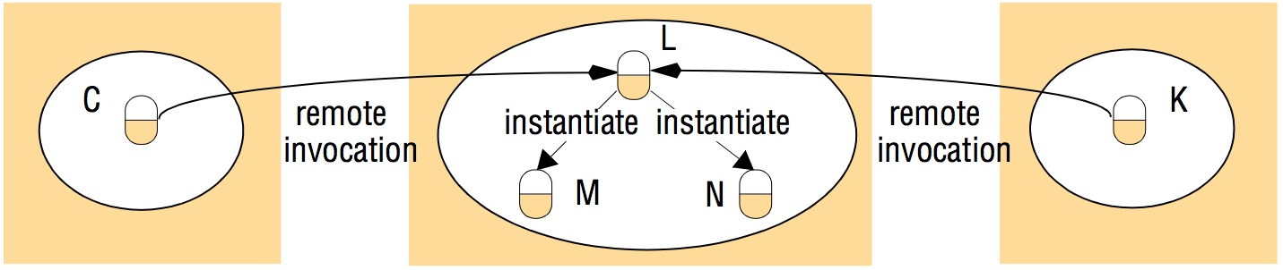
Figure 5.14 Instantiation of remote objects
Instructor’s Guide for Coulouris, Dollimore, Kindberg and Blair, Distributed Systems: Concepts and Design Edn. 5 © Pearson Education 2012

Slide 18
5.2. Communication between distributed objects
Actions in distributed object systems
Local activations plus remote invocations that could be chained across different processes/computers. Remote invocation activates the RMI interface using the remote object reference (identifier)
Example of chaining: In Figure 5.3 Object A received remote object reference of object F from object B
Distributed garbage collection (self-read)
Achieved by cooperation between local (language-specific) collectors and a designated reference module that keeps track of object reference-counting.
Exceptions (self-read)
Possible problems: remote process is busy, dead, suspended to reply, or lost reply; which will require timeout-retry in an exception handler implemented by the invoker/client
Usually, there are standard exceptions which can be raised plus others users implement

Slide 19
5.2. Communication between distributed objects
Design Issues of RMI
Choice of invocation semantics
Level of transparency that is desirable for RMI (self-read)
Local invocation semantics: exactly-once
Every method is executed exactly once
RMI invocation semantics:
Maybe: the remote method maybe executed once or not at all
At least once: invoker receives either a result, in which case invoker knows the method was executed at least once, or an exception informing no result was received
At most once: invoker receives either a result, in which case the invoker knows the method was executed exactly once, or an exception informing no result was received, in which case the method will have been executed either once or not at all

Slide 20
5.2. Communication between distributed objects
Request-reply protocol offers different choices of delivery guarantees:
Retry request message – retransmit until reply is received or on server failure
Duplicate message filtering – discard duplicates at server (seq #s or ReqID)
Retransmission of results: Buffer result messages at server for retransmission
– avoids redo of requests (even for idempotent ops)
 History: record of transmitted messages

Slide 21
5.2. Communication between distributed objects
Fault tolerance measures
Invocation semantics
Retransmit request message
Duplicate filtering
Re-execute procedure or retransmit reply
No
Yes
Not applicable
No
Not applicable
Re-execute procedure
Maybe
At-least-once
Yes
Yes
Retransmit reply
At-most-once

Slide 22
5.2. Communication between distributed objects
Invocation semantics: failure model
Maybe, At-least-once and At-most-once can suffer from crash failures when the server containing the remote object fails.
Maybe – executed once or not. If no reply, the client does not know if method was executed or not
Suffers from omission failures if the invocation or result message is lost

Slide 23
5.2. Communication between distributed objects
Invocation semantics: failure model
At-least-once - the client gets a result (and the method was executed at least once) or an exception (no result)
arbitrary failures. If the invocation message is retransmitted, the remote object may execute the method more than once, possibly causing wrong values to be stored or returned.
if idempotent operations are used, arbitrary failures will not occur
At-most-once - the client gets a result (and the method was executed exactly once) or an exception (instead of a result, in which case, the method was executed once or not at all)
Java RMI

Slide 24

5.2. Communication between distributed objects
Implementation of RMI:
Communication module: carry out request-reply protocol
Remote reference module: translating between local and remote object references
Uses remote object table (remote object ref. <-> local object ref.)
On client side, an entry for each proxy, to which local object ref. refers. On arrival of reply message, being asked for the local object ref.
On server side, an entry for each remote object, to which local object ref. refers. On arrival of request message, being asked for the local object ref.
client object A proxy for B
server skeleton
& dispatcher
for B’s class
remote object B
Request
Reply
Remote
Communication
Communication module
Remote reference module
servant
reference module
2005/10/14
module
24

Slide 25
5.2. Communication between distributed objects
Servant: an instance of a class which implements methods in remote interface, eventually handles the remote request
RMI software: layer of software between (application level) and (communication & remote reference modules)
Proxy: local (client side) representative for remote (server side) object; one for one remote obj. Implements methods in remote interface but in diff. way
Marshal request.; send; await reply; unmarshal reply; return to invoker
Dispatcher: one for each class of a remote object. On receiving request, uses methodId to select matching method in the skeleton
Skeleton: one for each class of a remote object. Implements methods in remote interface but in diff.way
Unmarshal request; invoke servant; await result; marshal into reply; send
25

Slide 26
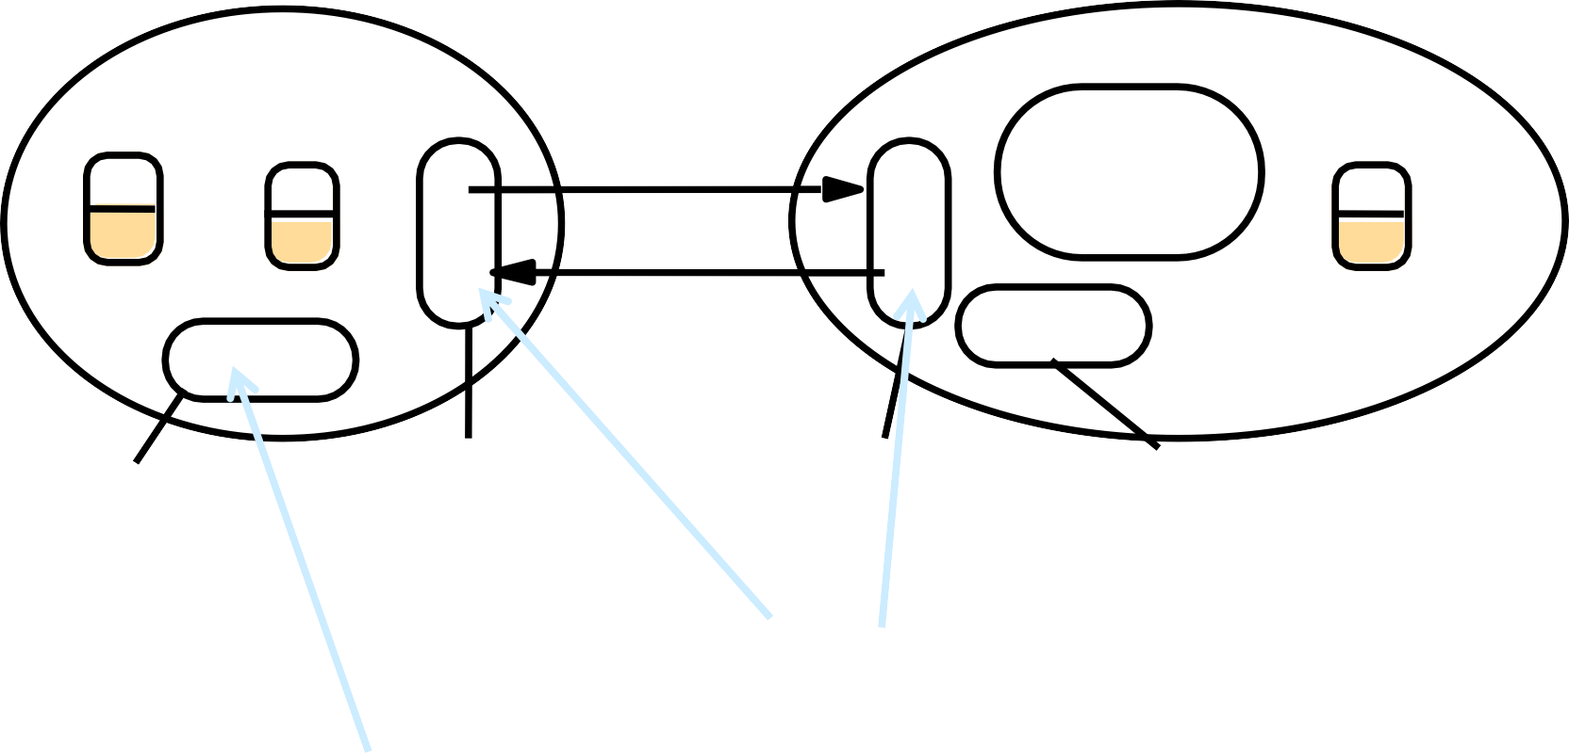
5.2. Communication between distributed objects
client object A proxy for B
server skeleton
& dispatcher
for B’s class
remote object B
Request
Reply
servant
Remote
Communication
Communication module
Remote reference module
reference module
module
Proxy - makes RMI transparent to client. Class implements remote interface. Marshals requests and unmarshals results. Forwards request.
Skeleton - implements methods in remote interface. _{D}Unmarshals requests and marshals results. Invokes _{i} method in remote object.
carries out Request-
reply protocol
RMI software - between
application level objects
translates between local and remote object a
ispatcher - gets request from communication module and ^{r} nvokes method in skeleton (using methodID in message). ^{m}
nd communication and emote reference odules
references and creates remote object
references. Uses remote object table
•
26

Slide 27
5.2. Communication between distributed objects
Some other concepts:
binder
client programs require a way of obtaining a remote object reference. A binder is a separate service that maintains a table containing mappings from textual names to remote object references
used by servers to register their remote objects by name
used by clients to look them up
e.g. Java binder: RMIregistry
Server and client programs
client program: contain the classes of the proxies for all remote objects it will invoke; it can use binders to look up remote object references
server program: contains the classes for the dispatchers and skeletons, together with implementations of the classes of all servants that it supports; it uses binders to register servants
27

