Slide 1
Deterministic Finite Automata(DFA)
The central concept of Automata theory
Formal Definition
Processing of a string
Extended Transition Function δ*
Languages of an DFA
Examples

Slide 2
Central concept of automata theory
Alphabets
Strings
languages

Slide 3
Formal Definition
The Deterministic Automata (DFA) is defined as 5-tuple or quintuple indicating five components:
A= { Q, ∑, δ, q₀, F}
Where:
1.Q is a finite set of states.
2. ∑ is a finite set of input symbols.
3. δ is the transition function that takes a state
in Q and an input symbol in ∑ as arguments
and returns a state
δ : Q x ∑ → Q
4. q₀ is the start state that belongs to Q
5. F is a subset of Q, is the set of final (or accepting) states.

Slide 4
Processing of strings by DFA
Suppose a1,a2,….an is the string to be processed then DFA starts with start state q0 and a1 the first character and consults the transition function δ to find the state that DFA stays after processing the input symbol. This is continued for all the input symbols for each state and finally DFA stays in a state and if it is a final state then the input is accepted or rejected.

Slide 5
Simpler Notations of DFA
A transition Diagram :
A transition diagram for DFA A ={ Q, ∑, δ, q0, F} is a graph defined as follows :
a. For each state in Q there is node
b. For each ‘q’ in Q and for each ‘a’ in ∑, let δ(q, a) = p then transition diagram must contain an arc from state ‘q’ to state ‘p’ with labelled ‘a’.
c. there is an arrow into the start state q0 labelled START
d. Node corresponding to accepting states (Those in F) are marked by double circle other states have a single circle

Slide 6
Simpler Notations of DFA
A transition table :
A transition table for DFA A ={ Q, ∑, δ, q0, F} is a conventional tabular representation of transition function δ where rows of the table corresponds to the states in Q and columns corresponds to the inputs from ∑. The entry for the row corresponding to state ‘q’ and the column corresponding to input ‘a’ is the state from δ(q, a)

Slide 7
Extended Transition Function δ *
The extended transition function δ* for DFA is an extension of Transition function δ of DFA and is defined as follows
Basis : δ*(q,Є) = {q} that is without reading any input symbols
DFA is still in same state q.
Induction: Suppose w is of the form w=xa where a is the final
symbol of w and x is the rest of w.
Then δ*(q, w)= δ(δ*(q, x),a)
If δ*(q, x) =p then
δ*(q, w)= δ(δ*(q, x),a) = δ(p, a)

Slide 8
Language of DFA
If A={Q,∑,δ, q0, F} is an NFA then
L(A) = {w | δ*(q0,w) = p Є F (i.e it is F) }
that is L(A) is the set of strings w in ∑ * such that δ*(q0,w) contains an accepting state
In other words
The language of a DFA (Q, Σ, δ, q₀, F) is the set of
all strings over Σ that, starting from q₀ and
following the transitions as the string is read left
to right, will reach some accepting state.

Slide 9
Language of a DFA
The language of a DFA (Q, Σ, δ, q₀, F) is the set of
all strings over Σ that, starting from q₀ and
following the transitions as the string is read left
to right, will reach some accepting state.
0,1
M:
even
odd
0, 1

Slide 10
Examples
Σ = {a, b}
q₀
Σ = {a, b}
a
b
b
a
a
a
q₁
q₃
b
q₀
q₁
b
b
a
a
b
b
q₂
q₄
a
0
1
0, 1
q₀
1
q₁
0
q₂
Σ = {0, 1}
What are the languages of these automata?

Slide 11
Problems on the Design of DFA
Design the DFA for the following languages on the Alphabet ∑={a, b}
1. Set of all strings that starts with prefix ‘ab’.
2. Set of all strings that contains exactly one ‘a’.
3a. Set of all strings that contains at least one ‘a’.
3b. Set of all strings having substring ‘aa’.
4 Set of all strings that contains not more than three a’^{s}

Slide 12
5. Set of all strings of a’s and b’s ending with substring ‘abb’.
6. Set of all strings of a’s and b’s not ending with substring ‘abb’.
7. L={ w : |w| mod 3 = 0 }
8. L={ w : |w| mod 5 <> 0 }
9. L={ awa : wЄ {a, b}* }
10. L={ aw1aaw2a : w1,w2 Є {a, b}* }
11. L={ ab⁵wb⁴ : wЄ {a, b}* }

Slide 13
12. Set of all strings of a’s and b’s having three consecutive a’s.
13. Set of all strings of a’s and b’s ending with ‘ab’ or ‘ba’.
14. L= { w : n_{a}(w) =2, n_{b}(w)>=3 }
15. L= { w : |w|mod 3 >= |w| mod 2 }

Slide 14
Non Deterministic Finite Automata(NFA)
Introduction and Why study NFA ?
Formal Definition
Processing of a string
Extended Transition Function δ*
Languages of an NFA
Design of NFA for some languages
Equivalence of Deterministic and Non Deterministic Finite Automata
Conversion of NFA to DFA using subset construction Scheme by Lazy evaluation
  Algorithm
  Examples

Slide 15
Introduction
Why NFA ?
In order to construct a DFA for some languages we have the following difficulties.
1. Construction is difficult.
2. DFA cannot guess about its inputs
3. At any point of time the DFA is in only one state and does not have the power to be in several states.
4. Not an efficient mechanism to describe some complicated languages concisely.
These difficulties can be overcome by using NFA

Slide 16
Formal Definition
The Non Deterministic Automata (NFA) is defined as 5-tuple or quintuple indicating five components:
A= { Q, ∑, δ, q₀, F}
Where:
1.Q is a finite set of states.
2. ∑ is a finite set of input symbols.
3. δ is the transition function that takes a state
in Q and an input symbol in ∑ as arguments
and returns a subset of Q i.e a set of states.
δ : Q x ∑ → 2^{Q}
4. q₀ is the start state that belongs to Q
5. F is a subset of Q, is the set of final (or accepting) states.

Slide 17
Processing of string by an NFA
Suppose a1,a2,….an is the string to be processed then NFA starts with start state q0 and a1 the first character and consults the transition function δ and takes all possible transition and stays in multiple states. This is continued for all the inputs for each state and finally the set of states in which NFA stays contains at least on final state then the input is accepted or rejected.

Slide 18
Extended Transition Function δ *
The extended transition function δ* for NFA is an extension of Transition function δ of NFA and is defined as follows
Basis : δ*(q,Є) = {q} that is without reading any input symbols
NFA is still in same state q.
Induction: Suppose w is of the form w=xa where a is the final
symbol of w and x is the rest of w.
Then δ*(q, w)= δ(δ*(q, x),a)
If δ*(q, x) ={p1, p2,……..pk} then
_{k}
δ*(q, w)= δ(δ*(q, x),a) = Ụ δ(pi, a) = {r1,r2….rm}
^{i=1}

Slide 19
Languages of an NFA
If A={Q,∑,δ, q0, F} is an NFA then
L(A) = {w | δ*(q0,w) П F<> φ }
that is L(A) is the set of strings w in ∑ * such that δ*(q0,w) contains at least one accepting state

Slide 20
Problems on the design of NFA
Design the NFA’s to recognize the following sets of strings
a. abc, abd, and aacd {∑={a,b,c,d}}
b. 0101, 101 and 011 {∑={0,1}}
c. ab,bc and ca { ∑={a,b,c}}
d. Set of strings of a’s and b’s having prefix ‘a’
e. Set of strings of a’s and b’s having exactly one ‘a’
f. Set of strings a’s and b’s ending with substring ‘abb’
g. L= { w │wε abab^{n} or aba^{n} for n>=0}

Slide 21
Equivalence of Deterministic and Non Deterministic Finite Automata
There are many languages for which a NFA is easier to construct than DFA. It means that every language that can described by some NFA can also be described by DFA.
We have a subset construction scheme using which any NFA is Converted to an equivalent DFA

Slide 22
Conversion of NFA to DFA using Subset Construction Scheme by Lazy evaluation
The Scheme starts from an NFA N=(Q_{N},∑,δ_{N}, q₀, F_{N}) and DFA D=(Q_{D},∑,δ_{D}, {q₀}, F_{D}) is constructed such that L(D) = L(N) and is as follows:
1. Initialize DFA state set QD to {q0} is the start state of DFA D which is the set containing only the start state of NFA N.

Slide 23
2. While (δ_{D} for all DFA state in Q_{D} is not defined) Do
Begin
For each state ‘S’ in Q_{D} and for each ‘a’ in ∑ find next state T_{D} by applying transition function δ and add T_{D} to Q_{D} if it is not already there.
i.e δ_{D}(S, a) = Ụ δ_{N}(p, a) → T_{D}
^{p in S}
END

Slide 24
3.FD is final states of DFA which contains all sets of NFA’s states that include at least one final state of NFA.
4. Construct the transition diagram or table to describe the DFA

Slide 25
Є-NFA
Introduction
Formal Definition
Processing of string
Extended Transition Function δ*
  What is Є-Closure? And its definition
  Definition of Extended Transition Function δ*
Languages of Є-NFA
Conversion of Є-NFA to DFA using subset construction Scheme by Lazy evaluation
  Algorithm
  Examples
Theorems

Slide 26
Introduction
Whenever a Transition takes place from one state to another State we say that NFA or DFA has taken a move and input is consumed and the input pointer is advanced to Next char.
But some times it necessary to take a transition spontaneously without consuming or reading the input. NFA with this feature is called as Є-NFA. This gives an added programming convenience to finite automata.

Slide 27
Formal Definition
Formally we represent Є-NFA E by E={Q,∑,δ, q0, F} where all components have their same interpretation as for an NFA, except that δ is now a function that takes as arguments:
1. A state in Q and
2. A member of ∑ Ụ {Є }, that is either an input symbol or the symbol Є.

Slide 28
Processing of string and Extended Transition Function δ*
Є-closure of any state q contains a state q and all the states from q that are reachable with only Є-transition.
We define Є-closure ECLOSE(q) recursively as follows
Basis : State q is in ECLOSE(q).
INDUCTION : If state p is ECLOSE(q) and there is transition from state p to state r labeled Є then r is in ECLOSE(q)

Slide 29
Formal definition
The extended transition function δ* for Є- NFA is an extension of Transition function δ of Є-NFA and is defined as follows
BASIS : δ*(q,Є) =ECLOSE(q) that is without reading any input symbols Є- NFA is in the set of states which is Є-closure of state q.
INDUCTION: Suppose w is of the form w=xa where a is the final symbol of w and x is the rest of w. Note that aЄ∑ and it cannot be Є.
Then δ*(q, w)= δ(δ*(q, x),a)
If δ*(q, x) ={p1, p2,……..pk} then
_{k}
δ*(q, w)= δ(δ*(q, x),a) = Ụ δ(pi, a) = {r1,r2…rm}
^{i=1} _{m}
= Ụ ECLOSE( rj )
^{j=1}

Slide 30
Languages of an Є-NFA
If E={Q,∑,δ, q0, F} is an Є-NFA then
L(E) = {w | δ*(q0,w) П F<> φ }
that is L(E) is the set of strings w in ∑ * such that δ*(q0,w) contains at least one accepting state

Slide 31
Conversion of Є-NFA to DFA using Subset Construction Scheme by Lazy evaluation
The Scheme starts from an Є-NFA E=(Q_{E},∑,δ_{E}, q₀, F_{E}) and DFA D=(Q_{D},∑,δ_{D}, {q₀}, F_{D}) is constructed such that L(D) = L(E) and is as follows:
1. Initialize DFA state set Q_{D} to ECLOSE(q0) is the start state of DFA D which is the set containing only the Є-closure start state of NFA E.

Slide 32
2. While ( δ_{D} for all DFA state in Q_{D} is not defined) Do
Begin
For each state S in Q_{D} and for each a in ∑ find next state T_{D} by applying transition function δ and add ECLOSE(T_{D} ) to Q_{D} if it is not already there.
i.e First Compute δ_{D}(S, a) = Ụ δ_{E}(p,a) → T_{D}
^{p in S}
and then Find ECLOSE(T_{D}) and add to Q_{D} if it is
not already there.
END

Slide 33
3.FD is final states of DFA which contains all sets of Є-NFA’s states that include at least one final state of Є-NFA.
4. Construct the transition diagram or table to describe the DFA

Slide 34
Theorem-2
Definition : If D=(Q_{D},∑,δ_{D}, {q₀}, F_{D}) is the DFA constructed from N =(Q_{N},∑,δ_{N}, q₀, F_{N}) by the subset construction scheme then L(D) = L(N).
Proof : By induction we have to first prove on |w| is that
δ_{D}*({q₀}, w)=δ_{N}*(q0,w)
NOTE : We know that δ* function returns a set of state from NFA and δ_{D}* for DFA interprets this as one state of Q_{D.}

Slide 35
BASIS : Let |w| = 0 it means w=Є. By the basis definitions of δ* for DFA and NFA
we have δ_{D}*({q0},Є) and δ_{N}*(q0,Є) are {q₀}.
INDUCTION : Let |w| = n, break up as w as w=xa where a is the final symbol of w and x is the remaining characters.
By the Induction hypothesis
δ_{N}*(q0,w) = δ_{N} (δ_{N}*(q0,x),a)
In order to see the transition δ_{N} on ‘a’ we must have processed s
Let this be δ_{N}*(q0,x) = {p1,p2…pk}. There fore
The inductive part of the definition of δ* for NFA tell us that
δ_{N}*(q0,w) = δ_{N}(δ_{N}*(q0,x) a)= δ_{N} ({p1,p2…pk},a)
k
= Ụ δ_{N}*(pi, a) → 1
^{i=1}

Slide 36
The subset construction scheme tells us that
δ_{D}*({q0}, w)= δ_{D}(δ_{D}*({q0},x),a)
Here in order to see the transition δ_{D} on ’a’ we must have processed ‘x’.
By subset construction
let this be δ_{D}*({q0},x) = δ_{N}*(q0,x) = {p1,p2…pk}
Because δ_{D} is expressed in term δ_{N} and set of NFA states is one DFA state by subset construction scheme , there fore by induction hypothesis
δ_{D}*({q0}, w)= δ_{D}(δ_{D}*({q0},x),a)
= δ_{D}(δ_{N}*({q0},x),a) _{k}
=δ_{D}({p1,p2..pk},a) = Ụ δ_{N}(pi, a) → 2
^{i=1}
From 1 and 2 it demonstrates that
δ_{D}*({q₀}, w)= δ_{N}*(q0,w) and w is valid only when they contain state in F_{N.}

Slide 37
DFA’s to Regular Expressions
(KLEEN’s Theorem )
Theorem : If L= L(A) for some DFA A, then there is regular expression R such that L= L(R).
Proof : Suppose DFA A has states from {1,2…n}
The first task is to construct a collection of regular expressions that describes progressively broader set of paths in the transition of DFA A

Slide 38
Consider a DFA(any), We can construct an equivalent regular expression and construction is based on the following idea
It can be observed that the strings like 00101,11101 and 111101 take the DFA from the start state q1 to the final state q3 and all are accepted.
Each string accepted corresponds to path from q1 to q3. Similarly each path from q1 to q3 has a corresponding a string

Slide 39
The set of all strings corresponding to all possible paths from q1 to q3 forms the language accepted by automata.
It means that given any two states qi and qj there is a set of strings(language) that takes DFA from qi to qj and there is a regular expression R^{K}ij for the set of strings from qi to qj through an intermediate states whose number is not greater than K(k=0 to n)

Slide 40
However the path from qi to qj are infinite we can systematically enumerate the set of paths by induction on the k set of intermediate nodes.
To construct the regular expressions R^{(k)}ij, we use the following inductive definition, starting at k=0
and finally reaching k=n.
Note -R^{(k)}ij is a regular expression for the set of strings which takes the DFA from qi to qj using intermediate states from 0 to k-1

Slide 41
Basis - R⁽⁰⁾ij,- when k=0, this indicates no intermediate states. The path from qi to qj has two conditions.
1. A direct edge from state qi to qj ( states are numbered 1 or above ) and i<>j. We must examine the DFA and find those input symbols ‘a’ such that there is transition from state qi to qj on input ‘a’
CASE 1: If there no symbol ‘a’ in a path then R⁽⁰⁾ij=φ.
CASE 2: If there exactly one symbol in a path then there is direct edge from qi to qj with label ‘a’. so, R⁽⁰⁾ij =a.
CASE 3:If there are many symbols a1,a2…ak then
R⁽⁰⁾ij = a1+ a2 + a3…..ak.

Slide 42
2 : If i=j then the legal path of length 0 and all loops from ‘i ‘to itself.
The path length is represented by a Regular expression ε.
And the various RE devised through CASE 1 to 3 are as follows
  CASE 1: no symbols the RE becomes R⁽⁰⁾ij,= ε
  CASE 2: One symbol the RE becomes R⁽⁰⁾ij,=ε +a
  CASE 3 :Multiple symbols the RE becomes
  R⁽⁰⁾ij,= ε +a1 +a2…ak

Slide 43
qk
qi

Slide 44
INDUCTION : Suppose there is a path form state qi to qj that goes through intermediate states whose number not higher than K. Any valid string w takes this path from qi to qj and the path length is infinite. This implies between qi and qj there is some position of state qk where the path repeats and finally it reaches qj. This is given in the figure.
Here there are two possible cases-
1. The path dose not go through state k at all.
In this case we have regular language whose RE is Rij^{(k-1)}
2. The path goes through K at least once, then we can break the path from qi to qj into several pieces as shown in the above figure.

Slide 45
I. The path from qi to qk not passing through a state higher than k is----- Rik^{(k-1)}
II. The path from qk to qk not passing through a state higher than k ( zero or more) is- (Rkk^{(k-1)})*
III. The path from qk to qj not passing through a state higher than k is----- Rkj^{(k-1)}
This implies Rik^{(k-1)} .(Rkk^{(k-1)})*Rkj^{(k-1)}
when we combine the paths from above two cases we have the Regular expression for the path qi to qj through intermediate states k=n
Rij^{(k)} = Rij^{(k-1)} + Rik^{(k-1)} .(Rkk^{(k-1)})*Rkj^{(k-1)}

Slide 47
Converting DFA’s to Regular Expression by State Elimination Method
Kleen’s theorem can be applied for NFA or even ε-NFA. However the construction of the regular expression is expensive i.e for an n-state automaton we have to construct about n³ expressions.
Also the length of the expression can grow by a factor of 4 on an average. If there is no simplification of the expressions then it could reach on the order of 4^{n} symbols

Slide 48
DFA to RE: State Elimination
Eliminates states of the automaton and replaces the edges with regular expressions that includes the behavior of the eliminated states.
Eventually we get down to the situation with just a start and final node, and this is easy to express as a RE

Slide 49
DFA to RE via State Elimination (1)
Starting with intermediate states and then moving to accepting states, apply the state elimination process to produce an equivalent automaton with regular expression labels on the edges.
Figure is to be drawn

Slide 50
Strategy for constructing RE from Finite Automata by state Elimination :
For each accepting state ‘q’ apply the following reduction or elimination process to produce an equivalent automata with regular expression as labels on the arcs.
Note :Eliminate all states except ‘q’ and the
start state ‘q0’
Principle :
Figure -1

Slide 51
Principle :
Consider a state s is to be eliminated. Let p be its successor and q be its predecessor. It is observed that all strings of the form ac*b take the automata from q to p and pass through s. We can now remove s and we can attach an edge labeled ac*b from q to p directly. During this process the transitions are labeled by regular expression. The resulting diagrams are called as Generalized Transition Diagrams.

Slide 52
Generic Case -1
Figure 1 is to be drawn
Final regular expression is d+ac*b
Generic Case -2 ( Refer Next figure)
for each predessor ‘qi’ of ‘S’ and each successor ‘pj’ pf ‘S’, a regular expression that represents all the paths that starts at ‘ qi’, go to ‘S’ and perhaps loops around, a zero or more times and finally reaches to pj.
The RE for all these paths would be QiS*Pj

Slide 53
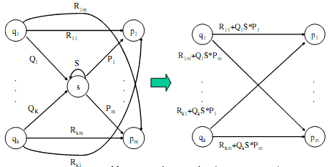
Generic case -2
Consider the figure below, which shows a generic state s about to be eliminated.
The labels on all edges are regular expressions.

Slide 54
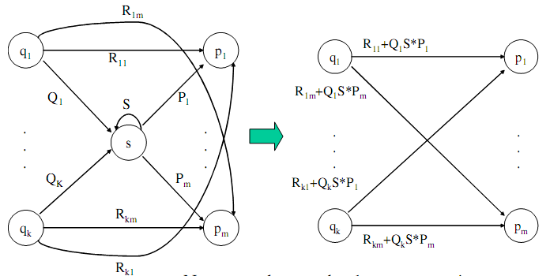

Slide 55
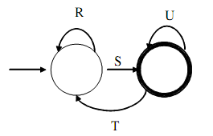
By this process we eliminate all intermediate states and the result will be a one or two state automaton with a start state and accepting state. The configuration at the end is one of the following patterns
A. No intermediate states between start and final state (generic Two state automaton.)
The regular expression in this case is (R+SU*T)*SU*

Slide 56
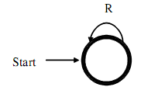
b. If the start state is also a accepting state then we must also perform a state elimination from the original automata to get rid of every state, except start state. Here we are left with one -state automata which looks as follows:
The regular expression in this case is R*
Favorably

Slide 57
DFA to RE State Elimination (4)
If there are n accepting states, we must repeat the above steps for each accepting states to get n different regular expressions, R1, R2, … Rn.
For each repeat we turn any other accepting state to non-accepting.
The desired regular expression for the automaton is then the union of each of the n regular expressions: R1 U R2… U RN

Slide 58
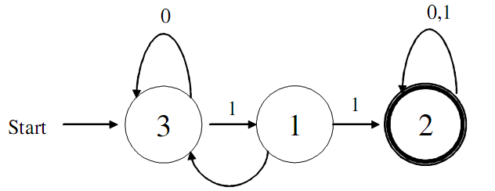
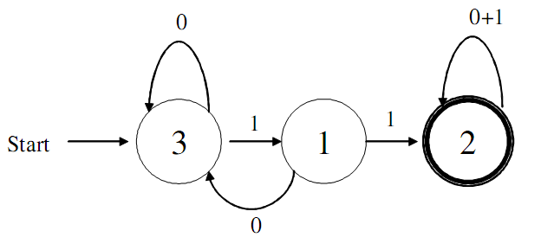
DFA->RE Example
Convert the following to a RE:
First convert the edges to RE’s:

Slide 59
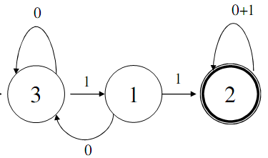
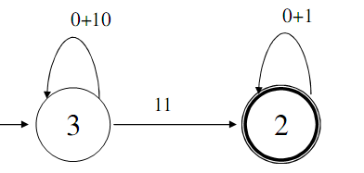
DFA -> RE Example (2)
Eliminate State 1:
Note edge from 3->3
Answer: (0+10)*11(0+1)*

Slide 60
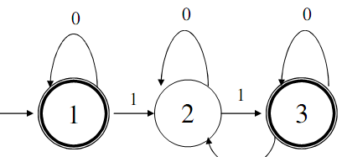

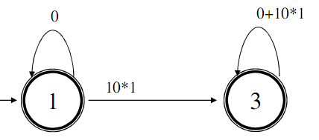
Second Example
Automata that accepts even number of 1’s
Eliminate state 2:

Slide 61
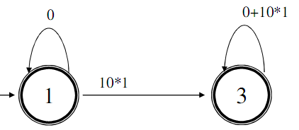
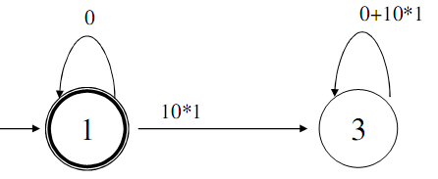
Second Example (2)
Two accepting states, turn off state 3 first
This is just 0*; can ignore going to state 3 since we would “die”

Slide 62
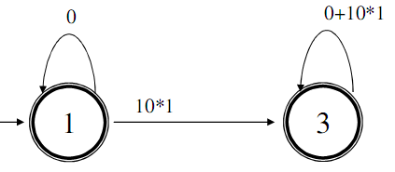
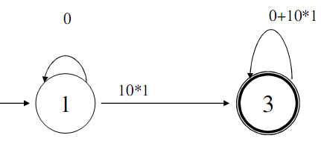
Second Example (3)
Turn off state 1 second:
This is just 0*10*1(0|10*1)*
Combine from previous slide to get 0* + 0*10*1(0+10*1)*

