Slide 1
Lex & Yacc
By Dr. M M Math, Professor , Department of CSE, GIT, Belagavi

Slide 2
A LEX Tool
Introduction.
Structure of LEX program Specification
Prerequisite for Writing LEX program
Running LEX program.
USE of VI editor.
Sample programs.

Slide 3
I. Introduction
What is LEX ?
LEX is a programming tool on UNIX platform that takes Lex input file specification ( which are set of descriptions Tokens in the form Regular expression) that generates a C-routine (lex.yy.c) which is termed as lexical analyzer or Lexer or scanner.
Tokens : Are nothing but the primitives of any programming language that includes Identifiers, constants, keywords, operators and punctuation symbols,
REGULAR Expression : It is a mechanism to describe the tokens that consists of combinations of symbols from the alphabet, digits, operators and special symbols called meta-characters
Lexical analyzer : Is a initial program for a typical compiler that reads the input streams character by Character and groups them into a meaningful sequence called as a tokens.
LEX Tool is Written and developed by Eric Schmidt and Mike Lesk.

Slide 4
Applications of LEX :
1. Mainly used by compiler writers to write compiler and interpreter.
2. Any application that looks for patterns in its inputs

Slide 5
II. Structure of LEX program Specification
The Structure of Lex program specification consists of three sections, separated by a line with just %% in it:
%{
SECTION -1 { Definition section }
%}
<Name> <pattern> Definition of long pattern -optional
%%
SCETION –II { RULES Sections }
%%
SECTION – III { User subroutine section }

Slide 6
Definition section :
It introduces any initial C program code like header files, declaration and initialization of variables used in the program. This is simply copied to generated C-code.
The C program code is surrounded with two special delimiters %{ and %}
It also contains declarations of simple name definitions to simplify the scanner specification which is of the following form
name definition { Optional }
Example:
DIGIT [0-9]+
LETTER [a-zA-Z]
NOTE : It is optional it can be used whenever long or complex patterns are to be simplified.

Slide 7
Rules section
The rules section of the Lex program specifications contains a series of rules where each rule is made up of two parts separated by whitespaces and is as follows :
<pattern> <action>
<Pattern> is a description of tokens in the form of Regular expressions written in UNIX style or regular name definition specified in the Definition section.
Example:
{DIGIT}+ {printf(“ IT is number :
%s\n“,yytext ); }
[0-9]+ {printf(“ IT is number :
%s\n“,yytext ); }

Slide 8
<action> is made of action routines written using C- language and are enclosed between curly braces { and }.
It also consists of call statements to c routines written in user subroutine section of LEX specification in section III.
An <action> consisting only of a vertical bar ('|') means "same as the action for the next rule.“
Example :
{DIGIT} { printf(“ IT is number :
%s\n“,yytext ); }
[0-9]+ { printf(“ IT is number :
%s\n“,yytext ); }

Slide 9
III. User Subroutine Section
This is a final section which consists of any legal C-code that is copied to the end of the Code generated.
It also consists of user defined c-functions which may called in the action part of the rule section.
Finally it includes the main() function consisting of a call statement to yylex(), where yylex() is c-routine generated by LEXER. Unless the action contains explicit return statement, yylex() would not return until it has processed the entire input.

Slide 10
IV. Prerequisite for Writing LEX program
Study of Regular expression :
As a part of rule section the pattern is made of regular expression written in UNIX style.
The regular expression is a string made up of symbols from alphabets, digits, operator symbols and special symbols called meta-characters.
Alphabets { a,b, c…z,A,B,C….Z }
digits {0,1,2…9}
operators and Special symbols :
“ \ [ ] ^ - ? . * + | ( ) $ / { } %

Slide 11
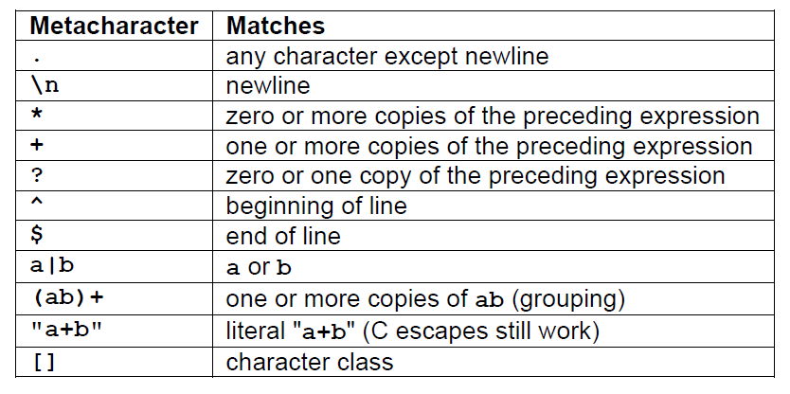
Lex- Pattern Matching Primitives

Slide 12
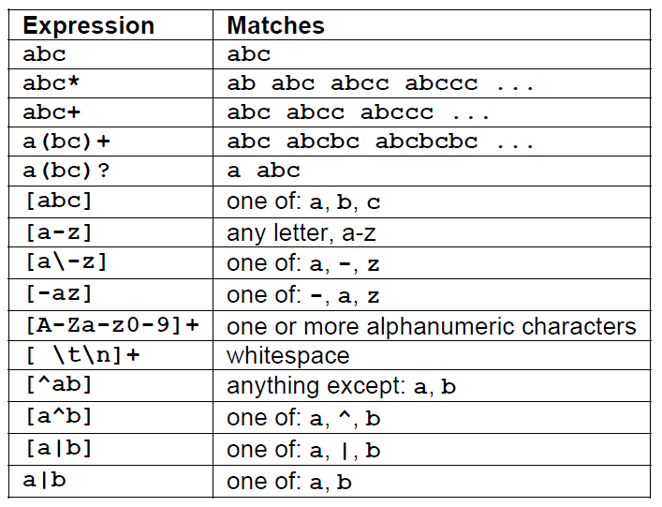
Example on pattern matching
Pattern Matching examples.

Slide 13
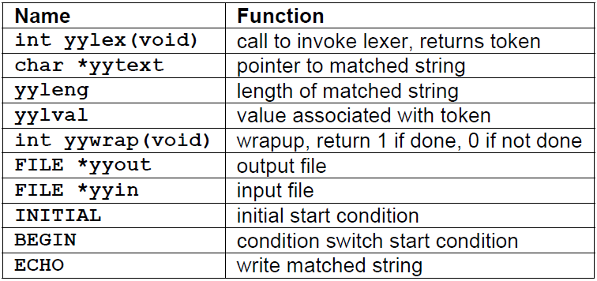
Lex predefined variables.

Slide 14
Running a Lex program
Lex source program
Lex
lex.yy.c
lex.yy.c
C compiler
a.out
input
a.out
tokens
$lex xyz.l
$ cc lex.yy.c –ll
$\.a.out

Slide 15
USE of VI editor.
VI editor is screen-oriented text editor that enables you to edit lines in context with other lines in the file.
It is considered to be standard editor for unix programming
To start using vi editor − we can execute the following commands
Command | Description
vi filename | Creates a new file if it already does not exist, otherwise opens existing file
vi -R filename | Opens an existing file in read only mode.
view filename | Opens an existing file in read only mode..

Slide 16
Operation Modes
While working with vi editor you would come across following two modes −
Command mode − This mode enables you to perform administrative tasks such as saving files, executing commands, moving the cursor, cutting (yanking) and pasting lines or words, and finding and replacing. In this mode, whatever you type is interpreted as a command.
Insert mode − This mode enables you to insert text into the file. Everything that's typed in this mode is interpreted as input and finally it is put in the file .
NOTE : The vi always starts in command mode. To enter text, you must be in insert mode. To come to in insert mode you simply type i. To get out of insert mode, press the Esc key, which will put you back into command mode.

Slide 17
Getting Out of vi-editor
The command to quit out of vi is
ESC:w - this save the file
:wq – Save and exit
: q! – exit without saving

Slide 18
Sample LEX programs
1. Write a LEX program to recognize the verbs of an English language sentence
Write a LEX program to count the number vowels and consonants in the given English language sentence.
Write a LEX program to count the number positive and negative integer numbers
Write a LEX program check sentence is simple or compund.
Write a LEX program to count number identifiers, constants and operators in an arithmetic expression
Write LEX program to count number of integers and Decimal numbers in a given list of numbers.
Write a LEX program to count number of comments in a C-program

Slide 19
8. Write a LEX program to check the entered string is an Identifier or keyword of C-language.
9. Write a LEX program to Count number of words, lines and Characters in a given Text
10. Write a LEX program to identify the language associated with RE-(a+b)*abb

