Slide 1
Public Key Cryptography and the RSA Algorithm

Slide 2
Private-Key Cryptography
traditional private/secret/single key cryptography uses one key
shared by both sender and receiver
if this key is disclosed communications are compromised
also is symmetric, parties are equal
hence does not protect sender from receiver forging a message & claiming is sent by sender
Notes:
So far all the cryptosystems discussed, from earliest history to modern times, have been private/secret/single key (symmetric) systems.
All classical, and modern block and stream ciphers are of this form, and still rely on the fundamental building blocks of substitution and permutation (transposition).

Slide 3
Public-Key Cryptography
probably most significant advance in the 3000 year history of cryptography
uses two keys – a public & a private key
asymmetric since parties are not equal
uses clever application of number theoretic concepts to function
complements rather than replaces private key crypto
Notes:
Will now discuss the radically different public key systems, in which two keys are used. The development of public-key cryptography is the greatest and perhaps the only true revolution in the entire history of cryptography. It is asymmetric, involving the use of two separate keys, in contrast to symmetric encryption,which uses only one key. Anyone knowing the public key can encrypt messages or verify signatures, but cannot decrypt messages or create signatures, counter-intuitive though this may seem. It works by the clever use of number theory problems that are easy one way but hard the other. Note that public key schemes are neither more nor less secure than private key (security depends on the key size for both), nor do they replace private key schemes (they are too slow to do so), rather they complement them. Both also have issues with key distribution, requiring the use of some suitable protocol.

Slide 4
Why Public-Key Cryptography?
Developed to address two key issues:
key distribution
2 communicants already share key.
The use Key Distribution Center
digital signatures – how to verify a message comes intact from the claimed sender
Notes:
The concept of public-key cryptography evolved from an attempt to attack two of the most difficult problems associated with symmetric encryption: key distribution and digital signatures. The idea of public key schemes, and the first practical scheme, which was for key distribution only, was published in 1977 by Diffie & Hellman. The concept had been previously described in a classified report in 1970 by James Ellis (UK CESG) - and subsequently declassified [ELLI99]. Its interesting to note that they discovered RSA first, then Diffie-Hellman, opposite to the order of public discovery! There is also a claim that the NSA knew of the concept in the mid-60’s [SIMM93].

Slide 5
Public-Key Cryptography
public-key/two-key/asymmetric cryptography involves the use of two keys:
a public-key, which may be known by anybody, and can be used to encrypt messages, and verify signatures
a private-key, known only to the recipient, used to decrypt messages, and sign (create) signatures
is asymmetric because
those who encrypt messages or verify signatures cannot decrypt messages or create signatures
Notes:
Emphasize here the radical difference with Public-Key Cryptography is the use of two related keys but with very different roles and abilities. Anyone knowing the public key can encrypt messages or verify signatures, but cannot decrypt messages or create signatures, all thanks to some clever use of number theory.

Slide 6
Characteristics
Infeasible to determine the decryption key using the knowledge of the algorithm and encryption key.
Either of the 2 keys can be used for encryption while the other used for decryption.

Slide 7
Ingredients of Public-key encryption
Six ingredients,
Plain text
Encryption algorithm
Public and Private keys
Decryption algorithm
Cipher text

Slide 8
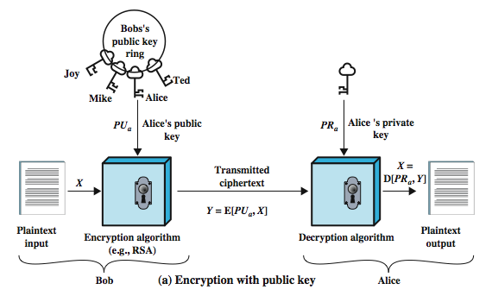
Public-Key Cryptography

Slide 9
Steps
Each user generates a pair of keys for encryption and decryption.
One key is put in public register for public access and is called public key
Another is used as private key.
Encryption : using receiver’s public key
Decryption : using receiver’s private key

Slide 10
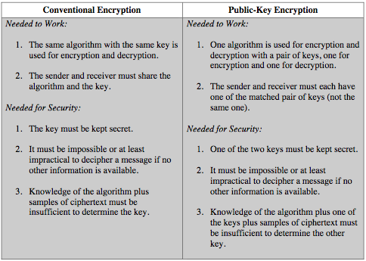
Symmetric vs Public-Key

Slide 11
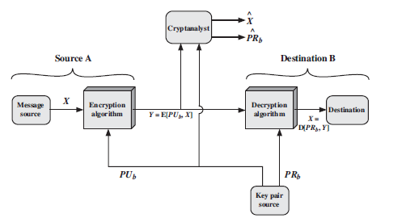
Public-key cryptosystem to provide secrecy

Slide 12
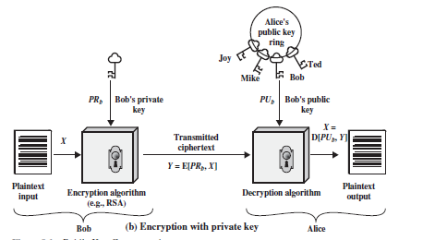
Public-key cryptosystem to provide Authentication

Slide 13
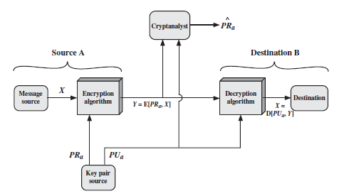

Slide 14
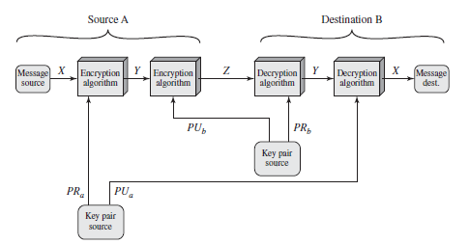
Public-key cryptosystem to provide Authentication and Secrecy

Slide 15
Applications for Public-Key Cryptosystems
We can classify the use of public-key cryptosystems into three categories
Encryption /decryption: The sender encrypts a message with the recipient’s public key.
Digital signature: The sender “signs” a message with its private key.
Key exchange: Two sides cooperate to exchange a session key.

Slide 16
Requirements for Public-Key Cryptography
Each algorithm must fulfill the following conditions.
It is computationally easy for a party B to generate a pair (public key PUb,private key PRb).
It is computationally easy for a sender A, knowing the public key and the message to be encrypted, to generate the corresponding cipher text:
C = E(PUb,M)

Slide 17
3. It is computationally easy for the receiver B to decrypt the resulting cipher text using the private key to recover the original message:
M = D(PRb, C) = D[PRb, E(PUb,M)]
4. It is computationally infeasible for an adversary, knowing the public key, PUb, to determine the private key,PRb.
5. It is computationally infeasible for an adversary, knowing the public key, PUb, and a cipher text, C, to recover the original message,M.
6. The two keys can be applied in either order:
M=Original msg
C= E(PRb,M)→ Encryption using private key of B
M=D(PUb,C)→ Decrypt using publik key of B
=D(PUb, E(PRb,M))
C=E(PUb,M)
M=D(PRb,C)
=D(PRb, E(PUb,M))
M = D[PUb, E(PRb,M)] = D[PRb, E(PUb,M)]

Slide 18
Another important requirement is to use a trap-door one-way function.
A one-way function is one that maps a domain into a range such that every function value has a unique inverse, with the condition that the calculation of the function is easy, whereas the calculation of the inverse is infeasible:
Y = f(X) easy
X = f-1(Y) infeasible

Slide 19
Trap-door one-way function
It is easy to calculate in one direction and infeasible to calculate in the other direction unless certain additional information is known.
Y = fk(X) easy, if k and X are known
X = fk-1(Y) easy, if k and Y are known
X = fk-1(Y) infeasible, if Y is known but k is not known

Slide 20
Public-Key Cryptanalysis
Public-key encryption scheme is vulnerable to a brute-force attack.
The countermeasure is : Use large keys.
The key size must be large enough to make brute-force attack impractical but small enough for practical encryption and decryption.

Slide 21
Another form of attack is to find some way to compute the private key given the public key.
One more form of attack that is peculiar to public-key systems is, a probable-message attack.

Slide 22
THE RSA ALGORITHM
Developed in 1977 by Ron Rivest, Adi Shamir, and Len Adleman.
The Rivest-Shamir-Adleman (RSA) scheme is the most widely accepted and implemented general-purpose approach to public-key encryption.
The RSA scheme is a block cipher.
Plaintext and ciphertext are integers between 0 and n - 1 for some n.
Size for n is 1024 bits, or 309 decimal digits.

Slide 23
Description of the Algorithm
RSA makes use of an expression with exponentials.
Encryption and decryption are of the following form, for some plaintext block M and cipher text block C.
C = M^e mod n
M = C^d mod n
= (M^e)^d mod n
= M^ed mod n

Slide 24
Both sender and receiver must know the value of n.
The sender knows the value of e, and only the receiver knows the value of d.
Public key PU = {e, n} and a private key
PR = {d, n}.
Requirements:
It is possible to find values of e, d, n such that M^ed mod n = M for all M < n.
It is relatively easy to calculate M^e mod n and C^d mod n for all values of M < n.
It is infeasible to determine d given e and n.

Slide 25
M^ed mod n = M, the equation holds only when,
ed mod φ(n) = 1
The ingredients are :
p, q, two prime numbers (private, chosen)
n = pq (public, calculated)
e, with gcd(f(n), e) = 1; 1 < e < f(n) (public, chosen)
d≡ e^-1 (mod f(n)) (private, calculated)
The private key consists of {d, n} and the public key
consists of {e, n}.

Slide 26
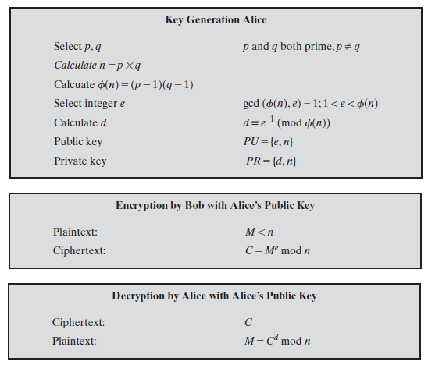

Slide 27
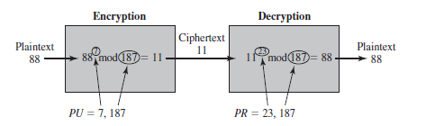

Slide 28
For this example,
Select two prime numbers, p = 17 and q = 11.
Calculate n = pq = 17 × 11 = 187.
Calculate f(n) = (p - 1)(q - 1) = 16 × 10 = 160.
Select e such that e is relatively prime to f(n) = 160 and less than f(n); we choose e = 7.
Determine d such that de ≡ 1 (mod 160) and d < 160.The correct value is d = 23, because 23 × 7 = 161 = (1 × 160) + 1; d can be calculated using the extended Euclid’s algorithm.
The resulting keys are public key PU = {7, 187} and private key PR = {23, 187}.

Slide 29
For a plaintext input of M= 88,
Encryption, C = 88^7 mod 187 =11
Decryption, M = 11^23 mod 187 = 88

Slide 30
RSA to process multiple blocks of data
The plaintext is an alphanumeric string.
Each plaintext symbol is assigned a unique code of two decimal digits (e.g., a = 00, A = 26).
A plaintext block consists of four decimal digits, or two alphanumeric characters.

Slide 31
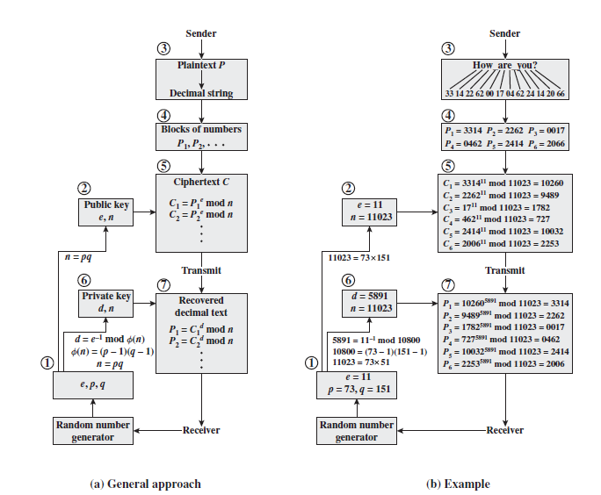

Slide 32
Computational Aspects
There are two issue of the complexity of the computation required to use RSA, namely:
encryption/decryption
key generation

Slide 33
Encryption/Decryption
EXPONENTIATION IN MODULAR ARITHMETIC
Both encryption and decryption in RSA involve raising an integer to an integer power, mod n.
We make use of a property of modular arithmetic:[(a mod n) * (b mod n)] mod n = (a * b) mod n
To increase efficiency, consider that we wish to compute x^16.
A straightforward approach requires 15 multiplications:
X^16 = x * x * x * x * x * x * x * x * x * x * x * x * x * x * x * x
However, we can achieve the same final result with only four multiplications if we repeatedly take the square of each partial result, successively forming (x2, x4, x8, x16).

Slide 35
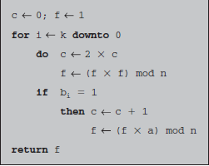
Algorithm for Computing a^b mod n

Slide 36
EFFICIENT OPERATION USING THE PUBLIC KEY
The choice of ‘e’ is made such that the speed is increased.
Popular choice ‘3’ and ‘17’ , as there are only 2 1s.
But small ‘e’ is vulnerable.
EFFICIENT OPERATION USING THE PRIVATE KEY

Slide 38
KEY GENERATION
Determining two prime numbers, p and q.
Selecting either e or d and calculating the other.

Slide 39
The Security of RSA
Brute force: This involves trying all possible private keys.
Mathematical attacks: There are several approaches, all equivalent in effort to factoring the product of two primes.
Timing attacks: These depend on the running time of the decryption algorithm.
Hardware fault-based attack: This involves inducing hardware faults in the processor that is generating digital signature.
Chosen cipher text attacks: This type of attack exploits properties of the RSA algorithm.

Slide 40
Brute force:
Trying all possible private keys.
Defense: Use a large key space.
Larger the size of the key, the slower the system will run.

Slide 41
Mathematical attacks
THE FACTORING PROBLEM:
Factor n into its two prime factors. This enables calculation of f(n) = (p - 1) × (q - 1), which in turn enables determination of d=e-1 (mod Ф (n)).
Determine f(n) directly, without first determining p and q. Again, this enables determination of d K e-1 (mod Ф(n)).
Determine d directly, without first determining Ф(n).

Slide 42
The challenge used a public key size of 129 decimal digits, or around 428 bits and attacks were made using an approach known as the quadratic sieve.
The attack on RSA-130 used a newer algorithm, the generalized number field sieve (GNFS), and was able to factor a larger number than RSA-129 at only 20% of the computing effort.
The special number field sieve (SNFS), can factor numbers considerably faster than the generalized number field sieve.

Slide 43
The threat to larger key sizes is twofold: the continuing increase in computing power and the continuing refinement of factoring algorithms.
To avoid values of n that may be factored more easily, the algorithm’s inventors suggest the following constraints on p and q.
p and q should differ in length by only a few digits.
Both (p - 1) and (q - 1) should contain a large prime factor.
gcd(p - 1, q - 1) should be small.
In addition, it has been demonstrated that if e < n and d < n1/4, then d can be easily determined.

Slide 44
TIMING ATTACKS
Paul Kocher, a cryptographic consultant, demonstrated that a snooper can determine a private key by keeping track of how long a computer takes to decipher messages.
This attack is alarming for two reasons: It comes from a completely unexpected direction, and it is a ciphertext-only attack.

Slide 45
In modular exponentiation algorithm, modular exponentiation is accomplished bit by bit, with one modular multiplication performed at each iteration and an additional modular multiplication performed for each 1 bit.

Slide 46
Countermeasures to be used for timing attacks are:
Constant exponentiation time: Ensure that all exponentiations take the same amount of time before returning a result.
Random delay: Better performance could be achieved by adding a random delay to the exponentiation algorithm to confuse the timing attack.
Blinding: Multiply the ciphertext by a random number before performing exponentiation. This process prevents the attacker from knowing what ciphertext bits are being processed inside the computer and therefore prevents the bit-by-bit analysis essential to the timing attack.

Slide 47
RSA Data Security incorporates a blinding feature.
The private-key operation M = C^d mod n is implemented as follows.
Generate a secret random number r between 0 and n - 1.
Compute C’ = C(r^e) mod n, where e is the public exponent.
Compute M’ = (C ‘)^d mod n with the ordinary RSA implementation.
Compute M=M’ r^-1 mod n. In this equation, r-1 is the multiplicative inverse of r mod n

Slide 48
Fault-Based Attack
It is an attack on the processor generating RSA digital signature.
The attack induces faults in the signature computation.
The faults cause the software to produce invalid signatures, which can be analyzed by the attacker to recover the private key.

Slide 49
CHOSEN CIPHERTEXT ATTACK AND OPTIMAL ASYMMETRIC ENCRYPTION PADDING
CCA is defined as an attack in which the adversary chooses a number of cipher texts and is then given the corresponding plaintexts, decrypted with the target’s private key.
The adversary could select a plaintext, encrypt it with the target’s public key, and then be able to get the plaintext back by having it decrypted with the private key.

Slide 50
E(PU,M1) × E(PU,M2) = E(PU, [M1 × M2])
We can decrypt C = M^e mod n using a CCA as follows.
Compute X = (C × 2^e) mod n.
Submit X as a chosen ciphertext and receive back Y = X^d mod n.
But now note that
X = (C mod n) * (2^e mod n)
= (M^e mod n) * (2^e mod n)
X= (2M)^e mod n

Slide 51
To overcome this simple attack, practical RSA-based cryptosystems randomly pad the plaintext prior to encryption.
Plaintext is modified using a procedure known as optimal asymmetric encryption padding (OAEP).

Slide 52
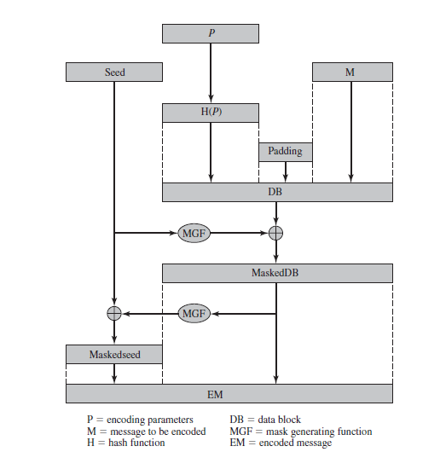

Slide 53
As a first step, the message M to be encrypted is padded.
A set of optional parameters,P, is passed through a hash function,H.
The output is then padded with zeros to get the desired length in the overall data block (DB).
Next, a random seed is generated and passed through another hash function, called the mask generating function (MGF).
The resulting hash value is bit-by-bit XORed with DB to produce a maskedDB.
The maskedDB is in turn passed through the MGF to form a hash that is XORed with the seed to produce the masked seed.
The concatenation of the maskedseed and the maskedDB forms the encoded message EM.
EM includes the padded message, masked by the seed, and the seed, masked by the maskedDB.
The EM is then encrypted using RSA.

