Slide 1
KEY MANAGEMENT AND DISTRIBUTION

Slide 2
Road Map
Symmetric key distribution using symmetric encryption
Symmetric key distribution using public-key encryption
Distribution of public keys
Announcement
Directory
Authority
CA

Slide 3
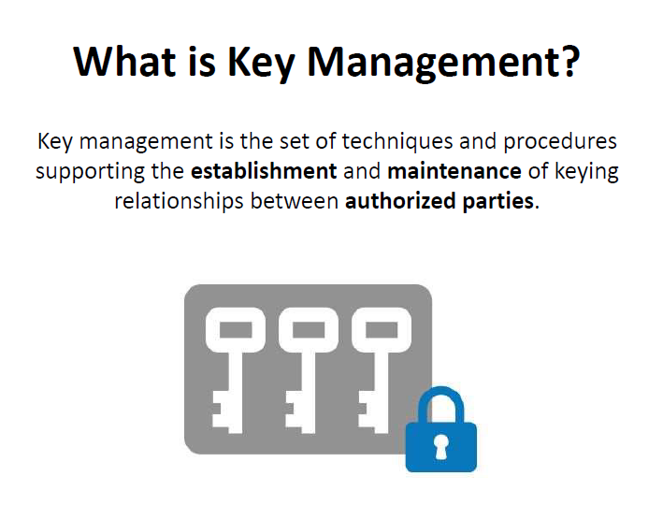

Slide 4
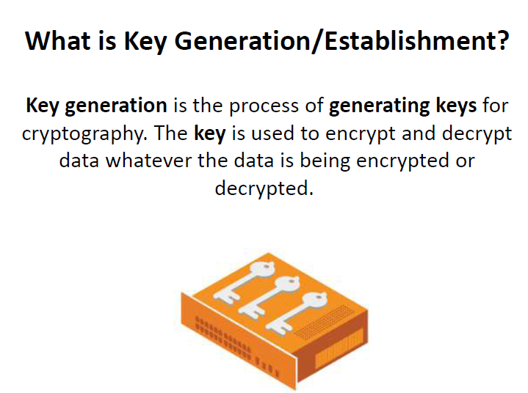

Slide 5
Types of Keys in Cryptography

Slide 6
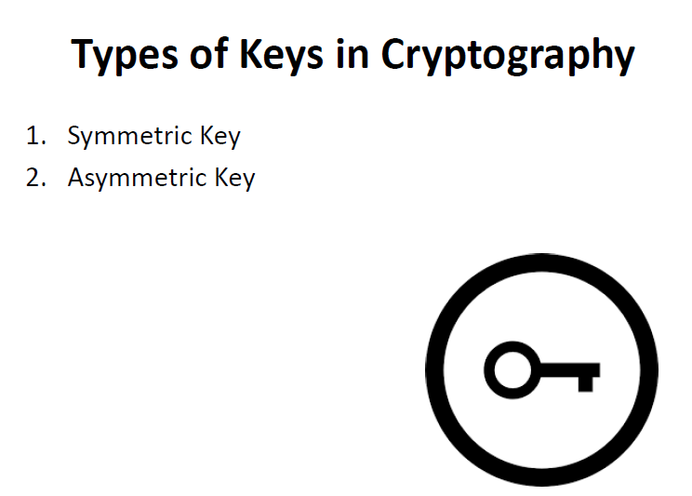

Slide 7
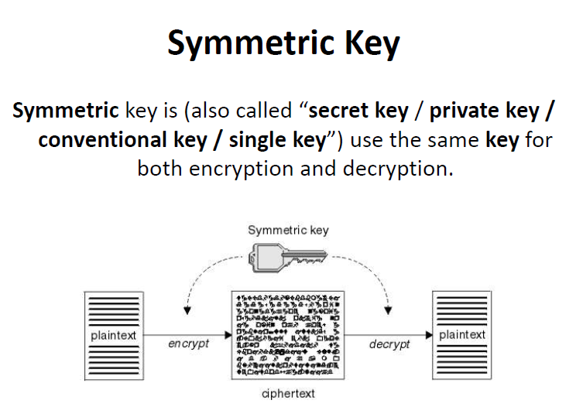

Slide 8
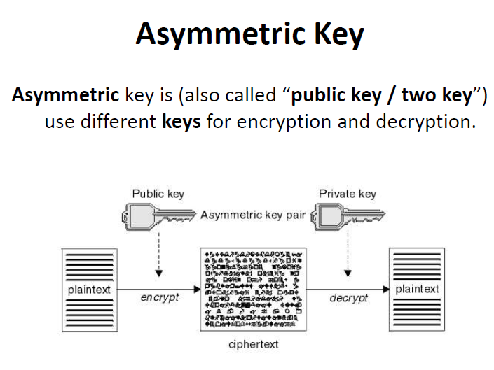

Slide 9
Symmetric key distribution using symmetric encryption

Slide 11
For two parties A and B, key distribution can be achieved in a number of ways, as follows:
A can select a key and physically deliver it to B.
A third party can select the key and physically deliver it to A and B.
If A and B have previously and recently used a key, one party can transmit the new key to the other, encrypted using the old key.
If A and B each has an encrypted connection to a third party C, C can deliver a key on the encrypted links to A and B.

Slide 12
Options 1 and 2 call for manual delivery of a key.
For link encryption, this is a reasonable requirement, because each link encryption device is going to be exchanging data only with its partner on the other end of the link.
In a distributed system, any given host or terminal may need to engage in exchanges with many other hosts and terminals over time.
If end-to-end encryption, then a key is needed for each pair of hosts on the network that wish to communicate. Thus, if there are N hosts, the number of required keys is [N(N-1)]/2 .

Slide 13
Option 3 is a possibility for either link encryption or end-to-end encryption.
But if an attacker ever succeeds in gaining access to one key, then all subsequent keys will be revealed.

Slide 14
Option 4, In this scheme, a key distribution center is responsible for distributing keys to pairs of users as needed.
Each user must share a unique key with the key distribution center for purposes of key distribution.

Slide 15
Key Hierarchy
Typically have a hierarchy of keys.
Master key
Used to encrypt session keys
Shared by user & key distribution center
Session key
Temporary key
Used for encryption of data between users
For one logical session then discarded

Slide 16
If there are entities N that wish to communicate in pairs, then, [N(N-1)]/2 session keys are needed at any one time.
Only N master keys are required, one for each entity.
Master keys can be distributed in some non cryptographic way, such as physical delivery.

Slide 17
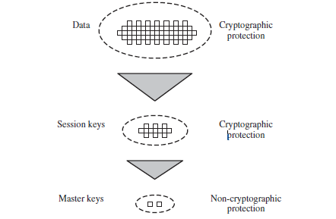

Slide 18
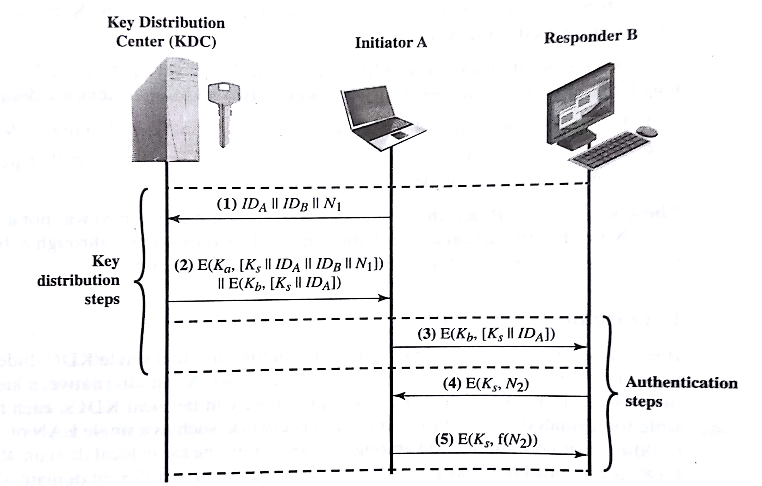
A Key Distribution Scenario

Slide 19
Assumptions:
Each user shares a unique master key with the key distribution center (KDC).
User A wishes to establish a logical connection with B and requires a one-time session key to protect the data transmitted over the connection.
A has a master key, Ka , known only to itself and the KDC; similarly, B shares the master key Kb with the KDC.

Slide 20
Hierarchical Key Control
For very large networks, it is not practical to use a single KDC.
A hierarchy of KDCs can be established.

Slide 21
Session Key Lifetime
The more frequently session keys are exchanged, the more secure they are.
On the other hand, the distribution of session keys delays the start of any exchange and places a burden on network capacity.

Slide 22
For connection-oriented protocols, one obvious choice is to use the same session key for the length of time that the connection is open, using a new session key for each new session.
If a logical connection has a very long lifetime, then it is better to change the session key periodically.

Slide 23
For a connectionless protocol, the most secure approach is to use a new session key for each exchange.
Induces delay for each transaction.
A better strategy is to use a given session key for a certain fixed period only or for a certain number of transactions.

Slide 24
A Transparent Key Control Scheme
The scheme is useful for providing end-to-end encryption at a network or transport level in a way that is transparent to the end users.
The approach assumes that communication makes use of a connection-oriented end-to-end protocol, such as TCP.
The important element of this approach is a session security module (SSM).

Slide 25
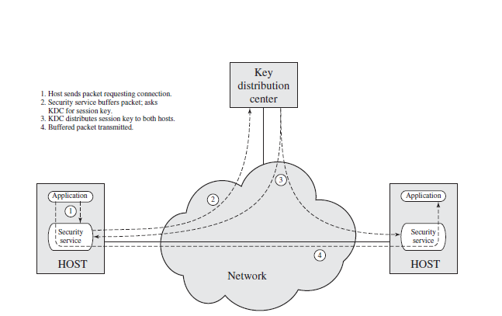

Slide 26
Decentralized Key Control
A decentralized approach requires that each end system be able to communicate in a secure manner with all potential partner end systems for purposes of session key distribution.
Thus, there may need to be as many as
[n(n-1)]/2 master keys for a configuration with end systems.

Slide 27
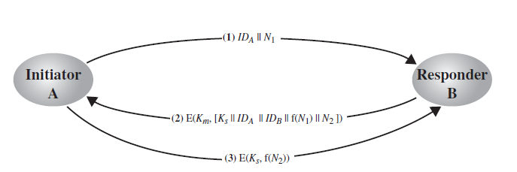

Slide 28
Controlling Key Usage
Key hierarchy and automated key distribution techniques reduce the number of keys that must be manually managed and distributed.
It is desirable to impose some control on the way in which automatically distributed keys are used.
Data-encrypting key, for general communication across a network
PIN-encrypting key, for personal identification numbers (PINs) used in electronic funds transfer and point-of-sale applications
File-encrypting key, for encrypting files stored in publicly accessible locations

Slide 29
Can Master key be imported as a data-encrypting key ?
It may be desirable to limit the ways in which keys are used, based on characteristics associated with those keys.
One simple plan is to associate a tag with each key.
The technique is for use with DES and makes use of the extra 8 bits in each 64-bit DES key.
The bits have the following interpretation:
One bit indicates whether the key is a session key or a master key.
One bit indicates whether the key can be used for encryption.
One bit indicates whether the key can be used for decryption.
The remaining bits are spares for future use.

Slide 30
Advantage:
Tag is embedded in the key, it is encrypted along with the key when that key is distributed, thus providing protection.
Drawbacks:
Limits the flexibility.
The tag is not transmitted in clear form, it can be used only at the point of decryption.

Slide 31
A more flexible scheme “control vector” is used.
In this scheme, each session key has an associated control vector consisting of a number of fields that specify the uses and restrictions for that session key.

Slide 32
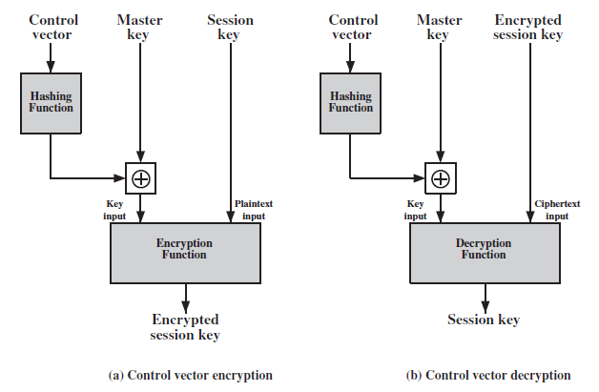

Slide 33
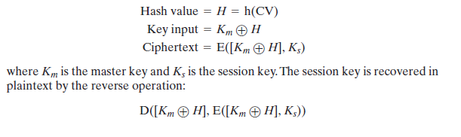

Slide 34
Symmetric key distribution using public-key encryption
One of the most important uses of a public-key cryptosystem is to encrypt secret keys for distribution.
Simple Secret Key Distribution
Put forward by Merkle

Slide 35
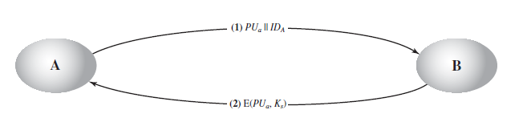
Simple Secret Key Distribution

Slide 36
This method is insecure against an adversary who can intercept messages and then either relay the intercepted message or substitute another message.
Such an attack is known as a man-in-the-middle attack .

Slide 37
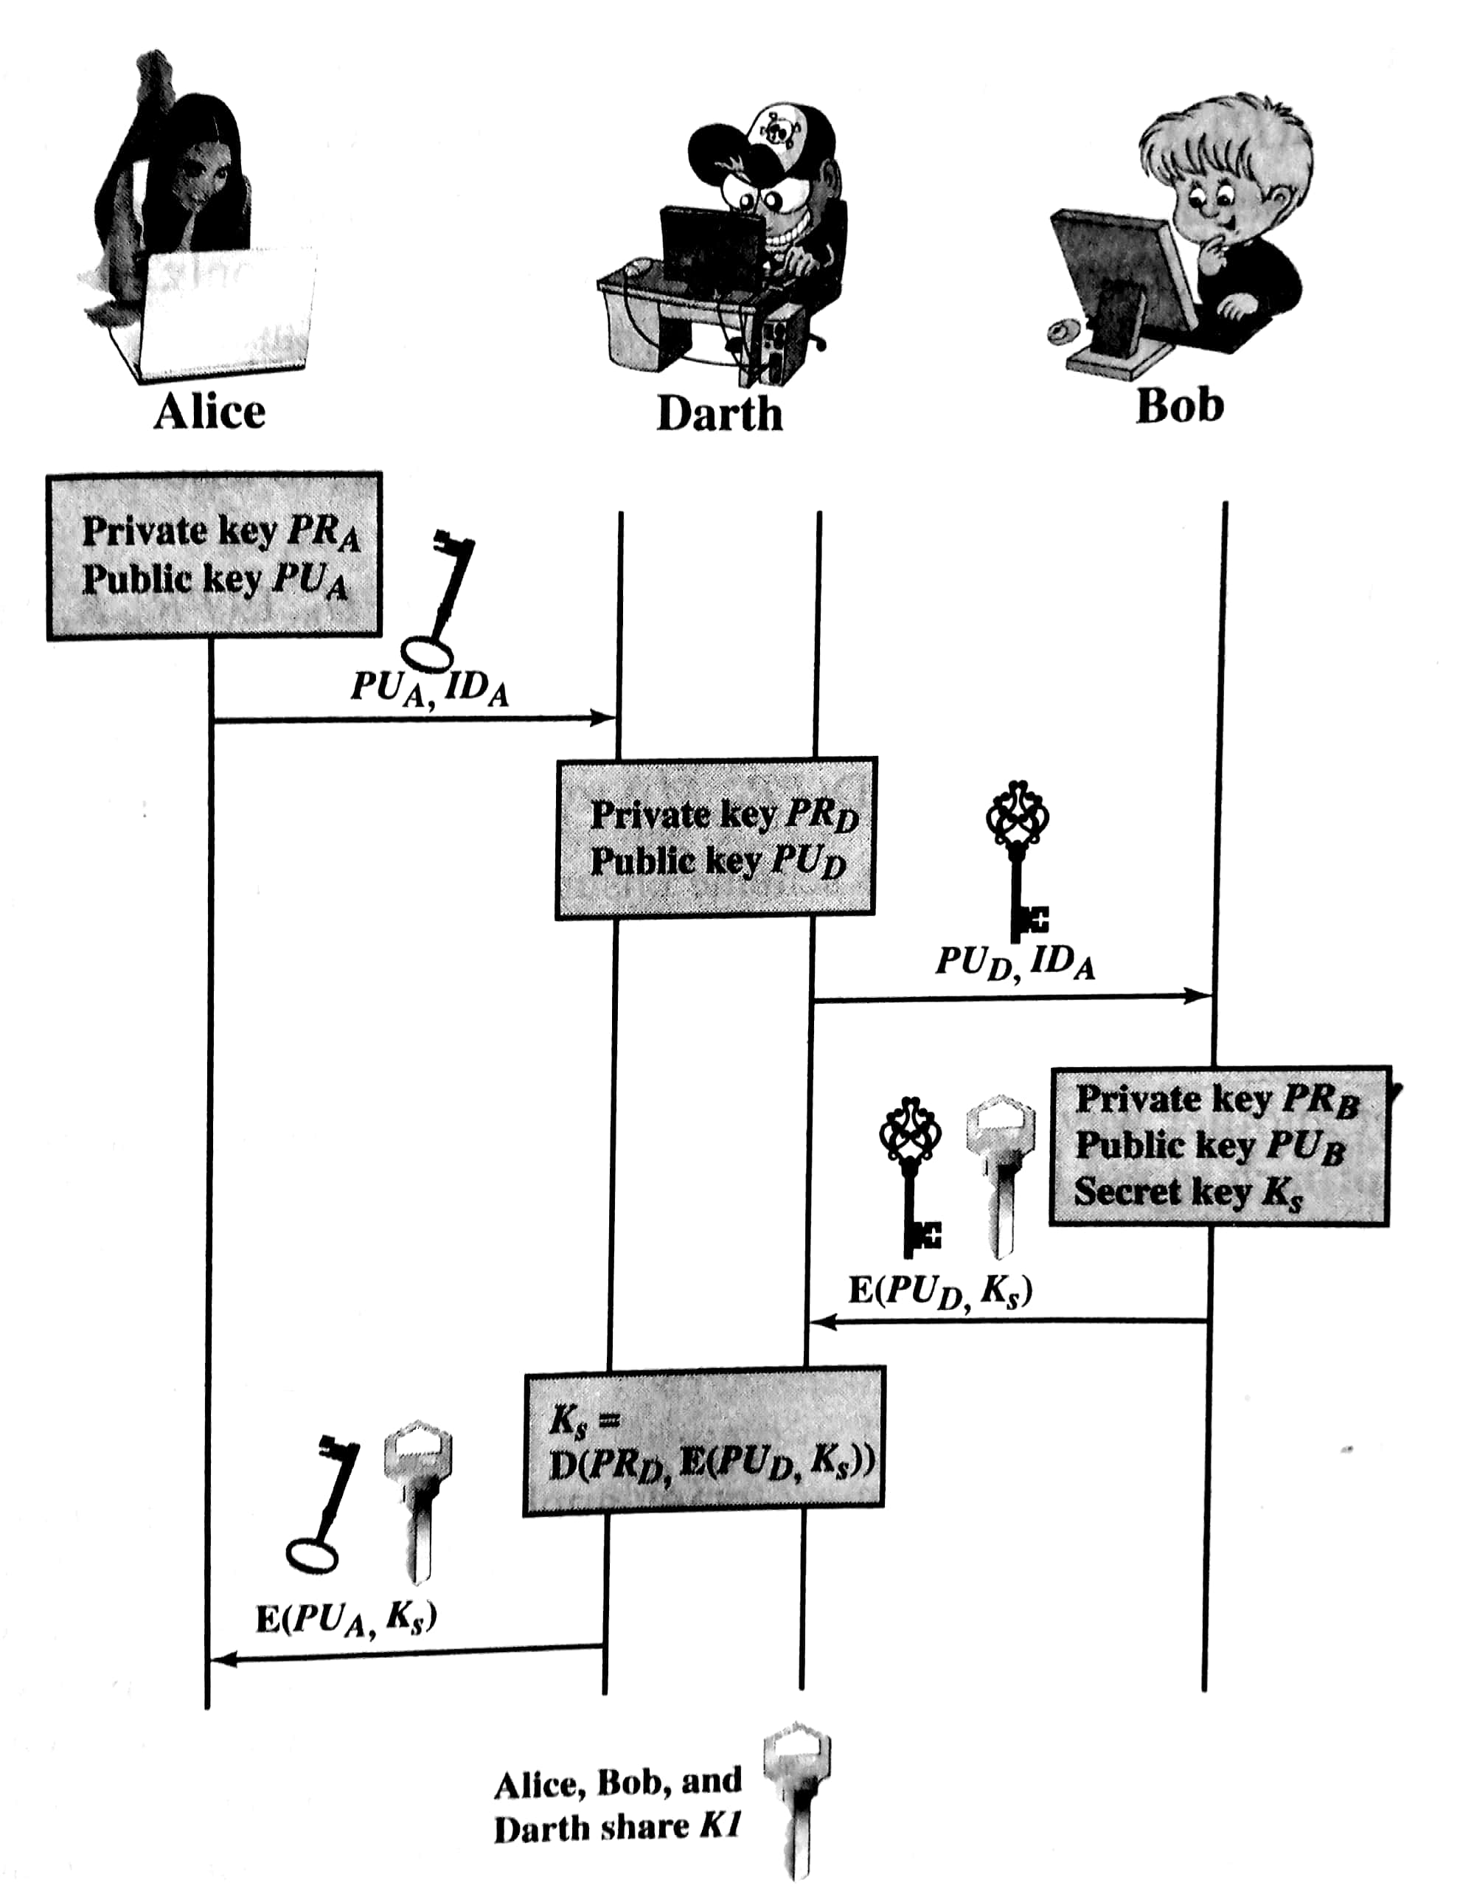

Slide 38
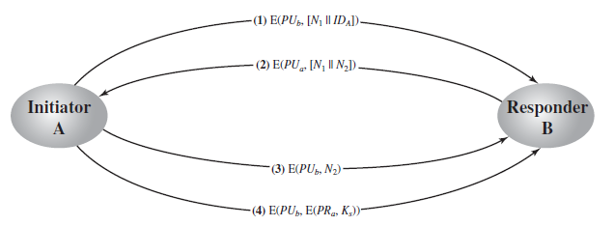
Secret Key Distribution with Confidentiality and Authentication

Slide 39
A Hybrid Scheme
This scheme retains the use of a KDC.
A public key scheme is used to distribute the master keys.
Advantages:
Performance
Backward compatibility

Slide 40
DISTRIBUTION OF PUBLIC KEYS
Public announcement
Publicly available directory
Public-key authority
Public-key certificates

Slide 41
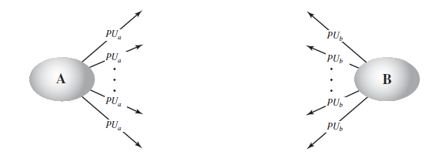
Public Announcement of Public Keys

Slide 42
Any participant can send his or her public key to any other participant or broadcast the key to the community at large.
Weakness:
Anyone can forge such a public announcement.
Ex: Some user could pretend to be user A and send a public key to another participant or broadcast such a public key.

Slide 43
Publicly Available Directory
The authority maintains a directory with a {name, public key} entry for each participant.
Each participant registers a public key with the directory authority. Registration would have to be in person or by some form of secure authenticated communication.
A participant may replace the existing key with a new one at any time, either because of the desire to replace a public key that has already been used for a large amount of data, or because the corresponding private key has been compromised in some way.
Participants could also access the directory electronically. For this purpose, secure, authenticated communication from the authority to the participant is mandatory.

Slide 44
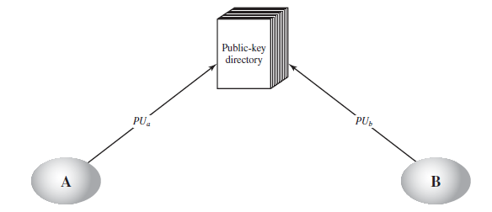

Slide 45
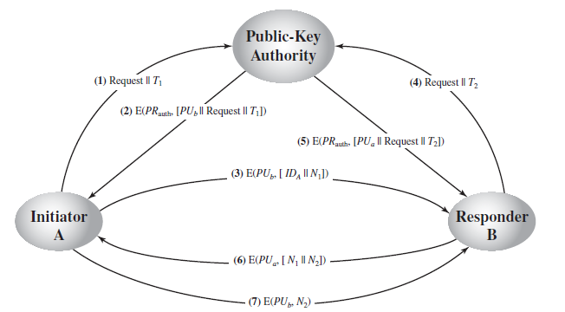
Public-Key Authority

Slide 46
Drawback:
The public-key authority could be somewhat of a bottleneck in the system, for a user must appeal to the authority for a public key for every other user that it wishes to contact.

Slide 47
Public-Key Certificates
Certificates can be used by participants to exchange keys without contacting a public-key authority, in a way that is as reliable as if the keys were obtained directly from a public-key authority.
A certificate consists of a public key, an identifier of the key owner, and the whole block signed by a trusted third party.
A user can present his or her public key to the authority in a secure manner and obtain a certificate.
The user can then publish the certificate.
Anyone needing this user’s public key can obtain the certificate and verify that it is valid by way of the attached trusted signature.

Slide 48
Requirements:
Any participant can read a certificate to determine the name and public key of the certificate’s owner.
Any participant can verify that the certificate originated from the certificate authority and is not counterfeit.
Only the certificate authority can create and update certificates.

Slide 49
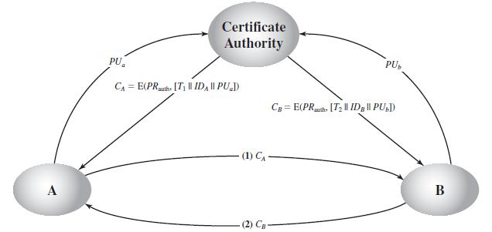

Slide 50
X.509 CERTIFICATES
X.509 is based on the use of public-key cryptography and digital signatures.
The standard does not dictate the use of a specific algorithm but recommends RSA.
The digital signature scheme is assumed to require the use of a hash function

Slide 51
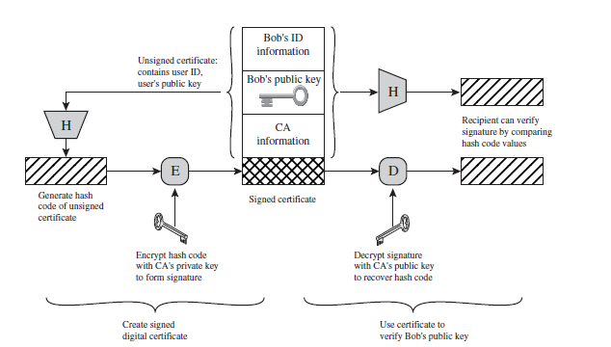
Certificates

Slide 52
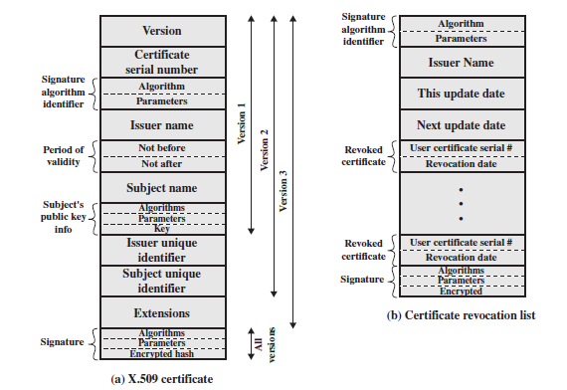
X.509 Formats

Slide 53
Version: Differentiates among successive versions of the certificate format; the default is version 1. If the issuer unique identifier or subject unique identifier are present, the value must be version 2. If one or more extensions are present, the version must be version 3.
Serial number: An integer value unique within the issuing CA that is unambiguously associated with this certificate.
Signature algorithm identifier: The algorithm used to sign the certificate together with any associated parameters.
Issuer name: X.500 is the name of the CA that created and signed this certificate.
Period of validity: Consists of two dates: the first and last on which the certificate is valid.

Slide 54
Subject name: The name of the user to whom this certificate refers.
Subject’s public-key information: The public key of the subject, plus an identifier of the algorithm for which this key is to be used, together with any associated parameters.
Issuer unique identifier: An optional-bit string field used to identify uniquely the issuing CA in the event the X.500 name has been reused for different entities.
Subject unique identifier: An optional-bit string field used to identify uniquely the subject in the event the X.500 name has been reused for different entities.
Extensions: A set of one or more extension fields. Extensions were added in version 3.
Signature: Covers all of the other fields of the certificate; it contains the hash code of the other fields encrypted with the CA’s private key. This field includes the signature algorithm identifier.

Slide 55
The standard uses the following notation to define a certificate:
CA<<W >>= CA {V, SN, AI, CA, UCA, A, UA, Ap, TA}
where,
Y<<X>>=the certificate of user X issued by certification authority Y
Y{I}=the signing of I by Y. It consists of I with an encrypted hash code appended

Slide 56
V = version of the certificate
SN = serial number of the certificate
AI = identifier of the algorithm used to sign the certificate
CA = name of certificate authority
UCA = optional unique identifier of the CA
A = name of user A
UA = optional unique identifier of the user A
AP = public key of user A
Ta = period of validity of the certificate

Slide 57
OBTAINING A USER’S CERTIFICATE
User certificates generated by a CA have the following characteristics:
Any user with access to the public key of the CA can verify the user public key that was certified.
No party other than the certification authority can modify the certificate without this being detected.

Slide 58
A obtains from the directory the certificate of X2 signed by X1 . Because A securely knows X1’s public key, A can obtain X2’s public key from its certificate and verify it by means of X1’s signature on the certificate.
A then goes back to the directory and obtains the certificate of B signed by X2. Because A now has a trusted copy of X2’s public key, A can verify the signature and securely obtain B’s public key.

Slide 59
X1<<X2>> X2<<B>>
X2<<X1>> X1<<A>>

Slide 60
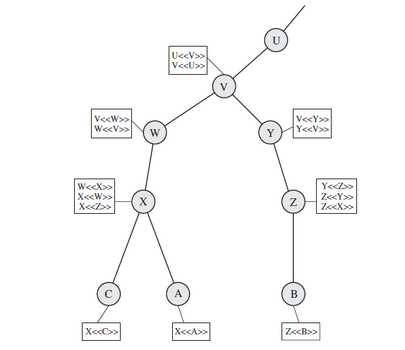

Slide 61
The connected circles indicate the hierarchical relationship among the CAs;
The associated boxes indicate certificates maintained in the directory for each CA entry.
The directory entry for each CA includes two types of certificates:
Forward certificates: Certificates of X generated by other CAs
Reverse certificates: Certificates generated by X that are the certificates of other CAs

Slide 62
REVOCATION OF CERTIFICATES
CA needs to revoke a certificate before it expires, for one of the following reasons:
The user’s private key is assumed to be compromised.
The user is no longer certified by this CA. Reasons for this include that the subject’s name has changed, the certificate is superseded, or the certificate was not issued in conformance with the CA’s policies.
The CA’s certificate is assumed to be compromised.

Slide 63
Each CA must maintain a list consisting of all revoked but not expired certificates issued by that CA, including both those issued to users and to other CAs.
Each certificate revocation list (CRL) posted to the directory is signed by the issuer and includes
the issuer’s name
the date the list was created
the date the next CRL is scheduled to be issued
an entry for each revoked certificate.
The serial number of a certificate
revocation date for that certificate.

Slide 64
X.509 Version 3
There is a need to indicate security policy information.
There is a need to limit the damage that can result from a faulty or malicious CA by setting constraints on the applicability of a particular certificate.
It is important to be able to identify different keys used by the same owner at different times.

Slide 65
Extension consist of,
Extension identifier
Criticality indicator
Extension

Slide 66
The certificate extensions fall into three main categories
Key and policy information
Authority key identifier
Subject key identifier
Key usage
Private-key usage period
Certificate policies
Policy mappings
Subject and issuer attributes
Subject alternative name
Issuer alternative name
Subject directory attributes
Certification path constraints
Basic constraints
Name constraints
Policy constraints

